Slide 1
Extensible Probabilistic Programming
Eyal Dechter & Matt Johnson

Slide 2
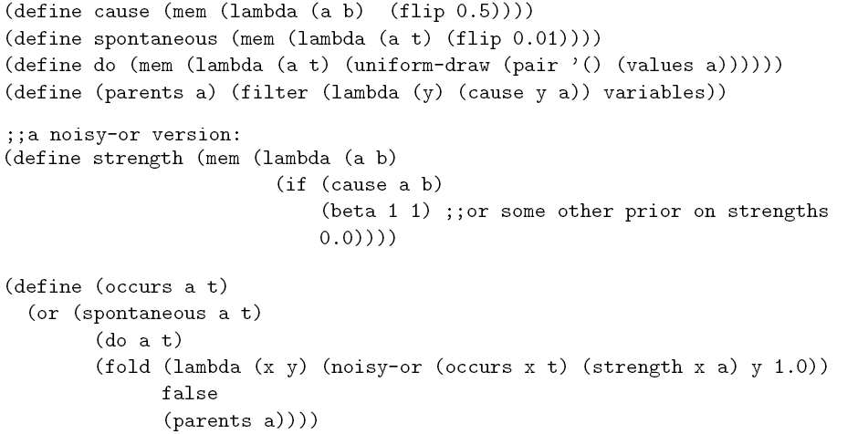
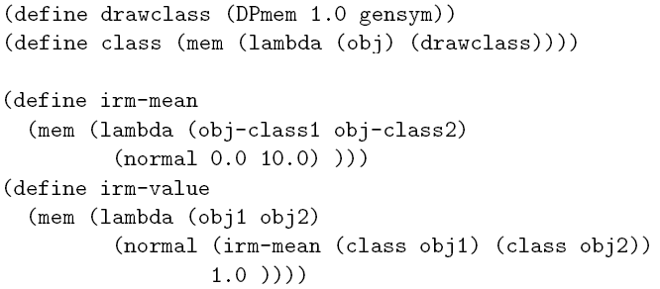
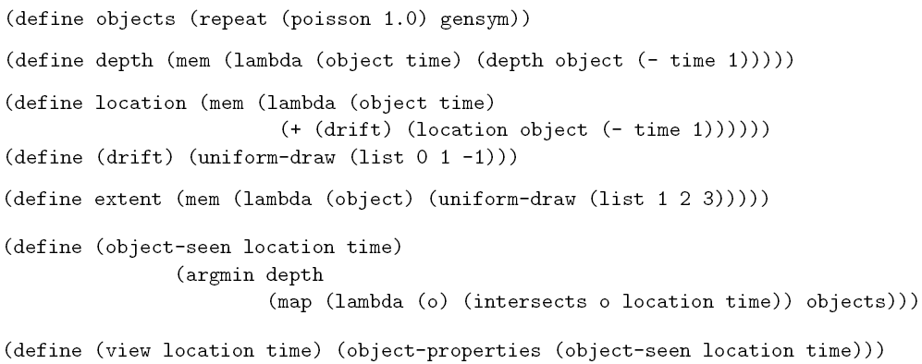
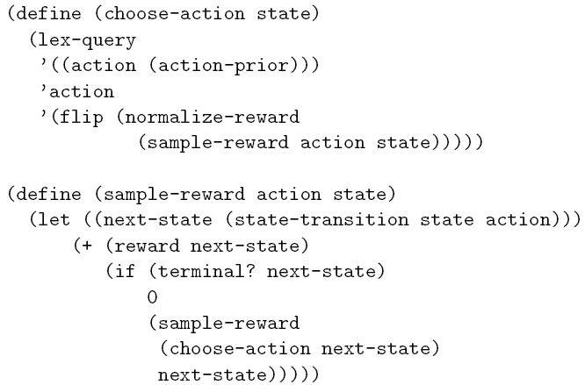
Motivation
Causal networks
Category hierarchies
Physical objects
Rational agents
(Goodman, Mansinghka, Roy, Bonawitz, Tenenbaum, UAI 2008)

Slide 3
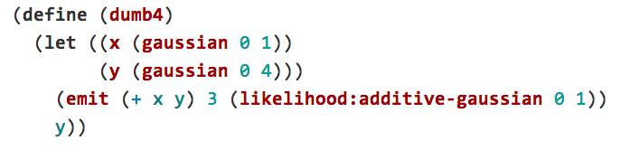
Motivation
A simple example:

Slide 4

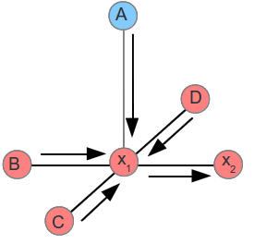
Our Approach
Metropolis - Hastings
Extensions to exploit structure
Small treewidth graphical models
Gaussians
HMC
Conjugate pairs
Gibbs sampling
…

Slide 5
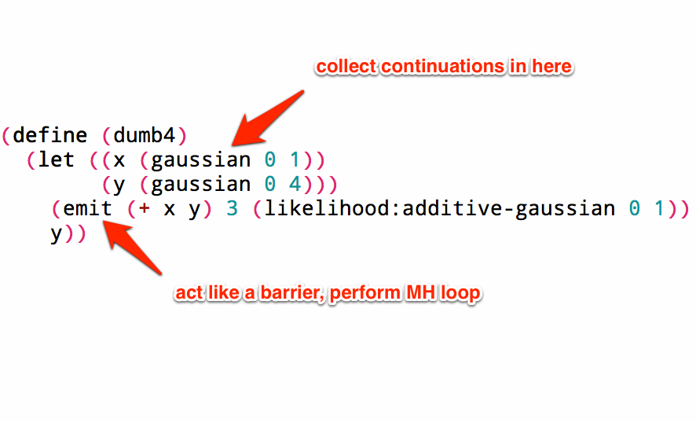
Our Approach

Slide 6
Code + Demo

Slide 7
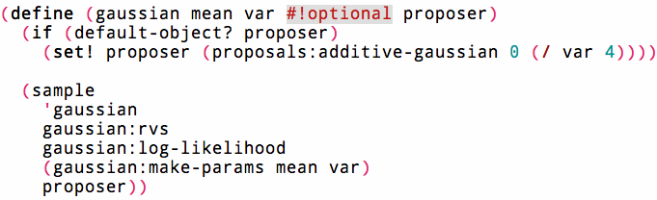
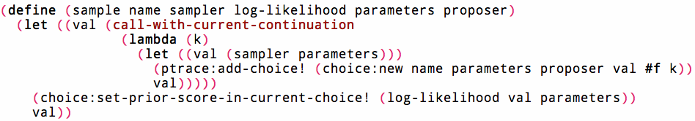

Slide 8
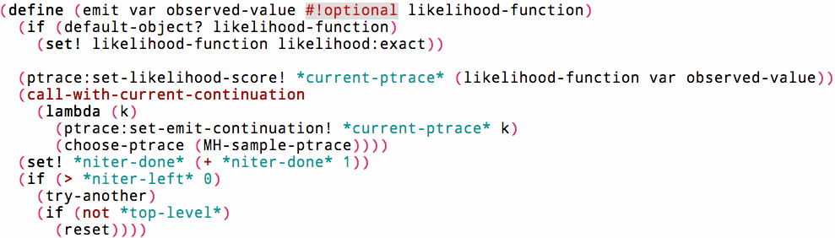

Slide 9
Extending to Exploit Structure
Big idea: lazy sampling and generic operators
Box random values
Ex.: for Gaussians, extend + and * to prevent sample collapse
API to add inference for uncollapsed distributions
Collapsed samples fall back to MH

Slide 10
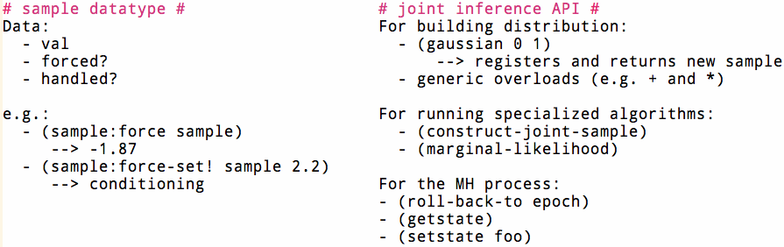
API

Slide 11

Summary
Probabilistic programming without specialized interpreter
MH system in a few dozen lines
User writes regular Scheme code
Fully compilable (incl. user code)
Extensible abstractions
Extend with your favorite distributions or algorithms!
MH fallback

