Slide 1
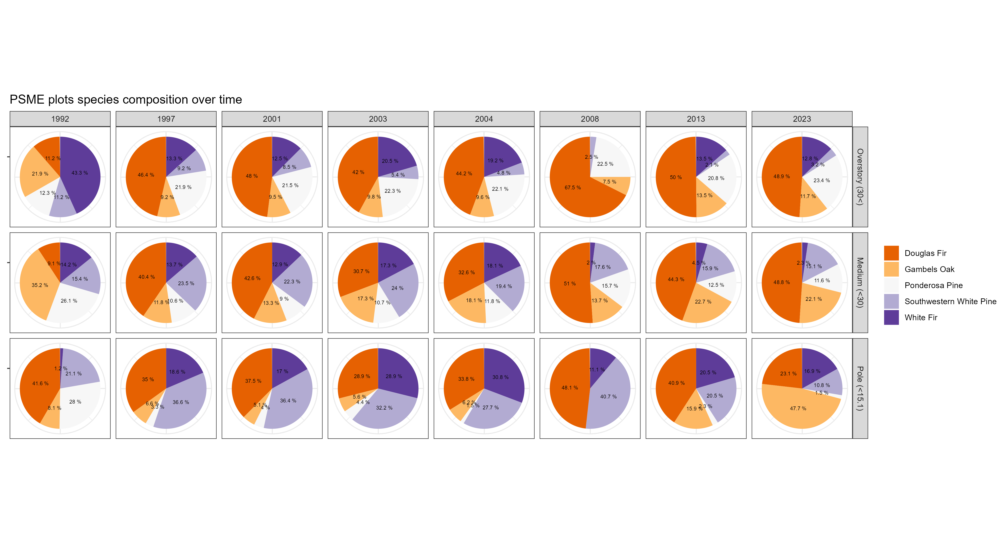
Saguaro NP PSME Plots Live Tree Species Composition Over Time
187
196
200
112
104
40
96
94
# Total Trees Recorded
253
255
256
150
144
51
88
86
161
183
176
90
65
27
44
65

Slide 2
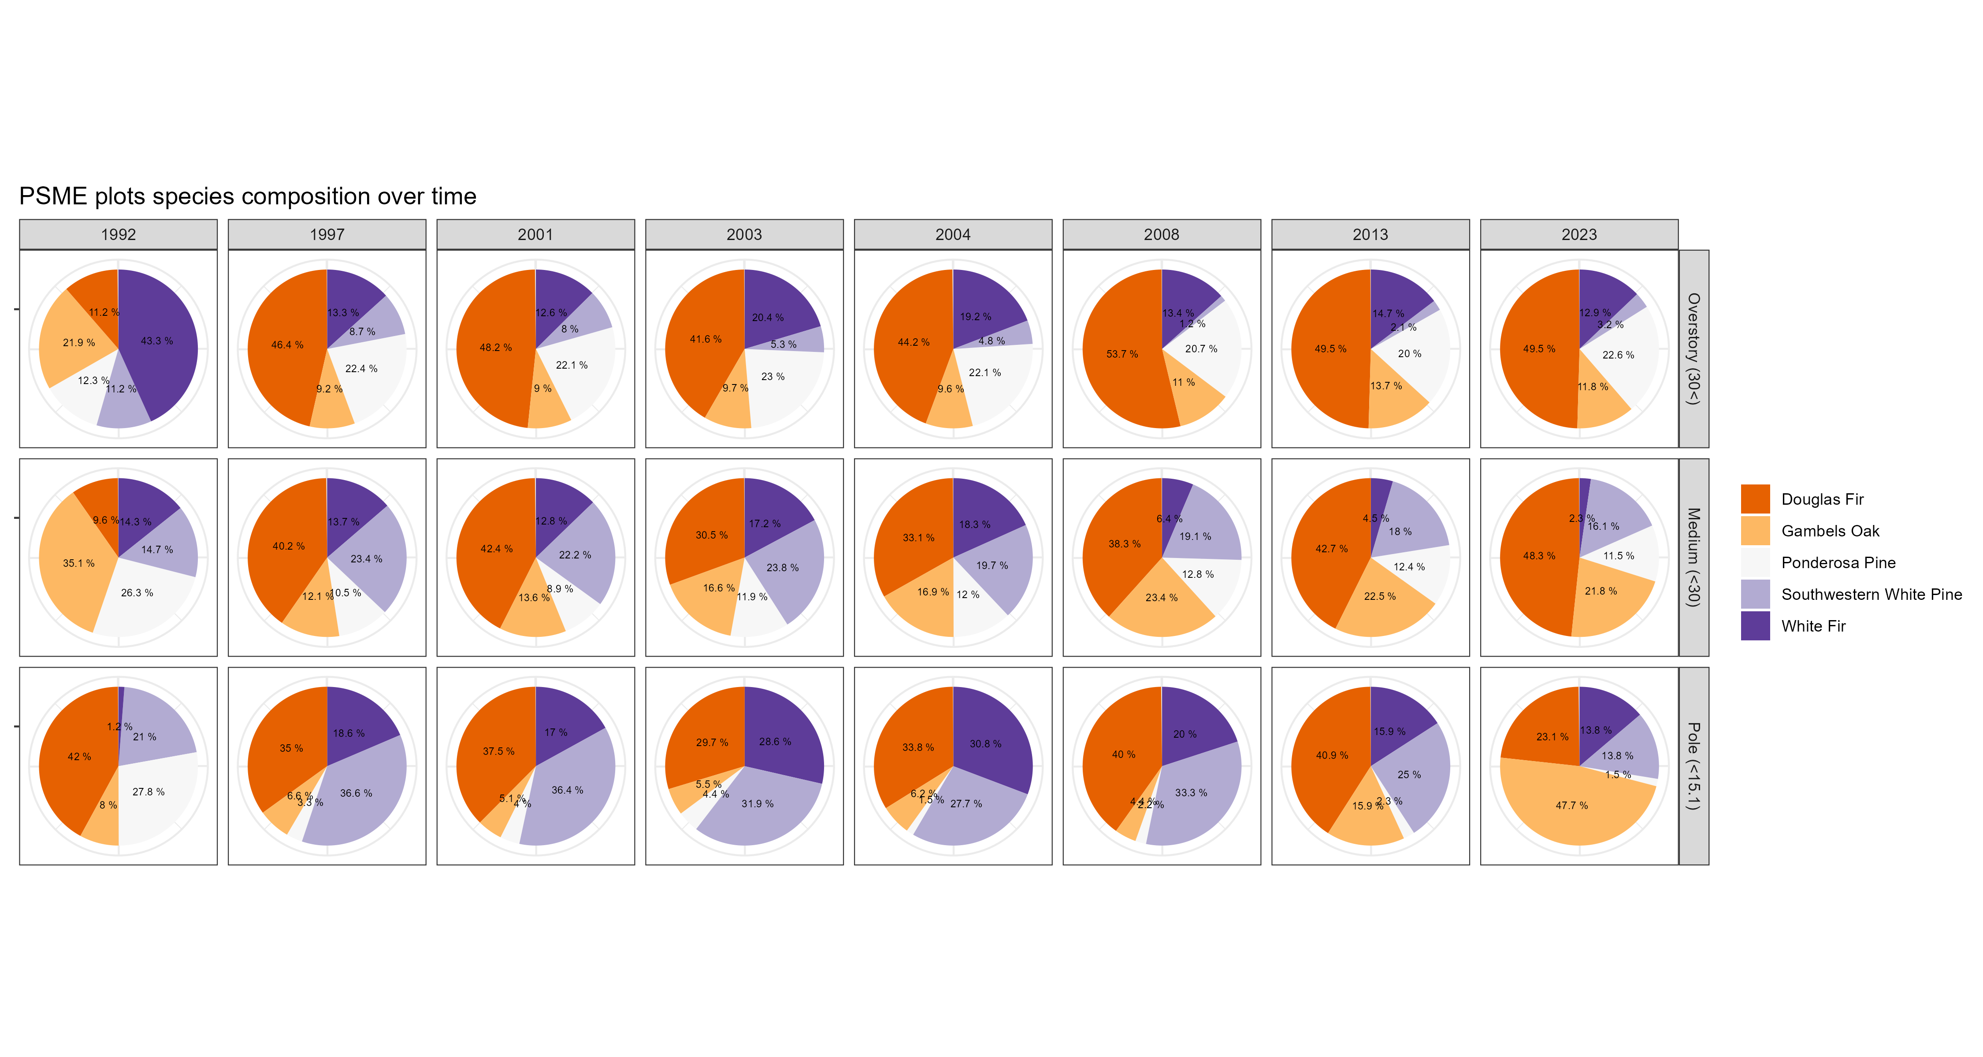
Saguaro NP PSME Plots Live Tree Species Composition Over Time
85
78
80
67
52
48
48
37
# Stems/Acre
114
102
103
89
71
55
45
35
295
293
282
214
130
106
88
104
Notes:
114.1 85.0 294.5 102.4 78.4 292.8 102.8 79.6 281.6 88.8 66.5 [12] 214.1 71.0 52.0 130.0 55.3 48.2 105.9 44.5 47.5 88.0 34.8 [23] 37.2 104.0

