Slide 1
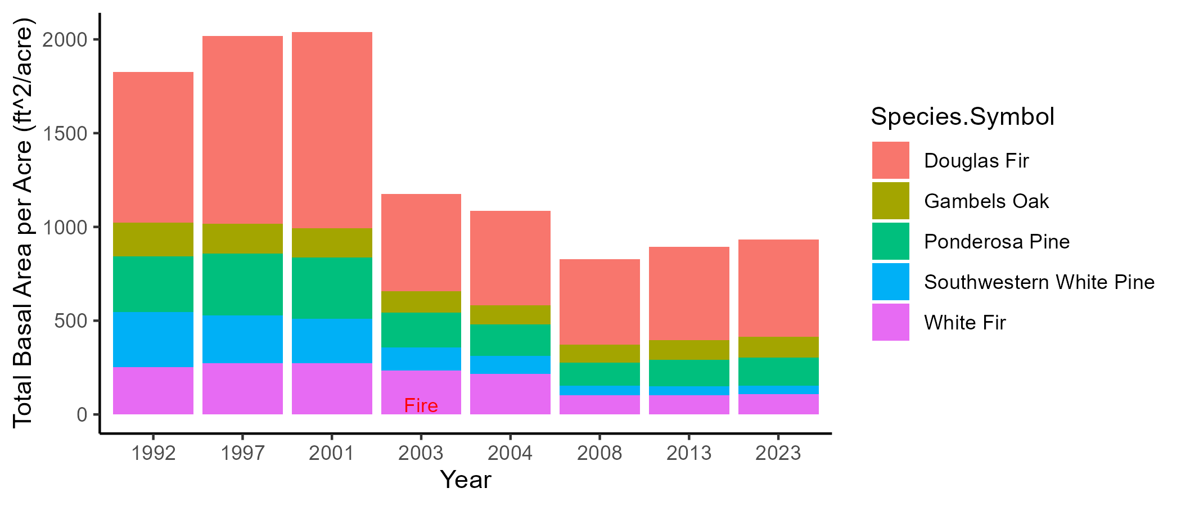
ab
a
ab
abc
abc
c
c
bc

Slide 2
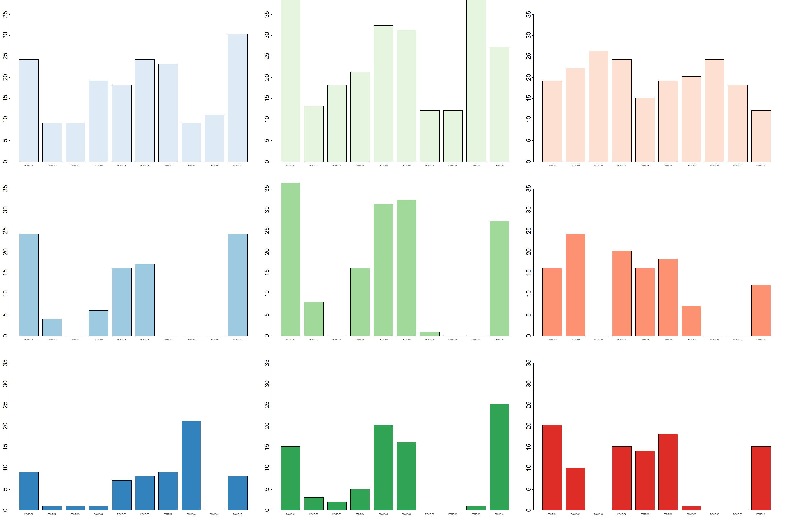
Live Pole Trees (<15.1 DBH)
Live Medium Trees (15.1-30 DBH)
Live Overstory Trees (>30 DBH)
2001
2003
Density (count/acre)
2023
Plot (PSME01 – PSME10)

Slide 3
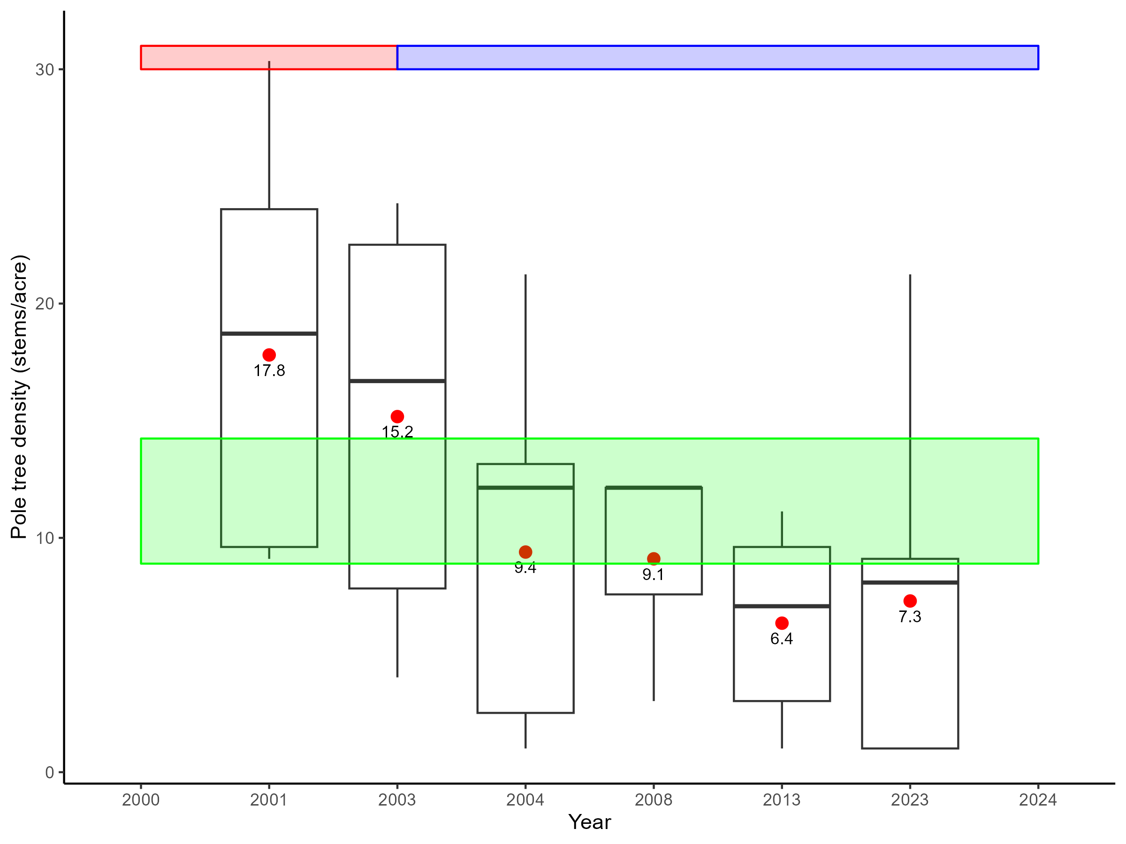
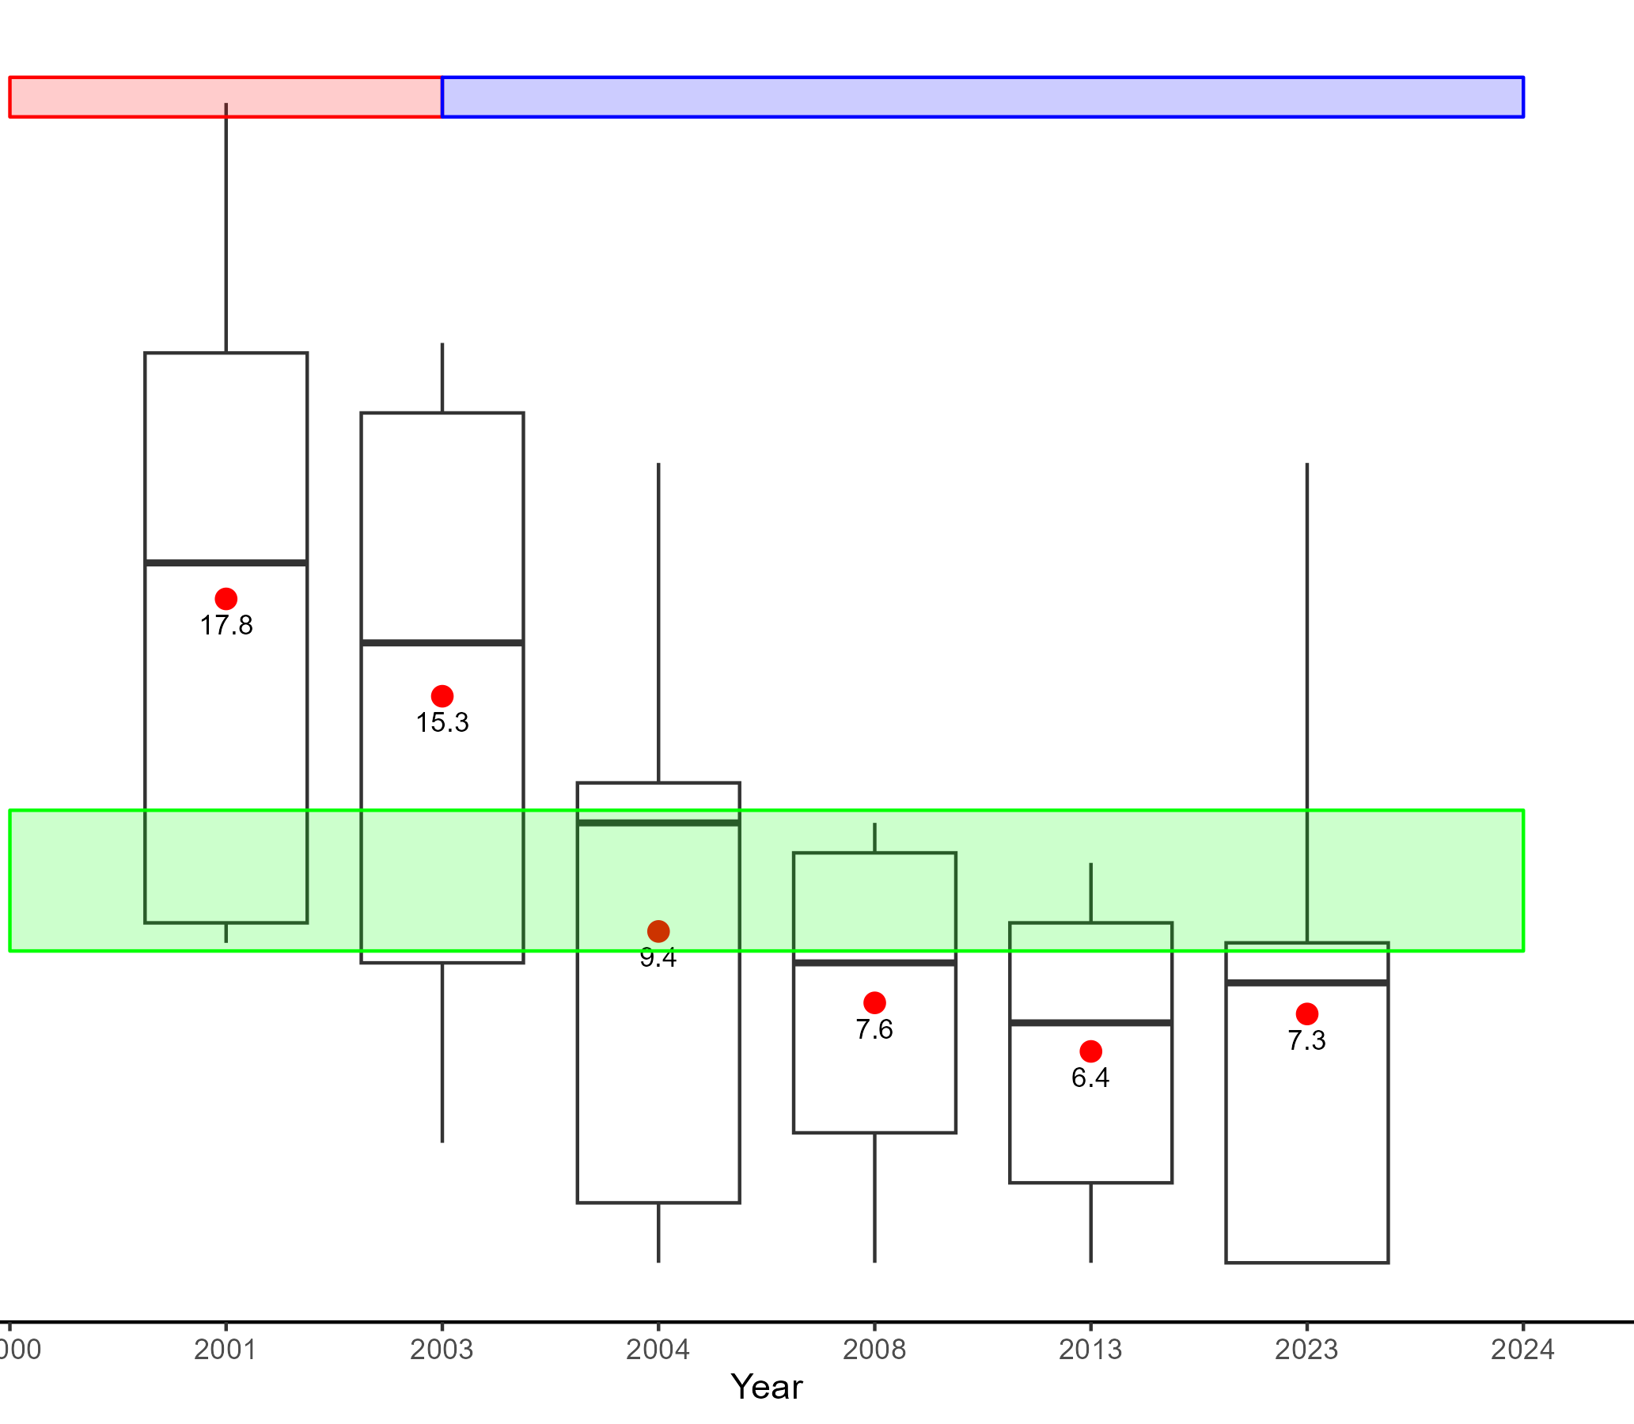
Pre-Fire
Post-Fire
- 13.8%
- 30%
- 47.2%
- 50%
- 59%
*2 years post-burn

Slide 4
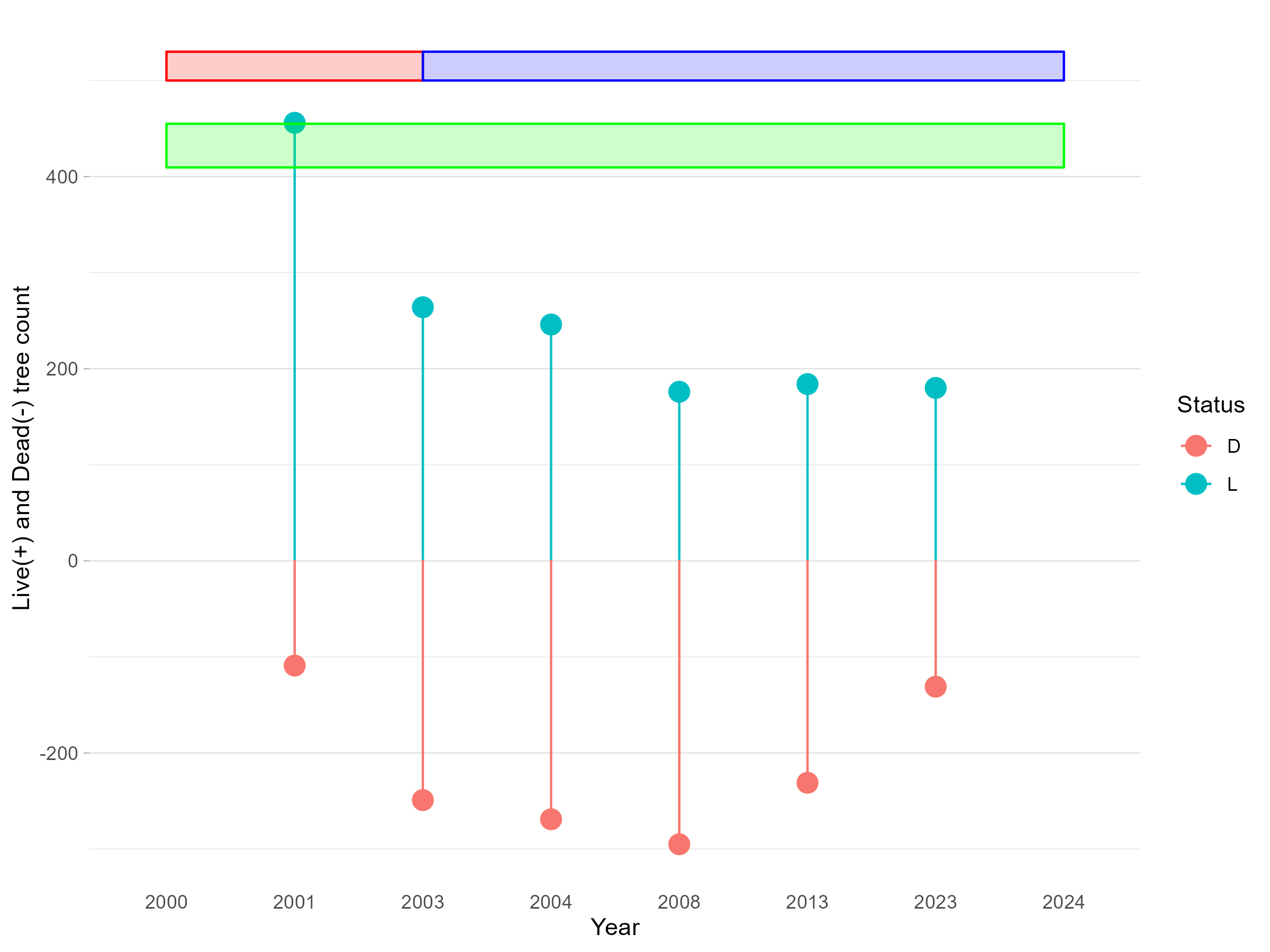
Pre-Fire
Post-Fire
0%
- 10%
- 42.6%
- 61.3%
- 60.4%
*5 years post-burn

Slide 5
