Slide 1
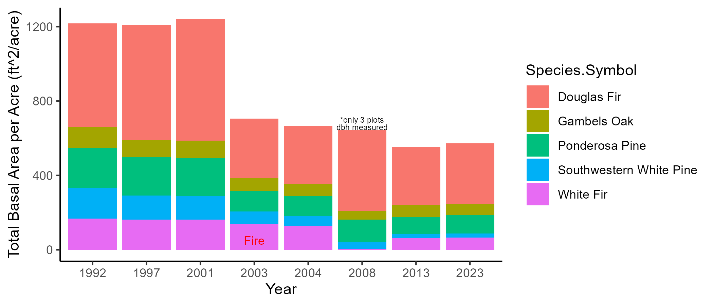
bc
abc
b
abcd
acd
ad
d
d

Slide 2
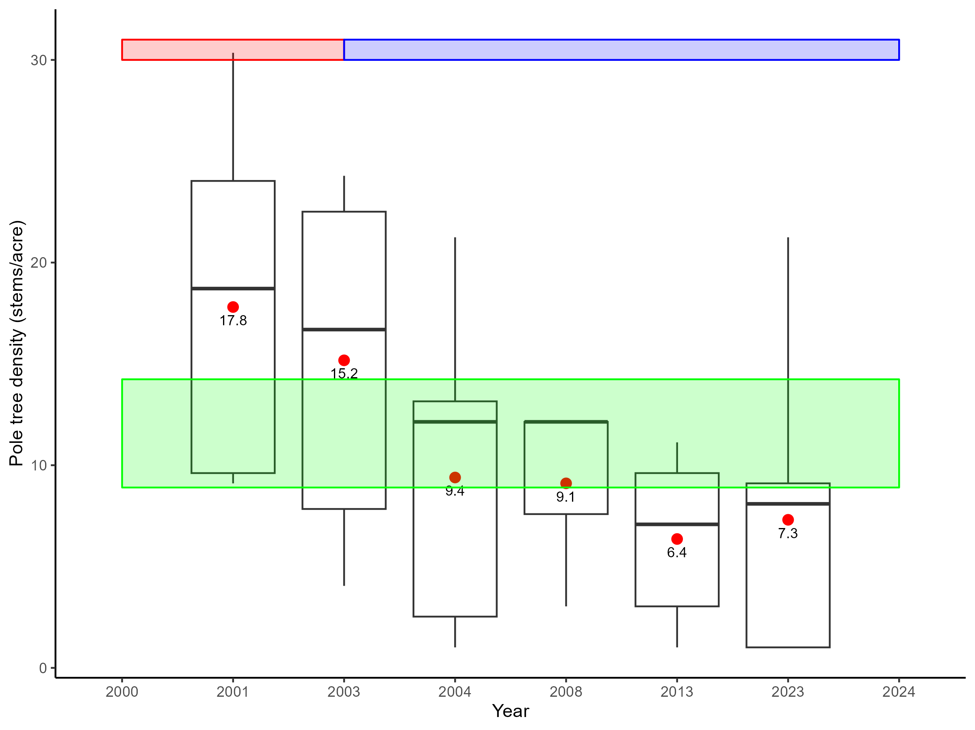
Pre-Fire
Post-Fire
- 14.7%
- 20%
- 47.2%
- 50%
- 59%
*2 years post-burn

Slide 3
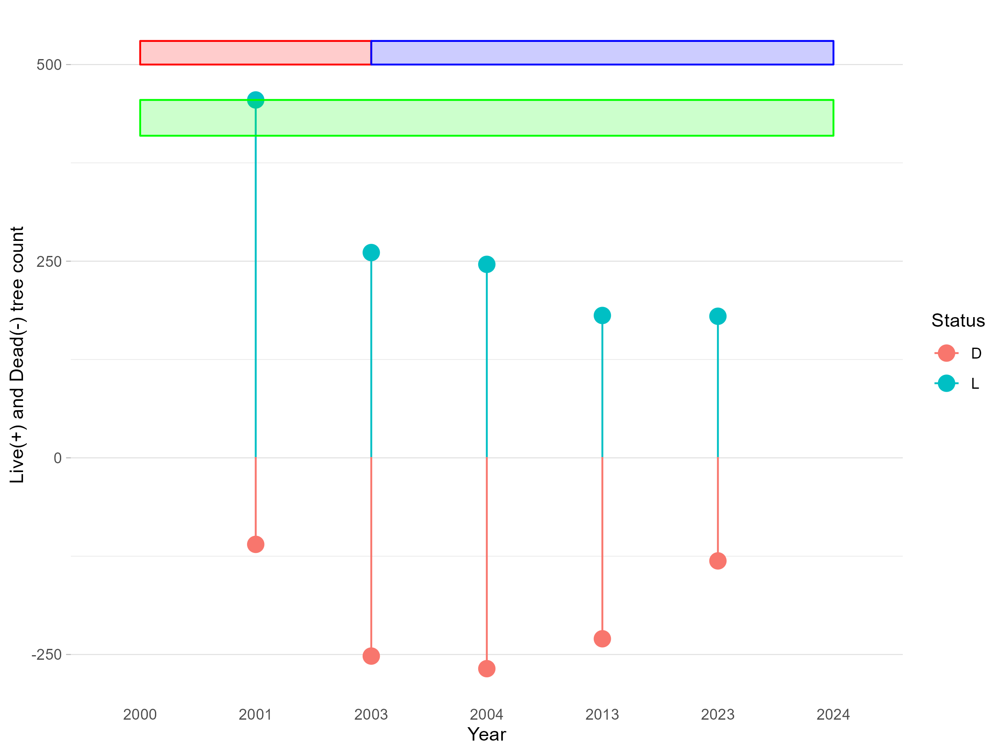
Pre-Fire
Post-Fire
0%
- 10%
- 42.6%
- 45.9%
- 60.4%
*5 years post-burn

