Slide 1
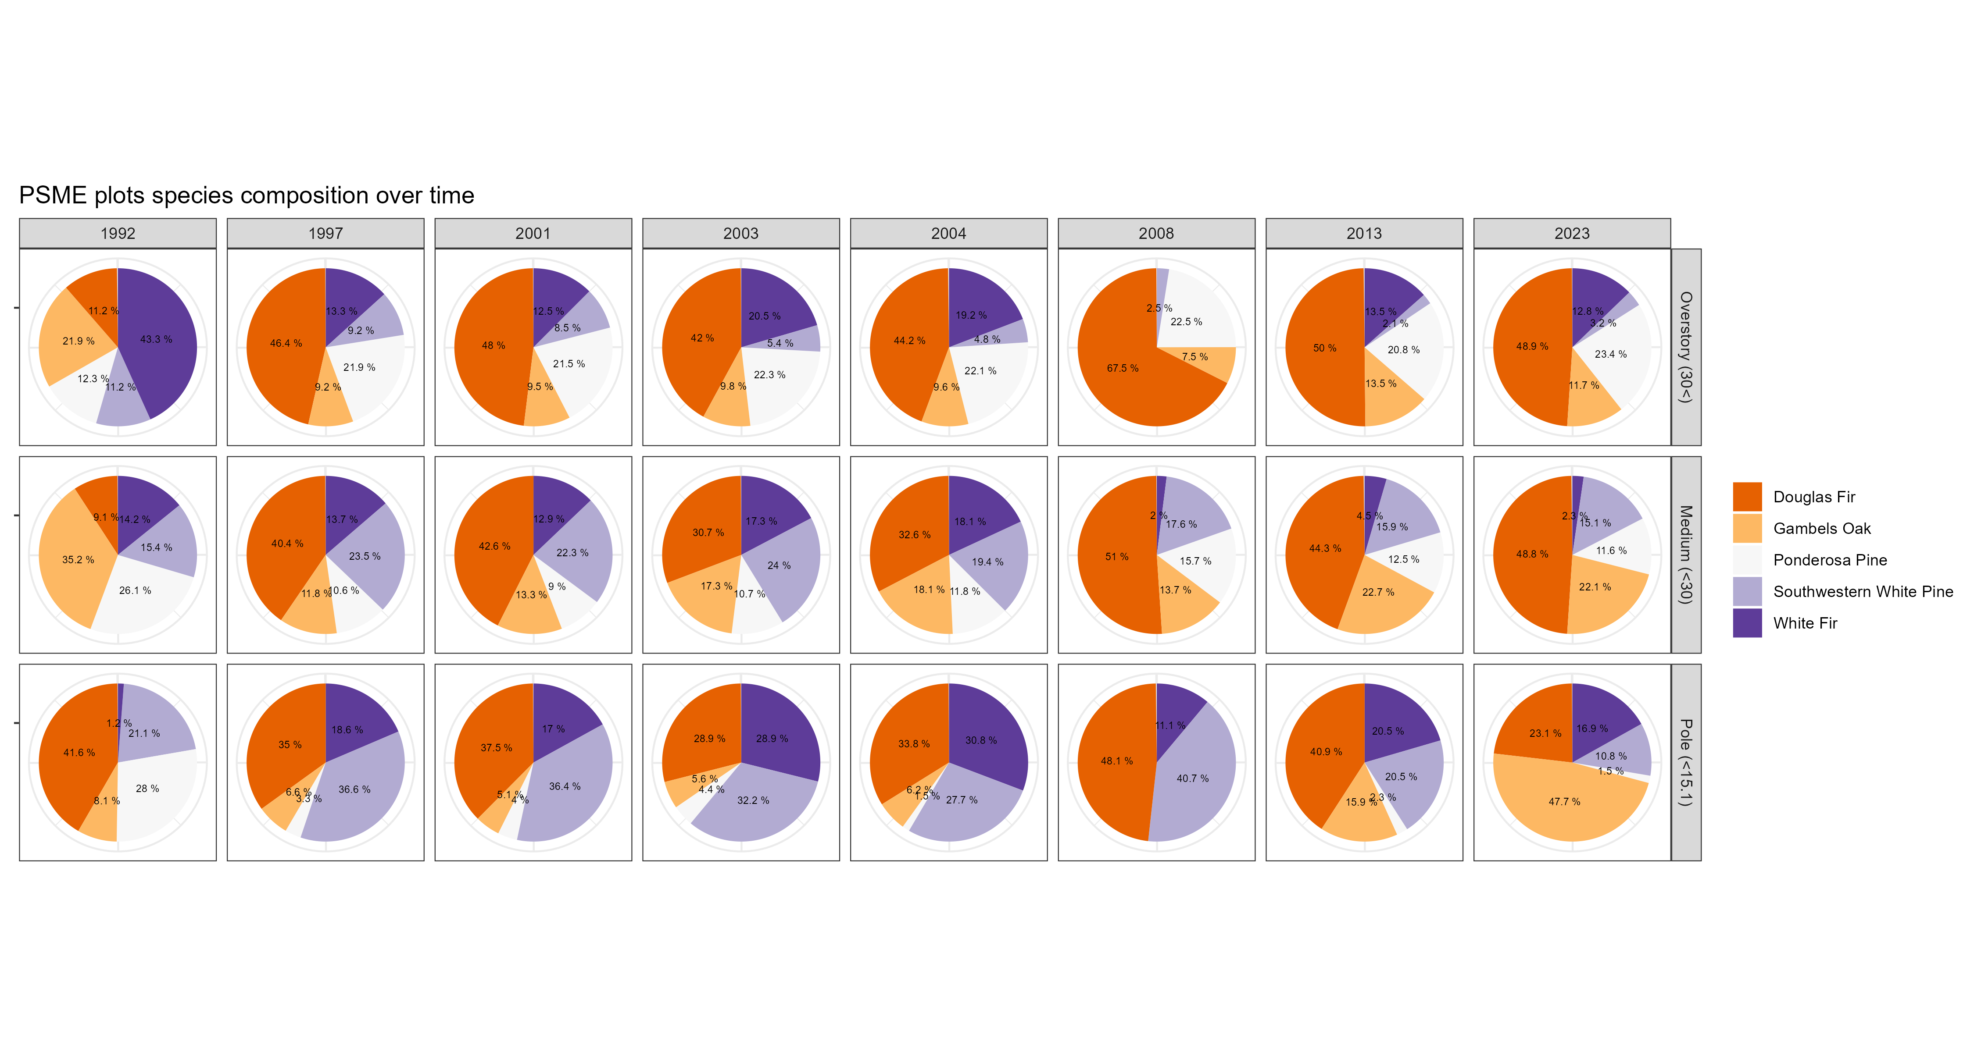
Saguaro NP PSME Plots Live Tree Species Composition Over Time
187
196
200
112
104
40
96
94
# Total Trees Recorded
253
255
256
150
144
51
88
86
161
183
176
90
65
27
44
65

Slide 2
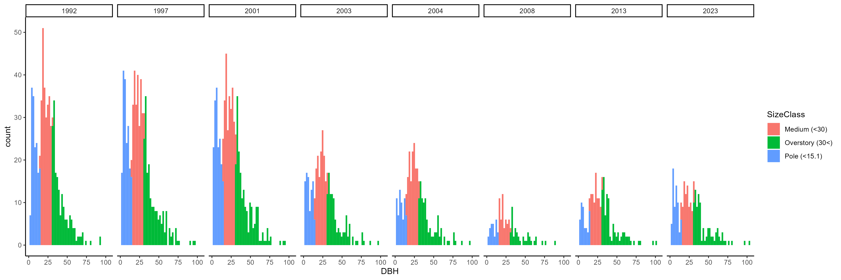
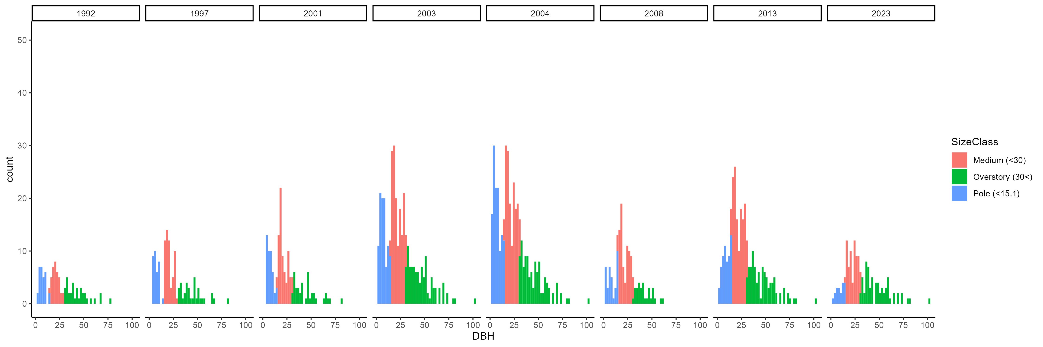
Live PSME tree size distribution over time
Dead PSME tree size distribution over time

