Slide 1

RESEARCH PRESENTATION
Guided Nutrition Support and Blood Pressure Outcomes
Dietitian Counseling vs. an AI Nutrition Assistant vs. Unguided Farmer's-Market Produce Provision
▪ Produce-prescription programs are a growing food-as-medicine strategy for hypertension, but most just hand out food and hope for the best.
▪ This study asks whether pairing produce with guidance, human or AI-delivered, actually improves outcomes over produce alone.
▪ The motivation: dietitian access is costly and hard to scale. If AI guidance captures a meaningful share of that benefit, it points to a scalable path for food-as-medicine programs.
Tony
July 16, 2026

Slide 2
SECTION 01
Abstract & Research Objectives
Abstract at a Glance
Research Questions & Hypotheses
▪ 296 participants, 3 arms (Dietitian, AI Assistant, Control), 99/99/98 after cleaning.
▪ Real baseline + synthetic study layer: demographics/BP from a real 70,000-record cardiovascular cohort.
▪ Both guided arms beat control on BP reduction (ANOVA, p < 0.001 for both outcomes).
▪ Effect survives adjustment for adherence and baseline BP (ANCOVA), not just an adherence artifact.
▪ Adherence is the strongest predictor in every model tested, and the relationship is linear, not curved.
▪ Core question: does guidance (human or AI) on top of produce provision change BP outcomes?
▪ H1: guided support produces significantly greater BP reduction than unguided provision.
▪ H2: the group effect is not fully explained by adherence alone.
▪ H3: adherence percentage is the strongest single predictor of BP change.
▪ H4: a tree-based model outperforms linear baselines, given the feature count.
Farmer's Market Produce & Blood Pressure Study
2 / 6

Slide 3
SECTION 02
Data & Methodology
Dataset
Data Preparation
▪ 296 rows, 57 columns. 99/99/98 participants per arm after cleaning, no missing values.
▪ Baseline (real): age, sex, BMI, cholesterol, glucose, smoking, activity, baseline BP.
▪ Study layer (synthetic): group, 34 produce_item_kg columns, adherence %, guidance sessions, follow-up BP.
▪ 4 rows dropped: physiologically impossible baseline BP readings (e.g. diastolic of 1000), likely data entry artifacts.
▪ Leakage columns removed: follow-up BP, participant ID excluded from model features.
▪ Preprocessing pipeline: StandardScaler on numerics, one-hot encoding on categoricals.
Analytical Methods
Why These Methods
▪ Hypothesis testing: one-way ANOVA + Kruskal-Wallis, then ANCOVA (group + adherence + baseline BP).
▪ Predictive modeling: Linear, Ridge, Random Forest, XGBoost under 5-fold CV (R², RMSE, MAE).
▪ Functional-form check: linear vs. polynomial fits on adherence vs. outcome, pooled and per arm.
▪ ANCOVA isolates the guidance effect from the adherence confound sitting underneath it.
▪ Cross-validated model comparison avoids picking a winner off one lucky split, with under 300 rows.
▪ The functional-form check avoids assuming linearity instead of testing it.
Farmer's Market Produce & Blood Pressure Study
3 / 6

Slide 4
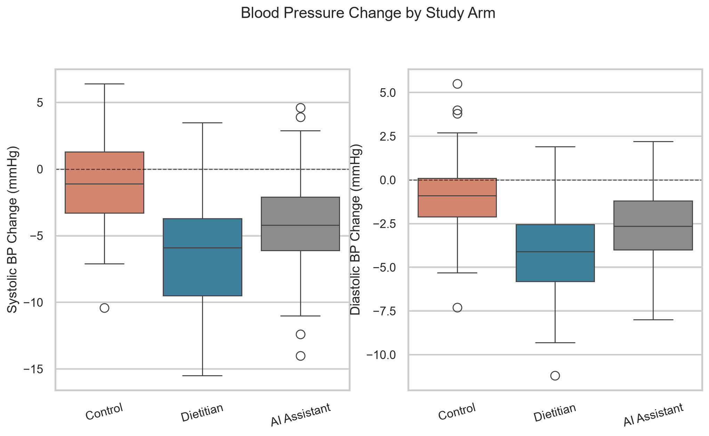
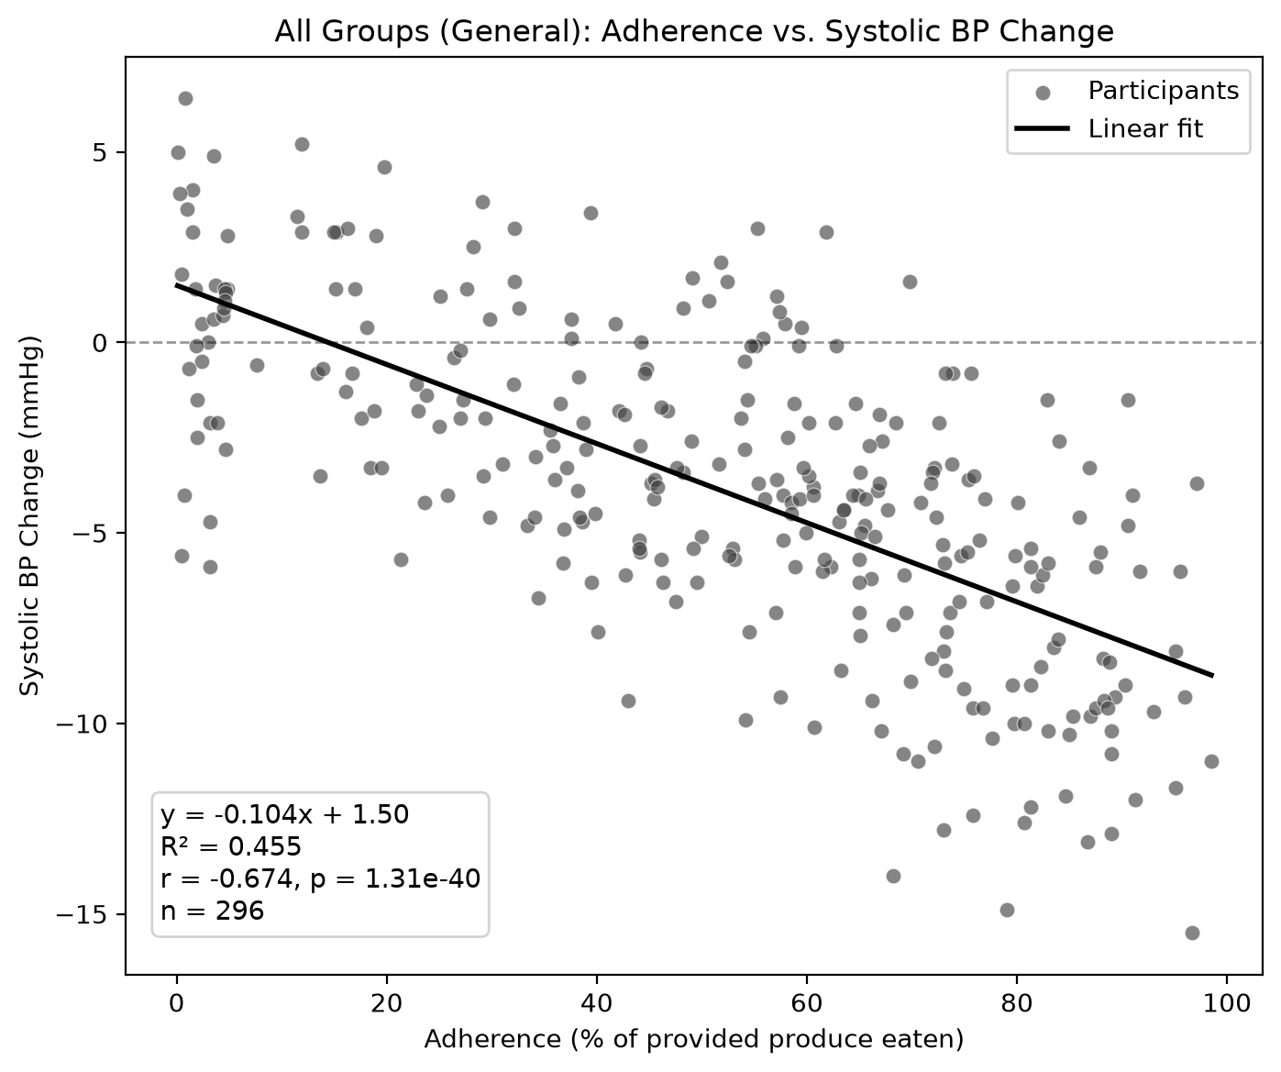
SECTION 03
Key Findings
BP Change by Study Arm
Dietitian shows the largest drop, Control hovers near zero, and AI Assistant lands in between on both systolic and diastolic change.
Adherence Drives the Outcome
A confirmed linear fit (R² = 0.45, p < 0.001): every point of adherence tracks a real, measurable drop in systolic BP.
Farmer's Market Produce & Blood Pressure Study
4 / 6

Slide 5
SECTION 04
Results & Discussion
Were the Hypotheses Supported?
Notable Patterns & Limitations
▪ H1 & H2 supported: guidance produces a real, significant effect that survives ANCOVA adjustment for adherence.
▪ H3 supported: adherence is the top predictor in every model and every analysis lens, by a wide margin.
▪ H4 partially supported: Random Forest wins, but only modestly, and the edge comes from variable interactions, not curvature in the adherence relationship itself.
▪ AI Assistant captures a real but partial share of the Dietitian benefit, suggesting non-human guidance can meaningfully move the needle.
▪ Unexpected: individual produce items (kale, beets, etc.) show only weak, noisy correlations, and no single vegetable stands out.
▪ Diastolic modeling is less stable: 5-fold CV favors systolic (R² 0.42 vs. 0.32), but a single holdout split flips the ranking, a sign of small-sample noise, not a real reversal.
▪ Outcome data is synthetic, layered on a real baseline cohort, so this is a methodology demonstration, not a clinical result.
▪ Causal subgroup analysis (CausalForestDML) was planned but not run in this environment; current importances are predictive, not causal.
Farmer's Market Produce & Blood Pressure Study
5 / 6

Slide 6
SECTION 05
Conclusion & Future Work
Main Takeaways
Recommendations & Future Work
▪ Guidance works: dietitian or AI support drives significantly larger BP reductions than produce alone, even after controlling for adherence.
▪ Adherence is the lever: it matters more than any individual produce item, regardless of arm.
▪ AI guidance is a viable, scalable complement to costly one-on-one dietitian access, not a full replacement, but a meaningful partial substitute.
▪ Run the causal forest subgroup analysis to test whether AI guidance helps some participants (e.g., low baseline adherence) more than others.
▪ Replicate on real trial data: every outcome here rests on a synthetic layer over a real baseline cohort.
▪ Study what drives adherence itself, since it is the single strongest lever found in this entire analysis.
▪ Simplify future models: the confirmed linear relationship means adherence can be modeled as a linear term, no polynomial expansion needed.
Practical Impact
▪ Produce-prescription programs should pair boxes with structured guidance, human or automated, rather than provision alone.
▪ Even a lightweight AI nutrition assistant appears to meaningfully improve outcomes over no guidance at all.
Guidance, not just groceries, is what turns a produce box into a blood pressure outcome.

