Slide 1
PRESENTATION ON Sentiment Analysis on BusinessDay Articles (2021-Present)
By Group 3
INTERNPULSE
April 2025

Slide 2
Project Overview
This research project aims to extract and analyze articles tagged under BDLead from BusinessDay Nigeria’s website.
The main goal is to perform sentiment analysis on editorial content, focusing on economic narratives in Nigeria from 2021 to present.
The project involves scraping article titles and links across 812 pages, extracting article content, and storing the data for further sentiment and textual analysis.

Slide 3
Sentiment Analysis
● Text Blob was used to compute sentiment polarity for each article.
Positive → (compound ≥ 0.05)
Neutral → (−0.05 < compound < 0.05)
Negative → (compound ≤ −0.05)
Sentiment | Percentage
Negative | ~46%
Neutral | ~38%
Positive | ~16%

Slide 4
INTERPRETATION
Negative Sentiment (~46%): This could imply that many of the stories or viewpoints in these articles focus on challenges, problems, or unfavorable conditions affecting Nigeria's economy, businesses, or societal issues.
Neutral Sentiment (~38%): This suggests that these articles either present factual information without strong emotional overtones or take a balanced approach in their coverage.
Positive Sentiment (~16%): A smaller proportion of the articles (about 16%) express positive sentiment, which likely reflects optimistic views or reports about growth, progress, or favorable developments.

Slide 5
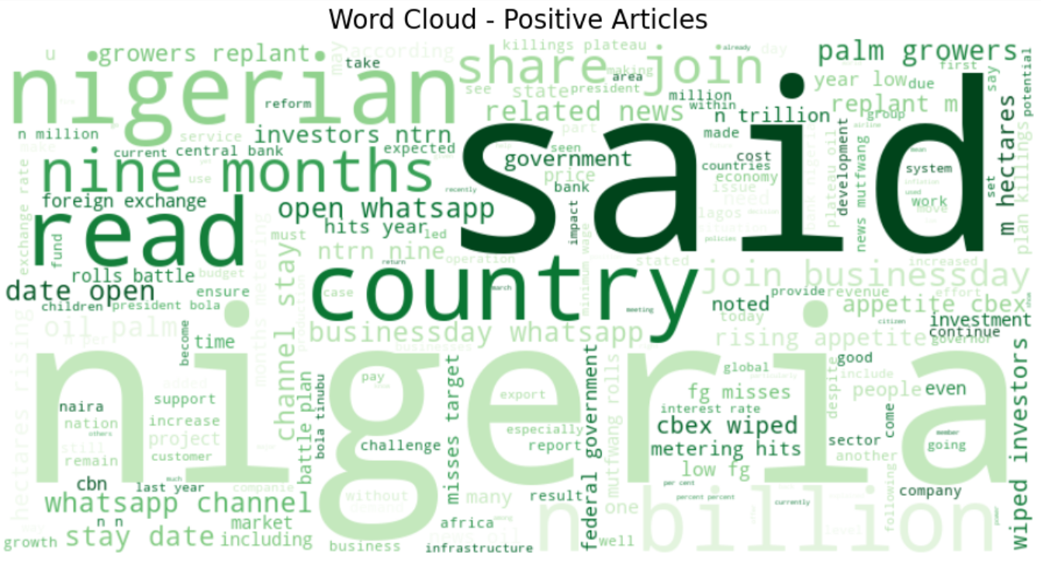
Most Frequent Words in Positive vs. Negative Articles
- Positive Articles: Frequent words included "growth", "investment", "increase", "development".

Slide 6
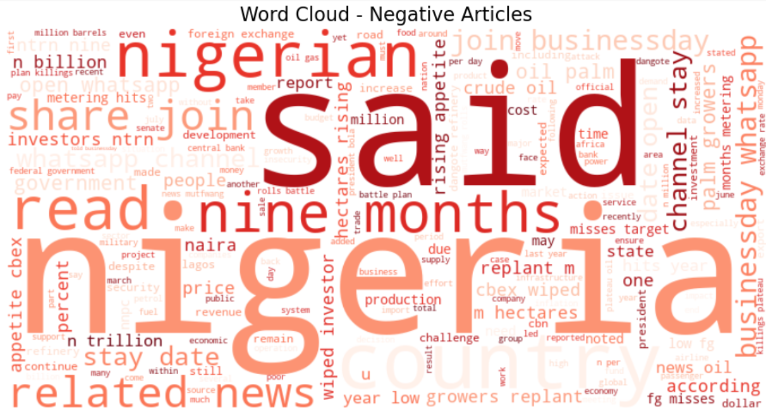
Negative articles
Negative Articles: Frequent words included "debt", "inflation", "crisis", "shortage", "decline".

Slide 7
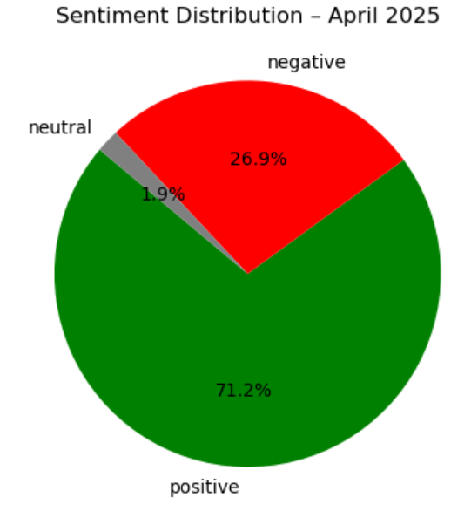
Sentiment DISTRIBUTION CHARTS

Slide 8
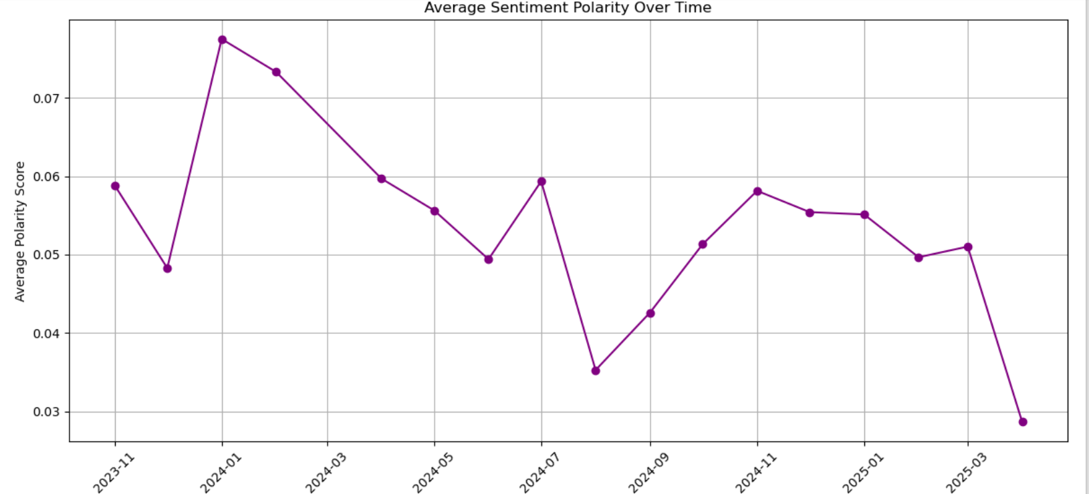
Sentiment DISTRIBUTION CHARTS

Slide 9
Conclusion
The sentiment analysis provides insights into BusinessDay's editorial tone over time, helping readers and researchers understand economic narratives in Nigeria from 2021 to 2025.
The overall sentiment distribution indicates that BusinessDay's 'BDLead' articles tend to focus more on negative or neutral aspects of the Nigerian economy, with positive news being less prevalent.

