Slide 1
JavaScript Introduction
Topics discussed this presentation
Brief introduction to and history of language
Roles of the language
Its data types
JavaScript Object Notation (JSON)
Simple program employing JavaScript

Slide 2
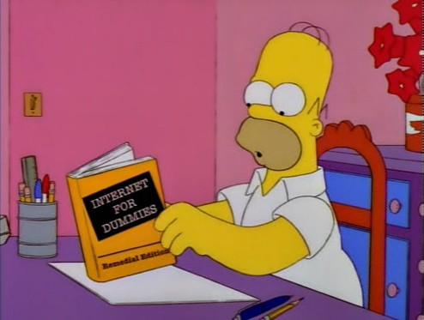
Javascript
Overview
Originally a small language
Not anymore - now enormous
Flawed but powerful
Not Java
Not a subset of Java
Very different languages
Shares C-family syntax
Similarities Scheme & Self
Scores of badly written books aimed at the dummies and amateur market

Slide 3
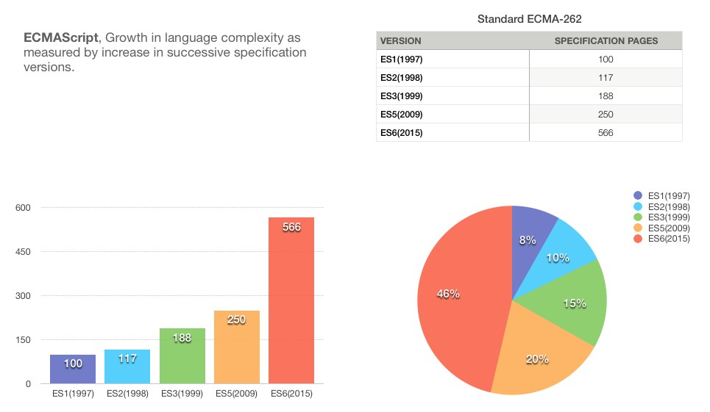
Javascript
Language specification growth

Slide 4
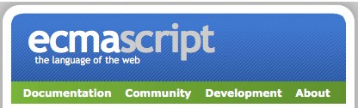
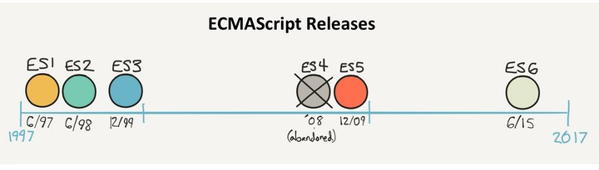
Ecma International
ECMAScript - the language of the web
ECMAScript: standardization body
Several popular implementations:
JavaScript
JScript
ActionScript
Edition 6 (ES6) published June 2015
Course applies ES6

Slide 5
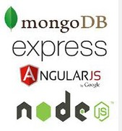
JavaScript
Several frameworks available
Client-side
Angular
Backbone
Ember
Aurelia
React
Server-side (node)
hapi
express
koa
sails
MEAN stack collection:
MongoDB
Express.js
Angular
Node.js

Slide 6
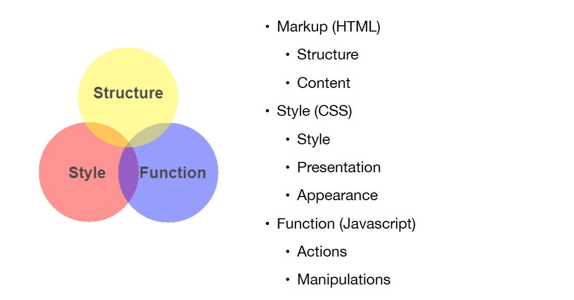
Nature of JavaScript
Structure Client-Side Web

Slide 7
Nature of JavaScript
The Language
Although not Java, has:
Similar syntax & keywords
Similar standard library naming conventions
Object oriented but does not have classes in classical sense.
uses syntactic sugar to simulate classes
prototypal: objects inherit from objects Dynamic typing
Variable may be reference to object of any type

Slide 8
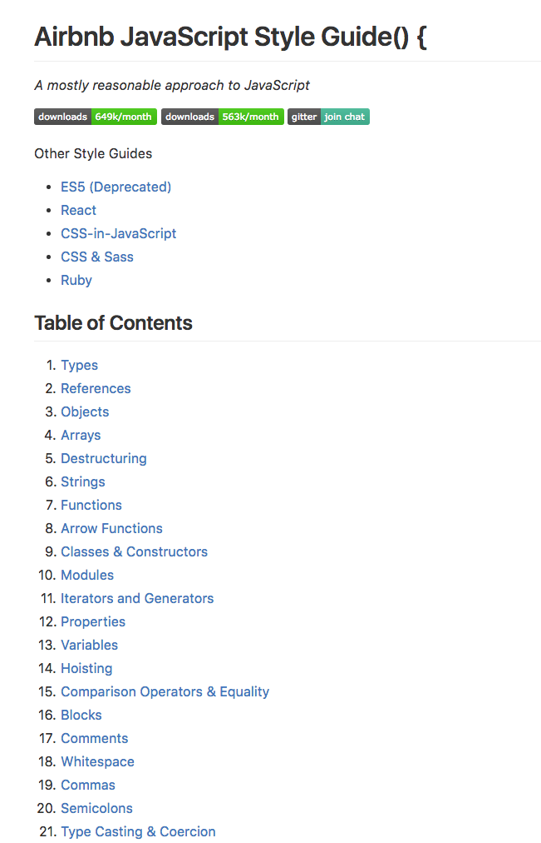
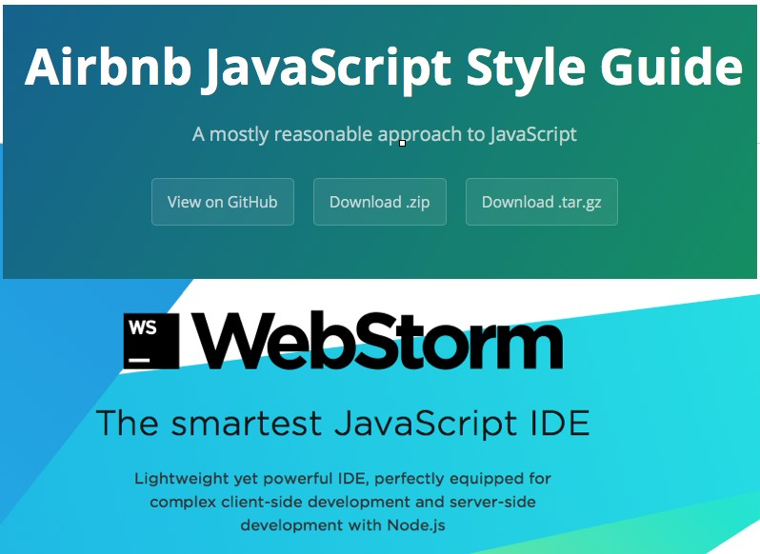
Javascript Styling
Our choice from several available Style Guides and IDEs
Airbnb JavaScript Style Guide
WebStorm JavaScript IDE

Slide 9
Nature of JavaScript
The Language
Provides access to main components web page:
Cascade Style Sheet (CSS) properties
Markup content (e.g.: div, img, p)
Forms (Communication to server)
Most often used client-side
Growing use server-side (node.js)
Weakly typed with first-class functions
function: block reusable code (more on this later)
functions are objects
may be passed as parameters

Slide 10
Javascript
Primitive Data Types
Six primitive types
boolean
number
string
null
undefined
symbol (ES6)
All other types are objects
console.log('This is a string'); console.log('true is a boolean'); console.log('10.5 is a number');

Slide 11
Javascript
Primitive Wrapper Data Types
Four wrapper types
Boolean
Number
String
Symbol
// Wrapper's valueOf returns primitive value. const b = Boolean(true); // b => true.

Slide 12
var, const and let
var, const and let used to store values and object references:
var exists since ES1.
const &let introduced ES6.
Significant behavioural differences.
Preference given henceforth to use of const, then let.
var usage should be avoided.
var x = 10; // Avoid future use
let y = 20; // Use where reassign likely const z = 30; // cannot be reasigned

Slide 13
Data types
boolean
boolean can be
true
false
// Output: b is true const b = true;
if (b) {
console.log('b is true');
};
// Ouput: b is true const b = true;
if (b) {
console.log('b is ', Boolean(b));
};

Slide 14
Data types
number
// Output is 3.3333333333333335 const val = 10 / 3; console.log(val);
number 64-bit floating point
Similar to Java’s double
No integer type
number type includes
NaN
Infinity
Problematic in finance
• 0.1 +0.2 == 0.3
This expression false
// Output: true. val is not a number const val = '2005/12/12'; console.log(isNaN(val)); // true
// Output: string
console.log(typeof val);
const val = 10 / 0; console.log(val); // Infinity console.log(typeof val); // number

Slide 15
Data types
string
string sequence of zero or more Unicode characters.
Similar to Java String.
No char type as in Java.
Literals use ’ or " to enclose characters
Either quote type may be used in pairs.
Illegal to mix.
Important: Use only single quotes to comply with style guide.
'This is a string.'
"This is also a string but we will not use double quotes."
"This is not a legal string'

Slide 16
Data types
string
const s = 'What\'s a \"celeb\" famous for?';
Internal quotes
Can use escape sequence \
// What's a "celeb" famous for?
console.log(s);

Slide 17
Data types
null & undefined
Variable not assigned a value is of type undefined
null indicates the absence of a value
Some experienced developers no longer use null.
var planes; // => undefined
// A language error in ES5, fixed ES6
console.log(typeof planes); // => object in ES5
const planes;
// SyntaxError: Missing initializer in const declaration

Slide 18
Data types
symbol
Associated wrapper class Symbol
Introduced in ES6
Can generate unique property keys
Eliminates risk collision
let uniqueKey = Symbol(); obj = {};
obj[uniqueKey] = 'unique';
console.log(obj[uniqueKey]); // => unique console.log(uniqueKey); // => Symbol() console.log(typeof (uniqueKey)); // => symbol

Slide 19
Data types
Object
const book = { title: 'Java', author: 'Chapman',
ISBN: 'ISBN−10 03219804333',
edition: 4,
isInPrint: true,
};
book.isInPrint // => true
Object literal
comma-separated list of colon-separated name:value pairs
in curly braces.

Slide 20
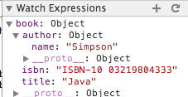
Data types
Object
Container comprising
name-value pairs
value may be object
may add new properties anytime
const book = { title: 'Java', author: {
name: 'Simpson',
}
};
console.log(book.title); // => Java
// Add new property (name−value pair)
book.isbn = 'ISBN−10 03219804333';

Slide 21
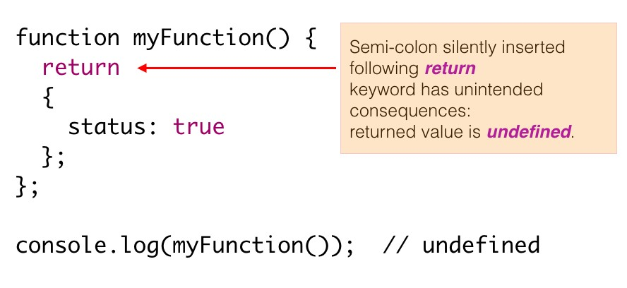
Semicolon insertion
Example where positioning of curly brace matters

Slide 22
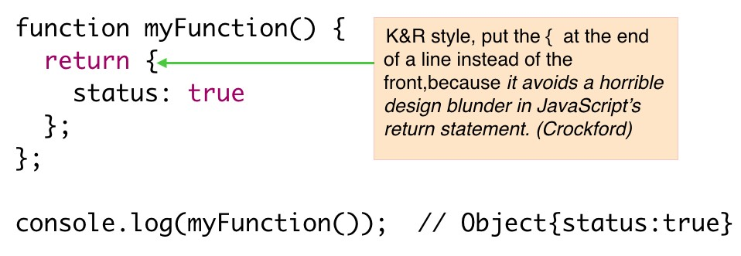
Semicolon insertion
Example where positioning of curly brace matters

Slide 23
JavaScript
Run Program - Simple Example
/∗∗
∗ A Web Page with HTML & reference to external JavaScript file
∗/
<!DOCTYPE html>
<html>
<head>
<meta charset="UTF−8">
</head>
<body>
<h1 id="hello">Hello ICTSkills</h1>
<script src="js/foo.js"></script>
</body>
</html>

Slide 24
JavaScript
Run Program - Simple Example
/∗∗
∗ Demo JavaScript code
∗/
alert('Hello ICTSkills');
function foo() { const size = 3;
for (let i = 0; i < size; i += 1) {
console.log(i);
}
}
foo();

Slide 25
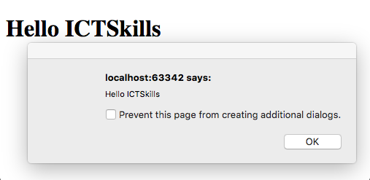
JavaScript
Run Program - Simple Example

Slide 26
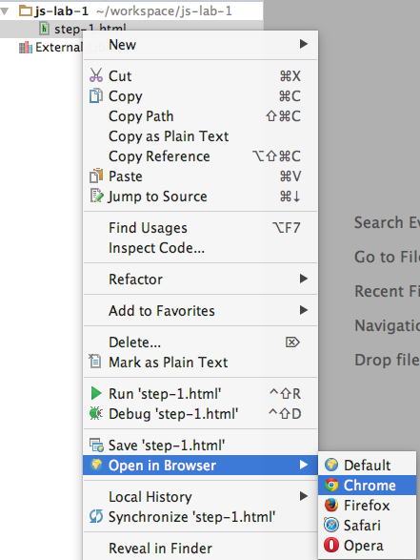
JavaScript
Run Program - Simple Example

Slide 27
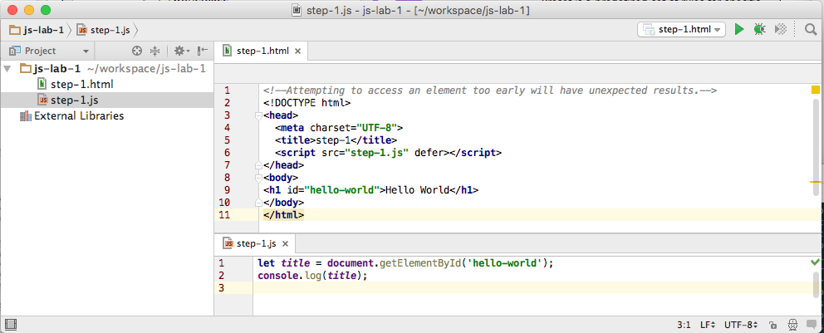
JavaScript
Run Program - Simple Example

