Slide 1
JavaScript Basics
Identifiers
Comments
Reserved Words
Operators
Control Flow
Truthy and Falsy

Slide 2
Identifiers
Style Guide Requirements
May comprise only letters, numbers, $ sign, underscore
Avoid single letter names.
camelCase for objects, functions, instances.
PascalCase for constructors, classes.
Leading underscore _ for private properties.
Number disallowed as first character.
function q() {...} // bad
function query {...} // good: descriptive const my_object = {} // bad
const myObject = {} // good: camelCase
const good = new User({...}); // good: PascalCase
const $domElement = $(this).get(0); // good: jQuery variable

Slide 3
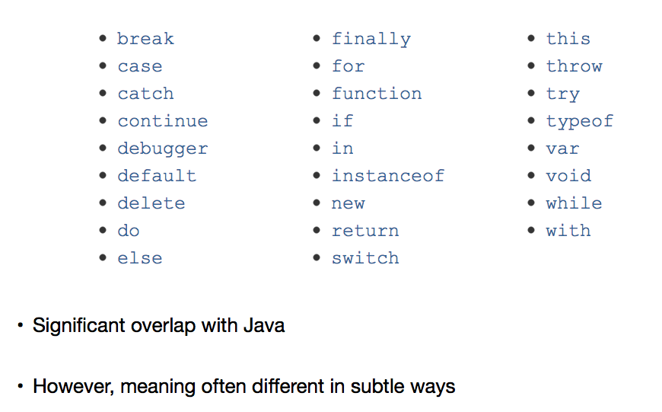
Reserved words
Java Overlap

Slide 4
Comments
Single line comments
Use // for single line comment.
Position on new line above target of comment.
If not start block, add blank line before comment.
function getRadius() {
// return radius of circle.
...
}

Slide 5
Comments
Multi-line comments
Use /*. . . */ for multi-line comments.
Include description.
Specify parameter types and values.
Specify return type and value.
/∗
∗ find() returns sought value based on parameter key.
∗
∗ @param {String} key
∗ @return {Value} value.
∗/
function find(key) {
// ...
return value;
}

Slide 6
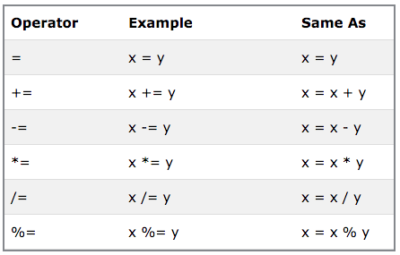
Operators
Assignment
const x = 5; const y = 2; let z = x + y;
z ∗= 2; // => 18
z /= 3; // => 6
x % 3; // => 2

Slide 7
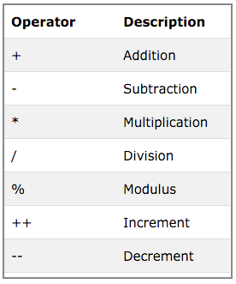
Operators
Arithmetic
const x = 5; const y = 2;
const z = x ∗ y; // => 10
z−−; // => 9

Slide 8
Operators
String
let txt1 = 'What a very ';
txt1 += 'nice day.';
// Output
What a very nice day.

Slide 9
Operators
Add Number to String
const x = 5 + 5;
const y = '5' + 5;
// => 10
// => 55
const z = 'Hello' + 5; // => Hello5

Slide 10
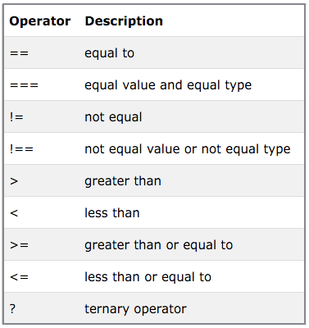
Operators
Comparison & Logical
const s = '5'; const n = 5;
s == n // => true (coercion)
s === n // => false (strict)

Slide 11
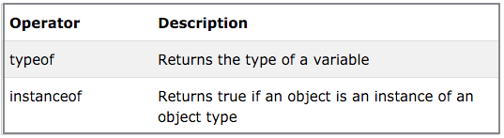
Operators
Type
const car = 'Nissan';
typeof car; // => string
const cars = ['Saab', 'Volvo', 'BMW'];
cars instanceof Array; // => true

Slide 12

Operators
Equals and not equals
// Use always
===
!==
// Evil twin (Crockford)
==
!=

Slide 13
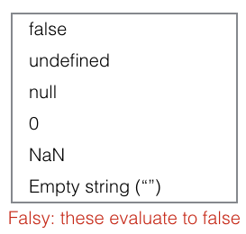
Control Flow
Truthy and Falsy
Expression either truthy or falsy.
Some developers avoid use.
Not reserved words.

Slide 14
Control Flow
Truthy and Falsy
Falsy
false
null
undefined
Empty string ”
Number 0
NaN
Truthy
All values not truthy
Warning: string ’false’ is truthy

Slide 15
Control Flow
Truthy and Falsy
Function to determine if value falsy
/∗∗
∗ Determines if argument resolves to a falsy or truthy value.
∗
∗ @see https://developer.mozilla.org/en−US/docs/Web/JavaScript/Reference
∗ @param arg Argument to be checked if falsy.
∗ @return Returns true if argument is falsy, otherwise false.
∗/
function falsy(arg) {
return [false, null, undefined, '', 0, NaN].includes(arg);
}

Slide 16
Control Flow
Logical Operators (AND, OR)
x && y // => x if x falsy otherwise y
x || y // => x if x truthy otherwise y
// Use OR to insert default values const person = {};
let name = person.name || 'No such person';
console.log(name); // => No such person
person.name = 'Jane Doe';
name = person.name || 'no such person';
console.log(name); // => Jane Doe

Slide 17
Control Flow
Logical Operators (AND, OR)
x && y // => x if x falsy otherwise y
x || y // => x if x truthy otherwise y
// Use AND to avoid TypeError exception const flight = {};
flight.airline; // => undefined
flight.airline.nationality; // => TypeError
flight.airline && flight.airline.nationality; // undefined

Slide 18
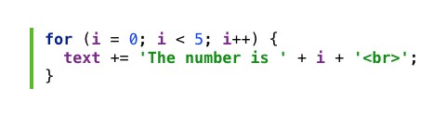
Control Flow
Loop using for
const limit = 5;
for (let i = 0; i < limit; i++) {
text += 'The number is ' + i + '<br>';
}

Slide 19

Control Flow
Using while
let i = 0;
while (i < 10) {
text += 'The number is ' + i; i++;
}

Slide 20
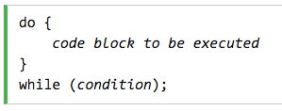
Control Flow
Using do-while
let i = 0;
const limit = 10; do {
text += 'The number is ' + i;
i++;
} while (i < limit);

Slide 21
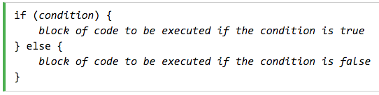
Control Flow
Using if-else
if (hour < 18) {
greeting = 'Good day';
} else {
greeting = 'Good evening';
}

Slide 22
Control Flow
Using break statement
// This trivial function return 0
function foo()
{
const limit = 10; const sum = 0;
for (let i = 0; i < limit; i += 1) {
if (i % 2 == 0) break;
else
sum += i;
}
break statement
Checks for condition
If met then immediately exits loop
return sum;
};

Slide 23
Control Flow
Using continue statement
continue statement
// Calculate sum of odd integers in range [0, 10]
function addOdd() { const limit = 10; let sum = 0;
for (let i = 0; i < limit; i += 1) {
if (i % 2 == 0) continue;
else
sum += i;
}
Checks for condition
If met, skips remainder iteration
Continues with next iteration
return sum;
};

Slide 24

Control Flow
Ternary (Conditional) Operator
// If argument a is negative return −a.
Otherwise, return a
function absoluteValue(a) {
return a < 0 ? −a : a;
};

Slide 25
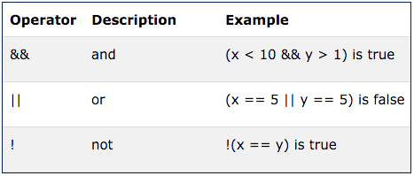
Control Flow
Logical Operators
function foo() { const limit = 5; let i = 0;
let j = 0;
let sum = 0;
while (++i < limit && ++j < limit) {
sum += i + j;
}
return sum;
};
console.log(foo()); // 20

Slide 26
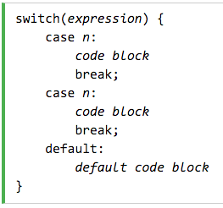
Control Flow
Using switch statement
switch (new Date().getDay()) { case 0:
case 6:
day = 'Weekend'; break;
default:
day = 'Weekday';
}

