Slide 1
JavaScript Introduction
Topics discussed
Scripts
Chrome Developer Tools
Firefox Developer Tools

Slide 2
Script Tags
Inserts program in html document
<script></script>
Allows program in html
Bad idea to place JavaScript in html
Instead use source tags
<!DOCTYPE html>
<html>
<head>
</head>
<body>
...
...
<script src="js/jquery−2.0.0.js"></script>
<script src="js/reportMap.js"></script>
</body>

Slide 3
Script Tags
Where to locate
<script></script>
Script files may have big impact on page load
Place tags close as possible to bottom of body
Place css <link> high as possible in head
Reduce number of script files as much as possible
Minify script files in release versions
Has big impact on load time

Slide 4
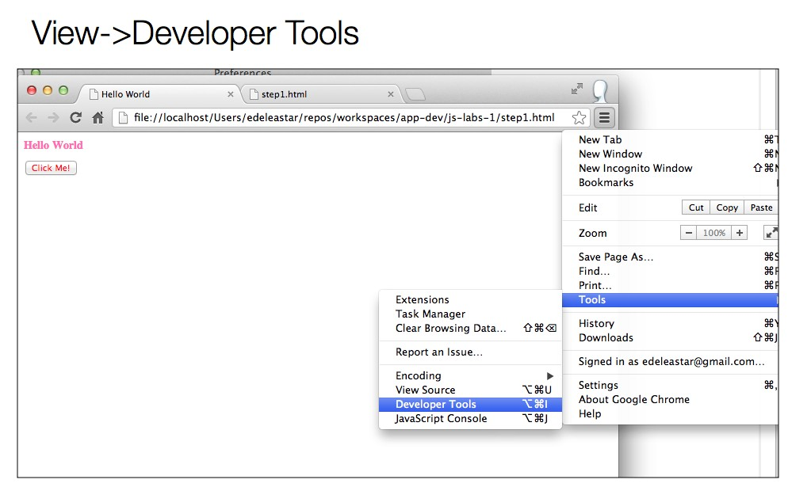
Chrome Dev Tools
Web authoring & debugging tools

Slide 5
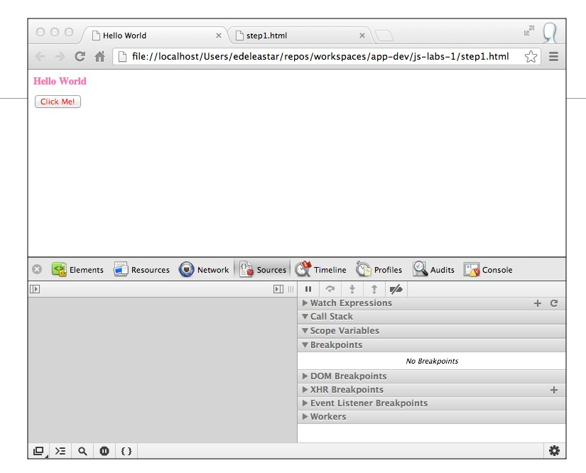
Chrome Dev Tools
Web authoring & debugging tools

Slide 6
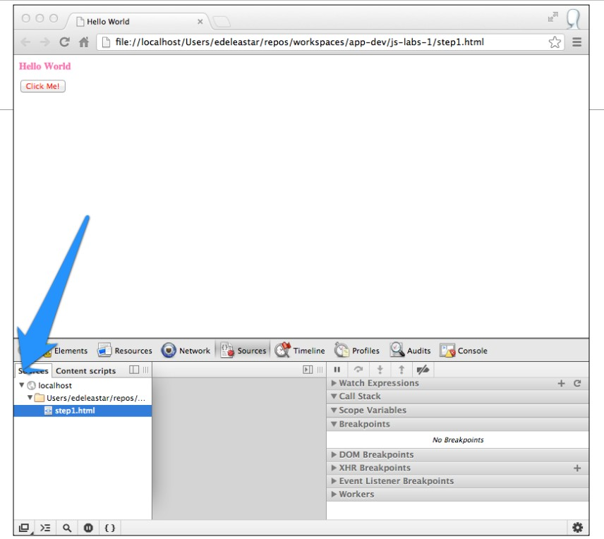
Chrome Dev Tools
Web authoring & debugging tools

Slide 7
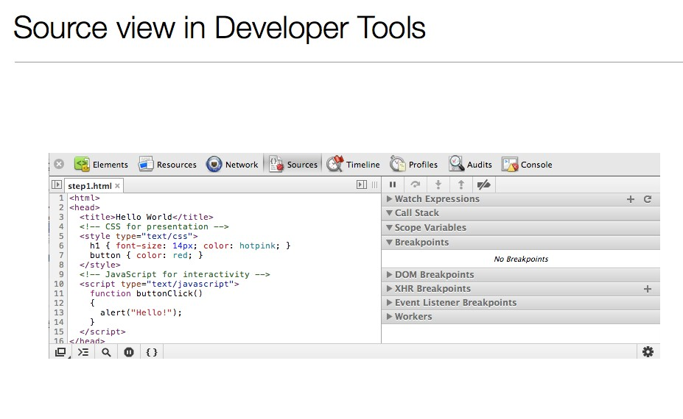
Chrome Dev Tools
Web authoring & debugging tools

Slide 8
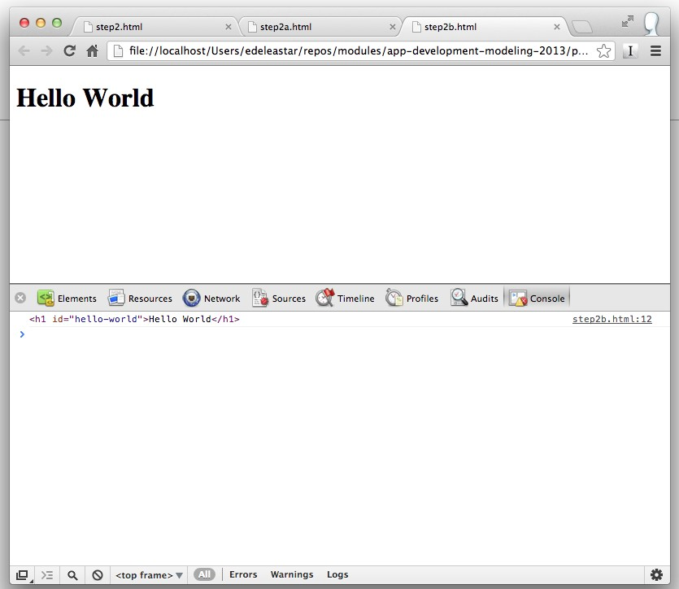
Chrome Dev Tools
Web authoring & debugging tools

Slide 9
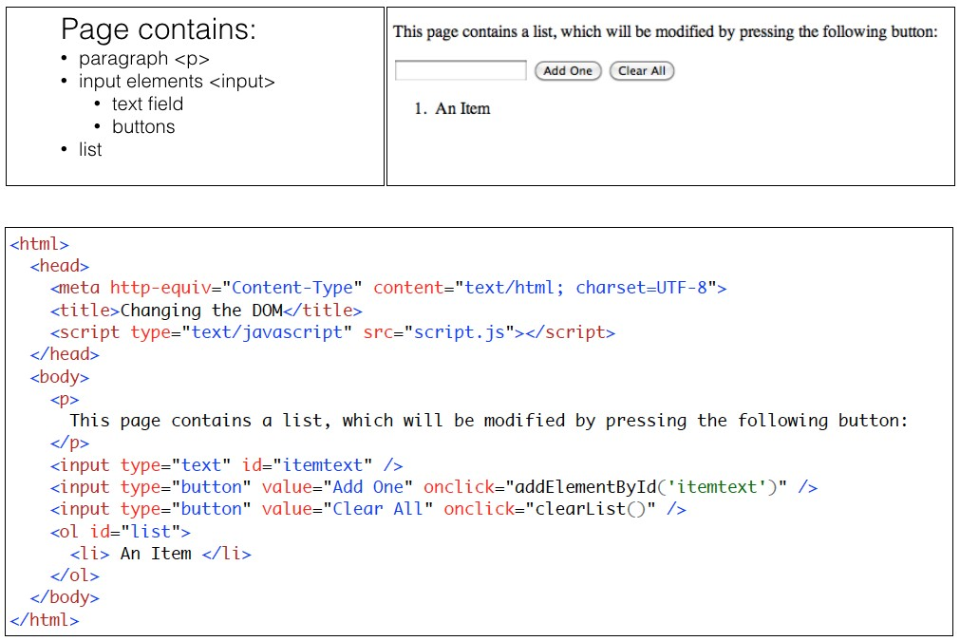
Example
Button press causes invocation JavaScript function

Slide 10
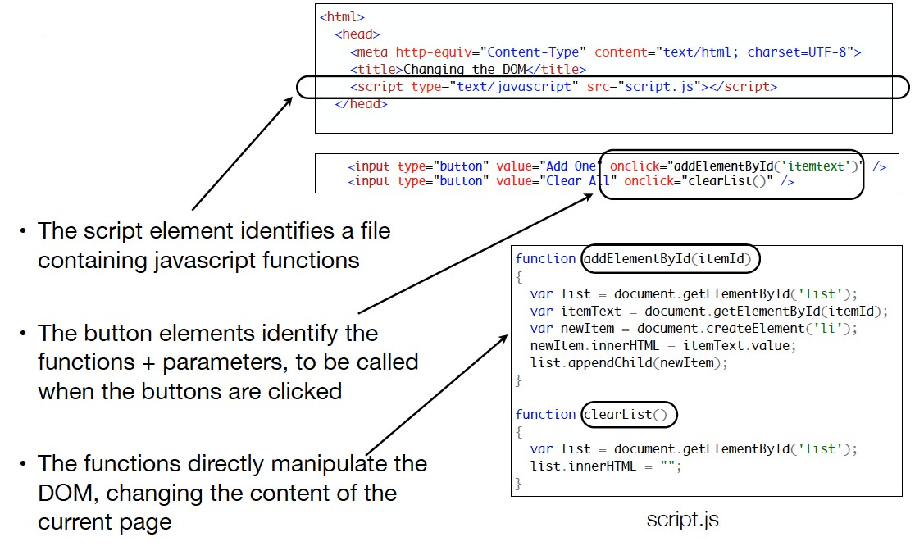
Example
JavaScript functions

Slide 11
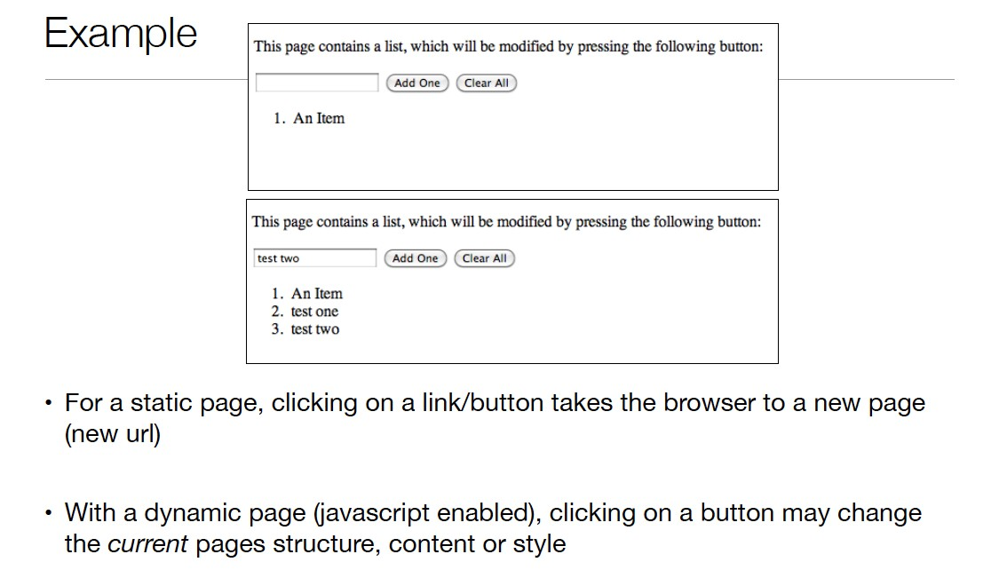
Static v Dynamic
JavaScript enabled page

Slide 12
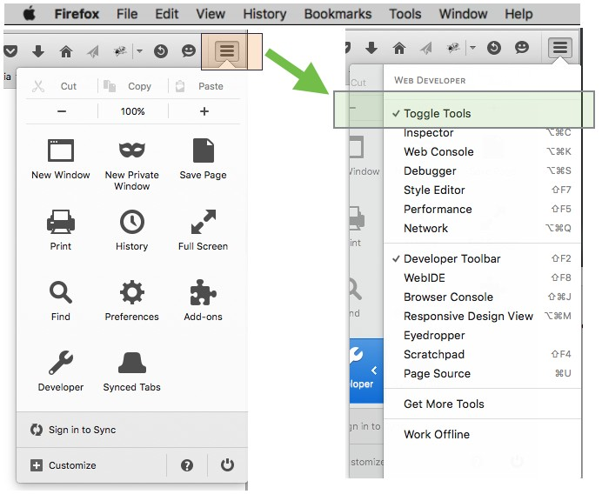
Firefox Dev Tools
Web authoring & debugging tools

Slide 13
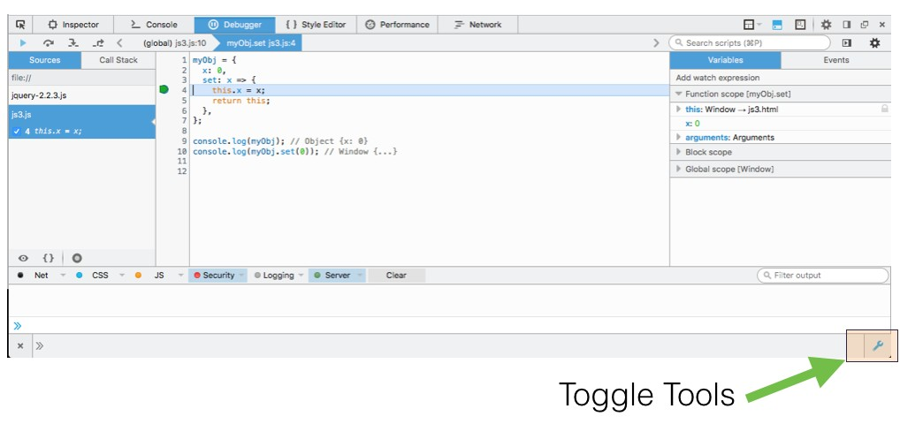
Firefox Dev Tools
Web authoring & debugging tools

Slide 14
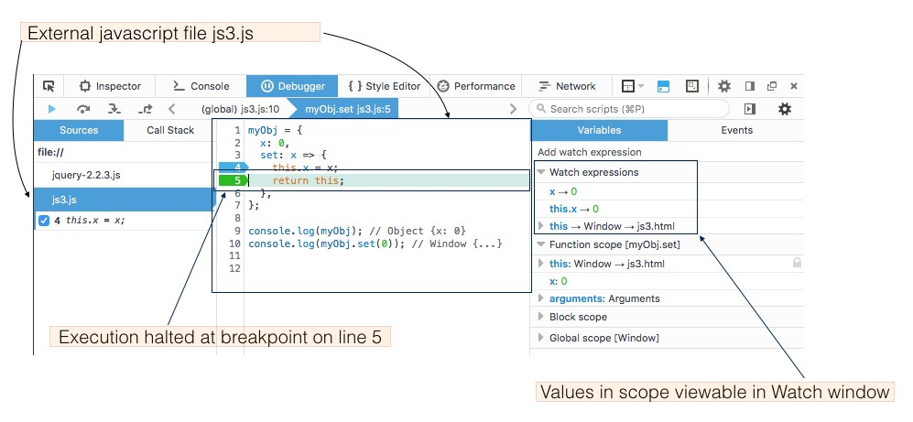
Firefox Dev Tools
Web authoring & debugging tools

Slide 15
Summary
Scripts
How to load - in html or external files
Strong recommendation to use external files only
Number scripts
Minification - use in production
Developer tools
Chrome
Firefox
Regular use encouraged
May be somtimes advantageous to simultaneously use both

