Slide 1
JavaScript Introduction
Document Object Model (DOM)

Slide 2
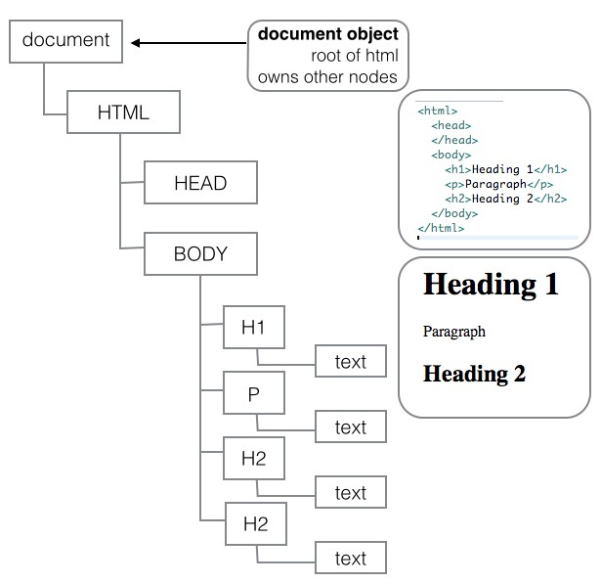
JavaScript
Document Object Model
The DOM

Slide 3
DOM
Document Object Model
The DOM
A World Wide Web Consortium (W3C) Standard
Defines standard for accessing web documents
Represents the displayed web page
Each element represented in the DOM by its own object
Access and modify individual elements
Add and delete elements
<script>
document.getElementById('demo').innerHTML = 'Hello JavaScript!';
</script>

Slide 4
HTML DOM Document Object
HTML DOM Nodes
In the HTML DOM (Document Object Model), everything is a node:
The document itself is a document node
All HTML elements are element nodes
All HTML attributes are attribute nodes
Text inside HTML elements are text nodes
Comments are comment nodes

Slide 5
DOM
The Web Browser
On opening HTML document in browser:
It becomes a document object
The document object is root node of HTML document
document object provides properties and methods to access node objects from within JavaScript.
<script>
let x = document.getElementsByName('map'); alert(map.length);
</script>

Slide 6
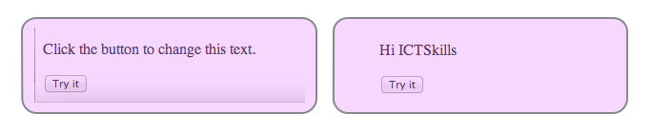
DOM Access
Demo change text

Slide 7
DOM Access
Using DOM method
<!DOCTYPE html>
<html>
<body>
<p id="demo">Click the button to change this text.</p>
<button onclick="domAccess()">Try it</button>
<script src="dom.js"></script>
</body>
</html>
//file: dom.js
function domAccess() {
document.getElementById('demo').innerHTML = 'Hi ICTSkills';
}

Slide 8
DOM Access
Using jQuery
<!DOCTYPE html>
<html>
<body>
<p id="demo">Click the button to change this text.</p>
<button onclick="jQueryAccess()">Try it</button>
<script src="jquery−2.0.0.js"></script>
<script src="jq.js"></script>
</body>
</html>
//file: jq.js
function jQueryAccess() {
$('#demo').html('Hi ICTSkills');
}

Slide 9
HTML Tags
Attributes name and id are not interchangeable
name: Identifies value in form data
id: Uniquely identifies an element so you can access it
//View (Semantic UI)
<input id="paypal" name="methodDonated" value="paypal" type="radio">
<label for="paypal">PayPal</label>
<input id="direct" name="methodDonated" value="direct" type="radio">
<label for="direct">Direct</label>
//Controller (Play): attribute name is methodDonated; content is value public static void donate(..., String methodDonated)

Slide 10
HTML Nodes
Methods to retrieve nodes
document.getElementById(id)
id unique on a page hence getElementById
document.getElementsByName(name)
returns array of elements with name attribute =name
name need not be unique hence getElementsByName
node.getElementsByTagName(tagName)
returns array of elements with tagName attribute =tagName

Slide 11
Get element by id
Simple demo document.getElementById(id)
Prints the height of image whose id="img1"
Native JavaScript
//in html file
<img src="img/01.png" id="img1">
//in javascript file
let image = document.getElementById('img1'); alert('Image height is ' + image.height);
jQuery
//in html file
<img src="img/01.png" id="img1">
//in javascript file
alert('Image height is ' + $('#img1').height());

Slide 12
Get elements by name
Simple demo document.getElementsByName(name)
Discovers images with attribute name="imgs"
Native JavaScript
let images = document.getElementsByName('imgs'); for (let i = 0; i < images.length; i++) {
alert('Image height is ' + images[i].height);
}
jQuery
let $images = $('[name="imgs"]'); images.each(function () {
alert('Image height is ' + $(this).height());
});

Slide 13
Get elements by tagName
Simple demo node.getElementsByTagName(tagName)
Can be used on a sub-tree, not just entire document
Native JavaScript
let imgDiv = document.getElementById('ictskills−images'); let images = imgDiv.getElementsByTagName('img');
for (let i = 0; i < images.length; i++) {
alert('Image height is ' + images[i].height);
}
jQuery
//let images: only those contained in node <div id="ictskills−imgs">
//with attribute name="imgs", e.g.: <img src="img/01.png" name="imgs">
let $images = $('#ictskills−imgs [name=\'imgs\']');
images.each(function () {
alert('Image height is ' + $(this).height());
});

Slide 14
Hide | Reveal Elements
Using Native JavaScript
HTML
<p id="text">Watch me appear and disappear</p>
<button onclick="hide()">Hide</button>
<button onclick="reveal()">Reveal</button>
JavaScript
function hide() {
document.getElementById('text').style.visibility = 'hidden';
}
function reveal() {
document.getElementById('text').style.visibility = 'visible';
}

Slide 15
Hide | Reveal Elements
Using jQuery
HTML
<p id="text">Watch me appear and disappear</p>
<button onclick="hide()">Hide</button>
<button onclick="reveal()">Reveal</button>
jQuery
function hide() {
$('#text').hide();
}
function reveal() {
$('#text').show();
}

Slide 16
Semantic UI
Enable Dropdown Box using JQuery
HTML
<div class="ui selection dropdown">
<input name="amountDonated" type="hidden">
<div class="default text">Amount</div>
<i class="dropdown icon"></i>
<div class="menu">
<div class="item" data−value="100">$100</div>
<div class="item" data−value="200">$200</div>
<div class="item" data−value="300">$300</div>
</div>
</div>
jQuery
//Ensure you use latest version jQuery
//http://code.jquery.com/jquery−latest.min.js
<script>$('.ui.selection.dropdown').dropdown('enable');</script>

Slide 17
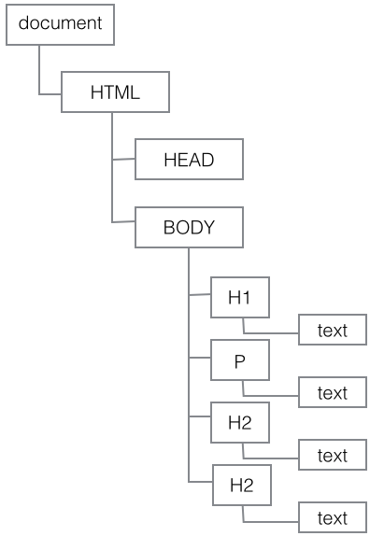
The DOM
Concluding with one expert’s view
DOM (Document Object Model)
"A vast source of incompatibilites, pain and misery" – Douglas Crockford (2006)

Slide 18
Summary
Document Object Model (DOM)
HTML page underlying data structure.
Difficult development environment.
Better to use jQuery v native JavaScript?

