Slide 1
JavaScript Introduction
Topic discussed
jQuery

Slide 2

jQuery
Introduction
jQuery JavaScript library:
In widespread but possibly declining use.
Competitors exist:
Prototype
Modernizer
Frameworks (Angular, Ember, . . . )
jQuery hides browser incompatibilities
Facilitates finding & manipulating elements in document

Slide 3
jQuery
Features
Facilitates modifications to web page:
Add or change specific content
Change HTML attributes
Change CSS properties
Define event handlers
Perform animation
<body>
<button class="edit" onclick="change()">Change</button>
<script src="jquery.js"></script>
<script>
function change() {
$("button.edit").html("Next Step...");
}
</script>
</body>

Slide 4
jQuery
Focus
jQuery focussed on queries Typically uses CSS selectors
Identify set document elements
Return object representing these
Object has useful methods to operate on data
Method chaining provided where possible
Can operate on elements as group rather than individually
// Returns a jQuery object containing all div elements in document.
// Observe jQuery variable naming convention: $div.
let $divs = $('div'); console.log($divs);

Slide 5
jQuery
Returned jQuery object
<body>
<button onclick="lotsadivs()">Press</button>
<div id = 'div−1'>
<div id = 'div−2'>
</div>
</div>
<script src="jquery−2.2.3.min.js"></script>
<script src="jquery.js"></script>
</body>
//File: jquery.js
function lotsadivs() {
console.log($('div').length);
}
// output
[div#div−1, div#div−2, ... selector:"div"]

Slide 6
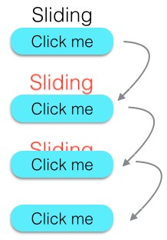
jQuery
Method chaining
//html
<body>
<p id="p1">Sliding</p>
<button>Click me</button>
<script src="jquery.js"></script>
<script>
$(function()
{
$('button').click(function(){
$('#p1').css('color','red').slideUp(2000);
});
});
</script>
</body>

Slide 7
jQuery
Terminology
the jQuery function
$() or jQuery(): single global function
a jQuery object
is object returned by $()
the selected elements
determined by CSS selector parameter in $
a jQuery function
a function defined within $()
a jQuery method
bound to jQuery object
//these 2 methods exactly the same
function change() {
$('button.edit').html('Next');
}
function change() {
jQuery('button.edit').html('Next');
}
//jQuery function: invoke func for each element of array
$.each(array, func);
//jQuery method: invoke func2 once for each selected element
$('a').each(func2);

Slide 8
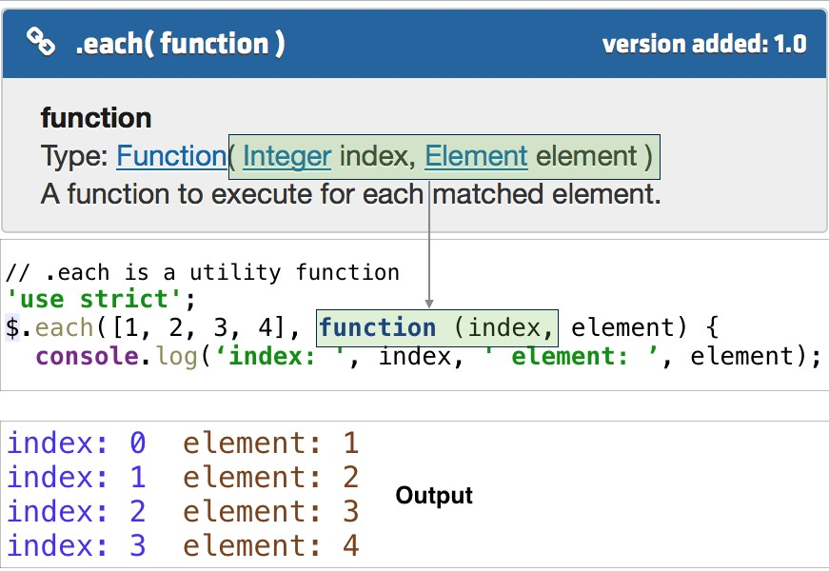
jQuery
$array.each()

Slide 9
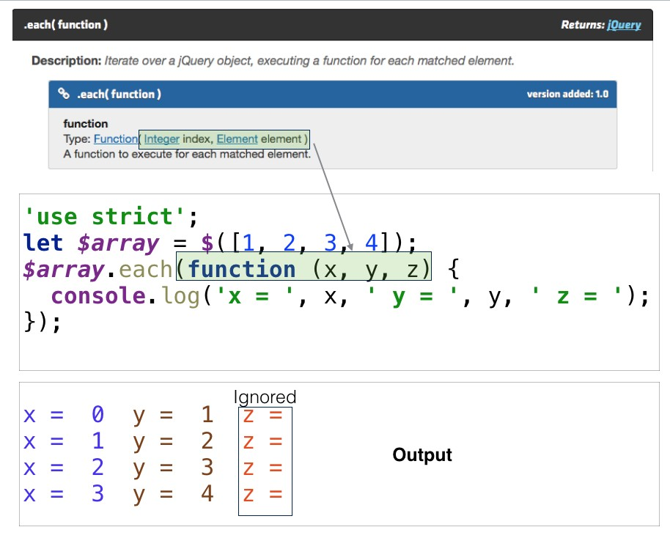
jQuery
$(array).each()

Slide 10
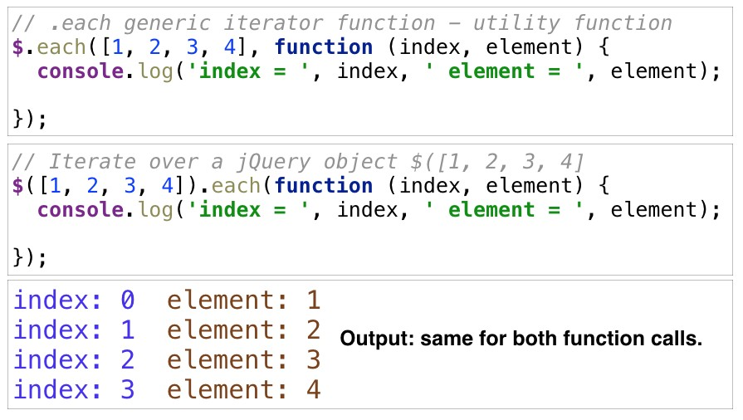
jQuery
$.each() methods comparison

Slide 11
jQuery
How to Obtain
Method 1
Download from jquery.com
Method 2
Use a content distribution network (CDN)
code.jquery.com/jquery-3.0.0.min.js
ajax.microsoft.com/ajax/jquery/jquery-3.0.0.min.js
ajax.googleapis.com/ajax/libs/jquery/3.0.0/jquery.min.js
//include jquery script tag before other script calls at end document body
//ensure use latest versions jquery (not shown here)
<script src="//ajax.googleapis.com/ajax/libs/jquery/1.11.1/jquery.min.js">

Slide 12
JavaScript
JQuery source - development usage
// extract from jquery−2.2.4.js
jQuery = function( selector, context ) {
// The jQuery object is actually just the init constructor 'enhanced' return new jQuery.fn.init( selector, context, rootjQuery );
},
// Match a standalone tag
rsingleTag = /^<(\w+)\s∗\/?>(?:<\/\1>|)$/,
// Matches dashed string for camelizing
rmsPrefix = /^−ms−/,
rdashAlpha = /−([\da−z])/gi,
// Used by jQuery.camelCase as callback to replace()
fcamelCase = function( all, letter ) { return letter.toUpperCase();
},

Slide 13
JavaScript
Minified jQuery
// extract from jquery−1.6.4.min.js
/∗! jQuery v1.6.4 http://jquery.com/ | http://jquery.org/license ∗/ (function(a,b){function cu(a){return f.isWindow(a)?a:a.nodeType===9?a.
defaultView||a.parentWindow:!1}function cr(a){if(!cg[a]){var b=c.body,d=f
("<"+a+">").appendTo(b),e=d.css("display");d.remove();if(e==="none"||e
===""){ch||(ch=c.createElement("iframe"),ch.frameBorder=ch.width=ch. height=0),b.appendChild(ch);if(!ci||!ch.createElement)ci=(ch. contentWindow||ch.contentDocument).document,ci.write((c.compatMode=== "CSS1Compat"?"<!doctype html>":"")+"<html><body>"),ci.close();d=ci. createElement(a),ci.body.appendChild(d),e=f.css(d,"display"),b. removeChild(ch)}cg[a]=e}return cg[a]}function cq(a,b){var c={};f.each(cm. concat.apply([],cm.slice(0,b)),function(){c[this]=a});return c}function cp()
{cn=b}function co(){setTimeout(cp,0);return cn=f.now()}function cf(){try
{return new a.ActiveXObject("Microsoft.XMLHTTP")}catch(b){}}function ce(){try{return new a.XMLHttpRequest}catch(b){}}

Slide 14
JavaScript
Plaintext
// sample javascript code
function OBJNAME(n) { return n; }
function dw(str) { document.write(str); }
function dumptbl(obj, row_callback_str, cell_callback_str)
{
dw('<table border=1>');
for (var i = 0; i < obj.length; ++i)
{
var tr = '<tr>'; eval(row_callback_str); dw(tr);
for (var j = 0; j < obj[i].length; ++j)
{
var td_s = '<td>', td_e = '</td>';
eval(cell_callback_str); dw(td_s); dw(obj[i][j]); dw(td_e);
}
}
dw('</table>');
}

Slide 15
JavaScript
Obfuscated
// sample javascript code minified and obfuscated
function z8c231aa888(z14851c4b0f){return z14851c4b0f;}function z0ab1f0a49e(z0721975593){document.write(z0721975593);}function zcd8c17c79d(z4716861143,z500f443098,z9bc82e0042){z0ab1f0a49e("\ x3c\x74\x61\x62\x6c\x65\x20\x62\x6f\x72\x64\x65\x72\x3d\x31\x3e ");for(varzd1ea46315e=(0x8e9+2039−0x10e0);zd1ea46315e<z4716861 143.length;++zd1ea46315e){var z708eb69ac7="\x3c\x74\x72\x3e"; eval(z500f443098);z0ab1f0a49z708eb69ac7);for(var z2d29194d43= (0x139b+2094−0x1bc9);z2d29194d43<z4716861143[zd1ea46315e].length;
++z2d29194d43){var z23b8891aeb="\x3c\x74\x64\x3e",z7f5411ee29=
"\x3c\x2f\x74\x64\x3e";eval(z9bc82e0042);z0ab1f0a49e(z23b8891aeb)
;z0ab1f0a49e(z4716861143[zd1ea46315e][z2d29194d43]);z0ab1f0a49e (z7f5411ee29);}}z0ab1f0a49e("\x3c\x2f\x74\x61\x62\x6c\x65\x3e")
;}zcd8c17c79d([[(0x2d7+5314−0x1798),(0xf7c+295−0x10a1),(0x900+
1599−0xf3c)],[(0x1e8+1063−0x60b),(0xfc1+580−0x1200),(0x1cf5+18
43−0x2422)],[(0x9f9+4410−0x1b2c),(0x1c6+8452−0x22c2),

Slide 16
JavaScript
Scope - Window object
Window object
The global object
Represents open window in browser
Entry point client-side JavaScript
Defines properties such as:
location: navigates to new page
document: returns DOM object
<!DOCTYPE html>
<html>
<head>
<title>Window</title>
</head>
<body>
<script>
window.location
= "http://www.wit.ie";
</script>
</body>
</html>

Slide 17
jQuery
Invoking $() function
jQuery(), a.k.a $(), invokable with 4 different parameters:
CSS selector
Element, Document or Window object
String of HTML
Function
//CSS selector: <p id="p1"></p>
$('#p1').append('Added material...');
//Element: <p class='p2'></p>
$('p.p2').append('Second para');
//String HTML: dynamically add node
$('<p>Third para</p>').appendTo('body');
//Function: function clickbutton param
$(function clickbutton() {
alert('Button clicked');
});

Slide 18
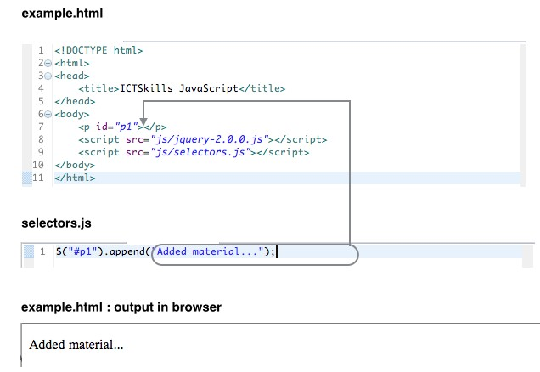
jQuery
Invoking $() function

Slide 19
jQuery
Immediately-Invoked Function Expression (IIFE)
// Click button to trigger alert
<button onclick="clickbutton()">Click</button>
<script src="jquery.js"></script>
<script>
function clickbutton() {
alert('Button clicked');
}
</script>
// Example of self−invoking function
// Alert triggered on refreshing page
<script src="jquery.js"></script>
<script>
(function clickbutton() {
alert('Button clicked');
}());
</script>

Slide 20
jQuery
Execute function when document loaded
onload event
Ensure page load complete before accessing script code.
$(function () {
alert('Page has loaded');
});
// Older, verbose equivalent
$(document).ready(function () {
alert('Page has loaded');
});

Slide 21
Summary
jQuery
A popular JavaScript library.
May be declining in popularity.
Losing market share to frameworks.
Abstracts browser inconsistencies.
Community support.
jquery-3.0.0 (June 2016) contains more than 10,000 lines.

Slide 22
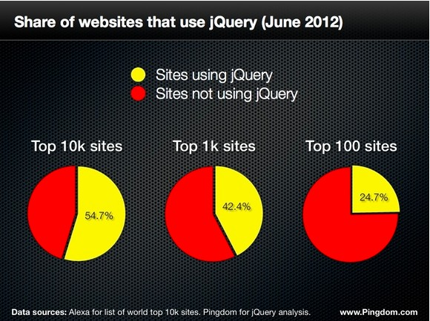
jQuery
Statistics – Peak JQuery

Slide 23
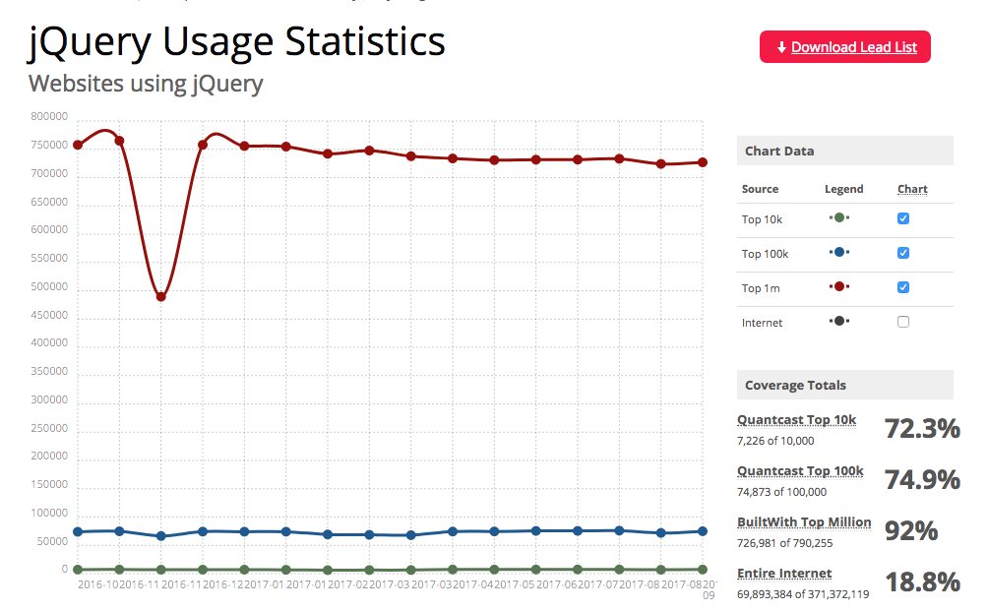
jQuery
Statistics

Slide 24
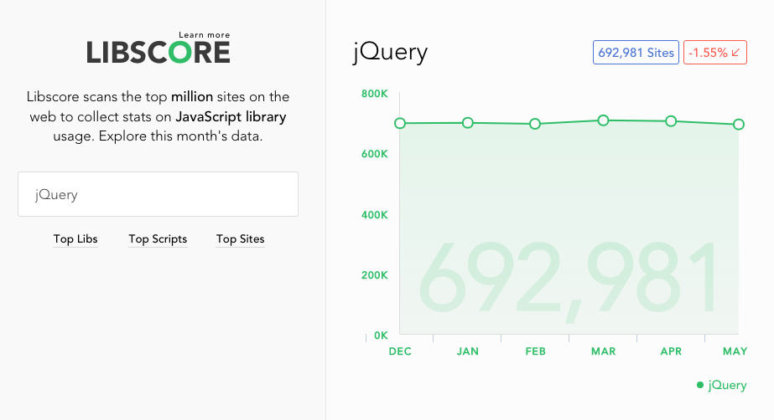
jQuery
Statistics

Slide 25
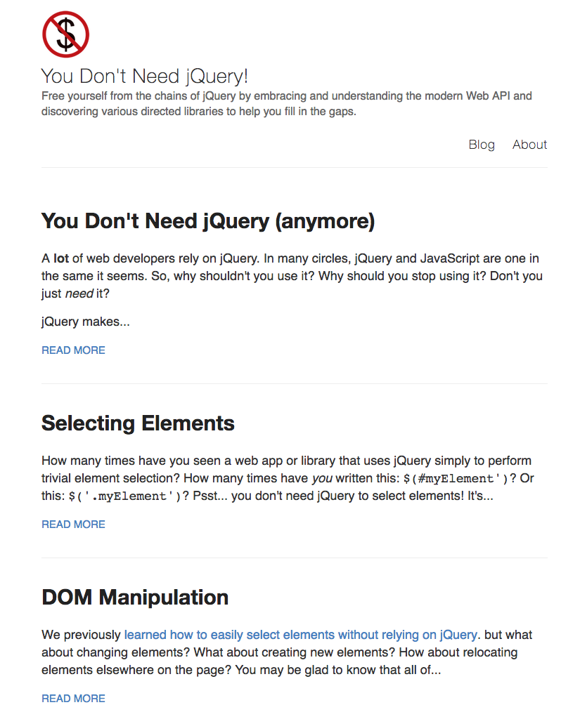
https://blog.garstasio.com/you-dont-need-jquery/

