Slide 1
Scope
Asynchronous JavaScript & XML (Ajax).
This presentation based on jQuery Ajax.
Using a very small subset of available functionality.

Slide 2
Ajax
What is it?
A technology to manage transmission of data between client and server.
Generally text-based data.
Binary data transmission also possible.
Originally data format Extensible Markup Language (XML).
JSON now the format of choice.

Slide 3
Ajax
Why use it?
Once Upon a Time. . .
Http request caused whole-page refresh
Complete pages ‘Server Rendered’ and delivered to the browser, replacing the previous page
Ajax Changed this dynamic. Requests can be issued by client for:
Specific information it needs
when itneeds it,
for exactly where on page it is needed. .
This avoids page flicker and facilitates greater efficiency.

Slide 4

Ajax
Asynchronous communication
Web page sends HTTP Ajax request.
User free to continue other page activity.
Request processed independently.
Server transmits respose to web page.
Synchronous communication also possible.

Slide 5
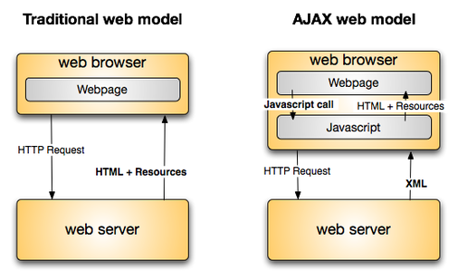
JSON

Slide 6
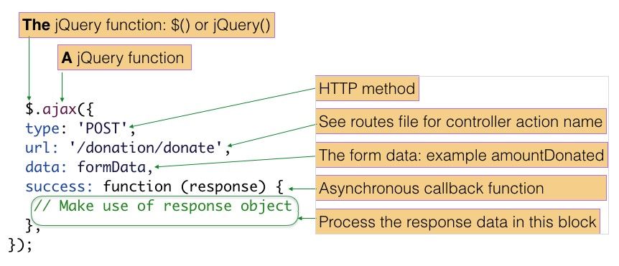
Ajax in jQuery

Slide 7
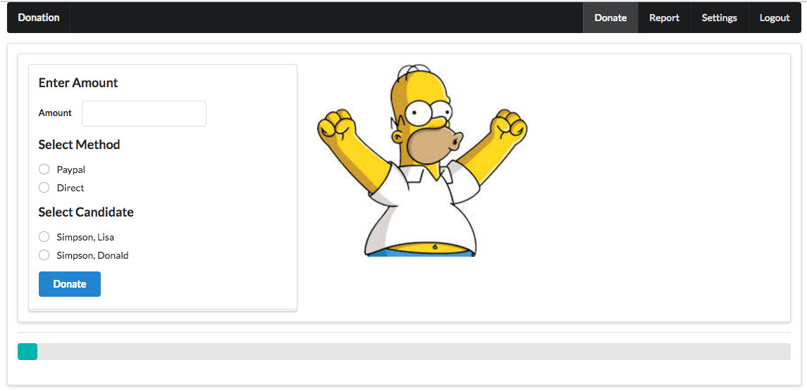
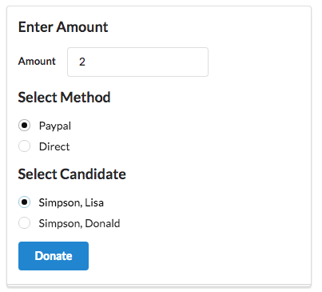
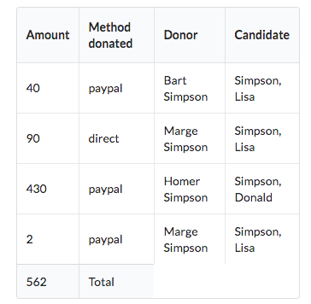
Ajax Example
Press Donate should update progress bar + table without page flicker/refresh

Slide 8
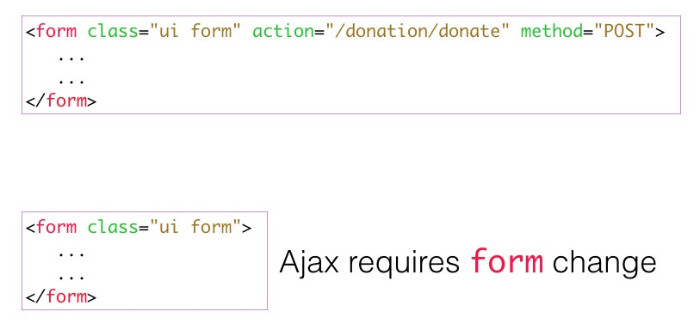
jQuery
Donation ajax call

Slide 9
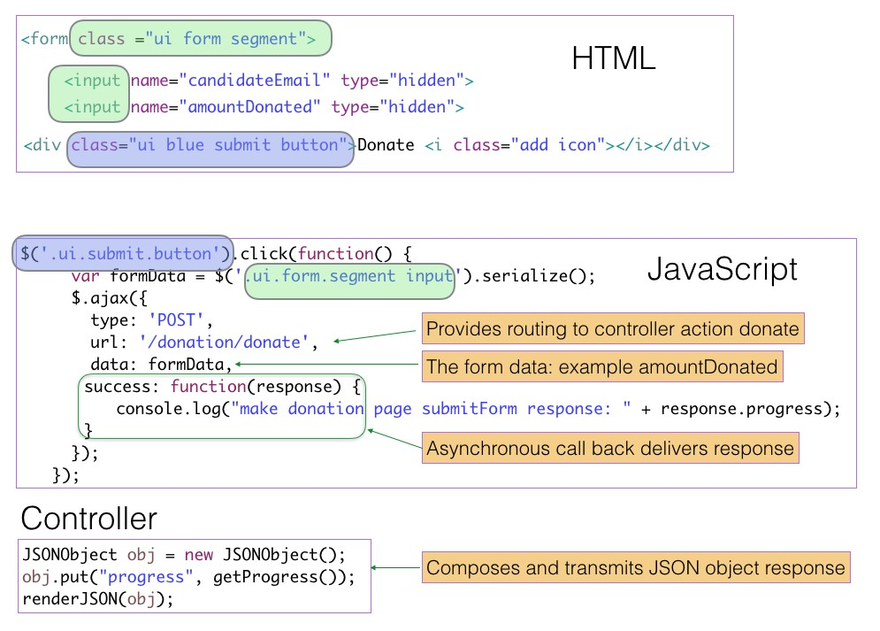
jQuery
Donation ajax call

Slide 10
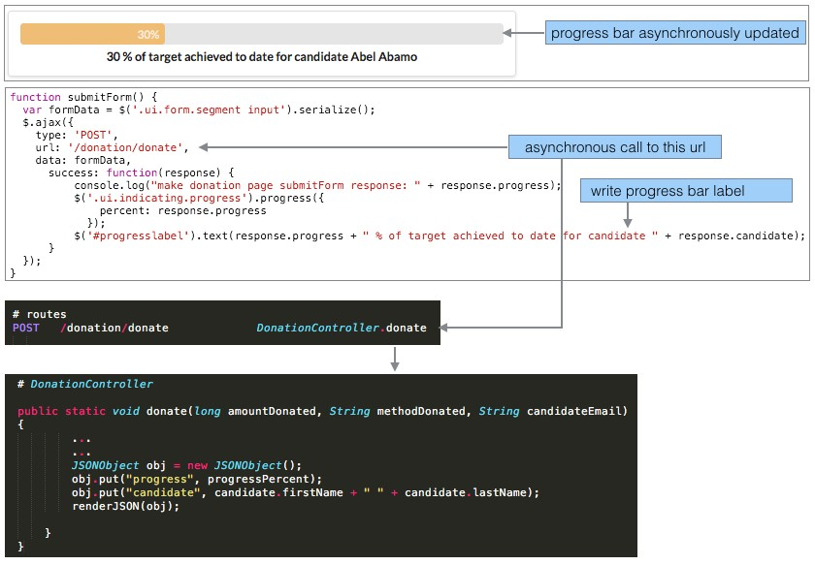

Slide 11
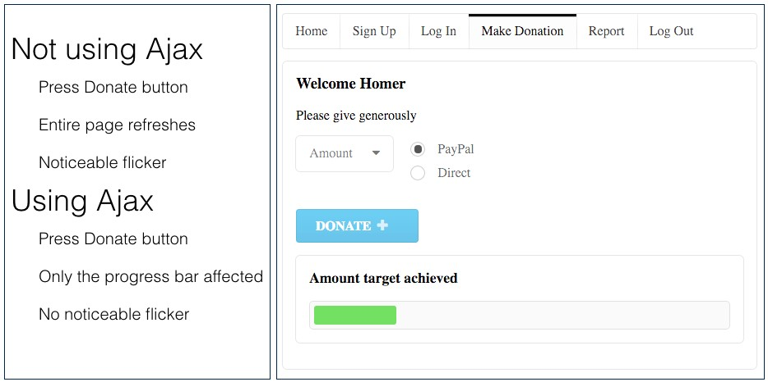
jQuery
Asynchronous Java and XML (Ajax)

