Slide 1
JavaScript Introduction
Topics discussed this presentation
Arrays
Prototypal inheritance

Slide 2
Arrays
Create
// literal method
const cars = ['Ford', 1Honda1, 1Nissan1, 1 Peugot1, 1Toyota1];
console.log(cars[0]);//Output: Ford
//using new
const sameCars = new Array(1Ford1, 1Honda1, 1Nissan1, 1Peugot1, 1Toyota1];
console.log(cars[0]);//Output: Ford
Not necessary to declare size when constructing
Create easily using array literal
Grow automatically
Locate values by key
Access using [ ] operator

Slide 3
Arrays
Iterate
const cars = [1Ford1, 1Honda1, 1Nissan1, 1 Peugot1, 1Toyota1];
for(let i = 0; i < cars.length; i += 1)
{
console.log(cars[i]);
}
for loop easy method of iterating
Size array: use length
property
//Output Ford Honda Nissan Peugot Toyota

Slide 4
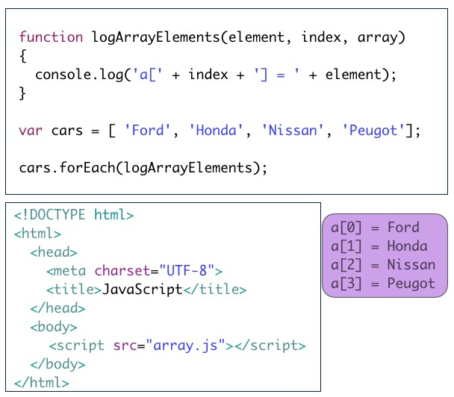
Arrays
Iterate - forEach

Slide 5
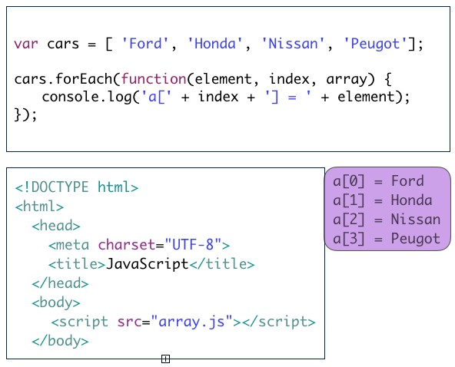
Arrays
Iterate - forEach

Slide 6
Arrays
Methods
Selection of array methods:
length : provides number elements in array
join :converts elements to string & concatenates
reverse: reverses order of elements
push: adds element(s) end array
pop : removes element(s) end array
unshift:adds element beginning array
shift: removes element beginning array
sort: sorts array

Slide 7
Arrays
Methods: length, join
const greet = [1hello1, 1ictskills1];
const length = greet.length; // => 2
const str1 = greet.join(); // => hello,ictskills
const str2 = greet.join(separator=1 1); // => hello ictskillls

Slide 8
Arrays
Methods: reverse, push, pop
const greet = [1hello1, 1ictskills1];
console.log(greet.reverse()); // => [1ictskills1, 1hello1]
greet.push(120161);
console.log(greet); // => [1hello1, 1ictskills1, 120161]
greet.pop();
console.log(greet); // => [1hello1, 1ictskills1]

Slide 9
Arrays
Methods: unshift, shift
const greet = [1hello1, 1ictskills1];
greet.unshift(120161);
console.log(greet); // => [120161, 1hello1, 1ictskills1]
greet.shift();
console.log(greet); // => [1hello1, 1ictskills1]

Slide 10
Arrays
Methods: sort
// The default sort order is according to string Unicode code points. const numbers = [6, 11, 22, 43, 19, 10];
numbers.sort();
console.log(numbers); // => [10, 11, 19, 22, 43, 6]
// Provide customized comparator function to sort numbers in ascending order.
function compare(a,b) { return a − b;
}
numbers.sort(compare);
console.log(numbers); // => [6, 10, 11, 19, 22, 43]

Slide 11

Arrays
Element types
const cars = [1Ford1, 1Honda1, 1Nissan1, 1Peugot1]; const manual = {
title:1Fix Me1,
author:1H. Wrench1,
};
cars.push(manual); cars.push(1Lexus1); cars.shift();
for (let i = 0; i < cars.length; i += 1)
{
console.log(cars[i]);
}
Array elements may be different types

Slide 12
JavaScript
Object v Array
// Objects: comprise key:value pairs const book = {};
book.title = 1Java1;
book.author = 1Chapman1;
console.log(book);
// Retrieval:
console.log(book.title); // => Java
// Arrays: Use for numerically indexed data const cars = [];
cars[4] = 1Toyota1;
// Retrieval: console.log(cars.length); // => 5 console.log(cars[0]); // => undefined
console.log(cars[4]); // => Toyota: length increases automatically
console.log(cars[6]); // => undefined
console.log(cars.length); // => 5: No array bounds error

Slide 13
JavaScript Inheritance
ES5 inheritance example
const shape = {
xPosition: 0.0,
yPosition: 0.0,
};
const circle = Object.create(shape); circle.area = function () {
return Math.round(Math.PI ∗ Math.pow(this.radius, 2));
};
circle.xPosition = 100;
circle.radius = 50;
console.log(1area 1 + circle.area()); // 7854
console.log(1xPosition 1 + circle.xPosition); // 100
console.log(1yPosition 1 + circle.yPosition); // 0 (default)

Slide 14
JavaScript Inheritance
ES6 simulates classical inheritance
class Shape {
constructor(xPosition, yPosition) { this.xPosition = xPosition; this.yPosition = yPosition;
}
}
class Circle extends Shape {
constructor(xPosition, yPosition, radius) { super(xPosition, yPosition);
this.radius = radius;
}
area() {
return Math.round(Math.PI ∗ Math.pow(this.radius, 2));
}
}
const circle = new Circle(100.0, 100.0, 50.0);
console.log(1area 1 + circle.area()); // 7854

Slide 15
JavaScript
Presentation summary
Arrays
Store multiple elements in single variable.
Elements may be different types.
Rich set Array methods available.
Inheritance
Prototypal
Syntactic sugar - ES6

