Slide 1
JavaScript Introduction
Topics discussed
Functions
Anonymous functions
Arrow function
Spread/Rest operator/parameters
this binding
Anonymous function as function parameter

Slide 2
JavaScript
Functions
function
Block of code defined once
Invokable many times
May include parameters
Observe differences Java
Functions attached to objects referred to as methods
Functions are objects
Assignable to variable
Allowable as parameter
function square(x) { return x ∗ x;
}
console.log(square(10)); // => 100
function add() {
let counter = 0;
function plus() {counter += 1;}
plus();
return counter;
console.log(add()); // => 1
}

Slide 3
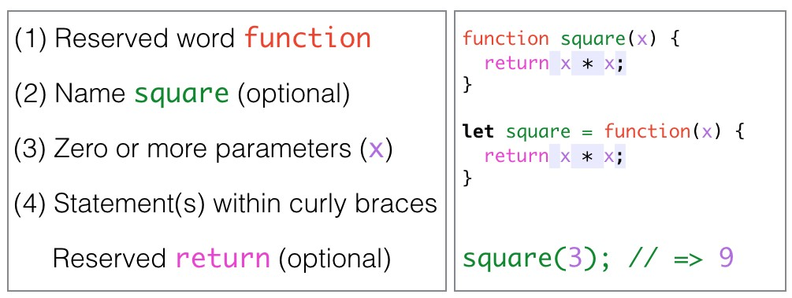
JavaScript
Function has four parts

Slide 4
Function
Hidden parameters
Every function has 2 hidden parameters
this
Reference determined by which of four available function invocation patterns used.
arguments
Array type object containing all parameters.
Treat as obsolete, instead use rest arguments.
Rest arguments a real Array, not
Array-like like arguments
let anObject = {
value: 0,
increment: function () { this.value += 1;
},
};
// Output: 1
anObject.increment();
function aFunction(...args) { return args.length;
}
// Output: 2
console.log(aFunction(3, 4));

Slide 5
Function
Rules re function arguments
Function declaration states arguments (parameters).
Pass too many, extra args ignored.
Pass too few, missing args assigned undefined.
Here we use deprecated arguments object.
function foo(x) {
console.log('x: ',x, 'arguments: ',arguments);
}
foo(); // x: undefined arguments: [] (missing arg)
foo(10); // x: 10 arguments [10] (correct number args)
foo(10, "arg 2"); // x: 10 arguments: [10, "arg 2"] (extra arg)

Slide 6
Function
Spread/Rest operator (ES6)
arguments now deprecated - use Spread/Rest
operator comprises three periods (. . . )
This example . . . is rest operator
Alternatively in MDN: rest parameters
/∗∗
∗ Example: Function defined to take variable number arguments
∗ @see MDN rest parameters (operator)
∗/
function foo(...args) {
console.log(args);
}
foo( 1, 2, 3, 4, 5); // [1,2,3,4,5]

Slide 7
Function
Spread/Rest operator (ES6)
Example: the power of spread/rest operator
This example . . . is spread operator
/∗∗
∗ Example: assembling new array
∗ @see MDN Spread operator
∗/
let parts = ['shoulders', 'knees'];
let all = ['head', ...parts, 'and', 'toes'];
console.log(all); //['head', 'shoulders', 'knees', 'and', 'toes'];

Slide 8
Function
Spread/Rest operator (ES6)
//Deprecated arguments hidden parameter
function add (x, y) { console.log(arguments); return x + y;
}
add(1, 2); // [1, 2]
/∗∗
∗ ES6 Using Spread|Rest operator
∗ Determine number parameters at runtime
∗ @see ES6 & Beyond page 13 (referenced)
∗/
function multiply(...args) {
console.log(args);
}
multiply(3,4); // [3, 4]

Slide 9
Functions
Invocation Patterns
Four function invocation patterns:
1. Method invocation
this bound to containing object
function is method - a property of containing object
2. Function invocation
this bound to global object
function property of global object
3. Constructor invocation
this bound to containing object
new not used: this bound to global
4. Apply invocation
Outside course scope
let anObject = {
value: 0,
increment: function () { this.value += 1;
},
};
// method invocation
anObject.increment();
value = 0;
function increment() { this.value += 1;
};
// function invocation
increment();

Slide 10
JavaScript
this binding
Note: behaviour different in strict mode
// Function invocation: this bound to global object
function set(x) { this.x = x;
console.log(x); // => 100
};
set(100); // sets global variable x to 100
// Here, because of strict mode, this is undefined 'use strict';
function set(x) {
this.x = x; // => TypeError
console.log(x);
};
set(100); // fails due to TypeError

Slide 11
JavaScript
this binding
// Method invocation: this bound to containing object const myObj = {
x: 100,
set: function (x) { this.x = x;
return this;
},
};
myObj.set(100);// sets myObj.x to 100 console.log(myObj); // Object {x: 100} console.log(myObj.set(100)); // Object {x: 100}

Slide 12
JavaScript
this binding
strict mode causes different behaviour:
'use strict';
Prevents access to global variable
this undefined
TypeError generated when code below run in strict mode
// Method invocation: this now bound to global object
myObj = {
x: 0,
set: function (x) {
modify(x);
function modify(val) { // nested function
this.x = x; // this bound to global obj: undefined in strict mode
};
},
};

Slide 13
JavaScript
=> arrow function
// What we're familiar with:
function add(x, y) { return x + y;
}
console.log(add(10, 20)); // 30
/∗∗
∗ Alternative approach: arrow function.
∗ @see page 46 ES6 and Beyond (referenced)
∗ @see MDN (referenced)
∗/
const add2 = (x, y) => x + y; console.log(add2(10, 20)); // 30

Slide 14
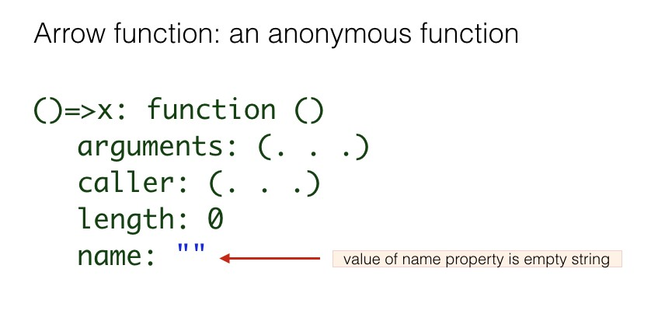
JavaScript
anonymous function: value of its property name is empty string

Slide 15
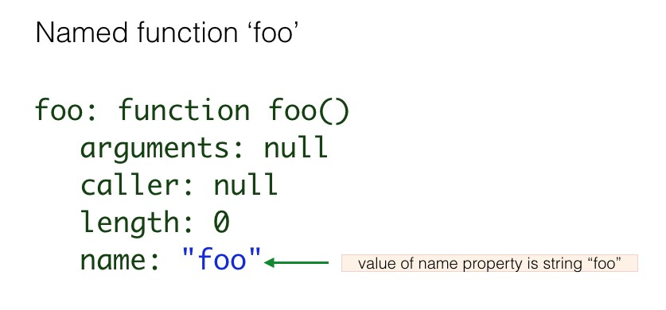
JavaScript
named function

Slide 16
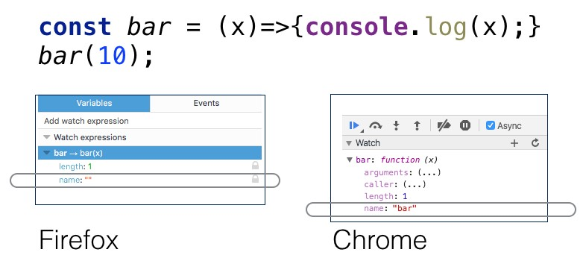
JavaScript
anonymous function
The code snippet illustrated is legal.
But note different browser treatments.

Slide 17
JavaScript
this binding
Pre-ES6 workaround hack
'use strict';
let myObj = {
x: 0,
set: function (x) { let that = this; modify(x);
function modify(val) { // nested function
that.x = x; // workaround hack
};
},
};
myObj.set(100); // myObj.x set to 100

Slide 18
JavaScript
this binding
Use arrow function to bind inner this to containing object
//this now bound to containing object myObj 'use strict';
let myObj = {
x: 0,
set: function (x) {
let modify = (val) => { // nested function this.x = val; // this now bound to myObj console.log(this); // Object{x: 0}
};
modify(x);
},
};
console.log(myObj); // Object { x: 100, set: myObj.set() } myObj.set(100); // myObj.x set to 100 console.log(myObj.x); // 100

Slide 19
JavaScript
this binding
Another JavaScript booby trap
// Okay: Method invocation: this bound to containing object
myObj = {
x: 0,
set: function (x) { this.x = x;
return this;
},
};
console.log(myObj); // Object {x: 0}
console.log(myObj.set(0)); // Object {x: 0}

Slide 20
JavaScript
this binding
Another JavaScript booby trap
/∗∗
∗ Not okay: Alternative approach: arrow function.
∗ Method invocation: this now bound to global object
∗ Here arrow function is NOT an inner function.
∗ As inner function its this would be bound to containing function.
∗ @see page 50 ES6 and Beyond (referenced)
∗/
myObj = {
x: 0,
set: x => { this.x = x; return this;
},
};
console.log(myObj); // Object {x: 0}
console.log(myObj.set(0)); // Window {...}

Slide 21
JavaScript
this binding
Constructor invocation: not recommended
'use strict';
function Person(name) {
this.name = name; // this bound to Person object
}
let x = new Person('Jane'); console.log(x); // Object { name: "Jane" }
// Omitting 'use strict'
// If strict mode & new omitted then this undefined
function Person(name) {
this.name = name; // this bound to global object
}
let x = Person('Jane'); // Oops! Forgot new keyword
console.log(x); // undefined

Slide 22
JavaScript
Passing function as function argument
// Passing a named function as an argument
function myFn(fn) { const result = fn(); console.log(result);
};
function myOtherFn() { return 'hello world';
};
// logs 'hello world'
myFn(myOtherFn);

Slide 23
Functions
Which to use? Function expression or function statement
// Function statements: Airbnb recommendation (ES6)
function outer1() { hoisted(); // => foo function hoisted() {
console.log('foo');
}
}
// Function expressions: Crockford recommendation (ES5)
let outer2 = function outer2() {
notHoisted(); // => TypeError: notHoisted is not a function
let notHoisted = function() {
console.log('bar');
};
};

Slide 24
Functions
Example use arrow function as function parameter
First attempt: method to filter even numbers.
'use strict';
const array = [1, 2, 3, 4, 5, 6, 7, 8, 9, 10];
function filter(numbers) { const filterNumbers = []; let j = 0;
for (let i = 0; i < numbers.length; i += 1) {
if (numbers[i] % 2 === 0) { filterNumbers[j] = numbers[i]; j += 1;
}
}
return filterNumbers;
}
console.log(filter(array)); // [2, 4, 6, 8, 10]

Slide 25
Functions
Example use arrow function as function parameter
Second attempt: use bespoke function & Array.filter
'use strict';
const array = [1, 2, 3, 4, 5, 6, 7, 8, 9, 10];
function even(x) { return x % 2 === 0;
}
console.log(array.filter(even)); // [2, 4, 6, 8, 10]

Slide 26
Functions
Example use arrow function as function parameter
Production: Use arrow function and Array.filter method
'use strict';
const array = [1, 2, 3, 4, 5, 6, 7, 8, 9, 10];
console.log(array.filter(x => x % 2 === 0)); // [2, 4, 6, 8, 10]

Slide 27
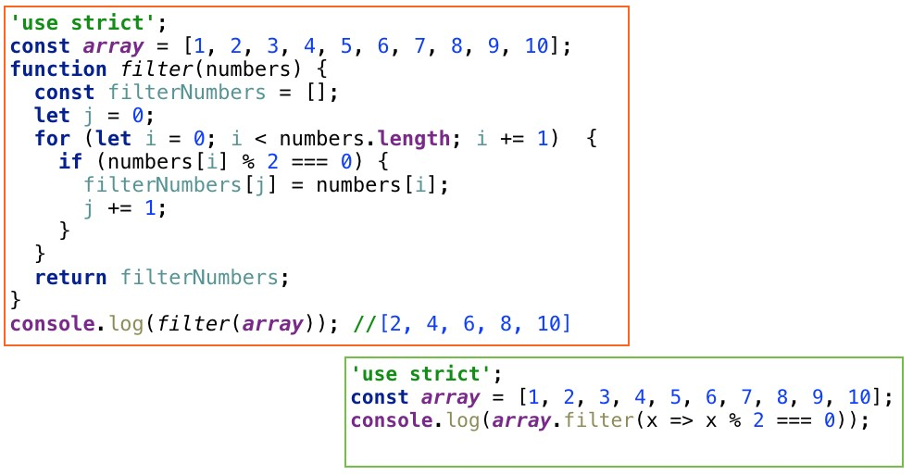
Functions
Example use arrow function as function parameter
About 80% reduction in code size

Slide 28
Summary
A JavaScript function:
Is a first class object,
Like any other object
Assignable to a variable,
May be anonymous,
Legal as parameter in function call,
May be a value in an object,
Could contain other functions,
Arrow function (ES6) form available.
Spread operator
Rest parameters

