Slide 1
JavaScript Introduction
Topics discussed this presentation
Scope
Closure

Slide 2
Scope
Global variables
Variables declared inside function
Visible throughout function
Invisible outside function
Variables declared outside function
These are global variables
Content both files visible program-wide.
Avoid using global variables
//file: script1.js
velocity = 10;
//file: script2.js
function square(x) { return x ∗ x;
}
//velocity visible here because global
console.log(square(velocity)); // 100

Slide 3
Scope
Global variables
Code below left generates error in strict mode:
Uncaught ReferenceError: velocity is not defined
// Valid code: declared global 'use strict';
let velocity = 10;
const speed = 10;
var acceleration = 10;
// Invalid code: undeclared global 'use strict';
velocity = 10;

Slide 4
Scope
Global variables
Variables defined but not declared inside function
Are global variables
Referred to as implied global
Dangerous practice - avoid
Use ES6 strict disallows
let circle;
function requestReport() {
center = circle.getCenter();
}
circle is a global variable
center is (implied) global variable

Slide 5

Scope
Implied Globals
Defined but not declared in function
velocity is implied global
Visible program-wide once f() invoked
Alert box displays 100
Illegal in strict mode
ReferenceError: velocity is not defined
function f() {
velocity = 100;
}
f();
alert(velocity);

Slide 6
Scope
Function scope
Defined but not declared in function
velocity is implied global
Visible program-wide once f() invoked
Alert box displays 100
Illegal in strict mode
ReferenceError: velocity is not defined
function f() {
velocity = 100;
}
f();
alert(velocity);

Slide 7
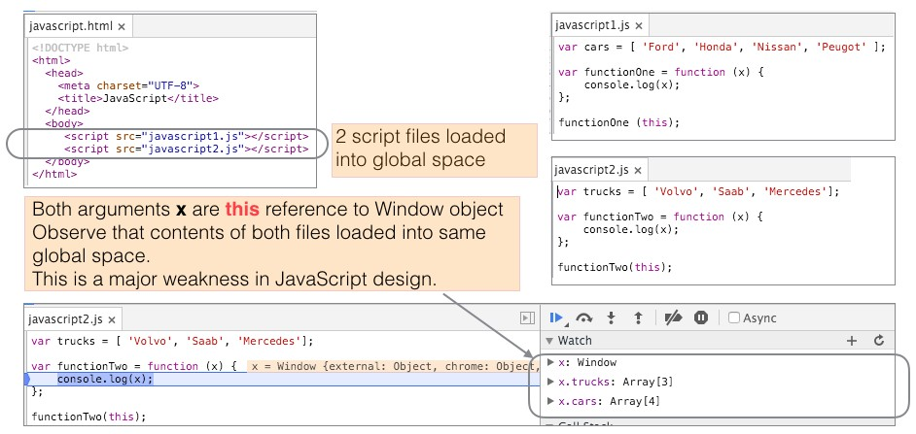
JavaScript
Global Object
In the browser, the global object is the window object

Slide 8
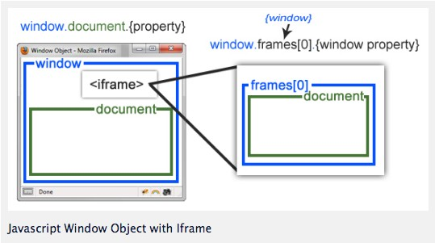
JavaScript
Global Object
Window and document objects

Slide 9
JavaScript
Global Abatement
Define global variable for app
const MyApp={}
This becomes container for app
const MYAPP = {};
MYAPP.square = function (x) { return x ∗ x;
};
console.log(MYAPP.square(val));

Slide 10
Global Abatement
Using Immediately Invoked Function Expression (IIFE)
(function () {
// code here
// objects declared here not visible outside function
}());

Slide 11
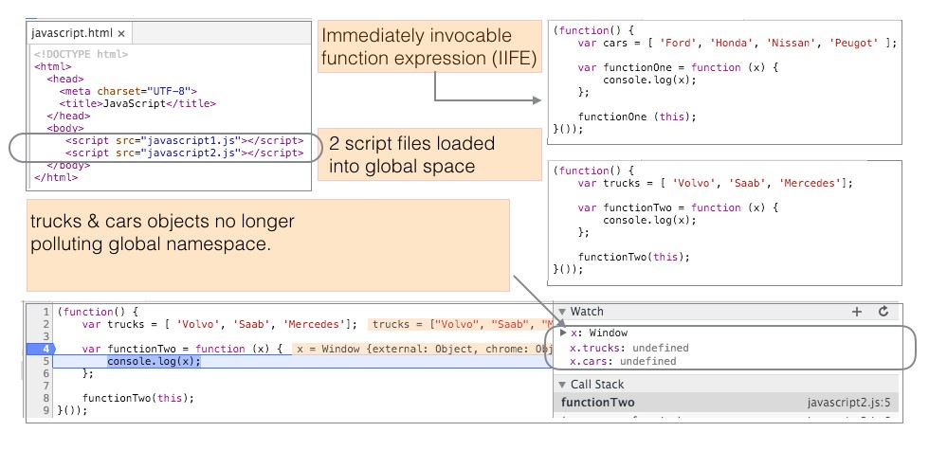
Global Abatement
Using Immediately Invoked Function Expression (IIFE)

Slide 12
Global Abatement
IIFE pattern used for global abatement
<!DOCTYPE html>
<html>
<head>
<meta charset='UTF−8'>
<title>AbateGlobals</title>
</head>
<body>
<button type='button' onclick='clickMe()'>Click Me</button>
<script src='abateglobals.js'></script>
</body>
</html>

Slide 13
Global Abatement
IIFE pattern used for global abatement
Function clickMe invoked on button press:
(function (context) { const bar = 100;
context.clickMe = function () {
foo();
alert('hey, it\'s me');
};
function foo() {
alert('in foo');
}
}());

Slide 14
jQuery
IIFE and document ready interaction
(function () { // <= IIFE
// Do something that doesn't require DOM to be ready.
console.log('within IIFE');
$(function () { // <= same as $(document).ready(function () {
// Do something involving DOM manipulation.
console.log($('#p'));
});
}());

Slide 15
Scope
Global abatement
// myapp.js
MYAPP = (function () {
function square(x) { return x ∗ x;
}
function cube(x) { return x ∗ square(x);
}
return { square, cube,
};
}());
<!DOCTYPE html>
<html>
<head>
...
</head>
<body>
<script src="myapp.js"></script>
<script src="calculator.js"></script>
</body>
</html>
// calculator.js
let x2 = MYAPP.square(10); // 100
let x3 = MYAPP.cube(10); // 1000

Slide 16
Java
Block Scope
Java has block scope:
Variable y out of scope (invisible) outside its block
public void scope() { int x = 10;
{
int y = 100;
}
System.out.println('x : ' + x); // ok: x in scope
System.out.println('y : ' + y); // compile−time error: y out of scope
}

Slide 17
JavaScript function scope
Hoisting
Declaration of y hoisted to top of function.
Initialization of y takes place as shown.
function scopeExample()
{
console.log('y : ', y); // undefined
var x = 10;
{
var y = 100;
}
console.log('x : ', x); // 10
console.log('y : ', y); // 100
};
scopeExample();

Slide 18
JavaScript block scope
ES6 variables let and const
var replaced by let
ReferenceError: y is not defined
let and const have block scope.
function scopeExample()
{
console.log('y : ', y); // ReferenceError
let x = 10;
{
let y = 100;
}
console.log('x : ', x); // 10
console.log('y : ', y); // 100
};
scopeExample();

Slide 19
JavaScript block scope
Test your knowledge
What is the console output here?
var x = 'outer scope';
function f() { console.log('x : ', x); var x = 'inner scope';
}
f();

Slide 20
JavaScript block scope
Test your knowledge
One change has been made: var x = . . . commented out.
What is the console output now?
var x = 'outer scope';
function f() {
console.log('x : ', x);
// var x = 'inner scope';
}
f();

Slide 21
JavaScript block scope
Test your knowledge
Final change: replace var x with let.
How does this influence the output?
var x = 'outer scope';
function f() { console.log('x : ', x); let x = 'inner scope';
}
f();

Slide 22
Scope
Temporal dead zone (TDZ)
Already encountered TDZ above.
let and const are hoisted.
Values undefined until initialized.
In meantime, are in TDZ:
Attempted access before initialization generates error
ReferenceError: x is not defined
let x = 'outer scope';
function f() {
console.log('x : ', x); // <= x in TDZ, value undefined
let x = 'inner scope';
}
f();

Slide 23
Scope
this variable
let calculator = {
result: 0,
multiply: function (number, multiplier) {
let _this = this; // this is bound to calculator object
let helper = function (x, y) {
_this.result = x ∗ y; // this is bound to global object
};
helper(number, multiplier); return _this;
},
getResult: function () { return this.result;
},
};
console.log(calculator.multiply(9, 4).result); // => 36

Slide 24
Scope
this variable problem solved by using arrow function
let calculator = {
result: 0,
multiply: (number, multiplier) => {
let helper = function (x, y) { this.result = x ∗ y;
};
helper(number, multiplier); return this;
},
getResult: function () { return this.result;
},
};
console.log(calculator.multiply(9, 4).result); // => 36

Slide 25
JavaScript Closure
A Powerful Feature
An inner function that has access to
its own variables,
the outer enclosing function’s variables,
the global variables.
This holds even when outer function has returned.
function favouriteBook(title, author) { const intro = 'My favourite book is '; return function book() {
return intro + title + ' by ' + author;
};
};
const favourite = favouriteBook('Eloquent JavaScript', 'Marijn Haverbeke');
console.log(favourite());

Slide 26
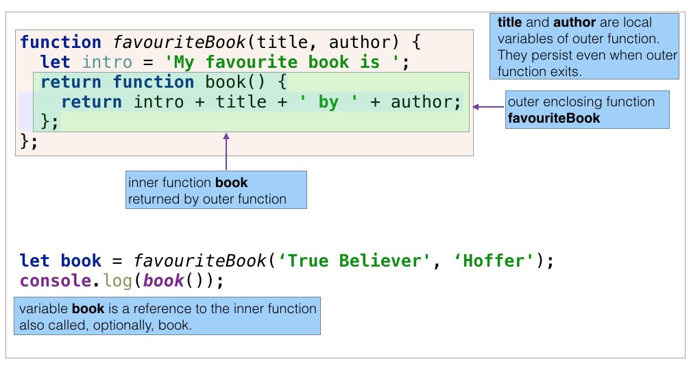
JavaScript Closure
A Powerful Feature

Slide 27
JavaScript Closure
A Powerful Feature
A closure example from Eloquent JavaScript
// @see page 50 http://eloquentjavascript.net/Eloquent_JavaScript.pdf
function multiplier(factor) { return function (number) { return number ∗ factor;
};
}
const twice = multiplier(2); const result = twice(5); console.log(result); // => 10
const thrice = multiplier(3); result = thrice(5); console.log(result); // => 15

Slide 28
JavaScript Closure
A Powerful Feature
A closure example from w3schools
// @see http://www.w3schools.com/js/js_function_closures.asp const add = (function () {
let counter = 0;
return function () { return counter += 1;
};
}());
console.log(add()); // => 1 console.log(add()); // => 2 console.log(add()); // => 3

Slide 29
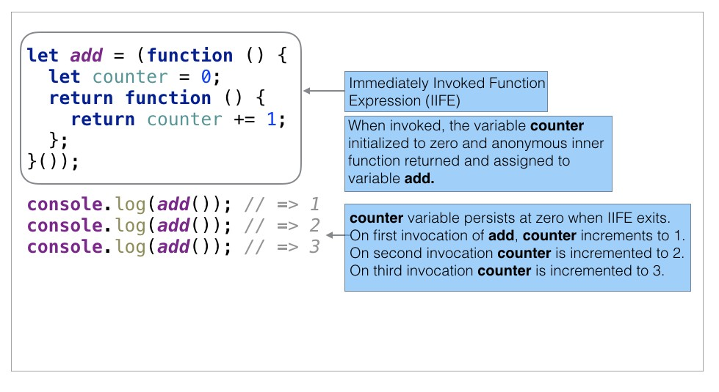
JavaScript Closure
A Powerful Feature

Slide 30
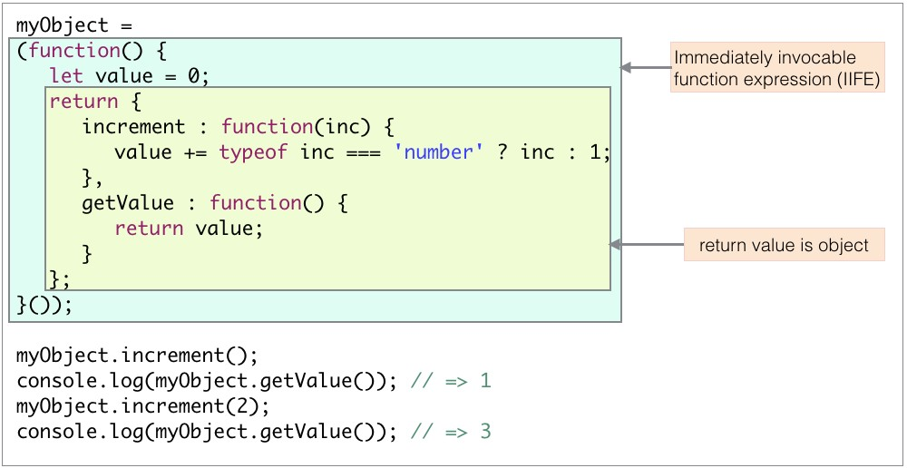
JavaScript Closure
Final Example

Slide 31
JavaScript
Presentation summary
Globals
Avoid use global variables.
Avoid polluting global namespace.
Use global abatement technique(s).
Scope
Pre ES6 - only function scope.
ES6 adds block scope.
Closure
A powerful language feature.

