Slide 1
Crash course in Cryptography (for 1st lab)
Three basic ingredients
Symmetric encryption
Public key cryptography
Message digests (cryptographic hash functions)

Slide 2
Symmetric Encryption

Slide 3
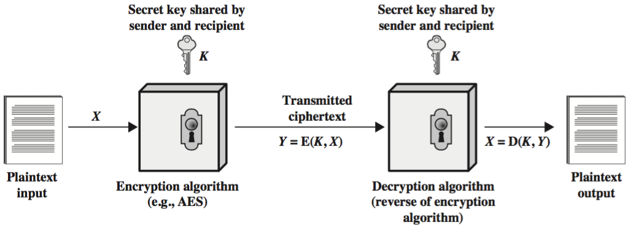
Symmetric Encryption

Slide 4
Symmetric Encryption
Also known as Conventional Encryption
Sender and receiver use same key (shared secret)
Was the only method used prior to the 1970s & still the main “workhorse”
Popular algorithms:
Advanced Encryption Standard (AES)
Triple Data Encryption Standard (3DES)
Rivest Cipher 4 (RC4)
Fast
But how to share secret keys?
“chicken-and-egg” problem

Slide 5
Public Key Encryption

Slide 6
Public Key Cryptography
Each party has two keys:
a public key, known potentially to anybody, used to encrypt messages, and verify signatures
a private key, known only to its owner, used to decrypt messages, and create signatures
Complements rather than replaces symmetric cryptography
Used for exchanging secret keys

Slide 7
Application: Secrecy
Alice (A) sends message to Bob (B) by encrypting with his public key
Message can only be decrypted with Bob’s corresponding private key (known only to him)

Slide 8
Secrecy Model
Encryption: C = E_{KUb}(M)
Decryption: M = D_{KRb}(C) = D_{KRb}(E_{KUb}(M))

Slide 9
Application: Authentication
Alice (A) sends message to Bob (B) encrypting it with her own private key (i.e. she signs the message)
Everyone with Alice’s public key can decrypt the message. A message that can be decrypted with Alice’s public key must have come from Alice.

Slide 10
Authentication Model
Signing: C = E_{KRa}(M)
Verifying: M = D_{KUa}(C) = D_{KUa}(E_{KRa}(M))

Slide 11
Authenticity of Public Keys: MITM attack
Bob’s public key is in the public domain and only Bob has the corresponding private key
What happens though if an eavesdropper (Eve) generates another key pair and advertises the public key produced as belonging to Bob?
People then may send messages to Bob using the wrong public key, for which Eve has the corresponding private key.
Need to be able to trust that a public key belongs to whom it’s reputed to belong.

Slide 12
Cryptographic Hash Functions

Slide 13
Data Integrity
Assurance of non-alteration
CRC or checksums (as implemented in TCP, say) are designed to detect accidental bit errors due to noise, etc.
Not enough to withstand a deliberate attack

Slide 14
Cryptographic Hash Function
Used to provide integrity of a message
Purpose is to produce a fixed-size hash-value:
where h is the hash value
H is the hash function
M is the message
Any change in M, however small, should produce a different h-value
h = H(M)

Slide 15
Cryptographic Hash Function
M
H
h
Message (any size)
Hash Function
Hash Value (fixed-size; e.g. 160 bits)
Note that a hash function is a many-to-one function. Potentially many messages can have the same hash, but finding these should be very difficult

