Slide 1
Security
Security services

Slide 2
Understanding security
For clear thinking, it is useful to separate the following:
Threat (potential security breach)
Service (measure to deal with this threat)
Mechanism (means to provide a service)
Technology (implementation of mechanism)
Deployment (configuration)
Verification (test if it works)
Maintenance (support & keep up to date)

Slide 3
Understanding security
For clear thinking, it is useful to separate the following:
Threat (e.g. leakage of private information on the Internet)
Service (e.g. confidentiality)
Mechanism (e.g. encryption)
Technology (e.g. TLS)
Deployment (e.g. configuration of version, algorithm, keys)
Verification (e.g. test deployment)
Maintenance (e.g. update keys, renew certificates)

Slide 4
Security Services
Authentication
Correct identification of entity or source of data
Access control
Who can access what; in what way
Data confidentiality
Non-disclosure to external parties
Data integrity
“Correctness” of data
Non-repudiation
Proof that communication or transaction took place
Availability
Ensuring system available to users when required

Slide 5
Mechanisms supporting services (examples)
Authentication
Passwords; biometrics
Access control
File permissions
Data confidentiality
Encryption; traffic padding
Data integrity
Message digests; checksums
Non-repudiation
Digital signatures
Availability
Replication of data and services; Backup systems

Slide 6
Attacks on Communications
Interruption
Cutting a communication line
Interception
Unauthorised party gains access
Modification
Unauthorised party gains access and tampers
Fabrication
Unauthorised party masquerades as an authorised party

Slide 7
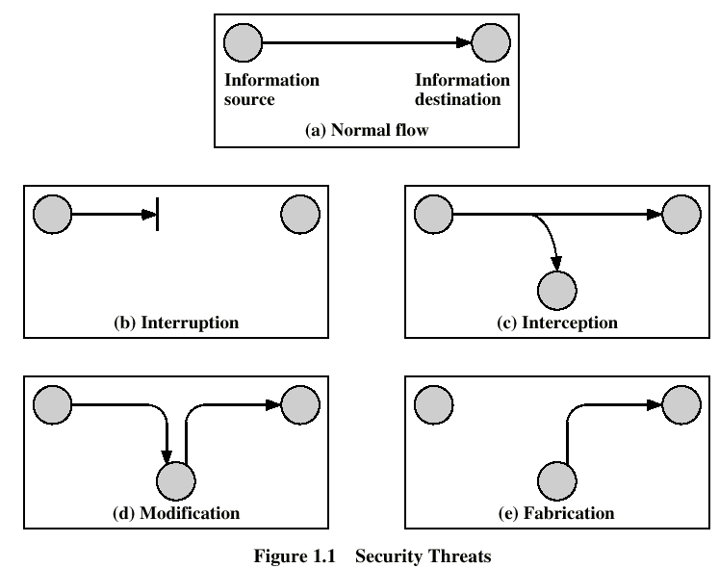
Attacks on Communications

Slide 8
Exercise
Consider the 4 communications security attack types shown on the previous 2 slides (interruption, interception, modification, fabrication)
Match each of these four attack types with a security service designed to prevent it.
Also suggest a mechanism/technology that would realise this service

