Slide 1
Security
Cryptography Essentials - Encryption

Slide 2
Objectives
Gain understanding of three main ingredients of most security protocols & products
Symmetric encryption
Public-key cryptography
Cryptographic hash functions (next week)
Learn about (public) key management using
Digital certificates (also next week)

Slide 3
Introduction

Slide 4
Some jargon
Cryptography: Science of “secret writing”
Plaintext: Original message
Ciphertext: Transformed message
Encryption: plaintext -> ciphertext process
Decryption: ciphertext -> plaintext process
Cipher: “Secret method of writing” (i.e. algorithm)
Key: Some critical information used by the cipher, known only to sender and/or receiver
Cryptanalysis: Attempting to discover plaintext or key or both

Slide 5
Symmetric Encryption
Sender and receiver use same key (shared secret)
Was the only method used prior to the 1970s & still the main “workhorse”
Popular algorithms:
Advanced Encryption Standard (AES)
Triple Data Encryption Standard (3DES)
Rivest Cipher 4 (RC4) – until recently!
Fast
But how to share secret keys?
“chicken-and-egg” problem

Slide 6
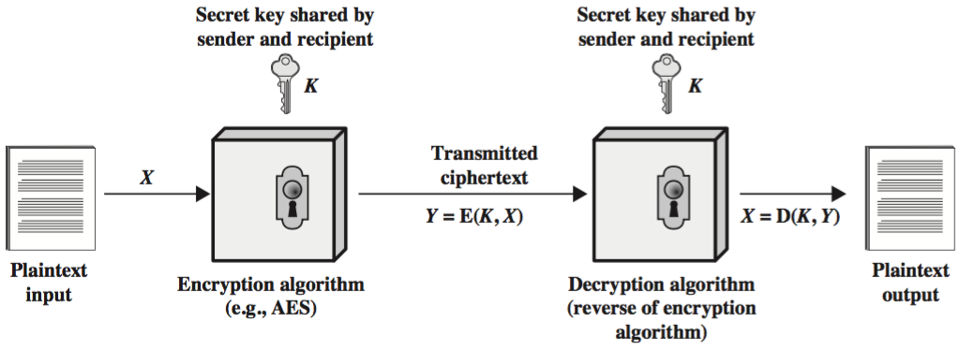
Symmetric Encryption

Slide 7
Public-key Cryptography
Major limitations of Symmetric Encryption:
Key distribution problem
Not suitable for authentication: receiver can forge message & claim it came from sender
Addressed by Public-key Cryptography
Public-key methods based on sender and receiver using different keys

Slide 8
Public-key Cryptography
Each party has two keys:
a public key, known potentially to anybody, used to encrypt messages, and verify signatures
a private key, known only to its owner, used to decrypt messages, and create signatures
Complements rather than replaces symmetric cryptography
Used for exchanging secret keys

Slide 9
Applications of Public-key Cryptography
Can classify uses of public-key cryptography into 3 categories:
encryption/decryption (provides secrecy)
digital signatures (provides authentication)
key exchange for symmetric encryption
which is a special case of (1)
Some public-key algorithms are suitable for all uses; others are specific to one of the above

Slide 10
Application: Secrecy
Alice (A) sends message to Bob (B) by encrypting with his public key
Message can only be decrypted with Bob’s corresponding private key (known only to him)

Slide 11
Secrecy Model
KU_{b} B’s pUblic key
KR_{b} B’s pRivate key

Slide 12
Application: Authentication
Alice (A) sends message to Bob (B) encrypting it with her own private key (i.e. she signs the message)
Everyone with Alice’s public key can decrypt the message. A message that can be decrypted with Alice’s public key must have come from Alice.

Slide 13
Authentication Model
KR_{a} A’s pRivate key
KU_{a} A’s pUblic key

Slide 14
Limitations of Public-key Cryptography
1. Processing speed
Calculations required for public-key algorithms (mainly multiplications) much slower than those of conventional algorithms (permutations & XORs)
Thus public-key methods not suitable for general-purpose encryption/decryption
Instead often just use public-key method to exchange session (secret) key at beginning of session & use session key thereafter

Slide 15
Limitations of Public-key Cryptography
2. Authenticity of public keys (MITM attack)
Bob’s public key is in the public domain and only Bob has the corresponding private key
What happens though if an eavesdropper (Eve) generates another key pair and advertises the public key produced as belonging to Bob?
People then may send messages to Bob using the wrong public key, for which Eve has the corresponding private key.
Need to be able to trust that a public key belongs to whom it is reputed to belong.

Slide 16
Cryptographic strength & cryptanalysis

Slide 17
Kerckhoff’s principle
Security should depend on the secrecy of the key, not the secrecy of the algorithm
Attempts to keep algorithms secret are usually ineffective (they leak out)
… and counterproductive as review by the wider crypto community allows weaknesses to be found early on, before deployment.

Slide 18
Cryptanalysis
Cryptanalysis is the process of trying to find the plaintext or key
Two main approaches
Brute Force
try all possible keys
Exploit weaknesses in the algorithm or key
e.g. key generated from password entered by user, where user can enter bad password

Slide 19
Cryptanalysis: Brute Force Attack
Try all possible keys until code is broken
On average, need to try half of all possible keys
Infeasible if key length is sufficiently long
Key size (bits) | No. of keys | Time required at 1 encryption per µs | Time required at 10⁶ encryptions per µs
32 | 4.3 x 10⁹ | 36 minutes | 2 milliseconds
56 | 7.2 x 10¹⁶ | 1142 years | 10 hours
128 | 3.4 x 10³⁸ | 5.4 x 10²⁴ years | 5.4 x 10¹⁸ years
168 | 3.7 x 10⁵⁰ | 5.9 x 10³⁶ years | 5.9 x 10³⁰ years
Age of universe: ~ 10¹⁰ years
Note: DES has a 56 bit key; AES key has 128+ bits

Slide 20
Symmetric Block Ciphers

Slide 21
XOR
Modern techniques use bits rather than text letters
Most transformations use eXclusive OR
Revsersibility and speed are the main benefits of using XOR
XOR truth table:
XOR properties:
A ⊕ A = 0
A ⊕ 0 = A
(A ⊕ B) ⊕ B = A
A | B | A ⊕ B
0 | 0 | 0
0 | 1 | 1
1 | 0 | 1
1 | 1 | 0

Slide 22
Block Cipher
A block cipher divides the plaintext into fixed-sixed blocks and transforms each block into a corresponding block of ciphertext
Padding is required where the plaintext size is not an integer multiple of the block size
Iterated block ciphers are based on a number of rounds where a round function is applied at each round.
The round function usually takes a round key as one of its inputs.
Each round key based on bits extracted from the key

Slide 23
Block Cipher – modes of operation
Electronic Codebook (ECB) mode
Each block treated independently.
Insecure, as repeated plaintext blocks map to repeated ciphertext blocks
Cipher Block Chaining (CBC) mode
Each plaintext block XORed with previous ciphertext block before encryption
Counter (CTR) mode
For each plaintext block encrypt a counter and XOR the result with the plaintext block. Increment the counter for the next block

Slide 24
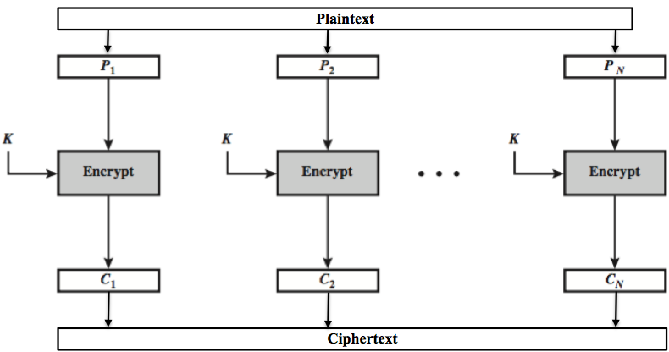
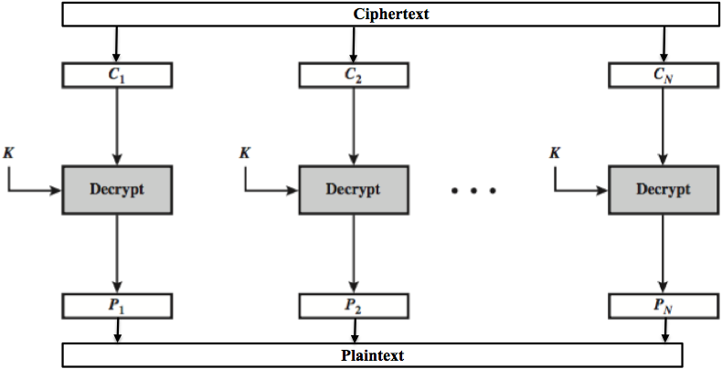
Electronic Codebook Mode (ECB) Encryption
ECB Decryption

Slide 25



Comparing CBC with ECB
Codebooks are a problem as patterns in the plaintext may remain in the ciphertext
Plaintext
Ciphertext (ECB)
Ciphertext (CBC)
Source: msdn.microsoft.com

Slide 26
DES
Data Encryption Standard (1976)
Block size: 64 bits
Key size: 56 bits
No. of rounds: 16
Based on design by Horst Feistel, IBM
Chosen by NBS (now called NIST), US national standards body
Influenced by NSA
Very influential algorithm
Now obsolete, but lives on in Triple DES (3DES)

Slide 27
AES
Advanced Encryption Standard (2001)
Chosen by design competition
Organised by NIST (US National Standards Inst.)
Winner: Rijndael (Belgium)
Block size: 128 bits
Key sizes: 128, 192, 256
Relatively small memory requirement
Suitable for variety of hardware and software architectures
Royalty-free
Considered secure
Very widely used

Slide 28
AES
You can find a nice AES animation here:
http://www.securityfit.cz/download/kib/rijndael_ingles2004.swf
or http://tinyurl.com/aesflash

Slide 29
Stream Ciphers

Slide 30
Stream Ciphers
Process message “continuously”
Optimised for real-time and two-way comms
Usually one byte at a time
As distinct from a block cipher
Typically simple XOR of each plaintext bit with the output of a pseudo-random number generator (PRNG)

Slide 31
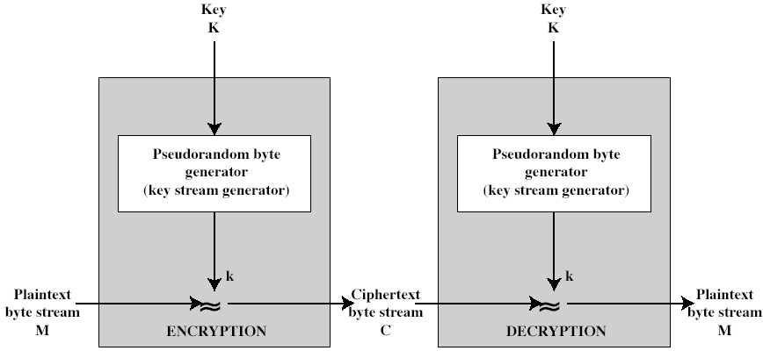
Stream Cipher Structure
⊕
⊕
C_{i} = M_{i} ⊕ k_{i}
M_{i} = C_{i} ⊕ k_{i}

Slide 32
Danger with Stream Cipher
If plaintext-ciphertext pairs can be gathered, then it is easy to record the keystream:
as M_{i} ⊕ C_{i} = k_{i}
Thus the cipher is broken if any way to predict key stream for next ciphertext
Key streams should never be re-used (or re-started with the same seed)

Slide 33
Public-key Algorithms

Slide 34
Trapdoor functions
Public-key cryptography relies on functions that are computationally easy in one direction and computationally infeasible in the other
Examples:
“Easy” problem | “Hard” problem | Technique
Multiplying prime numbers, n = pq | Factoring n | RSA
Modular exponentiation, g ^{x} (mod n) | Calculating discrete log; solving for x in a = g ^{x} (mod n) | Diffie-Hellmann
Elliptic curve point multiplication, R = kP | Finding elliptic curve multiplicand, k | Elliptic curve cryptography

Slide 35
RSA
Rivest, Shamir & Adleman, MIT, 1977
Very well known versatile public-key scheme
Uses large integers as keys (>1000 bits)
Security due to extreme difficulty of factoring large “semiprime” integers
i.e. factoring product of two prime numbers

Slide 36
RSA
Based on three related integers: e, d, n
RSA function (“encryption”):
Input: M < n
Output: C = M ^{e} (mod n)
Inverse RSA (“decryption”):
Input: C
Output: M = C ^{d} (mod n)
d and e are mathematically related: e is chosen and d is calculated from e and the factors of n

Slide 37
Diffie-Hellman
Public-key Technique for exchanging secret keys
First public-key technique (1976)
The secret key is calculated by both parties
Requires some global public parameters
Based on difficulty in solving for x:
a = g ^{x} (mod n) a, g, n known

Slide 38
Elliptic Curve Cryptography
Majority of public-key crypto (RSA, D-H) use either integer or polynomial arithmetic with very large numbers/polynomials
Imposes a significant load in storing and processing keys and messages
An alternative is to use elliptic curves
Offers same security as RSA with smaller bit sizes and lower processing and memory overhead
Recent growth in use

