Slide 1
Security
Cryptography Essentials
- Authentication & digital certificates

Slide 2
Objectives
Gain understanding of three main ingredients of most security protocols & products
Symmetric encryption (last week)
Public-key cryptography (last week)
Cryptographic hash functions
Learn about (public) key management using
Digital certificates

Slide 3
Data Integrity

Slide 4
Data Integrity
Integrity refers to assurance of non-alteration
Many systems and components have checksums or cyclic redundancy checks that are designed to detect accidental errors, etc.
For example, a credit card number contains a digit that is used to verify the others
But such schemes are not sufficient to prevent deliberate modifications

Slide 5
Cryptographic Hash Functions
Used to provide integrity of a message
Purpose is to produce a fixed-size hash-value:
where h is the hash value
H is the hash function
M is the message
Any change in M, however small, should produce a different h-value
h = H(M)

Slide 6
Cryptographic Hash Functions
M
H
h
Message (any size)
Hash Function
Hash Value (fixed-size; e.g. 160 bits)
Note that a hash function is a many-to-one function. Potentially many messages can have the same hash, but finding these should be very difficult

Slide 7
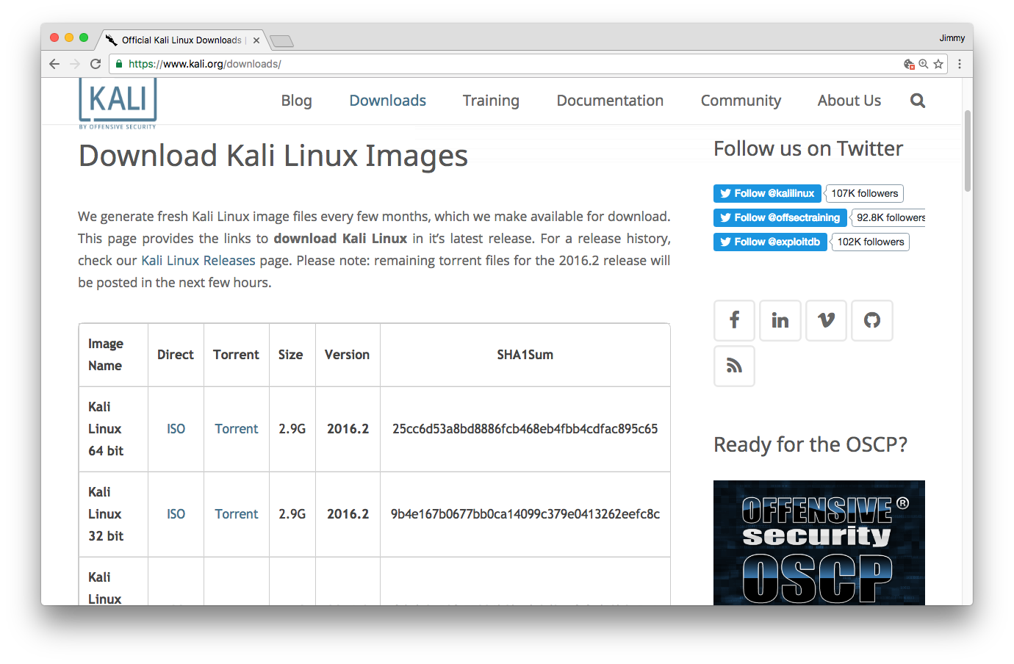
Applications of Hash Functions
As cryptographic checksum
e.g. to verify software downloads

Slide 8
Applications of Hash Functions
Authentication
It usually makes more sense to sign the hash of a message (with a private key) than to sign the original message
This is done with digital certificates and many other authentication schemes

Slide 9
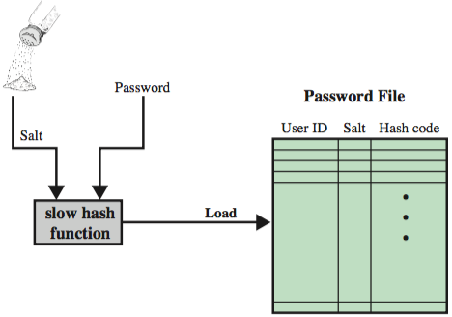
Applications of Hash Functions
Password storage
Store only the hash of password (+ salt)

Slide 10
Cryptanalysis: Breaking hash functions
Strength depends on the length, n, in bits of the hash value
Brute force attacks require time proportional to:
one-way property: 2 ^{n}
weak collisions property: 2 ^{n}
strong collisions property: 2 ^{n/2}
This means the ability to find any two messages that hash to the same value:

Slide 11
Main Hash Algorithms
MD5
Produces 128-bit hash value (i.e. 64-bit security)
Collisions found (2004)
No longer recommended for use
SHA-1
Produces 160-bit hash value (80-bit security)
Collisions found (2017)
No longer recommended for use
SHA-2
Set of 4 hash functions with different size outputs
SHA-224, SHA-256, SHA-384, SHA-512
Considered safe to use
(though new SHA-3 has been established due to concerns over structural similarities with SHA-1)

Slide 12
Authentication

Slide 13
Message Authentication Code (MAC)
Very similar to Hash Function
Difference is the use of a key
Hash Function:
M
H
H(M)
e.g. 256 bits
MAC:
M
MAC
C_{K}(M)
e.g. 256 bits
K

Slide 14
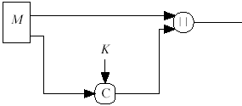
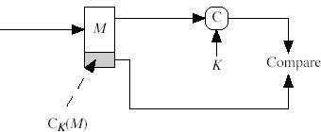
Basic use of MAC for authentication
Sender and recevier need to have shared secret
Note: The symbol with two vertical bars | | means concatenate; i.e. join inputs together

Slide 15
Digital Signatures: signing the hash
Digital signature created by adding a small authentication block to a message
Often done by taking the hash of the message and encrypt the hash with the sender’s private key
The result is a very compact signature (relative to message size)
And is just as secure as encrypting the entire message with the sender’s private key
assuming that a secure hash function is used

Slide 16
Typical Use of Hash Function with Digital Signature
Just sign the hash
much more efficient than signing full message
KR_{a}: Sender’s Private Key
KU_{a}: Sender’s Public Key
Note: The | | symbol means concatenate; i.e. join inputs together

Slide 17
Digital Certificates

Slide 18
(Public) Key Management
Q. When you receive a public key, how can you be sure that it is authentic?
A. If the received public key is digitally signed by someone whose own public key you have and are sure is correct and you trust them to sign keys responsibly.

Slide 19
Digital Certificate – components
Most important components of a digital certificate:
Subject (owner)
The name on the certificate – i.e. to whom it was issued
Subject’s public key
The purpose of a certificate is to validate the public key of the subject
Issuer (Certificate Authority)
The identity of entity that signed the certificate
Issuer’s digital signature
Serial number
Unique identifier for checking against revocation lists
Validity period
Start date; expiry date

Slide 20
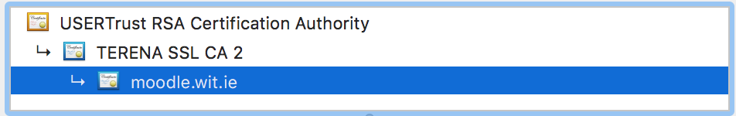
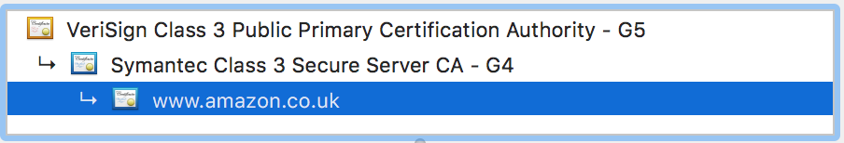
Chain of trust
Can build up a chain of trusts with linked digital certificates
This is the basis of what are known as Public Key Infrastructures (PKIs)

Slide 21
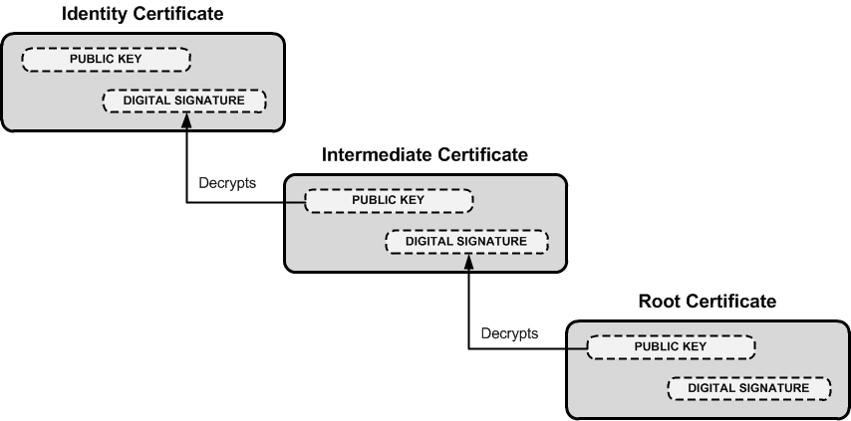
Verification using chain of trusts
Remember decryption using someone’s public key is used to verify their signature

Slide 22
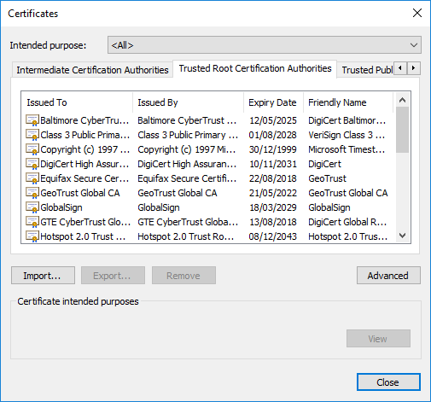
Chain of trust
The buck must stop somewhere. Ultimately, at the end of the chain, you must trust a public key that is not signed (usually belonging to some recognised “authority”).
In your browser, this is one of the trusted root certificate authorities

Slide 23
Certificate Expiry & Revocation
A Digital Certificate doesn’t last for ever
It normally expires after a certain time and must be renewed
It may be revoked:
If the subject’s private key is compromised
If there is a change in status of the subject
If the CA’s private key is compromised
Revoked certificates are placed on a Certificate Revocation List (CRL)

Slide 24
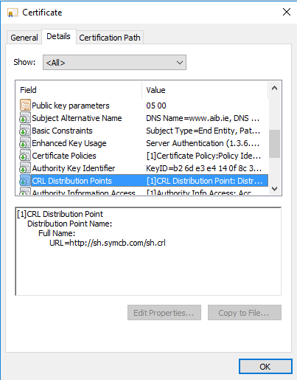
Certificate Revocation
An issue is where to find CRL to check if cert has been revoked
One solution is to provide as part of certificate URL pointing to CRL
Another solution is OCSP (online certificate status protocol) which allows real time queries.
Another is to just rely on local list which is refreshed by browser updates (Chrome does this)

