Slide 1
Security
Transport Layer Security

Slide 2
Securing Web content
HTTP by itself doesn’t provide any security
The approach to securing web content is to:
Leave HTTP as it is
Add security just above the transport layer
This has been variously known as
Secure Socket Layer (SSL)
Originated by Netscape
Transport Layer Security (TLS)
Vendor-neutral standard
RFC 5246 (TLS 1.2)

Slide 3
Reminder: TCP/IP (Internet) Protocol Stack
User
Application
Transport Layer Security
Transport
Internetwork
Network Access (link)
Physical

Slide 4
TLS Requirements
Client contacts Server (possibly for the first time)
Spontaneity
Client conveys secret info to Server
Confidentiality
Authentication – Who’s on the other side?
Server Authentication – required
Client authentication – optional
User doesn’t not want to know about security
Transparency
This property means that other protocols can also work over TLS (it’s not tied to HTTP)

Slide 5
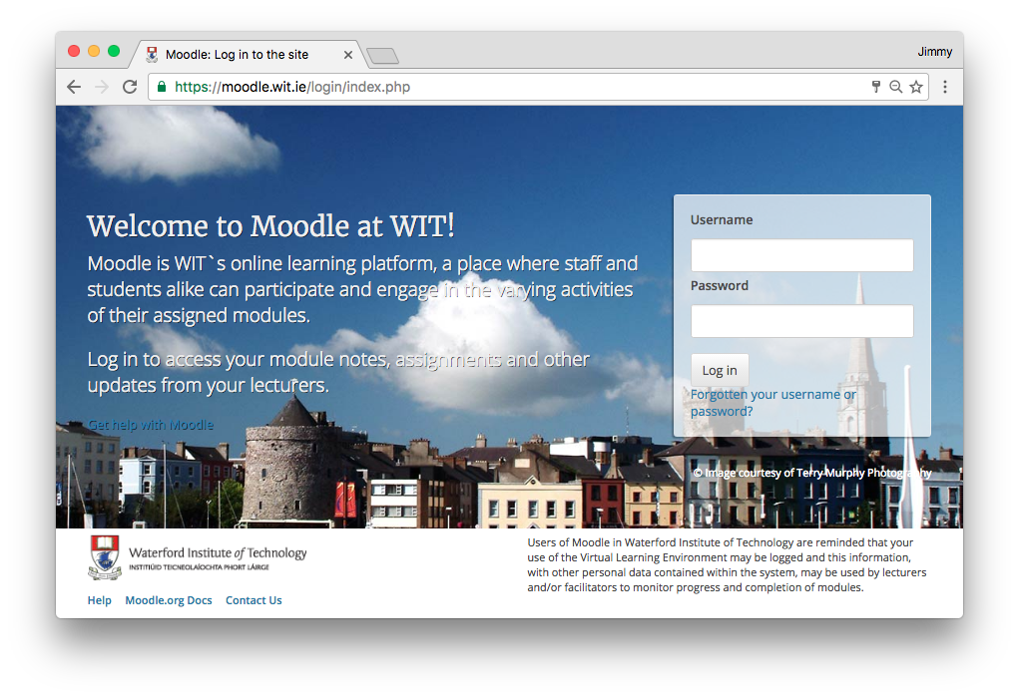
Recognising a TLS-secured page
Closed lock symbol
URL begins with https: rather than http:

Slide 6
TLS Protocol Overview
TLS has 2 layers of protocols:
One layer is a set of protocols for setting up a session, changing parameters, etc
TLS Handshake Protocol
TLS Change Cipher Spec Protocol
TLS Alert Protocol
The other is the “workhorse”, doing the encryption and authentication
TLS Record Protocol

Slide 7
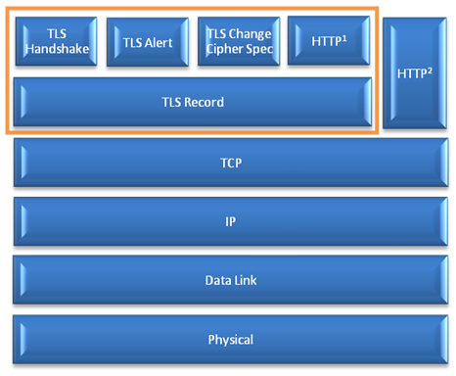
TLS Architecture

Slide 8
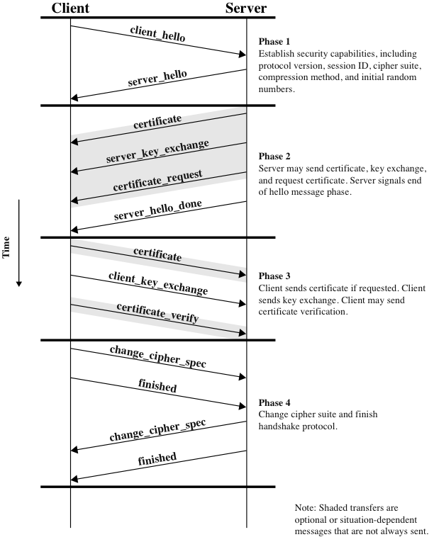
TLS Handshake Protocol
Agree TLS/SSL version & cipher suite (algorithms and settings)
Client authenticates server using its certificate; server optionally authenticates client.
Client generates random session key and shares with server by encrypting it with server’s public key (from its cert)
Client and server can now communicate using shared session key (for symmetric encryption)

Slide 9
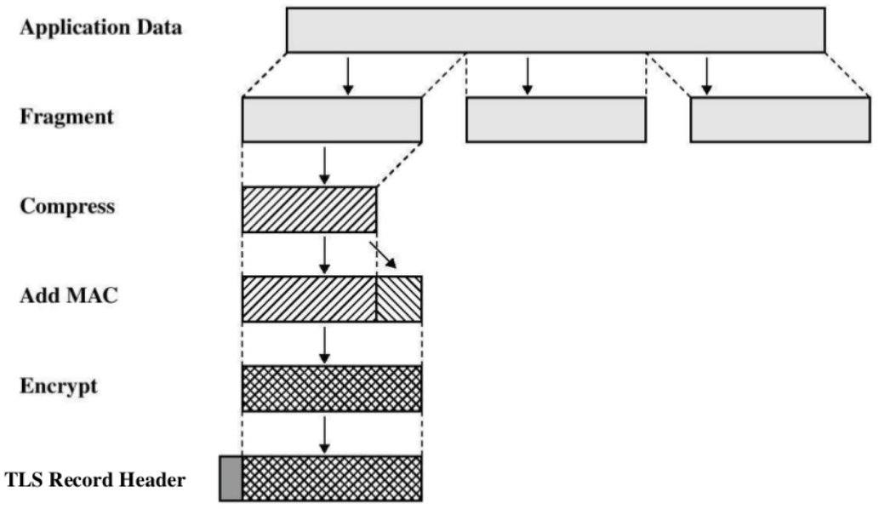
TLS Record Protocol
Compression is an optional feature (often disabled due to vulnerability).
MAC-based authentication and data encryption uses shared secret key (exchanged using TLS Handshake Protocol).
TLS header added to secured fragment. This (header + payload) is then passed to the next layer (TCP).

Slide 10
TLS Cipher Suites and Alerts
An official registry of cipher suites and alert types is maintained by the Internet Assigned Names and Numbers Authority (IANA)
http://www.iana.org/assignments/tls-parameters/

Slide 11
Is TLS secure?
So much relies on TLS nowadays that it is fair to ask whether it can be considered secure
The answer is yes and no
Yes, the protocol seems to be secure if used correctly
However it is very fragile – any of a large number of conditions can break it (completely)

Slide 12
Is TLS secure?
TLS fails if:
One “bad” certificate authority is added to the client’s list of trusted CAs
One of the “good” CAs is careless or unlucky
Weak algorithms are used
Key generation is weak (often due to bad pseudo-random number generator)
One side tricks the other into “stepping down” to use a weak algorithm or key length (e.g. MD5, 512 bit RSA). This is possible as TLS allows the two sides to negotiate these.
Client doesn’t check for certificate revocation

Slide 13
Is TLS secure?
TLS fails if (continued):
Client or server is modified by malware
Client or server has software bugs (e.g. Heartbleed)
Client is modified by system administrator to use company’s CA list
Pages contain a mix of secure and insecure content (frames, images, etc)
Users fail to understand security warnings and/or are conditioned to ignore them
Server fails to renew certificates

