Slide 1
Security
Threat Modelling
Security Requirements & Misuse Cases

Slide 2
Security Requirements Specification
Need to define:
Which controls are necessary
When are they necessary (applicability)
Why are they necessary; e.g.:
industry/customer expectation
regulatory requirement (PCI, Sarbanes-Oxley, FDA, SEC, …)
organisational policy,
common weaknesses and vulnerabilities
Should be easy to use reference for requirements teams

Slide 3
Use Cases: key ideas
A use case illustrates the activities that are performed by users of a system.
It identifies the Actors involved in an interaction and names the type of interaction.
It illustrates the functionality of the system.
Use cases are logical models -- they describe the activities of a system without specifying how the activities are implemented.

Slide 4
UML model of functional requirements
The System
Use-Case-Model Survey
- survey description
- list of all actors
- list of all use cases
Actor 1
Use Case 1
Actor 2
Use Case 2
Use Case 3
Actor 3
Use Case 1 Report
- brief description
- flow of events
Use Case 2 Report
- brief description
- flow of events
Use Case 3 Report
- brief description
- flow of events
Notes:
The use-case model consists of both diagrams and text. The diagrams give a visual overview of the system. The text gives descriptions of the actors and the use cases.
The most important part of the use-case model is the text. Many people get the wrong idea of the word “modeling” and believe that use cases are just about visual modeling: drawing figures and arrows.
Use cases involve writing text. Drawing the pictures is only a small part of the effort. Typically, more than 75% of all effort during requirements capture is to write the textual description of what happens in each use case. The description of what happens is called the flow of events.
The important part of the use-case model is the text. Too many people get the wrong idea of the word “modeling” and believe that use cases are just about drawing figures and arrows.
Use cases involve writing text. Don’t stress the modeling work; instead, stress the text work. A use case without the text is useless.
Typically, more than 75% of all effort during requirements capture is to write the textual description of the flow of events.

Slide 5
What are Use Case Descriptions?
Describe basic functions of the system
What the user can do
How the system responds
Use cases are building blocks for continued design activities.

Slide 6
How Are Use Cases Created?
Two steps:
Write text-based case descriptions
Translate descriptions into diagrams
Describes one and only one function, but may have multiple paths.
Developed working with users for content.

Slide 7
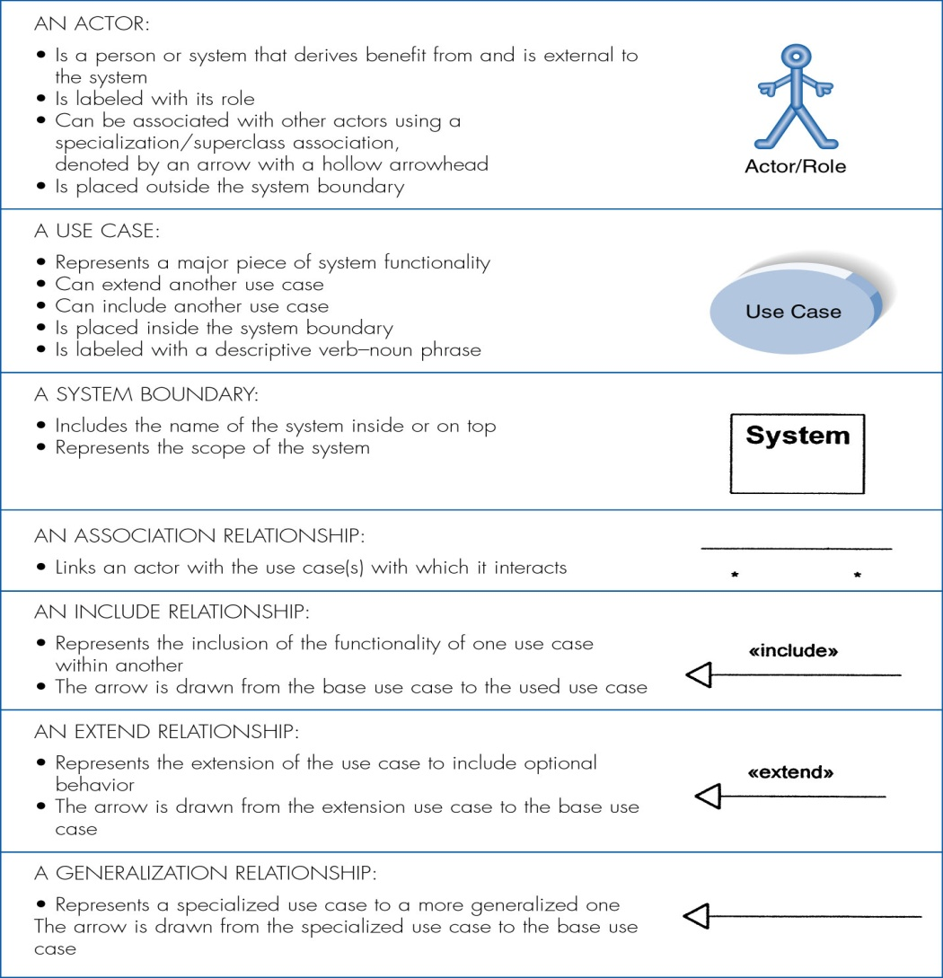
Syntax for Use Case Diagram (UML)

Slide 8
Elements of a Use Case Description
Use Case Section | Description
Name | An appropriate name for the use case
Brief Description | Description of the use case’s role and purpose.
Flow of Events | Description of what the system does with regard to the use case (not how specific problems are solved by the system)
Special Requirements | Description that collects all requirements, such as non-functional requirements, on the use case.
Preconditions | Defines any constraints on the system at the time the use case may start.
Post conditions | Defines any constraints on the system at the time the use case will terminate

Slide 9
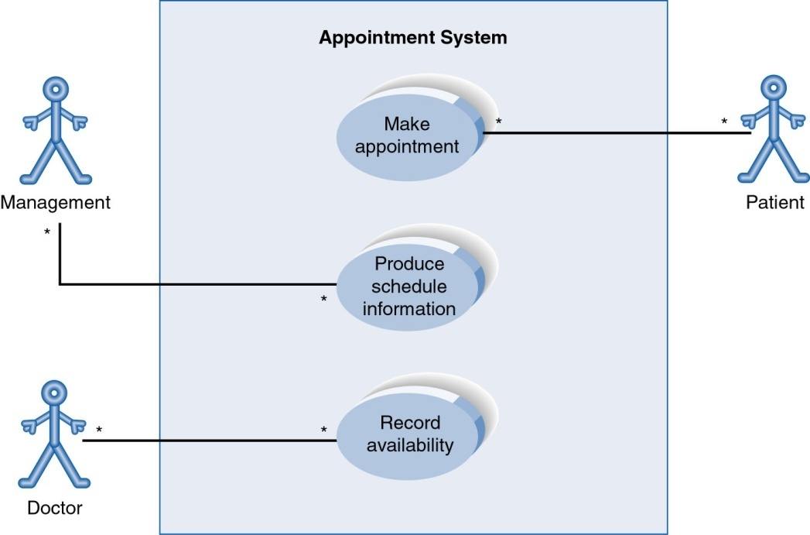
Use Case Diagram for Appointment System

Slide 10
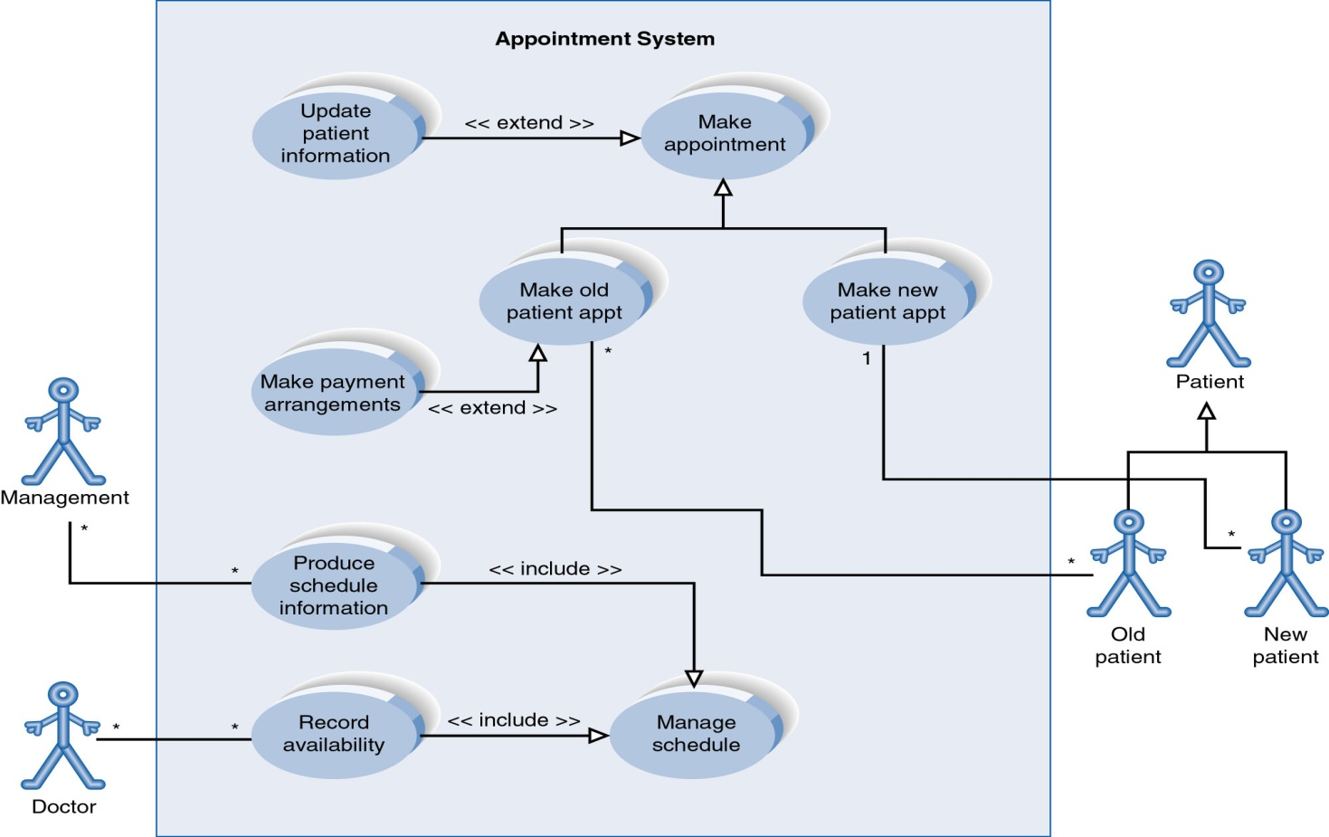
Extend and Include Relationships

Slide 11
What use cases do not cover
Implementation
How functions are implemented
Non-functional requirements
Performance
Scalability
Security
Price
etc
Sequencing
State modelling

Slide 12
Misuse Cases
UML does not cater specifically for misuse/abuse cases
Extending use cases to include misuse cases can be very useful for threat modelling
A number of different styles are used for misuse cases
New keywords introduced;
e.g.
<<threaten>> and <<mitigate>

Slide 13
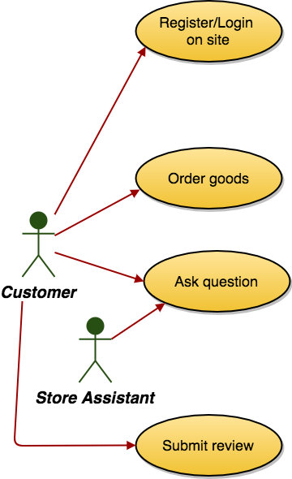
Misuse Cases Example
Adapted from: Eliciting security requirements with misuse cases, Sindre & Opdahl

Slide 14
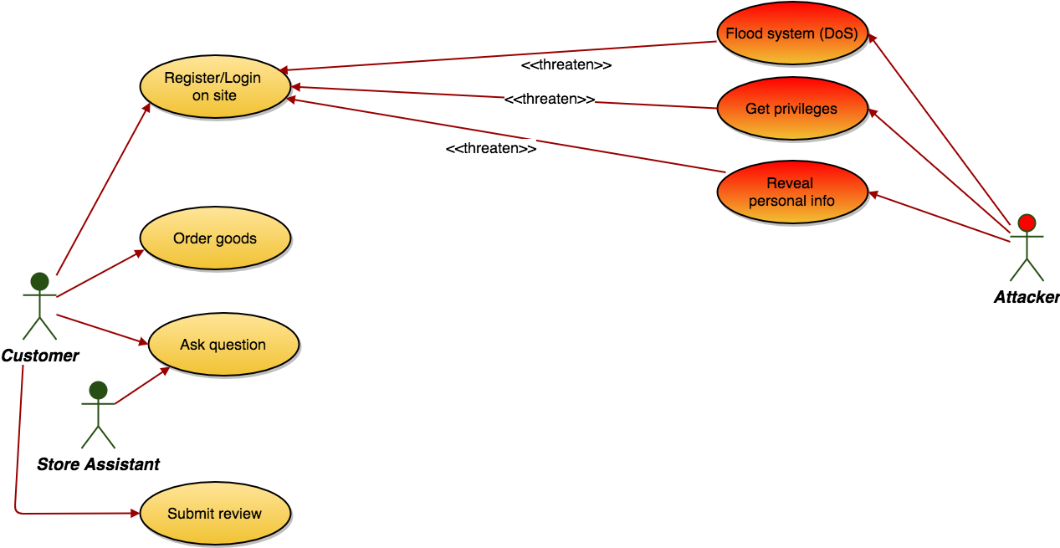
Misuse Cases Example
Adapted from: Eliciting security requirements with misuse cases, Sindre & Opdahl

Slide 15
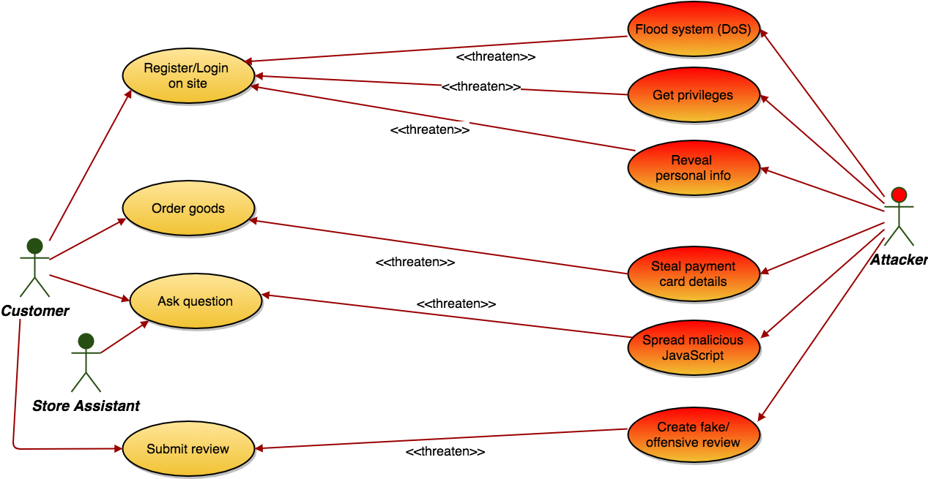
Misuse Cases Example
Adapted from: Eliciting security requirements with misuse cases, Sindre & Opdahl

Slide 16
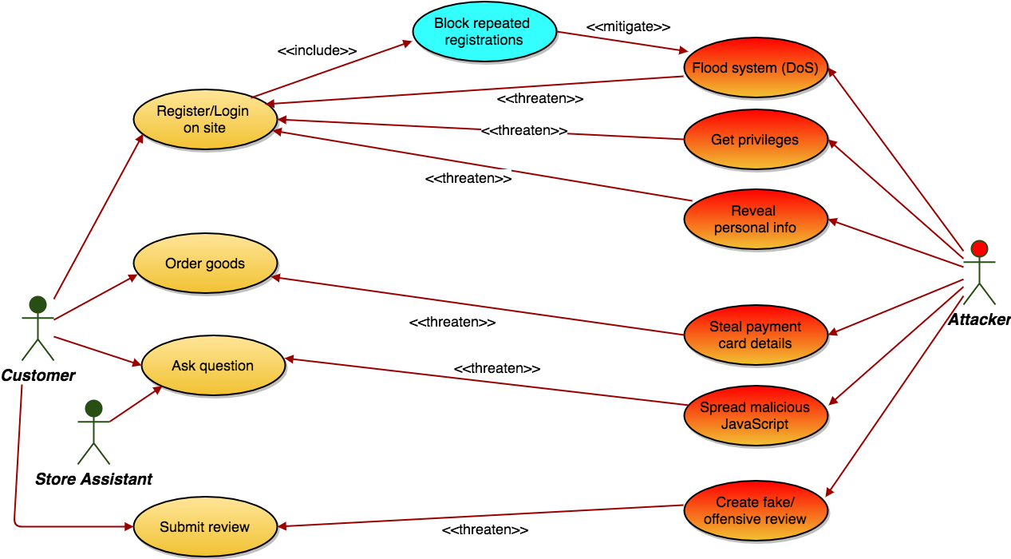
Misuse Cases Example
Adapted from: Eliciting security requirements with misuse cases, Sindre & Opdahl

Slide 17
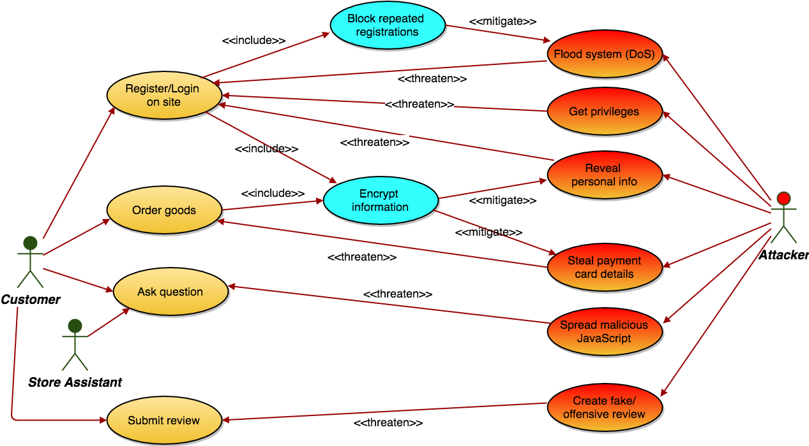
Misuse Cases Example
Adapted from: Eliciting security requirements with misuse cases, Sindre & Opdahl

Slide 18
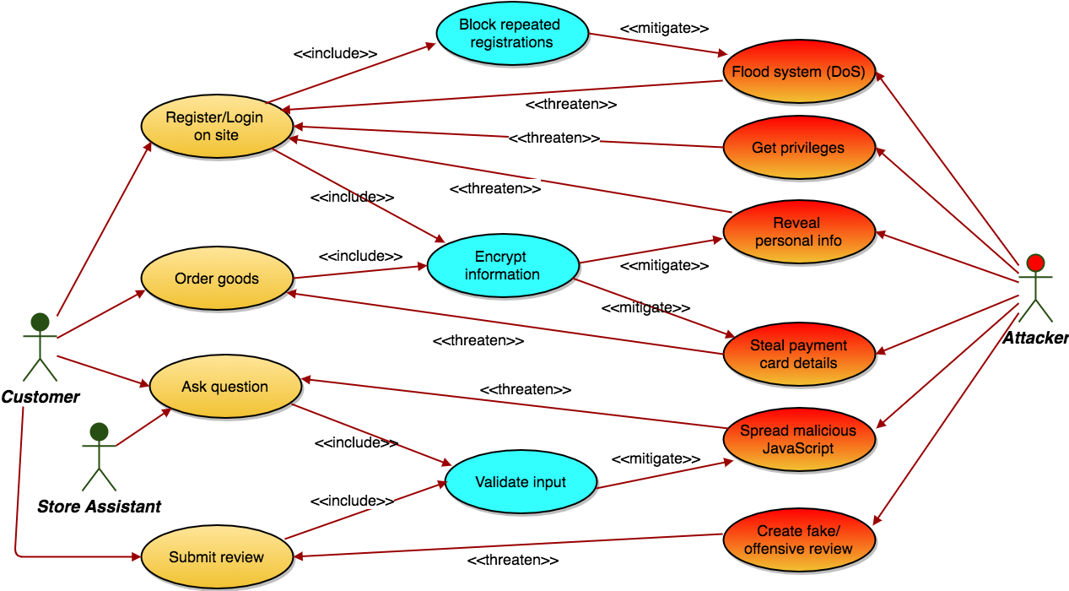
Misuse Cases Example
Adapted from: Eliciting security requirements with misuse cases, Sindre & Opdahl

Slide 19
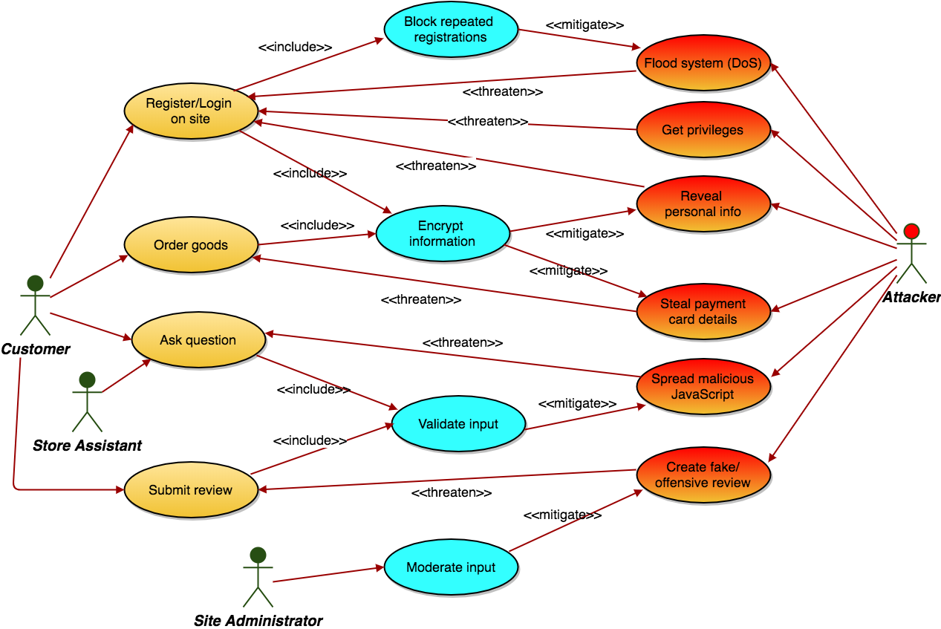
Misuse Cases Example
Adapted from: Eliciting security requirements with misuse cases, Sindre & Opdahl

