Slide 1
Security
Secure Web Development – Authentication

Slide 2
Web authentication – credentials
Do not include credentials in hidden fields, headers, cookies (or code!)
Passwords/credentials should be stored securely in a centralised location
Should only be readable by suitably privileged users
Passwords should be “salted” and hashed
Salting involves appending random bits to each password
Salted password is then hashed (i.e. one-way encrypted) for storage
Objective is to store something derived from the password that allows an entered candidate password to be checked …
… but such that the password cannot be retrieved (by anybody, even an administrator)

Slide 3
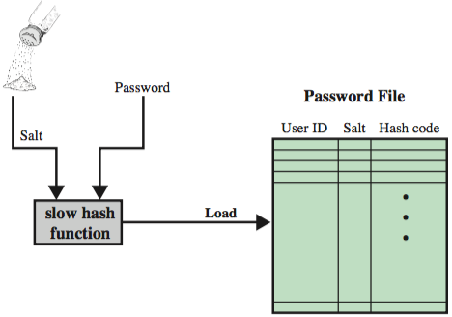
Loading a new password
New line in password file contains user id, salt, and output of (slow) hash function

Slide 4
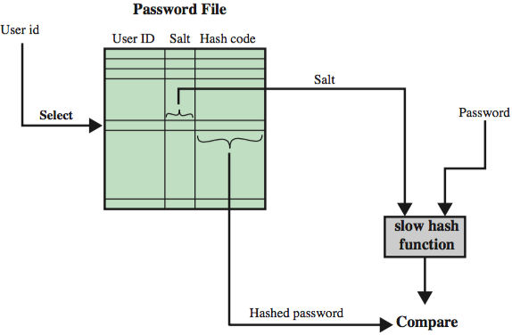
Verifying a password

Slide 5
Purpose of “salt”
The salt serves several purposes:
Frustrates dictionary attacks.
Makes reverse lookup of hash value more difficult
e.g. using a search engine or rainbow tables
Prevents duplicate passwords appearing as duplicates in password file
Protects users where same password is reused on different systems/sites.

Slide 6
Password hashing & salting in practice
The bcrypt module makes it fairly straightforward
To create password hash:
bcrypt.hash(plaintextPassword, saltRounds, function(err, hash) {
// Store hash in your password DB.
});
To check entered password:
bcrypt.compare(candidatePassword, hash, function(err, res) {
// res is true if password is correct
});
Bcrypt is also available for several other languages and frameworks – e.g. jBCrypt for Java

Slide 7
Password strength
Need to enforce strong passwords
Should be resistant to brute force attacks
Long, preferably a pass phrase
Hard to guess, ideally random
User awareness and support
Education on non-disclosure
Provision of tools (e.g. password manager)
People generally cannot remember passwords that are enough to reliably defend against dictionary attacks
Audit / check compliance with policy

Slide 8
Password/credentials change policy
Need secure password change policy
Do not use secret questions and answers.
Instead, e-mail the user with a time limited activation code and limit account capabilities for 24+ hours
Or use out-of-band messaging (e.g. SMS)
May require users to change passwords frequently
Often mandated by standards/regulations (e.g. PCI DSS)
Value of this is debatable
"Delete means delete"
Not a good idea to keep users' password history
Credentials such as API keys may have a lifetime and/or associated rotation policy

Slide 9
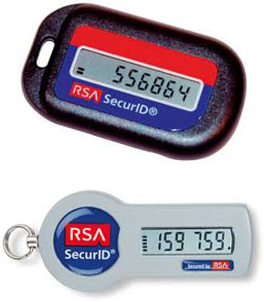
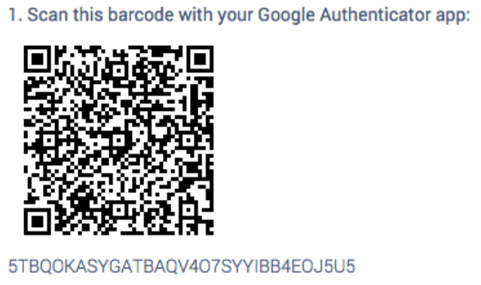

Multi-factor authentication
Authentication can be made stronger by requiring a combination of:
What you know (e.g. password or pass phrase)
What you have (e.g. SIM card, smartphone app, physical token, certificate file, ...)
What you are (biometrics)

Slide 10
Authentication failure logging
Authentication code should fail securely
i.e. software bugs, error modes (e.g. due to temporary loss connectivity or malformed user input) should not result in successful authentication
Count failed logins per user & impose soft lockout on multiple failures
Count failed logins per app
Report to user on last login time, failed logins, failed password recovery attempts
Log all authentication decisions, including failures

Slide 11
Cookies
Cookies are small pieces of information stored on a client and associated with a specific server
When you access a specific website, it might store information as a cookie
Every time you revisit that server, the cookie is re-sent to the server
Effectively used to hold state information over sessions
Cookies can hold any type of information
Can also hold sensitive information
This includes passwords, credit card information, social security number, etc.
Session cookies, non-persistent cookies, persistent cookies
Almost every sophisticated website uses cookies

Slide 12
Protecting Cookies
Make cookies HttpOnly
Restricts access from non-HTTP sources (e.g. JavaScript)
Set secure flag

Slide 13
Session cookies
Recommended practice is to store authentication tokens in session object on server side
A session is the time a user spends on a particular visit to a website.
Session data maintained by web server in session object to allow for preservation of state across sequence of browser requests
Store session ID in session cookie
Make sure framework uses secure session IDs
Session IDs should be long and random – i.e. impossible to guess
Don't leave sessions active unnecessarily
Provide logout button on every page
On logout, destroy the session object
Implement session timeout (idle time, total time)

Slide 14
HTTP Authentication

Slide 15
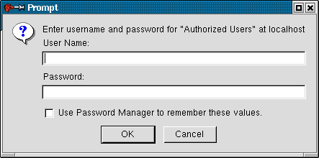
HTTP Authentication
HTTP provides built-in authentication
On browsers you get a login prompt
There are two types of authentication: Basic and Digest

Slide 16

HTTP Basic Access Authentication
GET /protected/index.html HTTP/1.1
HTTP/1.1 401 Unauthorized
WWW-Authenticate: Basic realm=“Private”
Display
Login panel
GET /protected/index.html HTTP/1.1
Authorization: Basic JAadf0987awe

Slide 17
Problems with Basic Authentication
Passwords are easy to intercept
Repeated Exposure: Password sent with every request
Passwords are trivial to decode (not encrypted, just Base64 encoded)
Insecure storage (password cached by browser)
No logout function

Slide 18
Digest Access Authentication
GET /protected/index.html HTTP/1.1
HTTP/1.1 401 Unauthorized
WWW-Authenticate: Digest realm=“Private”
nonce=“897sgkjhsadAdsiu”
Display
Login panel
GET /protected/index.html HTTP/1.1
Authorization: Digest username=“Alice”
realm=“Private” nonce=“897sgkjhsadAdsiu”
response=“5ijasd9734kuyasds0g”

Slide 19
Challenge and Response
Challenge (nonce): any changing string
e.g. MD5(IP address:timestamp:server secret)
Response: challenge hashed with the user’s name & password and URL of requested page
MD5(MD5(name:realm:password):nonce:MD5 (request))
Server-specific implementation options
One time nonce
Time-stamped nonce

Slide 20
Digest Advantages over Basic Auth
Can’t replay the client/server handshake because nonce changes each time
An intercepted response is valid only for a single web page because the response has the request hashed.
… still inherently insecure though!

