Slide 1
Security
Secure Web Development – Authorisation and Delegation

Slide 2

Authorisation and delegation: OAuth

Slide 3
OAuth concept
Open standard for authorisation
Focused on secure delegation of access
i.e. I allow a web application to have (perhaps limited) access to another web application
Based on access tokens
Related to idea of single sign-on (SSO)

Slide 4
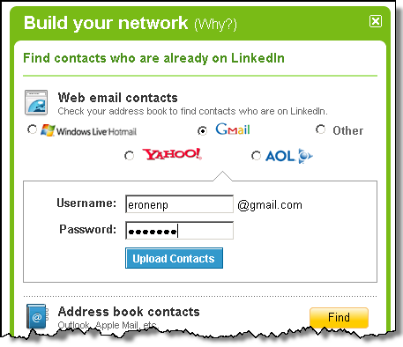

Slide 5
Example OAuth Exchange (slides adapted from IETF tutorial by H Tschofenig & B Cook)

Slide 6
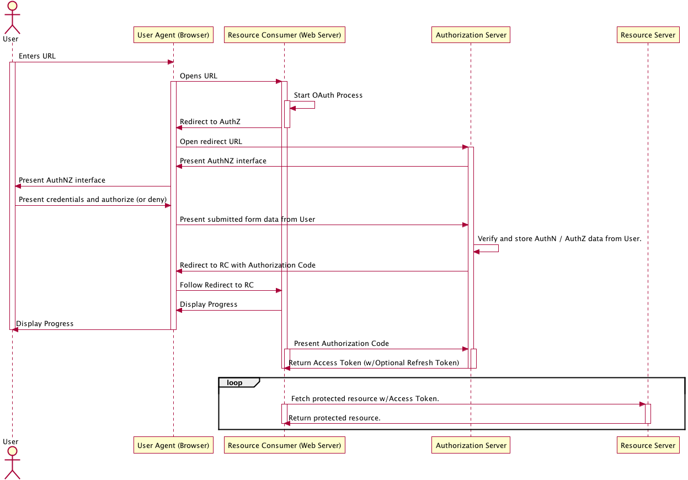
User Enters a URL
In the web browser

Slide 7
Browser opens URL

Slide 8
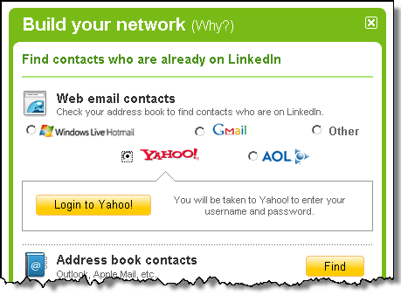
User is presented
With the option to access remote (but protected) data

Slide 9
Resource Consumer
Redirects to Authorization Server

Slide 10
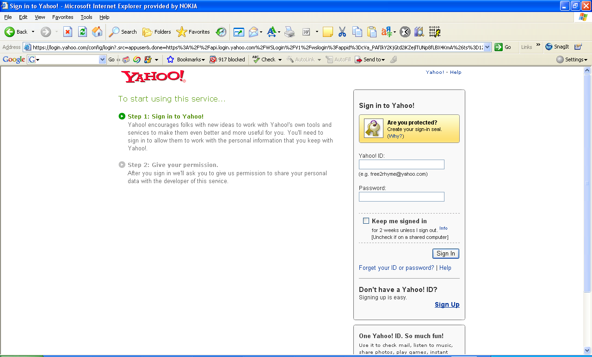
User authentication
takes place

Slide 11
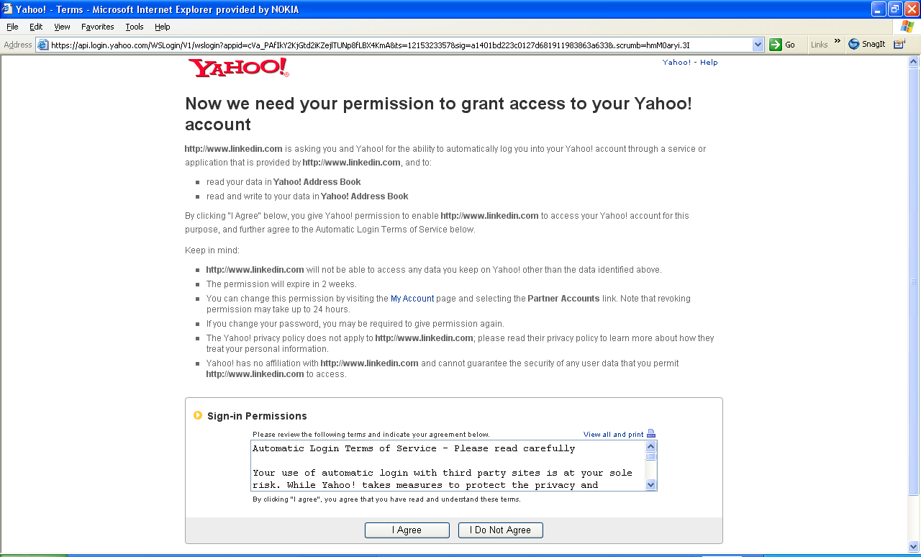
User authorizes
data exchange

Slide 12
Authorization Granted
Redirect from Authz Server back to Resource Consumer

Slide 13
Resource Consumer
Requests Token from
Authorization Server
For Access to the
Resource Server

Slide 14

Resource Consumer
Receives Token

Slide 15
Resource Consumer
Requests access to
Data at the Resource
Server

Slide 16
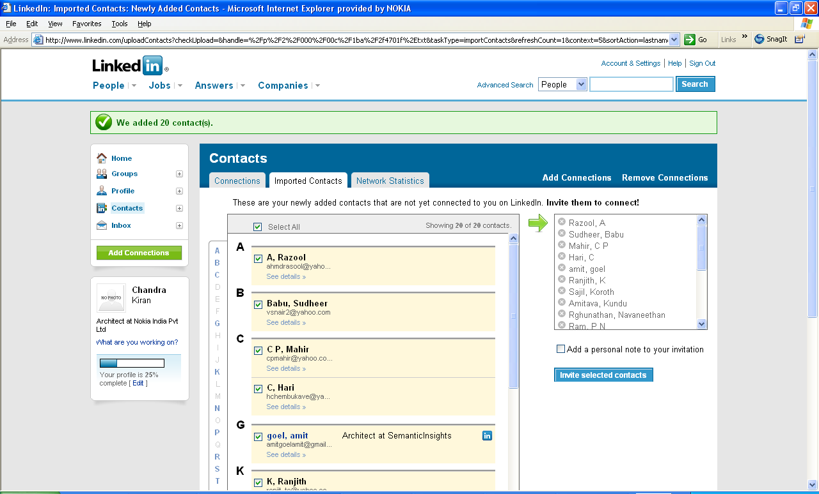
Data exchange takes
place

Slide 17
OAuth with Hapi
The bell module implements OAuth and has built-in support for many providers, including:
Facebook, GitHub, Google, Instagram, LinkedIn, Slack, Twitter, Yahoo, Foursquare, Windows Live, BitBucket, Dropbox, Reddit, Tumblr, Salesforce, Pinterest
Need to register app with provider and get app credentials - e.g. at apps.twitter.com
Excellent tutorial at this link:
https://www.sitepoint.com/oauth-integration-using-hapi/

Slide 18
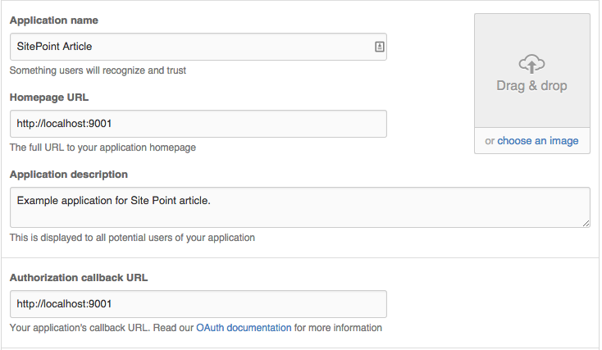
Registering with OAuth provider

Slide 19
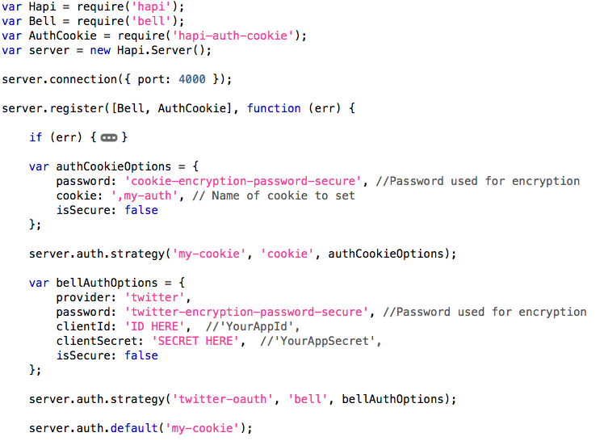
OAuth with bell (from SitePoint tutorial)

Slide 20
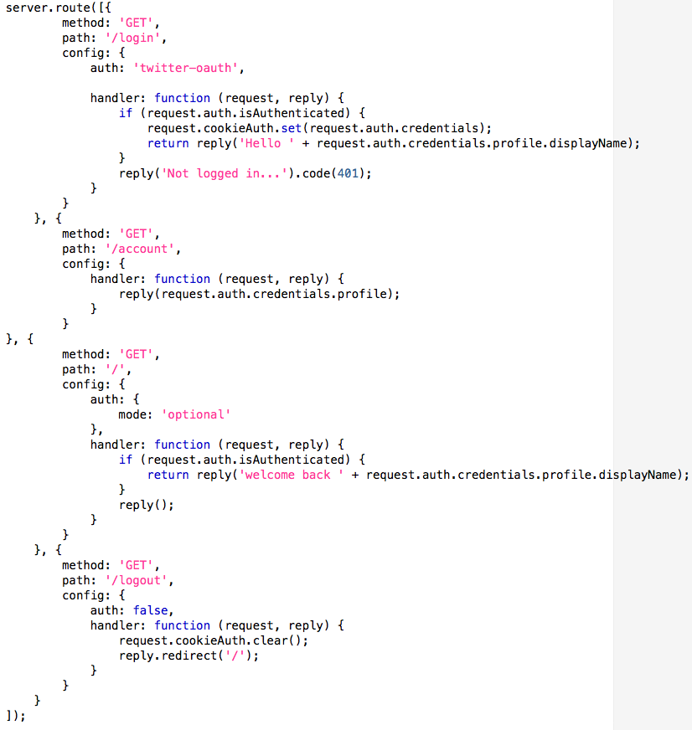
OAuth with bell (continued)

