Slide 1
MVC, MVP and MVVM Design Patterns
A comparison

Slide 2
Contents / Agenda
Separation of Concerns
MVC
Definition and Architecture
Explanation of Modules
Sequence Diagram
Advantages and Disadvantages
MVP
Definition and Architecture
Explanation of Modules
Sequence Diagram
Advantages and Disadvantages
MVVM
Definition and Architecture
Explanation of Modules
Sequence Diagram
Advantages and Disadvantages
Summary (a comparison of all three patterns)
One Last Tip

Slide 3
Separation of Concerns
All these methods do only one thing “Separation of Concerns” or “Layered Architecture” but in their own way.
All these concepts are pretty old, like idea of MVC was tossed in 1970s.
All these patterns forces a separation of concerns, it means domain model and controller logic are decoupled from user interface (view). As a result maintenance and testing of the application become simpler and easier.

Slide 4
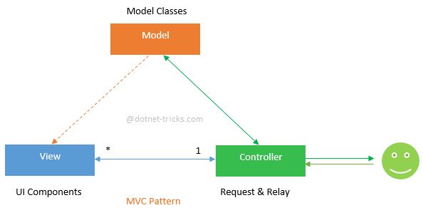
MVC Pattern Architecture
MVC stands for Model-View-Controller.

Slide 5
Explanation of Modules
Model:
The Model represents a set of classes that describe the business logic i.e. business model as well as data access operations i.e. data model. It also defines business rules for data means how the data can be changed and manipulated.
View:
The View represents the UI components like CSS, jQuery, html etc. It is only responsible for displaying the data that is received from the controller as the result. This also transforms the model(s) into UI.
Controller:
The Controller is responsible to process incoming requests. It receives input from users via the View, then process the user's data with the help of Model and passing the results back to the View. Typically, it acts as the coordinator between the View and the Model. There is One-to-Many relationship between Controller and View, means one controller can handle many views.

Slide 6
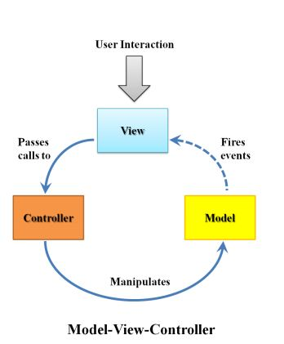
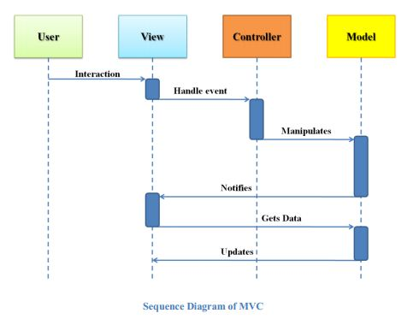
Sequence Diagram

Slide 7
Advantages of MVC
Since MVC handles the multiple views using the same enterprise model it is easier to maintain, test and upgrade the multiple system.
It will be easier to add new clients just by adding their views and controllers.
Since the Model is completely decoupled from view it allows lot of flexibilities to design and implement the model considering reusability and modularity. This model also can be extended for further distributed application.
It is possible to have development process in parallel for model, view and controller.
This makes the application extensible and scalable.
It is really effective with Microsoft’s ASP.Net and Entity Framework.

Slide 8
Disadvantages of MVC
Requires high skilled experienced professionals who can identify the requirements in depth at the front before actual design.
It requires the significant amount of time to analyze and design.
This design approach is not suitable for smaller applications.
In case of complicated user interface with states of views related to each other and
Possible workflow models, this information though not business functionality related
Has to be in the Model layer. In very large systems this may be beneficial, otherwise it is usually transferred to the control layer, somewhat breaching the pattern.

Slide 9
MVP Pattern
Model-View-Presenter (MVP) is a variation of the Model-View-Controller (MVC) pattern but specifically geared towards a page event model.
The primary differentiator of MVP is that the Presenter implements an Observer design of MVC but the basic ideas of MVC remain the same: the model stores the data, the view shows a representation of the model, and the presenter coordinates communications between the layers.

Slide 10
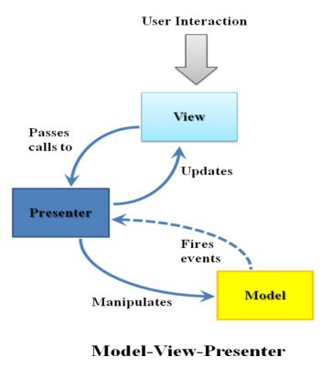
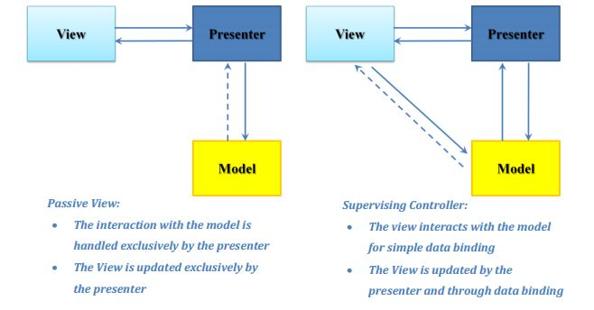
MVP Pattern Architecture

Slide 11
Explanation of Modules
Model:
The model in MVP is just the same, that is described earlier in the Model-View-Controller pattern.
Presenter:
The Presenter’s responsibility is to handle user input and use this to manipulate the model data. The interactions of the User are first received by the view and then passed to the presenter for interpretation. Often, a presenter will maintain a selection that identifies a range of data in the model that is current, and the gestures received from the view will be used to act on this. There is One-to-One relationship between View and Presenter, means each view will be handled by one presenter.
View:
When the model is updated, the view also has to be updated to reflect the changes. View updates can be handled in several ways.

Slide 12
Passive view and Supervising Controller
The Model-View-Presenter variants, Passive View and Supervising Controller, specify different approaches to implementing view updates.
In Passive View, the presenter updates the view to reflect changes in the model. The interaction with the model is handled exclusively by the presenter. The view is not aware of changes in the model.
In Supervising Controller, the view interacts directly with the model to perform simple data-binding that can be defined declaratively, without presenter intervention. The presenter updates the model; it manipulates the state of the view only in cases where complex UI logic that cannot be specified declaratively is required. .NET Data-binding technologies make this approach more appealing for many cases, although if not carefully designed it may result in coupling between view and model.

Slide 13
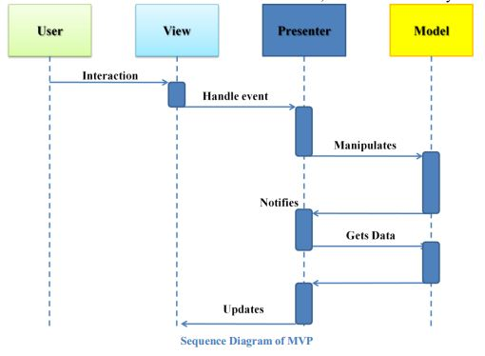
Sequence Diagram for MVP

Slide 14
Advantages of MVP
As with Model-View-Controller, Model-View-Presenter has the advantage that it clarifies the structure of our user interface code and can make it easier to maintain.
Not only do we have our data taken out of the View and put into the Model, but also almost all complex screen logic will now reside in the Presenter.
We have almost no code in our View apart from screen drawing code Model-View-Presenter also makes it theoretically much easier to replace user interface components, whole screens, or even the whole user interface (Windows Forms to WPF for example).
This makes the user opinion sensitive UI part perfectly separate of other parts of the application, hence it’s features can be enhanced separately with more involvement from the customer.
In addition unit testing the user interface becomes much easier as we can test the logic by just testing the Presenter.

Slide 15
Disadvantages of MVP
Requires high skilled experienced professionals who can identify the requirements in depth at the front before actual design.
It requires the significant amount of time to analyze and design.
This design approach is not suitable for smaller applications. It overkills the small applications.
It can be hard to debug events being fired in active Model-View-Presenter.
The Passive View version of Model-View-Presenter can lead to a certain amount of boilerplate code having to be written to get the interface into the View to work.
In both MVP and MVC cases the code for supporting the proper pattern implementation can be complex, hence it is not advised to use in smaller projects.

Slide 16
MVVM Pattern
The Model-View-ViewModel (MVVM or ViewModel) is a pattern for separating concerns in technologies that use data-binding.
The first two pattern the MVC and MVP does not work as well as MVVM in declarative user interfaces like Windows Presentation Foundation or Silverlight because the XAML that these technologies use can define some of the interface between the input and the view (because data binding, triggers, and states can be declared in XAML).
The MVVM pattern is an adaptation of the MVC and MVP patterns in which the view model provides a data model and behavior to the view but allows the view to declaratively bind to the view model.

Slide 17
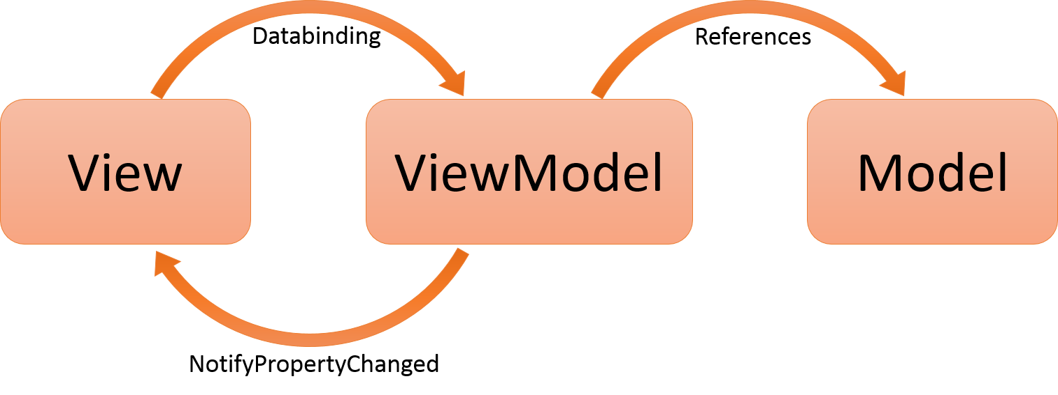
MVVM Architecture

Slide 18
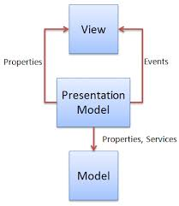
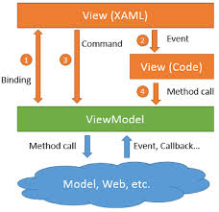
MVVM Architecture

Slide 19
Explanation of Modules
Model:
The model is especially important because it wraps the access to the data, whether access is through a set of Web services, an ADO.NET Data Service, or some other form of data retrieval. The model is separated from the view model so that the view's data (the view model) can be tested in isolation from the actual data.
View:
The pattern we use is to set the Data Context of a view to its ViewModel. The view classes have no idea that the model classes exist, while the ViewModel and model are unaware of the view. In fact, the model is completely oblivious to the fact that the ViewModel and view exist. A View is the actual UI behind a view in the application. The elements of the UI are implemented in XAML, and as a result of this the code behind file contains minimal code, or in some cases it does not contain code at all, however it is different in Silverlight and WPF.

Slide 20
Continued…
ViewModel:
A ViewModel is a model for a view in the application as shown by its name. It has a collection which contain the data from the model currently needed for the view. Unlike the Presenter in MVP, a ViewModel does not need a reference to a view. The view binds to properties on a ViewModel, which, in turn, exposes data contained in model objects and other state specific to the view. The bindings between view and ViewModel are simple to construct because a ViewModel object is set as the Data Context of a view. If property values in the ViewModel change, those new values automatically propagate to the view via data binding. When the user clicks a button in the View, a command on the ViewModel executes to perform the requested action. The ViewModel, never the View, performs all modifications made to the model data.

Slide 21
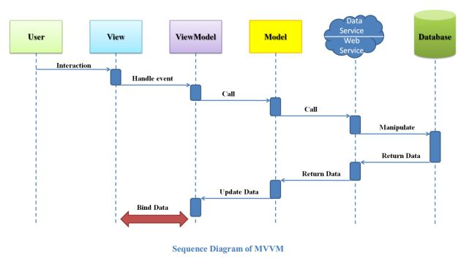
Sequence Diagram for MVVM

Slide 22
Advantages of MVVM
Reduces the amount of code in the View’s code behind file.
UI elements can be written in XAML
Strong Data Binding, which saves a lot of code. No need for manually refresh the view.

Slide 23
Disadvantages of MVVM
In bigger cases, it can be hard to design the ViewModel up front in order to get the right amount of generality.
Data-binding for all its wonders is declarative and harder to debug than nice imperative stuff where you just set breakpoints.

Slide 24
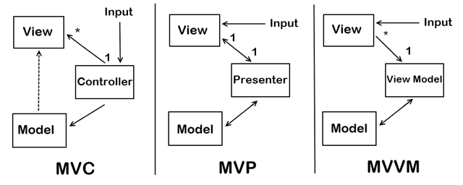
Summary (1)

Slide 25
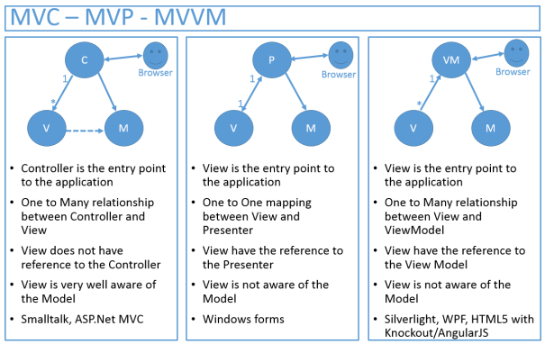
Summary (2)

Slide 26
Last Word
Must note the difference between the event responses of all patterns in Sequence diagram. It clears the confusion about the response of user input.

