Slide 1
Data Analytics
Dr. Brenda Mullally

Slide 2
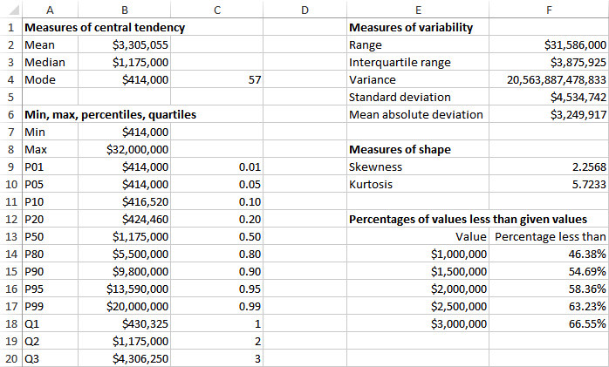
Example 2.3: Baseball Salaries 2011.xlsx

Slide 3
Measures of Variability
The range is the maximum value minus the minimum value.
The interquartile range (IQR) is the third quartile minus the first quartile.
Thus, it is the range of the middle 50% of the data.
It is less sensitive to extreme values than the range.
The variance is essentially the average of the squared deviations from the mean.
If X_{i} is a typical observation, its squared deviation from the mean is (X_{i} – mean)².
Notes:
If you learn that the mean or median salary is $100,000 this tells you the typical salary but it tells you nothing about the variability of the salaries.
The range is a fairly crude measure of variability. It is sensitive to the extremes.
Eg if one players salary increased to 40 million the range would increase by 10 million just because of one player.
More frequently used is the variance and std dev.

Slide 4


Measures of Variability
The sample variance is denoted by s², and the population variance by σ^{2.}
If all observations are close to the mean, their squared deviations from the mean—and the variance—will be relatively small.
If at least a few of the observations are far from the mean, their squared deviations from the mean—and the variance—will be large.
In Excel, use the VAR function to obtain the sample variance and the VARP function to obtain the population variance.
Notes:
Sample variance (VAR function) and population variance (VARP function)

Slide 5
Measures of Variability
A fundamental problem with variance is that it is in squared units (e.g., $ → $²).
A more natural measure is the standard deviation, which is the square root of variance.
The sample standard deviation, denoted by s, is the square root of the sample variance.
The population standard deviation, denoted by σ, is the square root of the population variance.
In Excel, use the STDEV function to find the sample standard deviation or the STDEVP function to find the population standard deviation.
Notes:
Squared dollars don’t mean much..

Slide 6
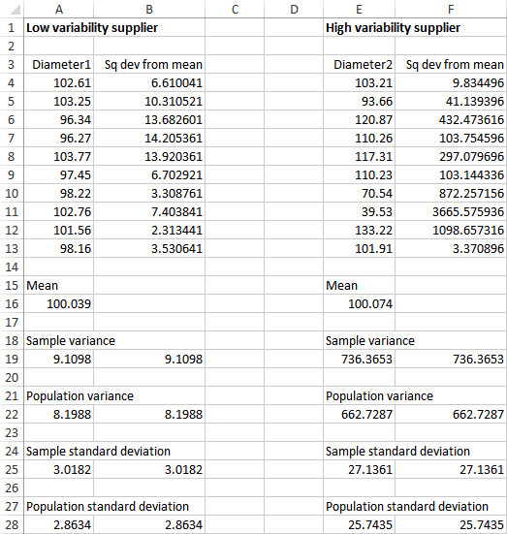
Notes:
This example shows why variability is important.
Both suppliers have an average diameter of 100 for the product, however the variance shown by supplier 2 is much larger.

Slide 7
Empirical Rules for Interpreting Standard Deviation
The interpretation of the standard deviation can be stated as three empirical rules.
If the values of a variable are approximately normally distributed (symmetric and bell-shaped), then the following rules hold:
Approximately 68% of the observations are within one standard deviation of the mean.
Approximately 95% of the observations are within two standard deviations of the mean.
Approximately 99.7% of the observations are within three standard deviations of the mean.
Notes:
Fortunately many variables in real world data are approximately normally distributed, so these rules apply.
If supplier 1’s diameters are normally distributed then the rules apply as follows:
68% of suppliers parts will have diameters from 97 to 103 (+- 3 for one standard dev)
95% of parts will be 94 to 106
99% will be 91 to 109
For supplier 2 it is much worse, with the std dev larger than 25 the variability is large.

Slide 8
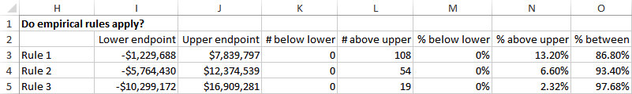
Empirical Rules for Baseball Salaries (slide 2 of 3)
The empirical rules should be applied with caution, especially when the data are clearly skewed, as illustrated by the calculations for baseball salaries below.
Notes:
Std dev of salaries was 4.535 million (the variance is shown but because it is in squared dollars it is huge and has no meaningful interpretation)
You can always try to apply the emipirical rules but if the salaries are not at least approximately normally distributed the rules won’t be very accurate. Because of the skewness in this data we can assume it is not normally distributed.
In this example the standard dev is larger than the mean!, thus all three lower end points are negative
The percentages given at the end show the difference from the rules of 68%, 95% and 99%

Slide 9
Measures of Shape (slide 1 of 2)
Skewness occurs when there is a lack of symmetry.
A variable can be skewed to the right (or positively skewed) because of some really large values (e.g., really large baseball salaries).
Or it can be skewed to the left (or negatively skewed) because of some really small values (e.g., temperature lows in Antarctica).
In Excel, a measure of skewness can be calculated with the SKEW function.
Notes:
Skewness occurs where there is a lack of symmetry. A few players have really large salaries and no players have really small salaries. The largest salaries are much further to the right of the mean than the smallest salaries are to the left of the mean. This is apparent when you draw a histogram.
These salaries are skewed to the right or positively skewed.
The value doesn’t make much difference, positive is skewed right, negative is skewed left and zero is no skew.

Slide 10
Measures of Shape (slide 2 of 2)
Kurtosis has to do with the “fatness” of the tails of the distribution relative to the tails of a normal distribution.
A distribution with high kurtosis has many more extreme observations.
In Excel, kurtosis can be calculated with the KURT function.

Slide 11
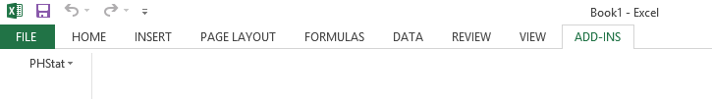
Excel Tools & Add-ins
Excel’s built in functions (average, stdev and others) were used to calculate a number of summary measures. You can generate the same results using an add-in. In the next lab there is a download for PhStat add-in.
Once downloaded and you run the PHStat.xlam file the it appears in the Add-ins tab in excel.

Slide 12
Charts for Numerical Variables
There are many graphical ways to indicate the distribution of a numerical variable.
For cross-sectional variables:
Histograms
Box plots
For time series variables:
Time series graphs

Slide 13
Histograms
A histogram is the most common type of chart for showing the distribution of a numerical variable.
It is based on binning the variable—that is, dividing it up into discrete categories.
It is a column chart of the counts in the various categories (with no gaps between the vertical bars).
A histogram is great for showing the shape of a distribution—whether the distribution is symmetric or skewed in one direction.
Notes:
We are particularly interested in whether the distribution is symmetric or is skewed in one direction.
Each of the summary measures discussed on numerical variables (mean etc) describe only one aspect of a numerical variable. In contrast a histogram provides the complete picture. It indicates the centre, the variability, the skewness all in one chart.

Slide 14
Baseball Salaries 2011.xlsx
Objective: To see the shape of the salary distribution through a histogram.
Solution: It is possible to create a histogram with Excel tools only—but it can be a tedious process.
The resulting table of counts is usually called a frequency table.
The counts are called frequencies.
It is easier to create a histogram with some add-ins but many of these are at a cost.

Slide 15
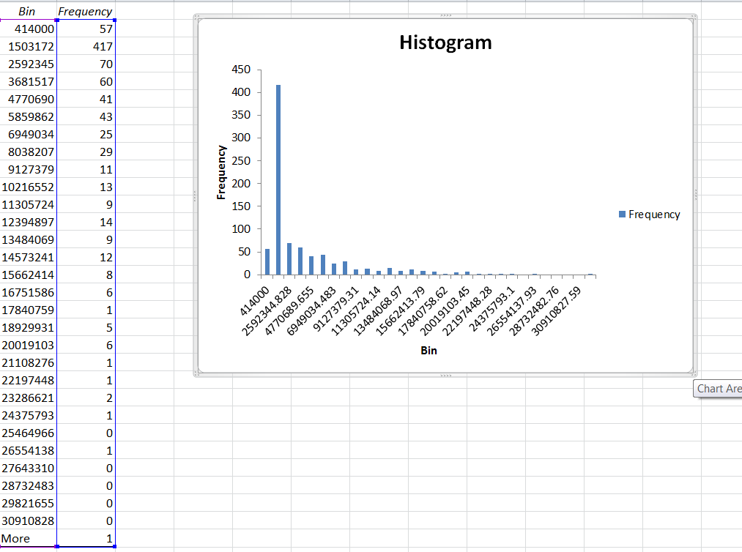
Baseball Salaries 2011.xlsx

Slide 16
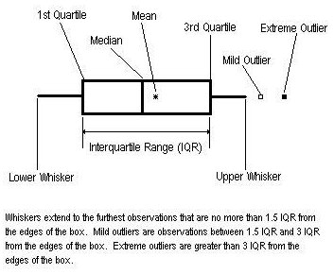
Box Plots
A box plot (or box-whisker plot) is an alternative type of chart for showing the distribution of a variable.
The elements of a generic box plot are shown below:
Notes:
A box plot is not as popular as the histogram but side by side box plots are useful for comparing distributions such as salaries for men versus salaries for women. They show you at a glance some of the key features of the distribution

Slide 17
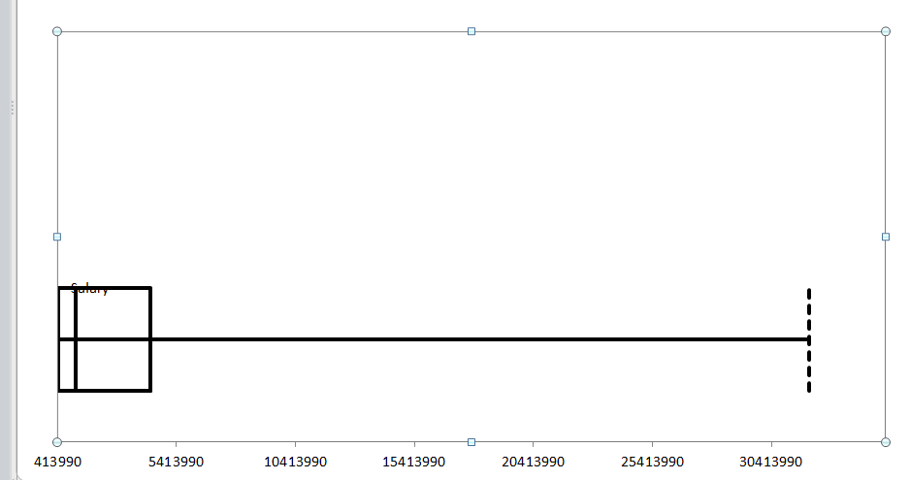
Baseball Salaries 2011.xlsx
Objective: To illustrate the features of a box plot, particularly how it indicates skewness.
Solution: In PhStat, select Box-Plot from the descriptive statistics dropdown list and fill in the dialog box.
Notes:
The box extends left to right from the 1st quartile to the 3rd quartile. The box contains the middle half of the data, the line in the box is the median, the line to the right is a whisker that extends to the outliers. It shows again that it is a right skewed distribution. Box plots and histograms are complemntary ways of displying the distribution of a numerical variable, histograms are more popular and intuitive.

Slide 18
Time Series Data
Our main interest in time series variables is how they change over time, and this information is lost in traditional summary measures and in histograms or box plots.
For time series data, a time series graph is used. This is a graph of the values of one or more time series, using time on the horizontal axis.
This is always the place to start a time series analysis.
Notes:
When we analyse time series data summary measures such as means and std dev and charts often don’t make much sense.
If you are interested in daily closing prices of a stock, if you create a histogram you will get counts for each bin range of closing value but you won’t know when they occurred, if you report the mean of stock prices over 40 years it really isn’t useful or relevant.

Slide 19
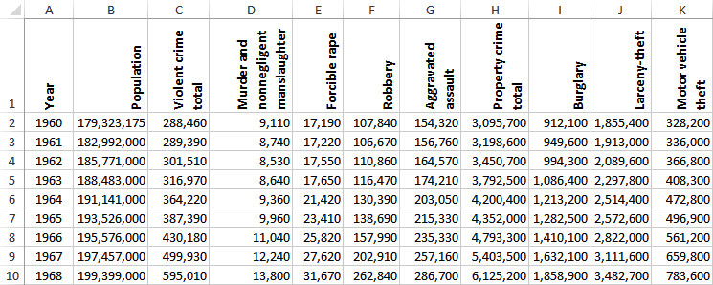
Crime in US.xlsx
Objective: To see how time series graphs help to detect trends in crime data.
Solution: Data set contains annual data on violent and property crimes for the years 1960 to 2010.
Notes:
Crime

Slide 20
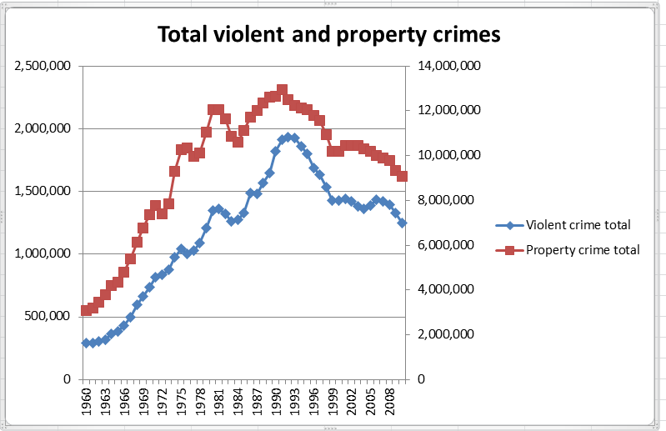
Crime in US.xlsx
Total Violent and
Property Crimes

Slide 21
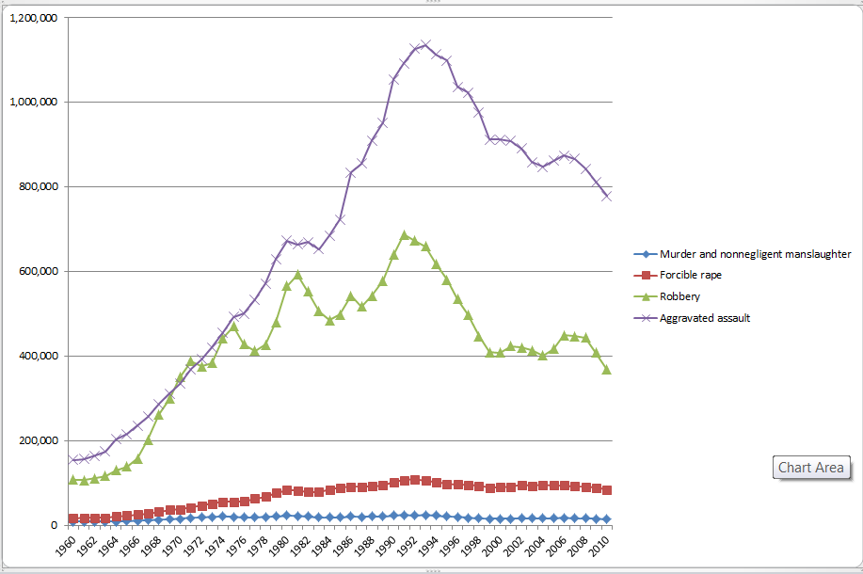
Crime in US.xlsx

Slide 22
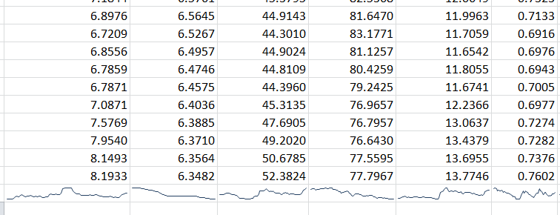
Sparkline graph
New to Excel 2010 is the mini-chart embedded in a cell. It is especially useful for time series data.
In the cell under a set of time series data include a sparkline

Slide 23
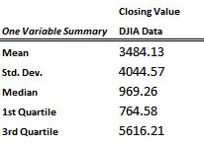
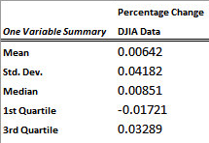
DJIA Monthly Close.xlsx
Objective: To find useful ways to summarize the monthly Dow data.
Solution: Data set contains monthly values of the Dow from 1950 through 2011.
Create summary measures and time series graphs for monthly values and percentage changes of the Dow.
Notes:
As mentioned, traditional summaries such as means, medians and std dev are not often very meaningful. It is useful to find differences or percentage changes in the data from period to period and then report traditional summaries of these.

Slide 24
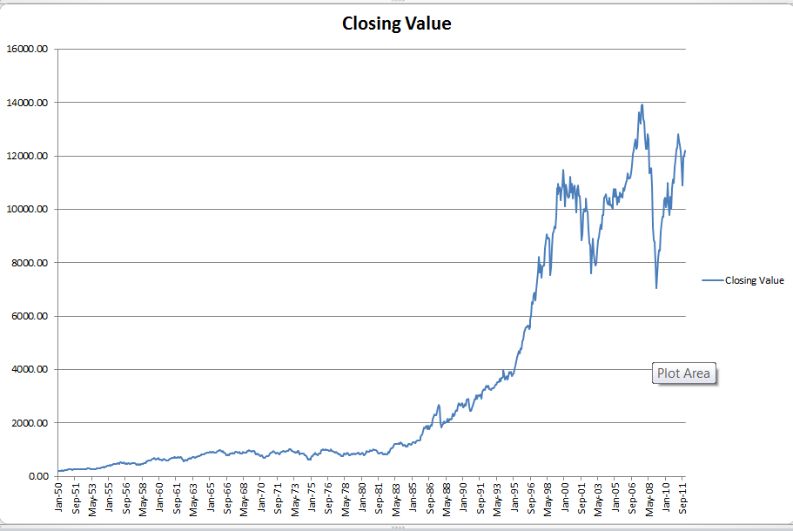
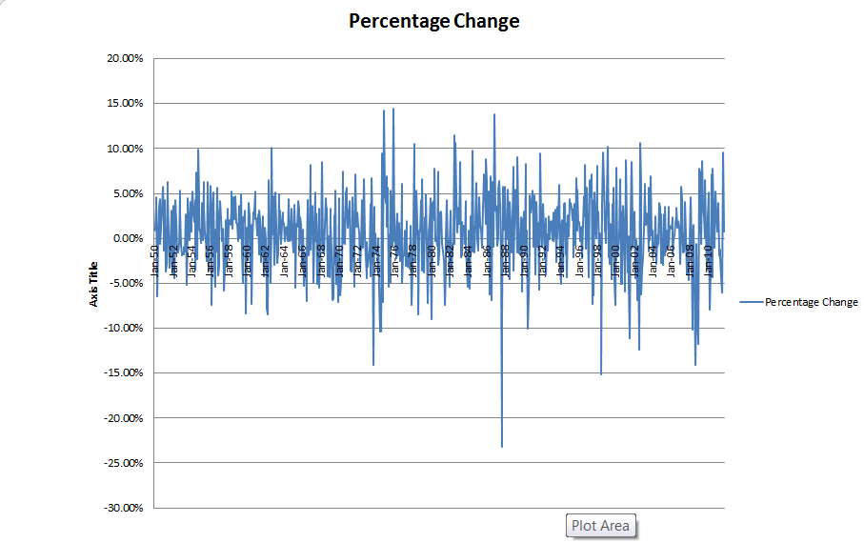
DJIA Monthly Close.xlsx
Notes:
The percentage changes in the DOW have been calculated

