Slide 1
Data Analytics
Dr. Brenda Mullally

Slide 2
Pivot Tables
The pivot table is an Excel tool that allows you to break data down by categories.
Sometimes pivot tables are used to display tables of counts, often called crosstabs or contingency tables.
However, crosstabs typically list only counts, whereas pivot tables can list counts, sums, averages, and other summary measures.
Notes:
One of Excel’s most powerful and easy to use tools, the pivot table. They allow you to see for example average sales by gender, by region of country, by time of day, or any combination of these.

Slide 3
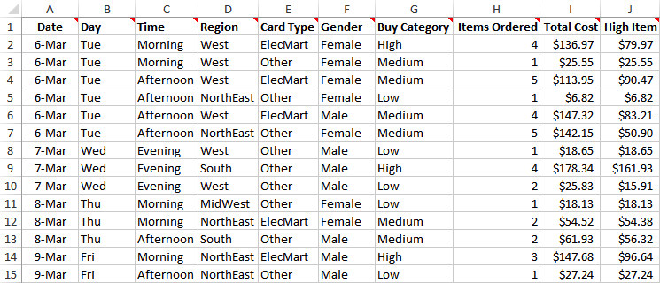
Elecmart Sales.xlsx
Objective: To use pivot tables to break down the customer order data by a number of categorical variables.
Solution: Data set contains data on 400 customer orders during several months for Elecmart company.
Create a pivot table by clicking the PivotTable button on the Insert ribbon.
Notes:
Categorical variables include day of week, time of day, region of country, type of credit card used, gender of customer, and buy category of customer, numerical variables include number of items ordered, total cost of order and price of highest item purchased.

Slide 4
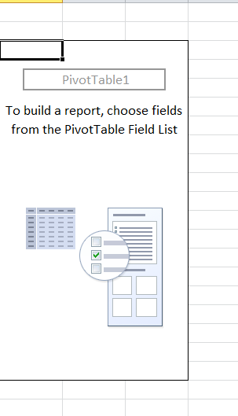
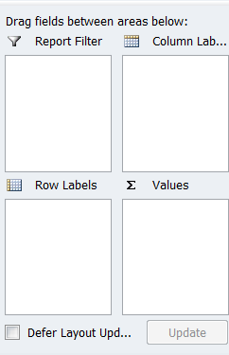
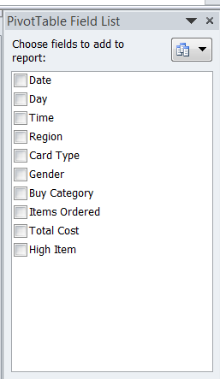
Pivot tables
Notes:
Pivot tables have four areas, filters, rows, columns and values.
A row has categores down the left hand side, a columns field has categories go across the top, a filter lets you filter the whole pivot table by its categories, a values field contains the data you want to summarise.
If you use the checkboxes for fields by default excel will apply the following rules:
When you check a text or date variable it is added to the rows area.
When you check a numeric variable it is added to the values area and summarised using the sum function.

Slide 5
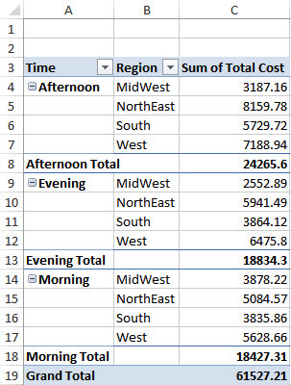
Elecmart Sales.xlsx

Slide 6
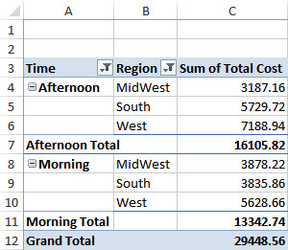
Hiding Categories (Filtering)
You can filter out any items in a pivot table that you don’t want to see.
Click the Row Labels dropdown arrow of the active field and check the items you want to filter on.
A pivot table with hidden categories is shown below.

Slide 7
Sorting on Values or Categories
It is easy to sort in a pivot table, either by the numbers in the Values area or by the labels in a Rows or Columns field.
To sort by the numbers in the Values area, right-click any number and select Sort.
To sort on the labels of a Rows or Columns field, right-click any of the categories and select Sort.
You can also click the dropdown arrow for the field and get the dialog box that allows both sorting and filtering.

Slide 8
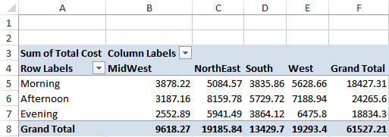
Changing Locations of Fields (Pivoting)
You can choose where to place variables in a pivot table.
For example, to place the Region variable in the Columns area, drag the Region button from the Rows area of the PivotTable Fields pane to the Columns area.

Slide 9
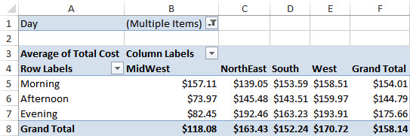
Changing Field Settings
You can change various settings in the Field Settings dialog box.
To get to this dialog box:
Click the Field Setting button on the Analyze/Options ribbon.
OR right-click any of the pivot table cells and select the Field Settings item.
The pivot table with Value Field Settings changed to Average is shown below.

Slide 10
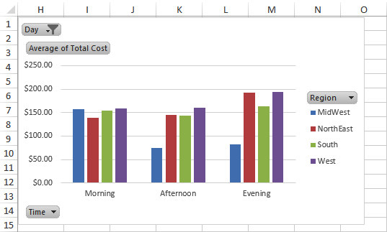
Pivot Charts
It is easy to accompany pivot tables with pivot charts.
These charts adapt automatically to the underlying pivot table.
To create a pivot chart, click anywhere inside the pivot table, select the PivotChart button on the Analyze/Options ribbon, and select a chart type.

Slide 11
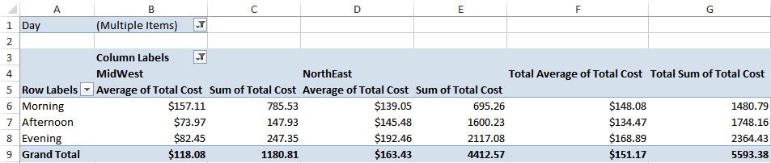
Multiple Variables in the Values Area
More than a single variable can be placed in the Values area.
Also, a given variable in the Values area can be summarized by more than one summarizing function.

Slide 12
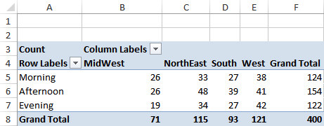
Summarizing by Count
The variable in the Values area can be summarized by the Count function.
This is useful when you want to know, for example, how many of the orders were placed by females in the South.
Right-click any number in the pivot table, select Value Field Settings, and select the Count function.
Notes:
This type of pivot table is a crosstab, when you change the values to counts it doesn’t matter what was in the values section (in this case it was total sales), you will need to rename the label appropriately. You may want to display them as percentages, for example as percentage of total, as percentages of row totals and as percentages of column totals. Right click and choose show values as.. You can show both by dragging in any variable into the values section and summarising it by count.

Slide 13
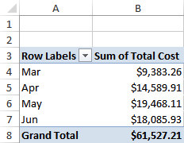
Grouping
Categories in a Rows or Columns variable can be grouped.
Suppose you want to summarize Sum of Total Cost by Date.
Starting with a blank pivot table, check both Date and Total Cost in the PivotTable Fields pane.
Then right-click any date and select Group.
Notes:
Grouping is useful when a rows or columns variable has many distinct values eg dates in a year grouped into months

Slide 14
Other Pivot Table Features
Showing/hiding subtotals and grand totals (check the Layout options on the Design ribbon)
Dealing with blank rows, that is, categories with no data (right-click any number, choose PivotTable Options, and check the options on the Layout & Format tab)
Displaying the data behind a given number in a pivot table (double-click any number in the Values area to get a new worksheet)
Formatting a pivot table with various styles (check the style options on the Design ribbon)
Moving or renaming pivot tables (check the PivotTable and Action groups on the Analyze/Options ribbon)
Refreshing pivot tables as the underlying data changes (check the Refresh dropdown list on the Analyze/Options ribbon)
Creating pivot table formulas for calculated fields or calculated items (check the Formulas dropdown list on the Analyze/Options ribbon)
Notes:
The key to pivot tables is to experiment, there are entire books written about pivot tables, you can learn a lot more by experimenting with the elecmart data, you can’t mess it up you can always start over.

Slide 15
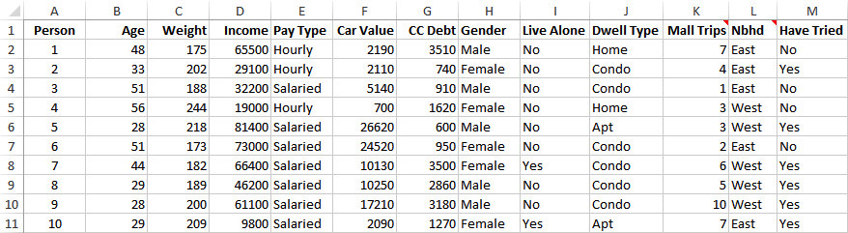
Lasagna Triers.xlsx
Objective: To use pivot tables to explore which demographic variables help to distinguish lasagna triers from nontriers.
Solution: Data set contains data on over 800 potential customers being tracked by a frozen lasagna company.
Set up a pivot table that shows counts of triers and nontriers for different categories of the variables.
Notes:
Market research on a frozen lasagne product
Does gender make a difference? What distinguishes triers from non triers?

Slide 16
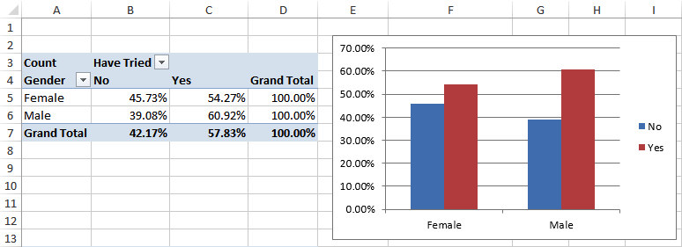
Lasagna Triers.xlsx
Pivot Table and Pivot Chart for Examining the Effect of Gender
Notes:
Row is gender
Column is have tried
Values is any variable as long as it is a count, set up as % of row
Then add a chart

Slide 17
Slicers and Timelines
In Excel 2010, Microsoft added slicers—lists of the distinct values of any variable, which you can then filter on.
You add a slicer from the Analyze/Options ribbon under PivotTable Tools.
In Excel 2013, a Timeline feature was added. A Timeline is like a slicer, but it is specifically for filtering on a date variable.

Slide 18
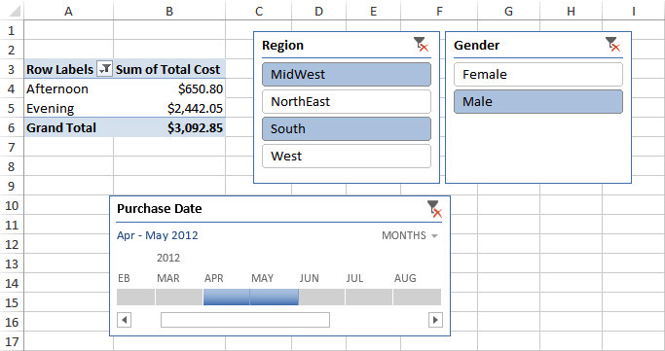
Pivot Table with Slicers and a Timeline

