Slide 1


Mobile Application Development
Higher Diploma in Science in Computer Science
Produced
by
Eamonn de Leastar (edeleastar@wit.ie)
Department of Computing, Maths & Physics
Waterford Institute of Technology
http://www.wit.ie
http://elearning.wit.ie

Slide 2
Project Briefing Session

Slide 3
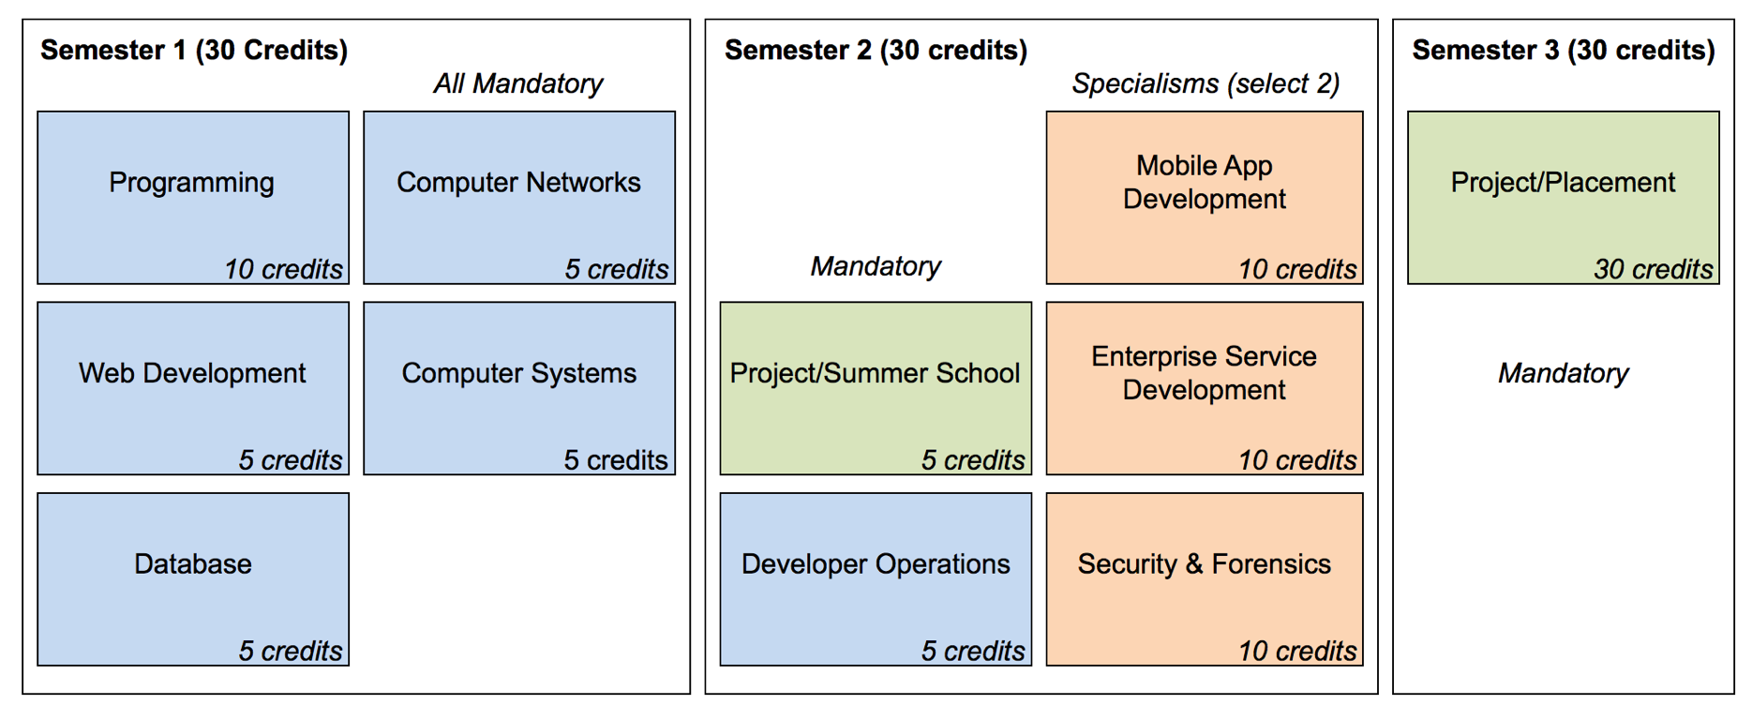
Structure of the Programme
Level 8 Higher Diploma in Science in Computer Science
3

Slide 4
Semester 3
“Internships or work placements are seen as crucial to providing graduates with the context and confidence in their new knowledge. ...academic and industry partners will cooperate in the provision of appropriate academic supervision resources for the duration of this work placement activity...”
Project Lifecycle:
Academic Project supervisor appointed in Semester 2
Develop a project proposal draft late in Semester 2 / early Semester 3, potentially in consultation placement opportunity
Ongoing contact with supervisor during Semester 3
Project assessed a conclusion
4

Slide 5
Project: Overall Goal
There is a long tradition of Final Year Projects in Computing programmes
They offer an opportunity to the student to apply their growing knowledge to diverse an interesting problems.
Employers often find the project a useful jumping off point during first contact with students
The project can be considered as part of a professional portfolio, within which the student can showcase key skills, abilities and achievements (for computing students - bitbucket/github is a particularly effective portfolio host).
5

Slide 6
Project Elements
Model
Documentation
Implementation
Originality / Innovation / Complexity
6

Slide 7
Model
Light-weight, relevant model of a problem/solution, generally in accordance with a recognised process.
For a software project this is most commonly expressed in a subset of UML.
For other types of project a different formalism may be more appropriate.
May be entirely informal - based on simple and clearly communicated conventions
7

Slide 8
Documentation
Project-related communication including:
keeping appropriate logs,
writing well-constructed formal reports,
maintaining sketches of ideas in diagrammatic/written form
8

Slide 9
Implementation
Based on the modelling and the content of the reports.
The implementation may a working prototype or software component
The implementation may be a comprehensive report / analysis or a technology enabled business process innovation
9

Slide 10
Originality / Innovation / Complexity
Use the project as an opportunity to explore a new process/technology
Use the project to get better acquainted with the business of your placement opportunity
Use the project to firm up an aspect of your core knowledge
Use the project to build a compelling prototype
Use the project to contribute to a community service
10

Slide 11
Structure of the Project
Inception Phase:
including formation of the project concept, initial meeting with supervisor, draft and final proposals + (optionally) interaction with work place mentor.
Development Phase:
Realisation of the project as proposed or amended in agreement with your supervisor.
Dissemination Phase:
Preparation of final report. Presentation of project demonstration/presentation. Delivery of final documentation.
11

Slide 12
Project Proposals
Representative examples:
An entire application (mobile app, web app or both)
A component of an application (database, or other software component)
A software tool, library or framework
An analysis/profile of a system or component (for instance from a security perspective)
A project may be a detailed state of the art for a given field.
A document or enhanced Business Process or Technology enabled process improvement
12

Slide 13
Three Reports Required
Proposal
This will articulate the project concept and nature and will serve to scope the work of realising the project. It may typically be less than 2 pages
Interim Report
This will be a substantial update on the progress of the project – and can be regarded as an early draft of the final report. It may be 10-15 pages, depending on the project type
Final Report
This is the final report – and may include a short number of slides for presentation/demonstration purposes. Final reports would typically be less than 40 pages.
13

Slide 14
Supervision
Each student will be appointed an academic supervisor to provide guidance and advice for the duration of the project.
Meetings will be by mutual agreement - and may be weekly initially. Typically this contact may amount to a total to 12 1/2 hour meetings or 6 1 hour meetings.
The student will be expect to show progress, with the emphasis on risk-reduction from week to week as issues associated with (a) project requirements gathering, (b) technologies and (c) skills building are addressed.
Each meeting must be logged perhaps simply by a brief exchange of emails between student and supervisor after the meeting outlining what was agreed and what is to be done for the next meeting.
The supervisors role is centred on providing advice and guidance on project scope, structure, and progress, not necessarily technical support.
Feel free to reach out to any member of the ICT Skills Tuition team for technical advice and support.
14

Slide 15
Milestones
Milestone 1: Initial Meeting with Supervisor (week of 7th December 2015)
Milestone 2: Draft Proposal: January 15th January 2015
Milestone 3: Final Proposal: 29th January 2016
Milestone 4: Interim Report: Friday 11th March 2016
Milestone 5: Submission of Final Project: 13th May 2016
Milestone 6: Presentation of Final Project: Friday 20th May 2016
15

Slide 16
Student Fair
In addition, Ian Downey who is coordinator for the B.Sc. Hons Computing Projects, will collect abstracts and photographs for the Project Book published at the end of the year.
This book is made available to future employers and others at the Student Fair at which you have the opportunity to show your projects.
16

Slide 17

Except where otherwise noted, this content is licensed under a Creative Commons Attribution-NonCommercial 3.0 License.
For more information, please see http://creativecommons.org/licenses/by-nc/3.0/
17

