Slide 1


Mobile Application Development
Produced
by
Eamonn de Leastar (edeleastar@wit.ie)
Department of Computing, Maths & Physics
Waterford Institute of Technology
http://www.wit.ie
http://elearning.wit.ie

Slide 2
Android <-> Play (3) - Android

Slide 3
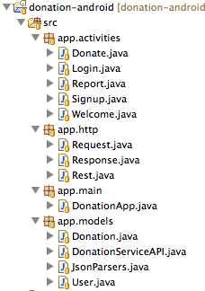
donation-android Project v4
activities
display and hander all UI
main
retain application wide data structures (users + donations)
models
Gateway object for accessing donation-service application
Local copies of core information models for the application (download from donation-play)
Parsers (transformers) for converting objects into format suitable for upload/download to/from donation-service
http
General purpose classes to support asynchronous http request/response to/from donation-service

Slide 4
Android AsyncTask Class
AsyncTask allows you to perform asynchronous work on your user interface.
It performs the blocking operations in a worker thread and then publishes the results on the UI thread.
You subclass AsyncTask and implement the doInBackground() callback method, which runs in a pool of background threads.
To update your UI, you implement onPostExecute(), which delivers the result from doInBackground() and runs in the UI thread, so you can safely update your UI.

Slide 5
HTTP
http
General purpose classes to support asynchronous http request/response to/from donation-service
These requests are performed in a separate thread of execution

Slide 6
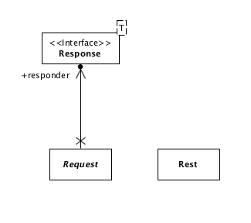

Slide 7
Rest
This server is your development machine
Issue HTTP requests to a server
GET
DELETE
PUT
POST
(http verbs)
public class Rest
{
private static final String URL = "http://10.0.2.2:9000";
public static String get(String path) throws Exception
{
//...
}
public static String delete(String path)
{
//...
}
public static String put(String path, String json)
{
//...
}
public static String post(String path, String json)
{
//...
}
}

Slide 8
Rest
Rest class can only send/receive strings (no Model objects like User or Donation)
Assumes all strings are Json encoded
Will very likely throw ‘exceptions’ if server error, network problem or other related issue
No need to edit/maintain this class as it adheres to HTTP protocol conventions
Is independent of donation application, and can be used in other apps as is
public class Rest
{
private static final String URL = "http://10.0.2.2:9000";
public static String get(String path) throws Exception
{
//...
}
public static String delete(String path) throws Exception
{
//...
}
public static String put(String path, String json) throws Exception
{
//...
}
public static String post(String path, String json) throws Exception
{
//...
}
}

Slide 9
Response
An Interface that must be implemented by the Activity that initiated the request.
Is ‘paramaterised’ by T, which will typically be some model object we are requesting/updating
e.g. User, Donation
However, interface is application independent, and can be used in other applications not related to Donation app.
public interface Response<T>
{
public void setReponse(List<T> aList);
public void setReponse(T anObject);
public void errorOccurred (Exception e);
}

Slide 10
Callbacks
When a request is made by an activity, then the activity will be ‘called back’ when a result becomes available.
One of these three methods will be called:
A single object of type T is returned from the service
A list of T objects is returned
An error has occurred
The callback will occur on the UI Thread, so the activity can update its components safely
public interface Response<T>
{
public void setReponse(List<T> aList);
public void setReponse(T anObject);
public void errorOccurred (Exception e);
}

Slide 11
Request
Put up a dialog saying ‘Processing…’
Launch a background thread/task
Report when finished to callback
Reusable class, can be used in apps unrelated to donation.
public abstract class Request extends AsyncTask<Object, Void, Object>
{
//...
public Request(Context context, Response responder, String message)
{
//...
}
@Override
protected void onPreExecute()
{
//...
}
@Override
protected Object doInBackground(Object... params)
{
//...
}
protected abstract Object doRequest(Object... params) throws Exception;
@Override
protected void onPostExecute(Object result)
{
//...
}
}

Slide 12
Request
public abstract class Request extends AsyncTask<Object, Void, Object>
{
//...
public Request(Context context, Response responder, String message)
{
//...
}
@Override
protected void onPreExecute()
{
//...
}
@Override
protected Object doInBackground(Object... params)
{
//...
}
protected abstract Object doRequest(Object... params) throws Exception;
@Override
protected void onPostExecute(Object result)
{
//...
}
}
An ‘Abstract’ class, so ‘abstract’ method ‘doRequest’ must be provided to do the actual background process
For donation-android app, this will be a call to http.Rest methods to get/set data in android-service

Slide 13
donation-android Project v4
models
Gateway object for accessing donation-service application
Local copies of core information models for the application (download from donation-play)
Parsers (transformers) for converting objects into format suitable for upload/download to/from donation-service

Slide 14
User & Donation
//...
public class User
{
public String firstName;
public String lastName;
public String email;
public String password;
public User(String firstName, String lastName,
String email, String password)
{
this.firstName = firstName;
this.lastName = lastName;
this.email = email;
this.password = password;
}
}
public class Donation
{
public int amount;
public String method;
public Donation (int amount, String method)
{
this.amount = amount;
this.method = method;
}
public String toString()
{
return amount + ", " + method;
}
}
No change from earlier versions

Slide 15
JsonParsers
public class JsonParsers
{
static Gson gson = new Gson();
public static User json2User(String json)
{
return gson.fromJson(json, User.class);
}
public static List<User> json2Users(String json)
{
Type collectionType = new TypeToken<List<User>>() {}.getType();
return gson.fromJson(json, collectionType);
}
public static String user2Json(Object obj)
{
return gson.toJson(obj);
}
public static Donation json2Donation(String json)
{
return gson.fromJson(json, Donation.class);
}
public static String donation2Json(Object obj)
{
return gson.toJson(obj);
}
public static List<Donation> json2Donations(String json)
{
Type collectionType = new TypeToken<List<Donation>>() {}.getType();
return gson.fromJson(json, collectionType);
}
}
Same class as in donation-play!
Convert Model object to/from Json format

Slide 16
DonationServiceAPI
Enable Activities to ‘invoke’ services on donation-service app.
Specifically:
GetUsers
GetDonations
CreateUser
CreateDonation
Each of these requests is ‘spun-out’ into separate thread
public class DonationServiceAPI
{
public static void getUsers(Context context,
Response<User> response,
String dialogMesssage)
{
new GetUsers(context, response, dialogMesssage).execute();
}
public static void createUser(Context context,
Response<User> response,
String dialogMesssage)
{
new CreateUser(context, response, dialogMesssage).execute(user);
}
public static void getDonations(Context context,
Response<User> response,
String dialogMesssage)
{
new GetDonations(context, response, dialogMesssage).execute();
}
public static void createDonation(Context context,
Response<User> response,
String dialogMesssage)
{
new CreateDonation(context, response, dialogMesssage).execute(donation);
}
}

Slide 17
GetUsers and CreateUser Requests
The doRequest() methods will run in a background thread
… and will use the Rest class to communicate with the server
class GetUsers extends Request
{
public GetUsers(Context context, Response<User> callback, String message)
{
super(context, callback, message);
}
@Override
protected List<User> doRequest(Object... params) throws Exception
{
String response = Rest.get("/api/users");
List<User> userList = JsonParsers.json2Users(response);
return userList;
}
}
class CreateUser extends Request
{
public CreateUser(Context context, Response<User> callback, String message)
{
super(context, callback, message);
}
@Override
protected User doRequest(Object... params) throws Exception
{
String response = Rest.post ("/api/users", JsonParsers.user2Json(params[0]));
return JsonParsers.json2User(response);
}
}

Slide 18
GetDonations and CreateDonation Requests
class GetDonations extends Request
{
public GetDonations(Context context, Response<Donation> callback, String message)
{
super(context, callback, message);
}
@Override
protected List<Donation> doRequest(Object... params) throws Exception
{
String response = Rest.get("/api/donations");
List<Donation> donationList = JsonParsers.json2Donations(response);
return donationList;
}
}
class CreateDonation extends Request
{
public CreateDonation(Context context, Response<Donation> callback, String message)
{
super(context, callback, message);
}
@Override
protected Donation doRequest(Object... params) throws Exception
{
String response = Rest.post ("/api/donations", JsonParsers.donation2Json(params[0]));
return JsonParsers.json2Donation(response);
}
}

Slide 19
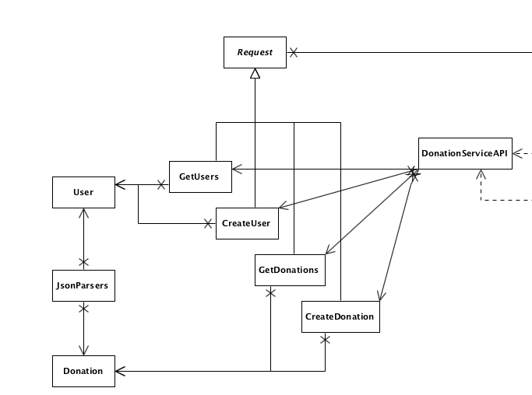

Slide 20
Activities
If an Activity needs to make a request of the donation-service, it must do two things:
Initiate a request by calling one of the methods in DonationServiceAPI
Implement the Response interface, though which the response (or error) will be delivered.
public class DonationServiceAPI
{
public static void getUsers(..)
//..
public static void createUser(..)
//..
public static void getDonations(..)
//..
public static void createDonation(..)
}
public interface Response<T>
{
public void setReponse(List<T> aList);
public void setReponse(T anObject);
public void errorOccurred (Exception e);
}

Slide 21
Login
When the Login activity starts we can:
Request the list of users from the donation-service
… and when those requests arrive, we store them in the application object
Then, when Login button pressed, we authenticate agains this list as usual.

Slide 22
Login Activity
public class Login extends Activity implements Response<User>
{
@Override
protected void onCreate(Bundle savedInstanceState)
{
super.onCreate(savedInstanceState);
setContentView(R.layout.activity_login);
DonationServiceAPI.getUsers(this, this, "Retrieving list of users");
}
public void signinPressed (View view)
{
DonationApp app = (DonationApp) getApplication();
TextView email = (TextView) findViewById(R.id.loginEmail);
TextView password = (TextView) findViewById(R.id.loginPassword);
if (app.validUser(email.getText().toString(), password.getText().toString()))
{
startActivity (new Intent(this, Donate.class));
}
else
{
Toast toast = Toast.makeText(this, "Invalid Credentials", Toast.LENGTH_SHORT);
toast.show();
}
}
@Override
public void setReponse(List<User> aList)
{
DonationApp app = (DonationApp) getApplication();
app.users = aList;
}
@Override
public void errorOccurred(Exception e)
{
Toast toast = Toast.makeText(this, "Donation Service Unavailable. Try again later",
Toast.LENGTH_LONG);
toast.show();
startActivity (new Intent(this, Welcome.class));
}
@Override
public void setReponse(User anObject)
{}
}
(no features hidden)

Slide 23
Login Activity
public class Login extends Activity implements Response<User>
{
@Override
protected void onCreate(Bundle savedInstanceState)
{
super.onCreate(savedInstanceState);
setContentView(R.layout.activity_login);
DonationServiceAPI.getUsers(this, this, "Retrieving list of users");
}
public void signinPressed (View view)
{
DonationApp app = (DonationApp) getApplication();
TextView email = (TextView) findViewById(R.id.loginEmail);
TextView password = (TextView) findViewById(R.id.loginPassword);
if (app.validUser(email.getText().toString(), password.getText().toString()))
{
startActivity (new Intent(this, Donate.class));
}
else
{
Toast toast = Toast.makeText(this, "Invalid Credentials", Toast.LENGTH_SHORT);
toast.show();
}
}
//…`
}

Slide 24
Login Activity
public class Login extends Activity implements Response<User>
{
//..
@Override
public void setReponse(List<User> aList)
{
DonationApp app = (DonationApp) getApplication();
app.users = aList;
}
@Override
public void errorOccurred(Exception e)
{
Toast toast = Toast.makeText(this, "Donation Service Unavailable. Try again later",
Toast.LENGTH_LONG);
toast.show();
startActivity (new Intent(this, Welcome.class));
}
@Override
public void setReponse(User anObject)
{}
}

Slide 25
Report Activity
public class Report extends Activity implements Response <Donation>
{
private ListView listView;
private DonationApp app;
private DonationAdapter adapter;
@Override
public boolean onCreateOptionsMenu(Menu menu)
//.. no change
@Override
public boolean onOptionsItemSelected(MenuItem item)
//.. no change
@Override
public void onCreate(Bundle savedInstanceState)
{
super.onCreate(savedInstanceState);
setContentView(R.layout.activity_report);
app = (DonationApp) getApplication();
listView = (ListView) findViewById(R.id.reportList);
adapter = new DonationAdapter (this, app.donations);
listView.setAdapter(adapter);
DonationServiceAPI.getDonations(this, this, "Downloading Donations List..");
}
@Override
public void setReponse(List<Donation> aList)
{
app.donations = aList;
adapter.donations = aList;
adapter.notifyDataSetChanged();
}
@Override
public void setReponse(Donation anObject)
{
}
@Override
public void errorOccurred(Exception e)
{
Toast toast = Toast.makeText(this, "Donation Service Unavailable!", Toast.LENGTH_LONG);
toast.show();
startActivity (new Intent(this, Welcome.class));
}
}

Slide 26
Report Activity
public class Report extends Activity implements Response <Donation>
{
private ListView listView;
private DonationApp app;
private DonationAdapter adapter;
@Override
public void onCreate(Bundle savedInstanceState)
{
super.onCreate(savedInstanceState);
setContentView(R.layout.activity_report);
app = (DonationApp) getApplication();
listView = (ListView) findViewById(R.id.reportList);
adapter = new DonationAdapter (this, app.donations);
listView.setAdapter(adapter);
DonationServiceAPI.getDonations(this, this, "Downloading Donations List..");
}
}

Slide 27
Report Activity
public class Report extends Activity implements Response <Donation>
{
private ListView listView;
private DonationApp app;
private DonationAdapter adapter;
@Override
public void setReponse(List<Donation> aList)
{
app.donations = aList;
adapter.donations = aList;
adapter.notifyDataSetChanged();
}
@Override
public void setReponse(Donation anObject)
{
}
@Override
public void errorOccurred(Exception e)
{
Toast toast = Toast.makeText(this, "Donation Service Unavailable!", Toast.LENGTH_LONG);
toast.show();
startActivity (new Intent(this, Welcome.class));
}
}

Slide 28
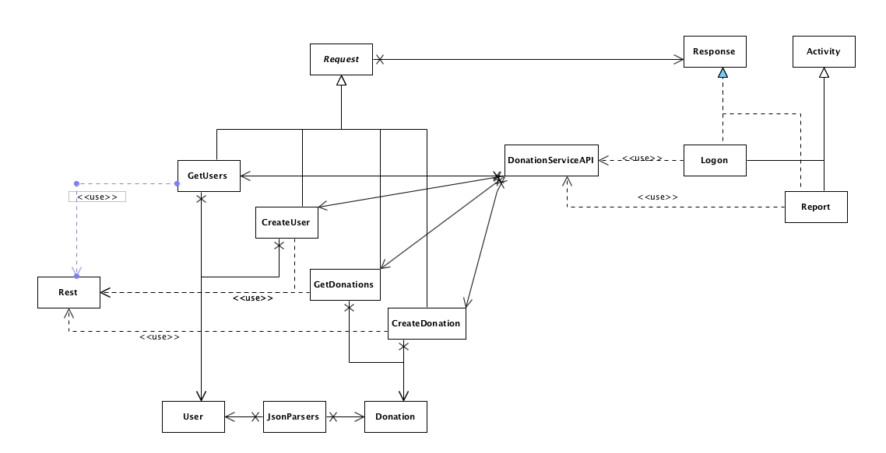

Slide 29

Except where otherwise noted, this content is licensed under a Creative Commons Attribution-NonCommercial 3.0 License.
For more information, please see http://creativecommons.org/licenses/by-nc/3.0/
Some of this material is adapted from
http://www.vogella.com/articles/JavaConcurrency/article.html
An excellent source for well structured tutorials and explanations of all thing related ot Java, Eclipse and Android development

