Slide 1

Pacemaker Solution (Assignment 1)
Dr. Siobhán Drohan (sdrohan@wit.ie)
Eamonn de Leastar (edeleastar@wit.ie)
Produced
by:
Department of Computing and Mathematics
http://www.wit.ie/

Slide 2
https://www.eclipse.org/papyrus/ In eclipse, help, install new software: http://download.eclipse.org/modeling/mdt/papyrus/updates/releases/oxygen

Slide 3

Initialising a new maven project in Eclipse

Slide 4
C:\Users\Siobhan\Desktop\agile workspace\pacemaker-console-solution>dir
19/10/2017 14:45 <DIR> .
19/10/2017 14:45 <DIR> ..
19/10/2017 14:33 1,122 pom.xml
19/10/2017 14:45 <DIR> src
1 File(s) 1,122 bytes
3 Dir(s) 60,339,650,560 bytes free
<project xmlns="http://maven.apache.org/POM/4.0.0" xmlns:xsi="http://www.w3.org/2001/XMLSchema-instance"
xsi:schemaLocation="http://maven.apache.org/POM/4.0.0 http://maven.apache.org/xsd/maven-4.0.0.xsd">
<modelVersion>4.0.0</modelVersion>
<groupId>pacemaker</groupId>
<artifactId>pacemaker-console-solution</artifactId>
<version>1.0-SNAPSHOT</version>
<packaging>jar</packaging>
<name>pacemaker-console-solution</name>
<url>https://wit-computing-msc-2017.github.io/agile</url>
<properties>
<project.build.sourceEncoding>UTF-8</project.build.sourceEncoding>
<maven.compiler.source>1.8</maven.compiler.source>
<maven.compiler.target>1.8</maven.compiler.target>
</properties>
<build>
<plugins>
<plugin>
<groupId>org.apache.maven.plugins</groupId>
<version>3.7.0</version>
<artifactId>maven-compiler-plugin</artifactId>
<configuration>
<source>1.8</source>
<target>1.8</target>
</configuration>
</plugin>
</plugins>
</build>
<dependencies>
</dependencies>
</project>
Create an empty folder in your workspace and add this pom.xml to it.

Slide 5
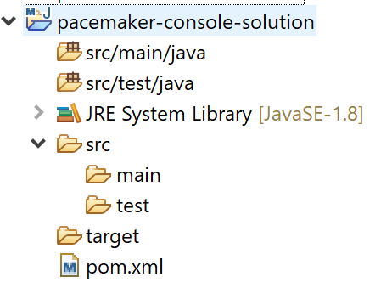
Once your pom.xml validates, open Eclipse and perform: Import… → Existing Maven Projects
C:\Users\Siobhan\Desktop\agile workspace\pacemaker-console-solution>mvn validate
[INFO] Scanning for projects...
[INFO]
[INFO] ------------------------------------------------------------------------
[INFO] Building pacemaker-console-solution 1.0-SNAPSHOT
[INFO] ------------------------------------------------------------------------
[INFO] ------------------------------------------------------------------------
[INFO] BUILD SUCCESS
[INFO] ------------------------------------------------------------------------
[INFO] Total time: 0.158 s
[INFO] Finished at: 2017-10-19T14:46:58+01:00
[INFO] Final Memory: 5M/123M
[INFO] ------------------------------------------------------------------------
C:\Users\Siobhan\Desktop\agile workspace\pacemaker-console-solution>

Slide 6
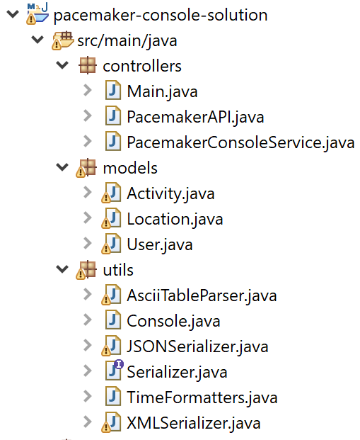
User and Location Models

Slide 7
public User(String firstName, String lastName, String email, String password) {
this.id = UUID.randomUUID().toString();
this.firstName = firstName;
this.lastName = lastName;
this.email = email;
this.password = password;
}
@Override
public boolean equals(final Object obj) {
if (obj instanceof User) {
final User other = (User) obj;
return Objects.equal(firstName, other.firstName)
&& Objects.equal(lastName, other.lastName)
&& Objects.equal(email, other.email)
&& Objects.equal(password, other.password)
&& Objects.equal(activities, other.activities);
} else {
return false;
}
}
@Override
public String toString() {
return toStringHelper(this).addValue(id)
.addValue(firstName)
.addValue(lastName)
.addValue(password)
.addValue(email)
.addValue(activities)
.toString();
}
@Override
public int hashCode() {
return Objects.hashCode(this.id, this.lastName, this.firstName,
this.email, this.password, this.activities);
}
}
package models;
import static com.google.common.base.MoreObjects.toStringHelper;
import java.io.Serializable;
import java.util.HashMap;
import java.util.Map;
import java.util.UUID;
import com.google.common.base.Objects;
public class User implements Serializable {
public String id;
public String firstName;
public String lastName;
public String email;
public String password;
public Map<String, Activity> activities = new HashMap<>();
public User() {
}
public String getId() {
return id;
}
public String getFirstname() {
return firstName;
}
public String getLastname() {
return lastName;
}
public String getEmail() {
return email;
}
Guava is not on the build path, so com.google.common.* isn’t recognised.

Slide 8
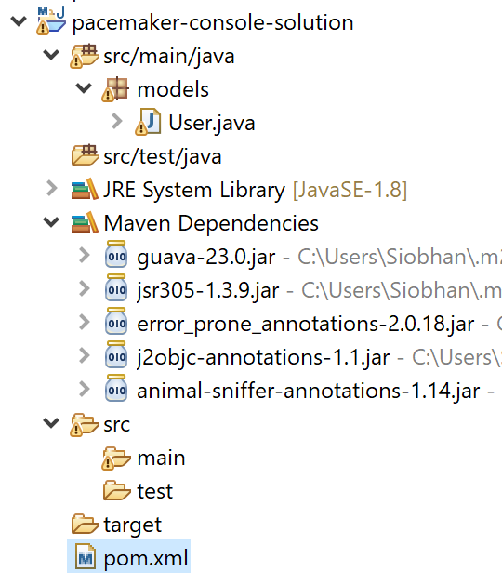
<dependency> <groupId>com.google.guava</groupId> <artifactId>guava</artifactId> <version>23.0</version> </dependency>
Add the above dependency to the pom.xml.
Eclipse Oxygen triggers a maven build and adds Guava as a dependency → errors resolved.

Slide 9
public class User implements Serializable {
//fields omitted – no change to them
public Map<String, Activity> activities = new HashMap<>();
//accessors & constructor omitted – no change to them
@Override
public boolean equals(final Object obj) {
if (obj instanceof User) {
final User other = (User) obj;
return Objects.equal(firstName, other.firstName)
&& Objects.equal(lastName, other.lastName)
&& Objects.equal(email, other.email)
&& Objects.equal(password, other.password)
&& Objects.equal(activities, other.activities);
} else {
return false;
}
}
@Override
public String toString() {
return toStringHelper(this).addValue(id)
.addValue(firstName)
.addValue(lastName)
.addValue(password)
.addValue(email)
.addValue(activities)
.toString();
}
@Override
public int hashCode() {
return Objects.hashCode(this.id, this.lastName, this.firstName,
this.email, this.password, this.activities);
}
}
Notice that we refactored User to contain a HashMap of activities.
Relationship:
A User has zero to many Activity objects!

Slide 10
package models;
import static com.google.common.base.MoreObjects.toStringHelper;
import java.io.Serializable;
import java.util.UUID;
import com.google.common.base.Objects;
public class Location implements Serializable {
public String id;
public double longitude;
public double latitude;
public Location() {
}
public Location(double latitude, double longitude) {
this.id = UUID.randomUUID().toString();
this.latitude = latitude;
this.longitude = longitude;
}
@Override
public boolean equals(final Object obj) {
if (obj instanceof Location) {
final Location other = (Location) obj;
return Objects.equal(latitude, other.latitude)
&& Objects.equal(longitude, other.longitude);
} else {
return false;
}
}
@Override
public String toString() {
return toStringHelper(this).addValue(id)
.addValue(latitude)
.addValue(longitude)
.toString();
}
@Override
public int hashCode() {
return Objects.hashCode(this.id, this.latitude,
this.longitude);
}
}

Slide 11
Activity Model & TimeFormatters

Slide 12
package utils;
import org.joda.time.format.PeriodFormatterBuilder;
import org.joda.time.format.DateTimeFormat;
import org.joda.time.format.DateTimeFormatter;
import org.joda.time.format.PeriodFormatter;
import org.joda.time.DateTime;
import org.joda.time.Duration;
public class TimeFormatters {
static PeriodFormatter periodFormatter = new PeriodFormatterBuilder().printZeroAlways()
.appendHours()
.appendSeparator(":")
.appendMinutes()
.appendSeparator(":")
.appendSeconds()
.toFormatter();
static DateTimeFormatter dateFormatter = DateTimeFormat.forPattern("dd:MM:yyyy HH:mm:ss");
public static DateTime parseDateTime(String dateTime) {
return new DateTime(dateFormatter.parseDateTime(dateTime));
}
public static String parseDateTime(DateTime dateTime) {
return dateFormatter.print(dateTime);
}
public static Duration parseDuration(String duration) {
return periodFormatter.parsePeriod(duration).toStandardDuration();
}
public static String parseDuration(Duration duration) {
return periodFormatter.print(duration.toPeriod());
}
}
TimeFormatter
Joda-Time is not on the build path, so org.joda.* isn’t recognised.

Slide 13
package models;
//imports omitted
import org.joda.time.DateTime;
import org.joda.time.Duration;
import static utils.TimeFormatters.parseDateTime;
import static utils.TimeFormatters.parseDuration;
public class Activity implements Serializable {
//code omitted
public DateTime starttime;
public Duration duration;
//code omitted
}
Include the Joda-Time dependency in the pom.xml
Refactor existing Activity to include date/time handling using our new utility.

Slide 14
@Override
public String toString() {
return toStringHelper(this).addValue(id)
.addValue(type)
.addValue(location)
.addValue(distance)
.addValue(parseDateTime(starttime))
.addValue(parseDuration(duration))
.addValue(route)
.toString();
}
public Activity(String type, String location, double distance,
String start, String duration) {
this.id = UUID.randomUUID().toString();
this.type = type;
this.location = location;
this.distance = distance;
this.starttime = parseDateTime(start);
this.duration = parseDuration(duration);
}
Refactor Activity to include date/time handling using our new utility.

Slide 15
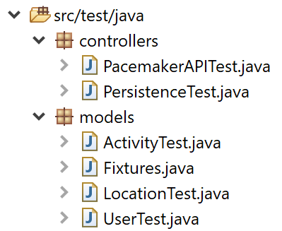
Models Testing

Slide 16
package models;
import java.util.ArrayList;
import java.util.Arrays;
import java.util.List;
public class Fixtures {
public static List<User> users = new ArrayList<>(Arrays.asList(
new User("marge", "simpson", "marge@simpson.com", "secret"),
new User("lisa", "simpson", "lisa@simpson.com", "secret"),
new User("bart", "simpson", "bart@simpson.com", "secret"),
new User("maggie", "simpson", "maggie@simpson.com", "secret")));
}
package models;
import static org.junit.Assert.*;
import java.util.HashSet;
import java.util.Set;
import org.junit.Test;
import static models.Fixtures.users;
public class UserTest {
User homer = new User("homer", "simpson", "homer@simpson.com", "secret");
@Test
public void testCreate() {
assertEquals("homer", homer.firstName);
assertEquals("simpson", homer.lastName);
assertEquals("homer@simpson.com", homer.email);
assertEquals("secret", homer.password);
}
@Test
public void testIds() {
Set<String> ids = new HashSet<>();
for (User user : users) {
ids.add(user.id);
}
assertEquals(users.size(), ids.size());
}
@Test
public void testToString() {
assertEquals("User{" + homer.id + ", homer, simpson, secret, homer@simpson.com}",
homer.toString());
}
}
JUnit is not on the build path, so org.junit.* isn’t recognised.
Include JUnit in the pom.

Slide 17
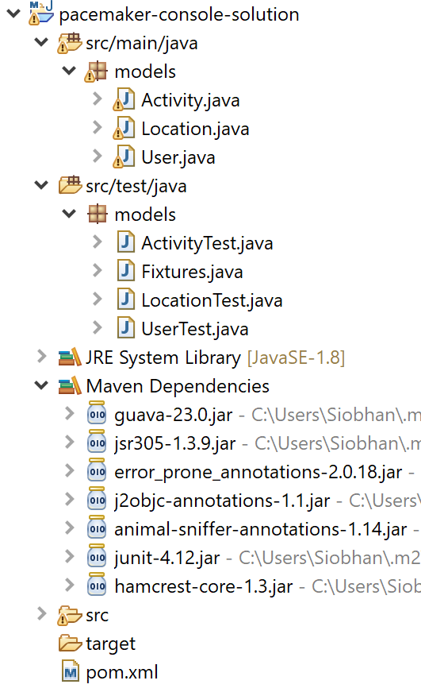
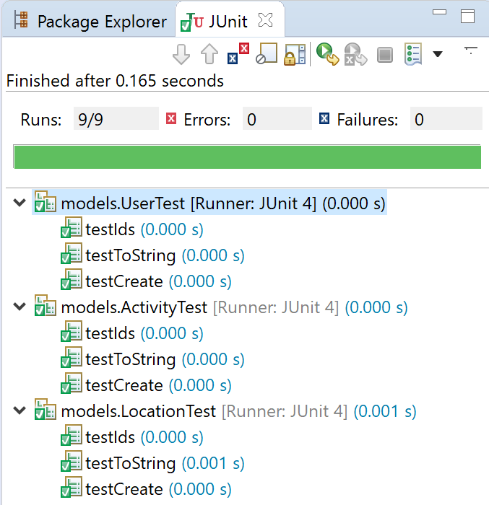
Activity and Location Models, with associated tests.

Slide 19
public class UserTest {
User homer = new User("homer", "simpson", "homer@simpson.com", "secret");
@Test
public void testCreate() {
assertEquals("homer", homer.firstName);
assertEquals("simpson", homer.lastName);
assertEquals("homer@simpson.com", homer.email);
assertEquals("secret", homer.password);
}
@Test
public void testIds() {
Set<String> ids = new HashSet<>();
for (User user : users) {
ids.add(user.id);
}
assertEquals(users.size(), ids.size());
}
@Test
public void testToString() {
assertEquals("User{" + homer.id + ", homer, simpson, secret, homer@simpson.com, {}}",
homer.toString());
}
@Test
public void tesAddActivity() {
Activity activity = new Activity("walk", "fridge", 0.001, "11:2:2012 9:00:00", "20:00:00");
homer.activities.put(activity.id,activity);
System.out.println(homer);
assertEquals("User{" + homer.id + ", homer, simpson, secret, homer@simpson.com, {"
+ activity.id + "=Activity{" + activity.id + ", walk, fridge, 0.001, []}}}",
homer.toString());
}
}
Refactoring UserTest to cater for activities.

Slide 20
Utilities

Slide 21
code coverage (7a)

Slide 22
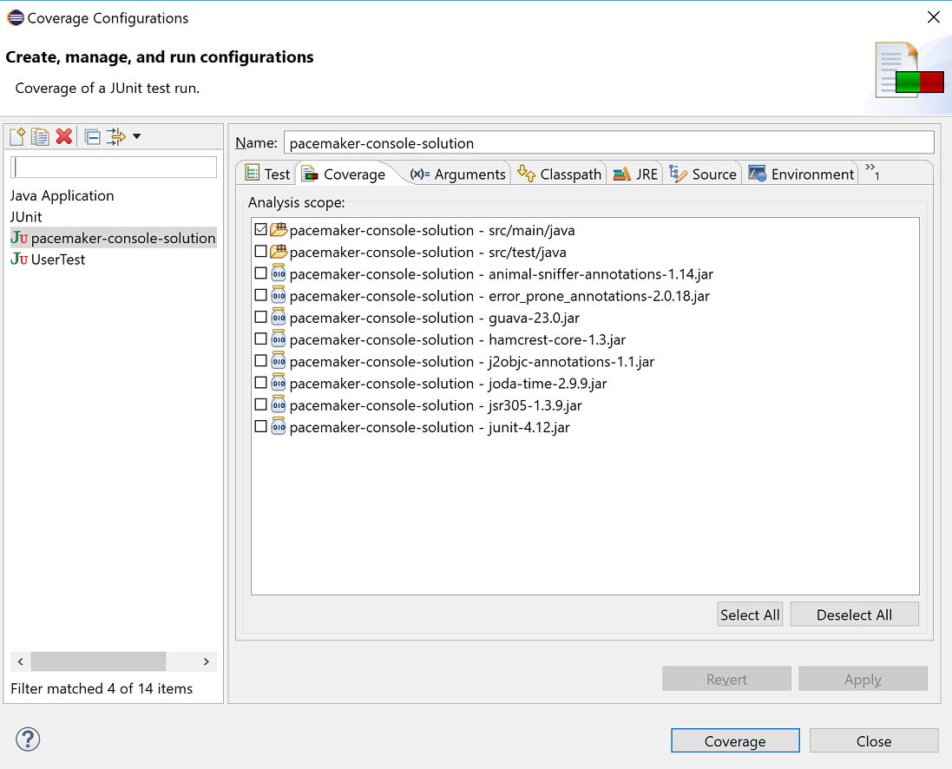
Run → Coverage...

Slide 23
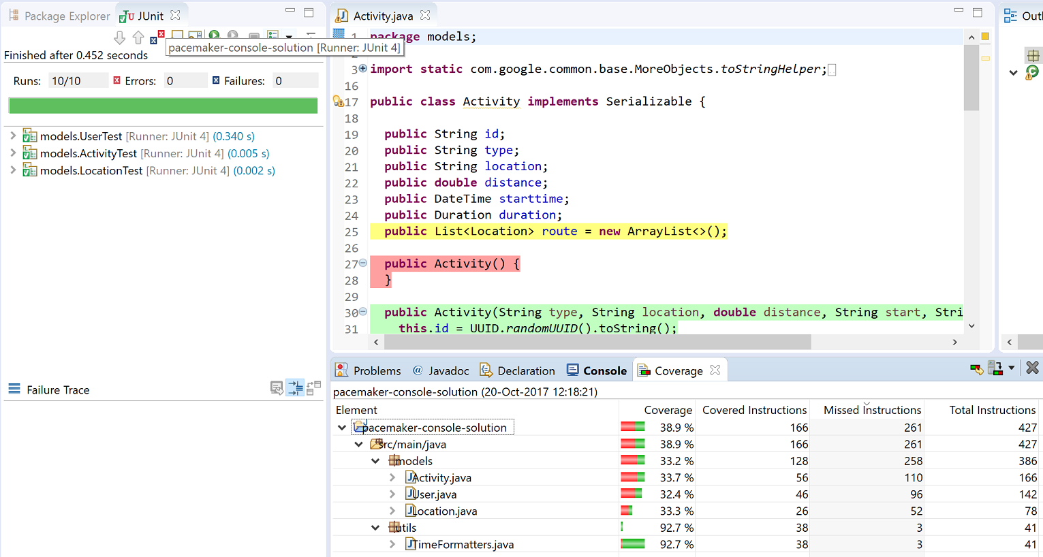

Slide 24
Generating a Coverage Report
Manually: File, Export..., Run/Debug, Coverage Session.
Via Maven to the target directory: using the plugin below and running the mvn jacoco:report command.
<plugin>
<groupId>org.jacoco</groupId>
<artifactId>jacoco-maven-plugin</artifactId>
<version>0.7.9</version>
<executions>
<execution>
<id>default-prepare-agent</id>
<goals>
<goal>prepare-agent</goal>
</goals>
</execution>
<execution>
<id>default-report</id>
<phase>prepare-package</phase>
<goals>
<goal>report</goal>
</goals>
</execution>
</executions>
</plugin>

Slide 25
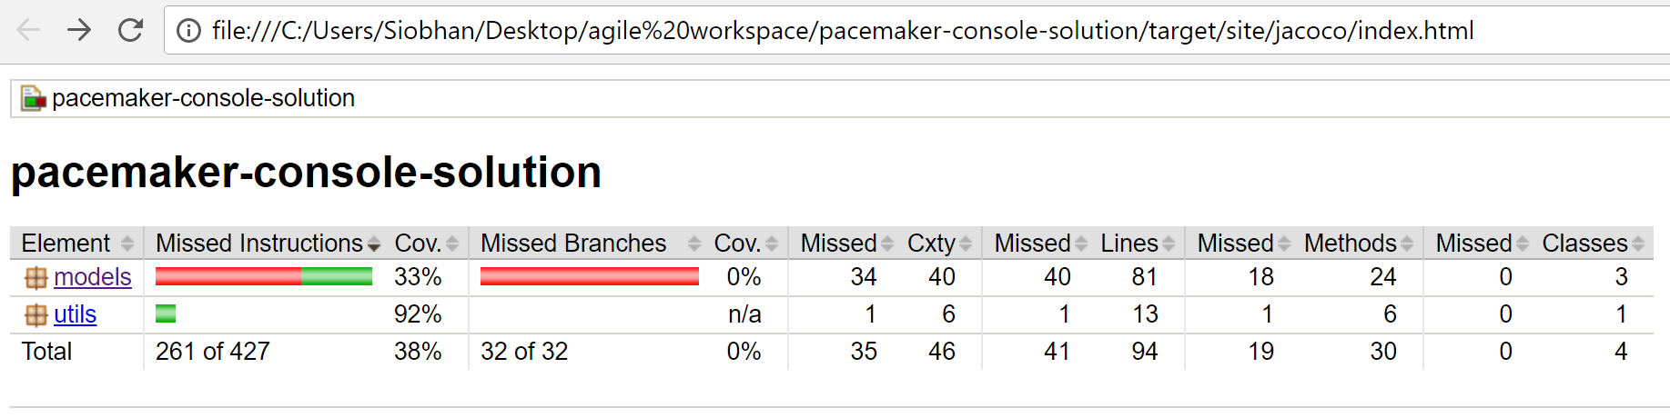
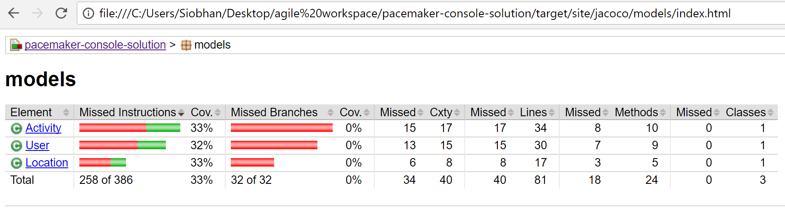

Slide 26
PacemakerAPI, partial implementation (7b)

Slide 27
public class PacemakerAPI {
private Map<String, User> emailIndex = new HashMap<>();
private Map<String, User> userIndex = new HashMap<>();
private Map<String, Activity> activitiesIndex = new HashMap<>();
public PacemakerAPI() {}
public Collection<User> getUsers() {
return userIndex.values();
}
public void deleteUsers() {
userIndex.clear();
emailIndex.clear();
}
public User createUser(String firstName, String lastName, String email, String password) {
User user = new User(firstName, lastName, email, password);
emailIndex.put(email, user);
userIndex.put(user.id, user);
return user;
}
public Activity createActivity(String id, String type, String location, double distance,
String starttime, String duration) {
Activity activity = null;
Optional<User> user = Optional.fromNullable(userIndex.get(id));
if (user.isPresent()) {
activity = new Activity(type, location, distance, starttime, duration);
user.get().activities.put(activity.id, activity);
activitiesIndex.put(activity.id, activity);
}
return activity;
}
public void addLocation(String id, double latitude, double longitude) {
Optional<Activity> activity = Optional.fromNullable(activitiesIndex.get(id));
if (activity.isPresent()) {
activity.get().route.add(new Location(latitude, longitude));
}
}
public List<Activity> listActivities(String userId, String sortBy) {
return null;
}
public Activity getActivity(String id) {
return activitiesIndex.get(id);
}
PacemakerAPI.java
public Collection<Activity> getActivities(String id) {
Collection<Activity> activities = null;
Optional<User> user = Optional.fromNullable(userIndex.get(id));
if (user.isPresent()) {
activities = user.get().activities.values();
}
return activities;
}
public User getUserByEmail(String email) {
return emailIndex.get(email);
}
public User getUser(String id) {
return userIndex.get(id);
}
public User deleteUser(String id) {
User user = userIndex.remove(id);
return emailIndex.remove(user.email);
}
}

Slide 28
@Test
public void testEquals() {
User homer = new User("homer", "simpson", "homer@simpson.com", "secret");
User homer2 = new User("homer", "simpson", "homer@simpson.com", "secret");
User bart = new User("bart", "simpson", "bartr@simpson.com", "secret");
assertEquals(homer, homer);
assertEquals(homer, homer2);
assertNotEquals(homer, bart);
assertSame(homer, homer);
assertNotSame(homer, homer2);
}
PacemakerAPITest.java
(sample of tests)
@Test
public void testDeleteUsers() {
assertEquals(users.size(), pacemaker.getUsers().size());
User marge = pacemaker.getUserByEmail("marge@simpson.com");
pacemaker.deleteUser(marge.id);
assertEquals(users.size() - 1, pacemaker.getUsers().size());
}
@Test
public void testAddActivityWithMultipleLocation() {
User marge = pacemaker.getUserByEmail("marge@simpson.com");
Activity testActivity = margeActivities.get(0);
String activityId = pacemaker
.createActivity(marge.id, testActivity.type, testActivity.location, testActivity.distance,
parseDateTime(testActivity.starttime), parseDuration(testActivity.duration)).id;
locations.forEach(
location -> pacemaker.addLocation(activityId, location.latitude, location.longitude));
Activity activity = pacemaker.getActivity(activityId);
assertEquals(locations.size(), activity.route.size());
int i = 0;
for (Location location : activity.route) {
assertEquals(location, locations.get(i));
i++;
}
}

Slide 29
Serialization (7b)

Slide 30
Briefly do XMLSerializer and JSON serializer (from solution) and the testing approach.

Slide 31
Lambdas…sorting….

Slide 32
pacemakerAPI – focus on the listActivities method and the lambdas / comparators…

Slide 33
public List<Activity> listActivities(String userId, String sortBy) {
List<Activity> activities = new ArrayList<>();
activities.addAll(userIndex.get(userId).activities.values());
switch (sortBy) {
case "type":
activities.sort((a1, a2) -> a1.type.compareTo(a2.type));
break;
case "location":
activities.sort((a1, a2) -> a1.location.compareTo(a2.location));
break;
case "distance":
activities.sort((a1, a2) -> Double.compare(a1.distance, a2.distance));
break;
case "date":
activities
.sort((a1, a2) -> DateTimeComparator.getInstance().compare(a1.starttime, a2.starttime));
break;
case "duration":
activities
.sort((a1, a2) -> {
if (a1.duration.getStandardSeconds() > a2.duration.getStandardSeconds()) {
return 1;
} else {
return -1;
}
});
break;
}
return activities;
}
PacemakerAPI.java

Slide 34
PacemakerAPITest.java
@Test
public void testSortedReports() {
User homer = pacemaker.createUser("homer", "simpson", "homer@simpson.com", "secret");
activities.forEach(
activity -> pacemaker
.createActivity(homer.id, activity.type, activity.location, activity.distance,
parseDateTime(activity.starttime), parseDuration(activity.duration))
);
List<Activity> activities = pacemaker.listActivities(homer.id, "type");
for (int i = 0; i < activities.size() - 1; i++) {
assertTrue(activities.get(i).type.compareTo(activities.get(i + 1).type) <= 0);
}
activities = pacemaker.listActivities(homer.id, "location");
for (int i = 0; i < activities.size() - 1; i++) {
assertTrue(activities.get(i).location.compareTo(activities.get(i + 1).location) <= 0);
}
activities = pacemaker.listActivities(homer.id, "distance");
for (int i = 0; i < activities.size() - 1; i++) {
assertTrue(activities.get(i).distance <= activities.get(i + 1).distance);
}
activities = pacemaker.listActivities(homer.id, "date");
for (int i = 0; i < activities.size() - 1; i++) {
assertTrue( DateTimeComparator.getInstance().compare(activities.get(i).starttime, activities.get(i+1).starttime) <= 0);
}
activities = pacemaker.listActivities(homer.id, "duration");
for (int i = 0; i < activities.size() - 1; i++) {
assertTrue( activities.get(i).duration.getStandardSeconds() < activities.get(i+1).duration.getStandardSeconds());
}
}

Slide 35
UX (7b)

Slide 36
Console, parser, pacemaker console service

