Slide 1

Writing JUnit Tests
Dr. Siobhán Drohan (sdrohan@wit.ie)
Eamonn de Leastar (edeleastar@wit.ie)
Produced
by:
Department of Computing and Mathematics
http://www.wit.ie/

Slide 2
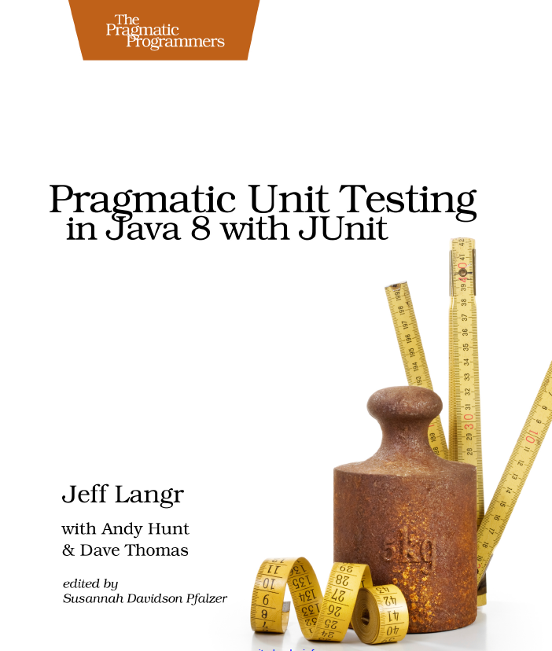
Anatomy of a Unit Test
Four Phase Test i.e. Setup, Exercise, Verify, Teardown.
In-Line Setup and Teardown.
Arrange, Act, Assert.
Structuring Tests.
JUnit4 Assertions.
Source Code: https://pragprog.com/titles/utj2/source_code

Slide 3
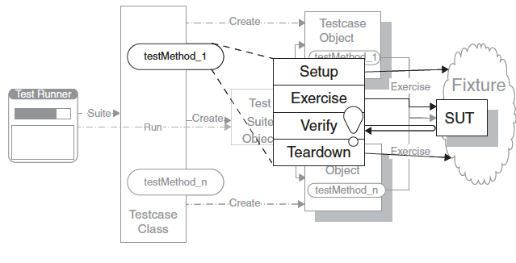
Four Phase Test
How do we structure our test logic to make what we are testing obvious?
We structure each test with four distinct parts executed in sequence.
SUT = System Under Test

Slide 4
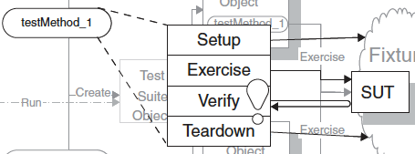
How it works
SETUP: In the first phase, we set up the test fixture (the “before” picture) that is required for the SUT to exhibit the expected behavior as well as anything you need to put in place to be able to observe the actual outcome.
EXERCISE: In the second phase, we interact with the SUT.
VERIFY: In the third phase, we do whatever is necessary to determine whether the expected outcome has been obtained.
TEARDOWN: In the fourth phase, we tear down the test fixture to put the world back into the state in which we found it.

Slide 5
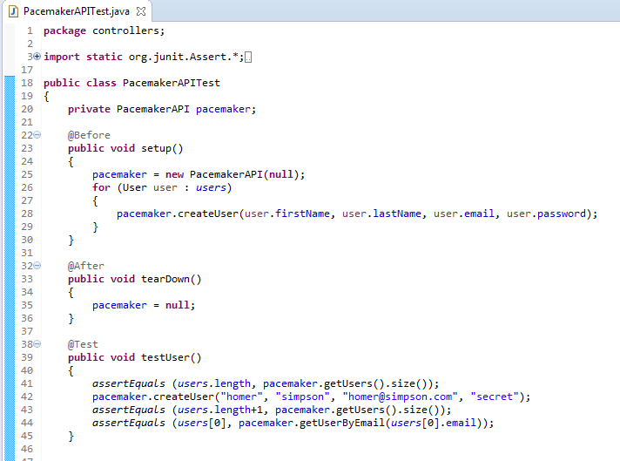
Four Phase Test: Example
Phase 1 (setup)
Phase 4 (teardown)
Phase 2 (exercise) Phase 3 (verify)

Slide 6
Anatomy of a Unit Test
Four Phase Test i.e. Setup, Exercise, Verify, Teardown.
In-Line Setup and Teardown.
Arrange, Act, Assert.
Structuring Tests.
JUnit4 Assertions.
Source Code: https://pragprog.com/titles/utj2/source_code

Slide 7
In-line Setup and Teardown
@Test
public void testXMLSerializer() throws Exception
{
String datastoreFile = "testdatastore.xml";
deleteFile (datastoreFile);
Serializer serializer = new XMLSerializer(new File (datastoreFile));
pacemaker = new PacemakerAPI(serializer);
populate(pacemaker);
pacemaker.store();
PacemakerAPI pacemaker2 = new PacemakerAPI(serializer);
pacemaker2.load();
assertEquals (pacemaker.getUsers().size(), pacemaker2.getUsers().size());
for (User user : pacemaker.getUsers())
{
Collection<User> users = pacemaker2.getUsers();
System.out.println("User to search for:");
System.out.println(user);
System.out.println("Collection");
System.out.println(users);
assertTrue (users.contains(user));
}
deleteFile (datastoreFile);
}
Phase 1 (setup)
Phase 2(exercise)
Phase 3 (verify)
Phase 4 (teardown)

Slide 8
Anatomy of a Unit Test
Four Phase Test i.e. Setup, Exercise, Verify, Teardown.
In-Line Setup and Teardown.
Arrange, Act, Assert.
Structuring Tests.
JUnit4 Assertions.
Source Code: https://pragprog.com/titles/utj2/source_code

Slide 9
Arrange, Act, Assert (AAA)
AAA is an alternative, or a complement to the Four-phases pattern:
Arrange, Act, Assert (AAA) is a pattern of arranging the code within the method, something similar to In-Line Setup and Teardown.
Source: http://www.agile-code.com/blog/the-anatomy-of-a-unit-test/

Slide 10
Arrange, Act, Assert
Arrange | To do anything in a test, we first need to arrange things with code that sets up the state in a test e.g. creating objects, interacting with them, calling other APIs etc. In some rare cases, we won’t arrange anything, because the system is already in the state we need.
Act | After we arrange the test, we act on—execute—the code we’re trying to verify. Usually this is a call to a single method.
Assert | Finally, we assert that we get the expected result. Verify that the exercised code behaved as expected. This can involve inspecting the return value of the exercised code or the new state of any objects involved. It can also involve verifying that interactions between the tested code and other objects took place.
After | You might need a fourth step…if running the test results in any resources being allocated, ensure that they get cleaned up.

Slide 11
First, a note on the iloveyouboss project
Job-search website.
Attempts to match prospective employees with potential employers, and vice versa, much as a dating site would.
Employers and employees both create profiles by answering a series of multiple-choice or yes-no questions.
The site scores profiles based on criteria from the other party and shows the best potential matches from the perspective of both employee and employer.
A sample question could be “Are you willing to relocate?”.

Slide 12
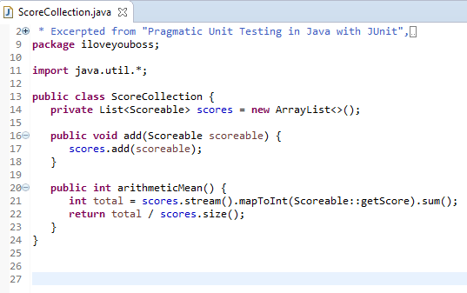
Arrange, Act, Assert: Basic Example (iloveyouboss)
A ScoreCollection class accepts a Scoreable instance through its add() method.
A Scoreable object is simply one that can return an int score value.
arithmeticMean() returns the average for a collection of scoreable objects i.e. things that answer with a score.
Nice tutorial on Streams: http://winterbe.com/posts/2014/07/31/java8-stream-tutorial-examples/

Slide 13
Arrange, Act, Assert: Basic Example
—a test case—
To test a ScoreCollection object, we can add
the numbers 5 and 7 to it and expect that the arithmeticMean() method will return 6.
(5 + 7) / 2 = 6

Slide 14
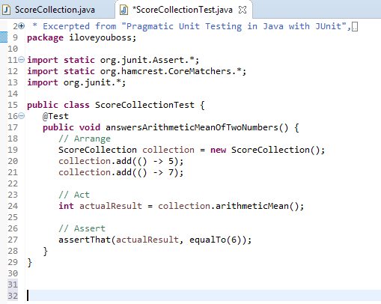
Arrange, Act, Assert: Basic Example
—a test case—
To test a ScoreCollection object, we can add
the numbers 5 and 7 to it and expect that the arithmeticMean() method will return 6.
i.e. (5 + 7) / 2 = 6
We will return to this example in a later lecture

Slide 15
Using AAA to complement Four Phase Test
public class SomeTestClass
{
@Before
public void SetUp()
{
//Initialisation of our test
}
@Test
public void Test()
{
//Arrange
// Act
// Assert
}
@After
public void Teardown()
{
//Lets get back to the original state
}
}
Source: http://www.agile-code.com/blog/the-anatomy-of-a-unit-test/

Slide 16
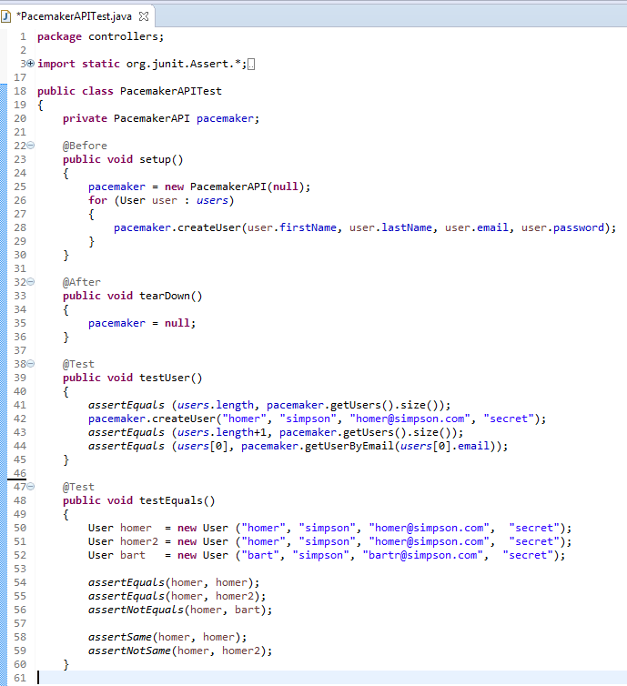
Using AAA to complement Four Phase Test
Phase 1 (setup) / Arrange
Phase 4 (teardown) / After
Act
Assert

Slide 17
Anatomy of a Unit Test
Four Phase Test i.e. Setup, Exercise, Verify, Teardown.
In-Line Setup and Teardown.
Arrange, Act, Assert.
Structuring Tests.
JUnit4 Assertions.
Source Code: https://pragprog.com/titles/utj2/source_code

Slide 18
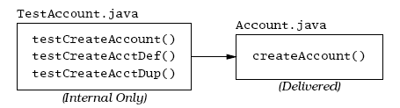
Structuring Tests
Adopt Naming conventions
A method named create-Account to be tested, then test method might be named testCreateAccount.
The method testCreateAccount will call createAccount with the necessary parameters and verify that createAccount works as advertised.
Can have many test methods that exercise createAccount.

Slide 19
Structuring Tests
Adopt Naming conventions
A method named create-Account to be tested, then test method might be named testCreateAccount.
The method testCreateAccount will call createAccount with the necessary parameters and verify that createAccount works as advertised.
Can have many test methods that exercise createAccount.
Distinguish between Testing vs Production Code (separate directories in the same project).
The test code is for our internal use only - Customers or end-users will never see it or use it.

Slide 20
Naming Individual Tests (1)
Aim for more granular tests i.e. focused on a distinct behaviour
→ test names can be more meaningful.
Instead of suggesting what context you’re going to test
→ suggest what happens as a result of invoking some behaviour against a certain context.

Slide 21
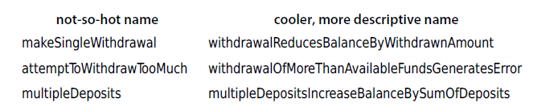
Naming Individual Tests (1)
Aim for more granular tests i.e. focused on a distinct behaviour
→ test names can be more meaningful.
Instead of suggesting what context you’re going to test
→ suggest what happens as a result of invoking some behaviour against a certain context.
Reasonable test names can consist of up to seven or so words.

Slide 22
Naming Individual Tests (2)
The cooler, more descriptive names all follow the form:
doingSomeOperationGeneratesSomeResult

Slide 23
Naming Individual Tests (2)
The cooler, more descriptive names all follow the form:
doingSomeOperationGeneratesSomeResult
You might also use a slightly different form such as:
someResultOccursUnderSomeCondition

Slide 24
Naming Individual Tests (2)
The cooler, more descriptive names all follow the form:
doingSomeOperationGeneratesSomeResult
You might also use a slightly different form such as:
someResultOccursUnderSomeCondition
Or you might decide to go with the given-when-then naming pattern (which can be a mouthful): givenSomeContextWhenDoingSomeBehaviorThenSomeResultOccurs

Slide 25
Naming Individual Tests (2)
The cooler, more descriptive names all follow the form:
doingSomeOperationGeneratesSomeResult
You might also use a slightly different form such as:
someResultOccursUnderSomeCondition
Or you might decide to go with the given-when-then naming pattern (which can be a mouthful): givenSomeContextWhenDoingSomeBehaviorThenSomeResultOccurs
You can usually drop the givenSomeContext portion without creating too much additional work for your test reader:
whenDoingSomeBehaviorThenSomeResultOccurs

Slide 26
Naming Individual Tests (2)
The cooler, more descriptive names all follow the form:
doingSomeOperationGeneratesSomeResult
You might also use a slightly different form such as:
someResultOccursUnderSomeCondition
Or you might decide to go with the given-when-then naming pattern (which can be a mouthful): givenSomeContextWhenDoingSomeBehaviorThenSomeResultOccurs
You can usually drop the givenSomeContext portion without creating too much additional work for your test reader:
whenDoingSomeBehaviorThenSomeResultOccurs
…which is about the same as doingSomeOperationGeneratesSomeResult.

Slide 27
Anatomy of a Unit Test
Four Phase Test i.e. Setup, Exercise, Verify, Teardown.
In-Line Setup and Teardown.
Arrange, Act, Assert.
Structuring Tests.
JUnit4 Assertions.
Source Code: https://pragprog.com/titles/utj2/source_code

Slide 28
JUnit Asserts
…methods that assist in determining
whether a method under test is
performing correctly or not.

Slide 29
JUnit Asserts
…methods that assist in determining
whether a method under test is
performing correctly or not.
The developer asserts that some condition is true; that two bits of data are equal, or not equal, or the same, etc.

Slide 30
JUnit Asserts
Records failures (when the assertion is false) or errors (when an unexpected exception occurs), and reports these through the JUnit classes.
GUI version → red bar indicates failure.
Asserts are the fundamental building block for unit tests; the JUnit library provides a number of different forms of assert.

Slide 31
assertTrue
assertTrue([String message], boolean condition)
Asserts that the given boolean condition is true, otherwise the test fails.
If test code is littered with the following:
assertTrue(true);
it suggests that the construct is used to verify some sort of branching or exception logic, it's probably a bad idea and may indicate unnecessarily complex test logic.

Slide 32
assertTrue / assertFalse
assertTrue([String message], boolean condition)
Asserts that the given boolean condition is true, otherwise the test fails.
If test code is littered with the following:
assertTrue(true);
it suggests that the construct is used to verify some sort of branching or exception logic, it's probably a bad idea and may indicate unnecessarily complex test logic.
assertFalse([String message], boolean condition)
Asserts that the given boolean condition is false, otherwise the test fails.

Slide 33
assertThat (using Hamcrest assertion, equalTo)
assertThat(actual, matcher);
actual: value to verify; often a call to the SUT.
matcher: a static method call that allows comparing the results of an expression against an actual value. Matchers can impart greater readability to your tests as they read fairly well left-to-right as a sentence.
assertThat(account.getBalance(), equalTo(100));
Note: you need to import static org.hamcrest.CoreMatchers.*;

Slide 34
assertThat (using Hamcrest assertion, equalTo)
assertThat(account.getBalance(), equalTo(100));
equalTo uses the equals() method as the basis for comparison.
Primitive types are autoboxed into instances, so we can compare any type.

Slide 35
assertThat (using Hamcrest assertion, equalTo)
assertThat(account.getBalance(), equalTo(100));
equalTo uses the equals() method as the basis for comparison.
Primitive types are autoboxed into instances, so we can compare any type.
Hamcrest assertions provide a more helpful message when they fail. The prior test expected account.getBalance() to return 100. If it returns 101 instead, you see this:
java.lang.AssertionError: Expected: <100> but: was <101> at org.hamcrest.MatcherAssert.assertThat(MatcherAssert.java:20)
assertTrue(): when it fails, we get the following stack trace:
java.lang.AssertionError at org.junit.Assert.fail(Assert.java:86)

Slide 36
assertThat (other Hamcrest assertions)
assertThat(account.getName(), startsWith("xyz"));
When the assertThat() call fails, we get the following stack trace:
java.lang.AssertionError:
Expected: a string starting with "xyz"
but: was "an account name“
at org.hamcrest.MatcherAssert.assertThat(MatcherAssert.java:20)

Slide 37
assertThat (other Hamcrest assertions)
assertThat(account.getName(), startsWith("xyz"));
When the assertThat() call fails, we get the following stack trace:
java.lang.AssertionError:
Expected: a string starting with "xyz"
but: was "an account name“
at org.hamcrest.MatcherAssert.assertThat(MatcherAssert.java:20)
assertThat(account.getName(), not(equalTo("plunderings"))); assertThat(account.getName(), is(not(nullValue()))); assertThat(account.getName(), is(notNullValue()));
And many more hamcrest matchers: http://hamcrest.org/JavaHamcrest/javadoc/1.3/org/hamcrest/CoreMatchers.html
Good comparison of assertThat vs asserts: https://objectpartners.com/2013/09/18/the-benefits-of-using-assertthat-over-other-assert-methods-in-unit-tests/

Slide 38
assertEquals
assertEquals([String message], expected, actual)
expected → a value predicted to be correct (typically hard-coded).
actual → a value actually produced by the code under test.
message → an optional and will be reported in the event of a failure.
Any kind of object may be tested for equality; the appropriate equals method will be used for the comparison (e.g. String.equals()).
A note of caution: the equals method for native arrays, however, does not compare the contents of the arrays, just the array reference itself.

Slide 39
assertEquals (with Tolerance)
Computers cannot represent all floating-point numbers exactly, and will usually be off a little bit → a loss of precision.
Thus using assert to compare floating point numbers (floats or doubles in Java), you should specify one additional piece of information, the tolerance.
assertEquals([String message], expected, actual, tolerance)
e.g.
assertEquals("Should be 3 1/3", 3.33, 10.0/3.0, 0.01);

Slide 40
assertNull / assertNotNull
assertNull([String message], java.lang.Object object)
assertNotNull([String message], java.lang.Object object)
Asserts that the given object is null (or not null), failing otherwise.

Slide 41
assertSame / assertNotSame
assertSame([String message], expected, actual)
Asserts that expected and actual refer to the same object, and fails the test if they do not.
assertNotSame([String message], expected, actual)
Asserts that expected and actual do not refer to the same object, and fails the test if they are the same object.

Slide 42
fail
fail([String message])
Fails the test immediately, with the optional message.
Often used to mark sections of code that should not be reached (for instance, after an exception is expected).

Slide 43
Using asserts
Usually have multiple asserts in a given test method, as you prove various aspects and relationships of the method(s) under test.
When an assert fails, that test method will be aborted and the remaining assertions in that method will not be executed this time.
Normally expect that all tests pass all of the time.
In practice, that means that when a bug introduced, only one or two tests fail.
Developer should NOT continue to add features when there are failing tests.

Slide 44
JUnit4 Framework
import static org.junit.Assert.assertEquals;
import org.junit.Test;
public class TestClassOne
{
@Test
public void testAddition ()
{
assertEquals(4, 2 + 2);
}
@Test
public void testSubtraction ()
{
assertEquals(0, 2 - 2);
}
}
The import statement brings in the necessary JUnit methods/annotations.
Individual tests are marked with the @Test annotation against public methods.

Slide 45
@Before / @After
public class TestLargest
{
private int[] arr;
@Before
public void setUp()
{
arr = new int[] {8,9,7};
}
@After
public void tearDown()
{
arr = null;
}
}
Each test should run independently of every other test; this allows any individual test to be run at any time, in any order.
This requires ability to reset some parts of the testing environment in between tests, and/or clean up after a test has run.
@Before / @After annotations ensure that these methods are called before and after each test is executed.
You can have multiple methods annotated with @Before / @After however the order of execution is out of your control; if you require your @Before methods to run in a specific order, resort to just having one method.

Slide 46
@Before / @After Example
public class TestDB extends TestCase {
private Connection dbConn;
@Before
public void setUp() {
dbConn = new Connection("oracle", 1521, "fred", "foobar");
dbConn.connect();
}
@After
public void tearDown() {
dbConn.disconnect();
dbConn = null;
}
@Test
public void testAccountAccess() // Uses dbConn
{
}
@Test
public void testEmployeeAccess() // Uses dbConn
{
}
}

Slide 47
@BeforeClass / @AfterClass
public class TestDB extends TestCase {
private Connection dbConn;
@Before
public void setUp() {
dbConn = new Connection("oracle", 1521, "fred", "foobar");
dbConn.connect();
}
@After
public void tearDown() {
dbConn.disconnect();
dbConn = null;
}
@BeforeClass
public static void populateDB()
{
}
@AfterClass
public static void depopulateDB()
{
}
}
One Time set up for full TestCase.
Called once before all tests are executed.
Called once after all tests have executed.
Does not effect @Before / @After.
Usually used for expensive operations/initialisatione.g. populate a database.

Slide 48
@Ignore
public class TestClassTwo
{
// This one takes a few hours...
@Ignore
@Test
public void testLongRunner (){
TSP tsp = new TSP(); // Load with default cities
assertEquals(2300, tsp.shortestPath(50)); // top 50
}
@Test
public void testShortTest (){
TSP tsp = new TSP(); // Load with default cities
assertEquals(140, tsp.shortestPath(5)); // top 5
}
@Test
public void testAnotherShortTest (){
TSP tsp = new TSP(); // Load with default cities
assertEquals(586, tsp.shortestPath(10)); // top 10
}
}
JUnit runs all of the @Test annotated methods automatically.
Individual tests can be removed temporarily via the @Ignore annotation. You can include an explanatory message e.g.:
@Ignore(“takes too long”)
testLongRunner uses a brute-force algorithm to find the shortest route for the Travelling Salesman Problem (TSP). @Ignore removed it from default tests .....

Slide 49
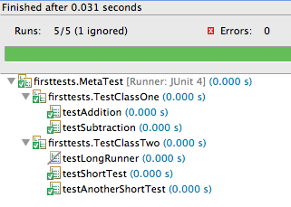
Composed Tests
import org.junit.AfterClass;
import org.junit.BeforeClass;
import org.junit.runner.RunWith;
import org.junit.runners.Suite;
@RunWith(Suite.class)
@Suite.SuiteClasses({TestClassOne.class,
TestClassTwo.class})
public class MetaTest
{
}
Higher-level test that is composed of both of two (or more) other test classes.
The following individual test methods will be run:
testAddition() from TestClassOne
testSubtraction() from TestClassOne
testShortTest() from TestClassTwo
testAnotherShortTest() from TestClassTwo

Slide 50
Composed Tests
import org.junit.AfterClass;
import org.junit.BeforeClass;
import org.junit.runner.RunWith;
import org.junit.runners.Suite;
@RunWith(Suite.class)
@Suite.SuiteClasses({TestClassOne.class,
TestClassTwo.class})
public class MetaTest
{
}
Class Level Annotations:
@RunWith JUnit will invoke the annotated class to run the tests, instead of using the runner built into JUnit.
@Suite.SuiteClasses The SuiteClasses annotation specifies the classes to be executed when a class annotated with @RunWith(Suite.class) is run.
Notes:
http://examples.javacodegeeks.com/core-java/junit/junit-suite-test-example/

Slide 51
Composed Tests: @BeforeClass / @AfterClass
@RunWith(Suite.class)
@Suite.SuiteClasses({TestClassOne.class,
TestClassTwo.class})
public class MetaTest
{
@BeforeClass
public static void initialize(){
System.out.println(“setting up”);
// …
}
@AfterClass
public static void terminate(){
System.out.println(“tearing down”);
//...
}
}
public class TestClassOne
{
@Test
public void test1()
{
System.out.println("test1");
//…
}
}
1
One time initialization in class MetaTest.
public class TestClassTwo
{
@Test
public void test2()
{
System.out.println("test2");
//…
}
}
Output:
setting up
test1
test2
tearing down
Good Article on Test Order: https://garygregory.wordpress.com/2011/09/25/understaning-junit-method-order-execution/
Notes:
http://stackoverflow.com/questions/82949/before-and-after-suite-execution-hook-in-junit-4-x

Slide 52
Composed Tests: @BeforeClass / @AfterClass
@RunWith(Suite.class)
@Suite.SuiteClasses({TestClassOne.class,
TestClassTwo.class})
public class MetaTest
{
@BeforeClass
public static void initialize(){
System.out.println(“setting up”);
// …
}
@AfterClass
public static void terminate(){
System.out.println(“tearing down”);
//...
}
}
public class TestClassOne
{
@Test
public void test1()
{
System.out.println("test1");
//…
}
}
2
Then all
(non-ignored) tests in TestClassOne and TestClassTwo
public class TestClassTwo
{
@Test
public void test2()
{
System.out.println("test2");
//…
}
}
Output:
setting up
test1
test2
tearing down
Good Article on Test Order: https://garygregory.wordpress.com/2011/09/25/understaning-junit-method-order-execution/
Notes:
http://stackoverflow.com/questions/82949/before-and-after-suite-execution-hook-in-junit-4-x

Slide 53
Composed Tests: @BeforeClass / @AfterClass
@RunWith(Suite.class)
@Suite.SuiteClasses({TestClassOne.class,
TestClassTwo.class})
public class MetaTest
{
@BeforeClass
public static void initialize(){
System.out.println(“setting up”);
// …
}
@AfterClass
public static void terminate(){
System.out.println(“tearing down”);
//...
}
}
public class TestClassOne
{
@Test
public void test1()
{
System.out.println("test1");
//…
}
}
Note
If any exist, all @Before @After @BeforeClass @AfterClass methods in TestClassOne and TestClassTwo are executed.
public class TestClassTwo
{
@Test
public void test2()
{
System.out.println("test2");
//…
}
}
Output:
setting up
test1
test2
tearing down
Good Article on Test Order: https://garygregory.wordpress.com/2011/09/25/understaning-junit-method-order-execution/
Notes:
http://stackoverflow.com/questions/82949/before-and-after-suite-execution-hook-in-junit-4-x

Slide 54
Composed Tests: @BeforeClass / @AfterClass
@RunWith(Suite.class)
@Suite.SuiteClasses({TestClassOne.class,
TestClassTwo.class})
public class MetaTest
{
@BeforeClass
public static void initialize(){
System.out.println(“setting up”);
// …
}
@AfterClass
public static void terminate(){
System.out.println(“tearing down”);
//...
}
}
public class TestClassOne
{
@Test
public void test1()
{
System.out.println("test1");
//…
}
}
3
One time teardown in class MetaTest.
public class TestClassTwo
{
@Test
public void test2()
{
System.out.println("test2");
//…
}
}
Output:
setting up
test1
test2
tearing down
Good Article on Test Order: https://garygregory.wordpress.com/2011/09/25/understaning-junit-method-order-execution/
Notes:
http://stackoverflow.com/questions/82949/before-and-after-suite-execution-hook-in-junit-4-x

Slide 55
JUnit & Exceptions
There are two kinds of exceptions worth noting:
Case 1. Expected exceptions resulting from a test
Case 2. Unexpected exceptions from something that’s gone horribly wrong
For case 2 - JUnit will catch these and provide a complete stack trace.

Slide 56
Expected Exceptions
Old School Approach
@Test
public void testEmpty ()
{
try
{
Largest.largest(new int[] {});
fail("Should have thrown an exception");
}
catch (RuntimeException e)
{
assertTrue(true);
}
}
Case 1 - sometimes in a test, need to verify that the method under test has actually thrown an exception.
Simple School Approach
Simple School Approach: “expected” annotation parameter declares that the specified exception should have been thrown.
@Test (expected = RuntimeException.class)
public void testEmpty ()
{
Largest.largest(new int[] {});
}

Slide 57
Expected Exceptions – New School Approach
New School Approach (JUnit 4)
import org.junit.rules.*;
// ...
@Rule
public ExpectedException thrown = ExpectedException.none();
@Test
public void exceptionRule() {
thrown.expect(InsufficientFundsException.class);
thrown.expectMessage("balance only 0");
account.withdraw(100);
}
JUnit allows you to define rules, which can provide greater control over what happens during the flow of test execution.

Slide 58
Expected Exceptions – New School Approach
New School Approach (JUnit 4)
import org.junit.rules.*;
// ...
@Rule
public ExpectedException thrown = ExpectedException.none();
@Test
public void exceptionRule() {
thrown.expect(InsufficientFundsException.class);
thrown.expectMessage("balance only 0");
account.withdraw(100);
}
Suppose we’re designing a test in which we withdraw funds from a new account—that is, one with no money. Withdrawing any money from the account should generate an exception.
To use the ExpectedException rule, declare a public instance of ExpectedException in the test class and mark it with @Rule.

Slide 59
Expected Exceptions – New School Approach
New School Approach (JUnit 4)
import org.junit.rules.*;
// ...
@Rule
public ExpectedException thrown
= ExpectedException.none();
@Test
public void exceptionRule() {
thrown.expect(InsufficientFundsException.class);
thrown.expectMessage("balance only 0");
account.withdraw(100);
}
We tell the thrown rule instance to expect that an InsufficientFundsException gets thrown.
We set another expectation on the thrown rule…the thrown exception should contain the passed substring.
Finally, our act portion of the test withdraws money which hopefully triggers the exception we expect. JUnit’s rule mechanism handles the rest, passing the test if all expectations on the rule were met and failing the test otherwise.

Slide 60
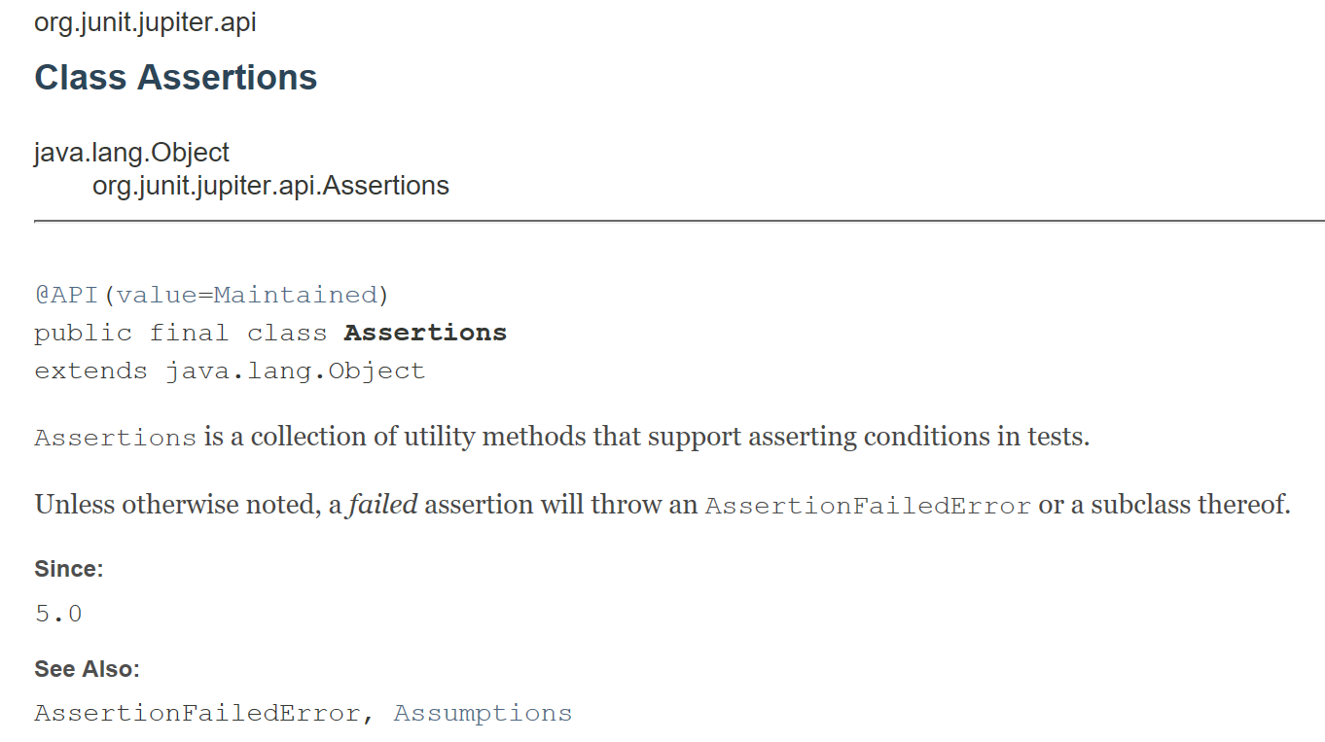
Testing Exceptions - New School Approach (JUnit 5)
The @Rule annotation no longer exists in JUnit5; use assertThrows instead!

Slide 61
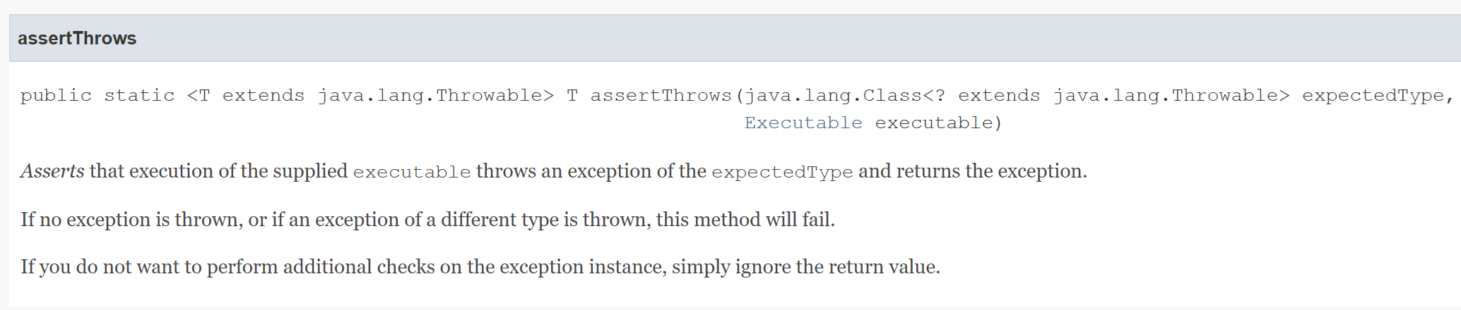
Testing Exceptions - New School Approach (JUnit 5)
@Test
@DisplayName("throws EmptyStackException when popped")
void throwsExceptionWhenPopped()
{
assertThrows(EmptyStackException.class, () -> stack.pop());
}
@Test
@DisplayName("throws EmptyStackException when peeked")
void throwsExceptionWhenPeeked()
{
assertThrows(EmptyStackException.class, () -> stack.peek());
}

Slide 62
JUnit Testing Advice (so far)
You should make your tests visually consistent using AAA(A).
You should keep your tests maintainable by testing behaviour, not methods (i.e. focus on the behaviours of your class and not individual methods).
Adhere to test naming conventions (and separate folder structures).
Use @Before and @After for common initialisation and cleanup needs. You can have multiples of these methods (can’t guarantee order of execution, though).
Safely ignore tests getting in your way.
Source: http://www.agile-code.com/blog/the-anatomy-of-a-unit-test/

