Slide 1

Right B.I.C.E.P.
Eamonn de Leastar (edeleastar@wit.ie)
Dr. Siobhán Drohan (sdrohan@wit.ie)
Produced
by:
Department of Computing and Mathematics
http://www.wit.ie/

Slide 2
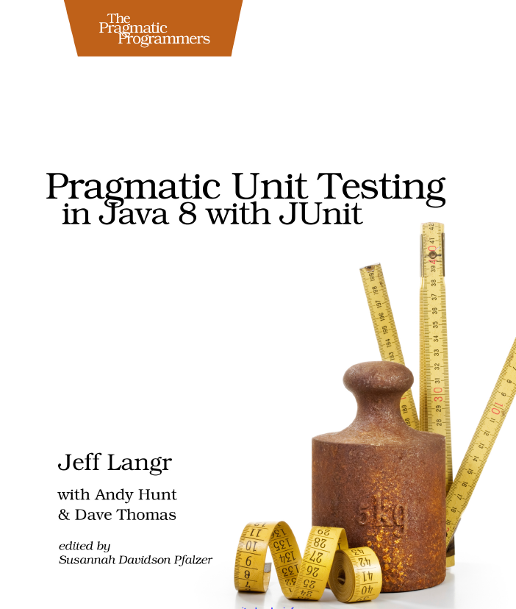
Right B.I.C.E.P.
It’s essential to understand what’s important to test.
Right BICEP helps you ask the right questions about what to test.
Source Code: https://pragprog.com/titles/utj2/source_code

Slide 3
Right B.I.C.E.P.
Guidelines of some areas that are important to test:
Right - Are the results right?
B - Are all the boundary conditions CORRECT?
I - Can you check inverse relationships?
C - Can you cross-check results using other means?
E - Can you force error conditions to happen?
P - Are performance characteristics within bounds?
Source Code: https://pragprog.com/titles/utj2/source_code

Slide 4
[Right] – B.I.C.E.P
Key question : If the code ran correctly, how would the developer know?
If this question cannot be answered satisfactorily, then writing the code or the test may be a complete waste of time.

Slide 5
[Right] – B.I.C.E.P
Key question : If the code ran correctly, how would the developer know?
If this question cannot be answered satisfactorily, then writing the code or the test may be a complete waste of time.
Does that mean code cannot be written until all the requirements are in?
Nothing stops you from proceeding without answers to every last question.
Use your best judgment to make a choice about how to code things, and later refine the code when answers do come.
The definition of correct may change over the lifetime of the code in question, but at any point, developer should be able to prove that it's doing what he/she thinks it should be doing.

Slide 6
Right B.I.C.E.P.
Guidelines of some areas that are important to test:
Right - Are the results right?
B - Are all the boundary conditions CORRECT?
I - Can you check inverse relationships?
C - Can you cross-check results using other means?
E - Can you force error conditions to happen?
P - Are performance characteristics within bounds?
Source Code: https://pragprog.com/titles/utj2/source_code

Slide 7
B. Boundary Conditions
public void testOrder (){
assertEquals(9, Largest.largest(new int[] { 9, 8, 7 }));
assertEquals(9, Largest.largest(new int[] { 8, 9, 7 }));
assertEquals(9, Largest.largest(new int[] { 7, 8, 9 }));
}
public void testDups (){
assertEquals(9, Largest.largest(new int[] { 9, 7, 9, 8 }));
}
public void testOne (){
assertEquals(1, Largest.largest(new int[] { 1 }));
}
public void testNegative (){
int[] negList = new int[] { -9, -8, -7 };
assertEquals(-7, Largest.largest(negList));
}
public void testEmpty (){
try
{
Largest.largest(new int[] {});
fail("Should have thrown an exception");
}
catch (RuntimeException e)
{
assertTrue(true);
}
}
Identifying boundary conditions is one of the most valuable parts of unit testing, because this is where most bugs generally live - at the edges.

Slide 8
Example Boundaries:
Totally bogus or inconsistent input values, such as a file name of "!*W:Xn&Gi/w>g/h#WQ@".

Slide 9
Example Boundaries:
Totally bogus or inconsistent input values, such as a file name of "!*W:Xn&Gi/w>g/h#WQ@".
Badly formatted data, such as an e-mail address without a top-level domain ("fred@foobar.").

Slide 10
Example Boundaries:
Totally bogus or inconsistent input values, such as a file name of "!*W:Xn&Gi/w>g/h#WQ@".
Badly formatted data, such as an e-mail address without a top-level domain ("fred@foobar.").
Computations that can result in numeric overflow.

Slide 11
Example Boundaries:
Totally bogus or inconsistent input values, such as a file name of "!*W:Xn&Gi/w>g/h#WQ@".
Badly formatted data, such as an e-mail address without a top-level domain ("fred@foobar.").
Computations that can result in numeric overflow.
Empty or missing values (such as 0, 0:0, "", or null).

Slide 12
Example Boundaries:
Totally bogus or inconsistent input values, such as a file name of "!*W:Xn&Gi/w>g/h#WQ@".
Badly formatted data, such as an e-mail address without a top-level domain ("fred@foobar.").
Computations that can result in numeric overflow.
Empty or missing values (such as 0, 0:0, "", or null).
Values far in excess of reasonable expectations, such as a person's age of 150 years.

Slide 13
Example Boundaries:
Totally bogus or inconsistent input values, such as a file name of "!*W:Xn&Gi/w>g/h#WQ@".
Badly formatted data, such as an e-mail address without a top-level domain ("fred@foobar.").
Computations that can result in numeric overflow.
Empty or missing values (such as 0, 0:0, "", or null).
Values far in excess of reasonable expectations, such as a person's age of 150 years.
Duplicates in lists that shouldn't have duplicates e.g. class attendance.

Slide 14
Example Boundaries:
Totally bogus or inconsistent input values, such as a file name of "!*W:Xn&Gi/w>g/h#WQ@".
Badly formatted data, such as an e-mail address without a top-level domain ("fred@foobar.").
Computations that can result in numeric overflow.
Empty or missing values (such as 0, 0:0, "", or null).
Values far in excess of reasonable expectations, such as a person's age of 150 years.
Duplicates in lists that shouldn't have duplicates e.g. class attendance.
Ordered lists that aren't, and vice-versa. Try handing a pre-sorted list to a sort algorithm, for instance, or even a reverse-sorted list.

Slide 15
Example Boundaries:
Totally bogus or inconsistent input values, such as a file name of "!*W:Xn&Gi/w>g/h#WQ@".
Badly formatted data, such as an e-mail address without a top-level domain ("fred@foobar.").
Computations that can result in numeric overflow.
Empty or missing values (such as 0, 0:0, "", or null).
Values far in excess of reasonable expectations, such as a person's age of 150 years.
Duplicates in lists that shouldn't have duplicates e.g. class attendance.
Ordered lists that aren't, and vice-versa. Try handing a pre-sorted list to a sort algorithm, for instance, or even a reverse-sorted list.
Things that arrive out of order, or happen out of expected order, such as trying to print a document before logging in.

Slide 16
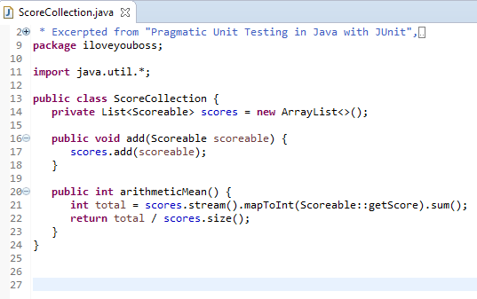
Recall this class from a previous lecture
A ScoreCollection class accepts a Scoreable instance through its add() method.
A Scoreable object is simply one that returns an int score.
arithmeticMean() returns the average score for a collection of Scoreable objects.

Slide 17
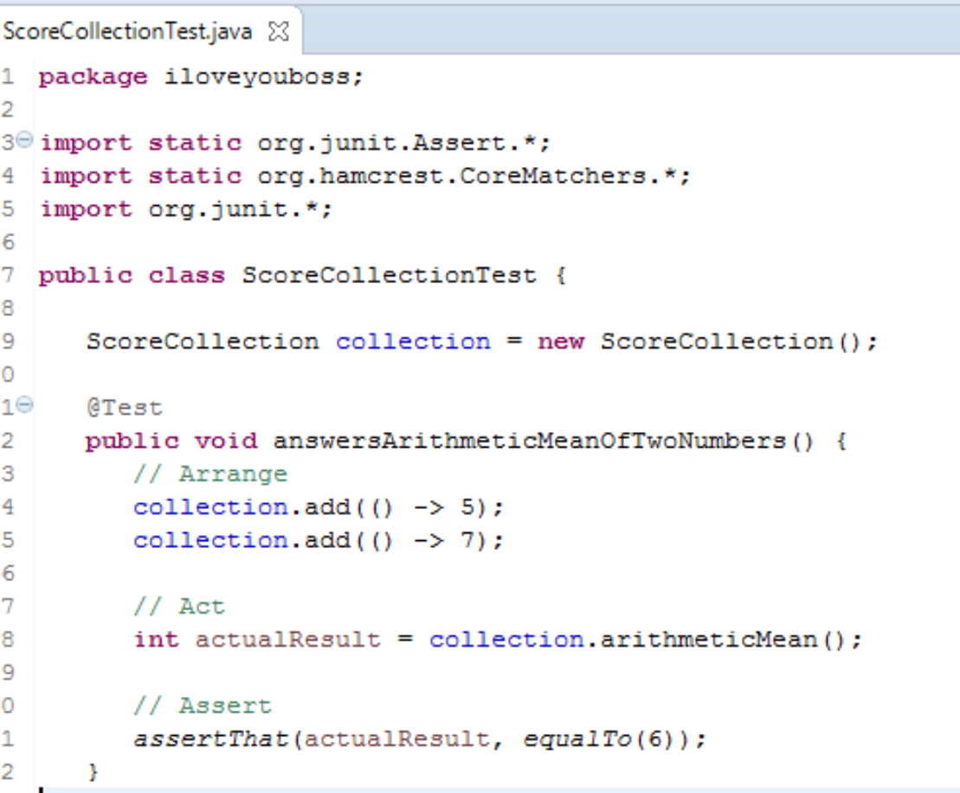
Recall it’s associated (very, very basic) test
—a test case—
To test a ScoreCollection object, we can add
the numbers 5 and 7 to it and expect that the arithmeticMean() method will return 6.
i.e. (5 + 7) / 2 = 6

Slide 18
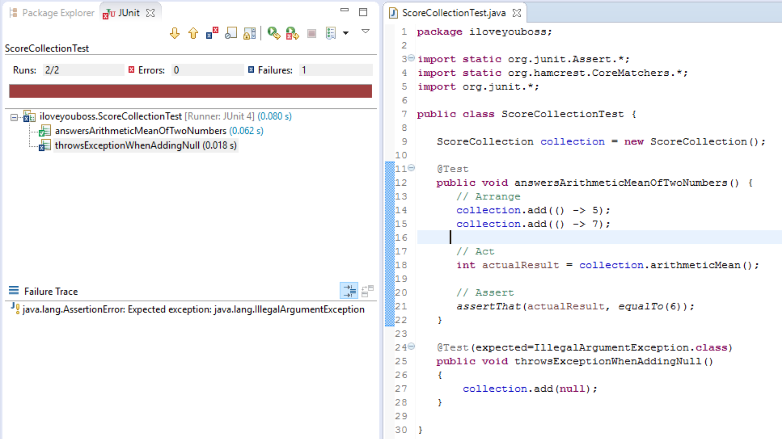
New boundary test (1): adding a null to the collection

Slide 19
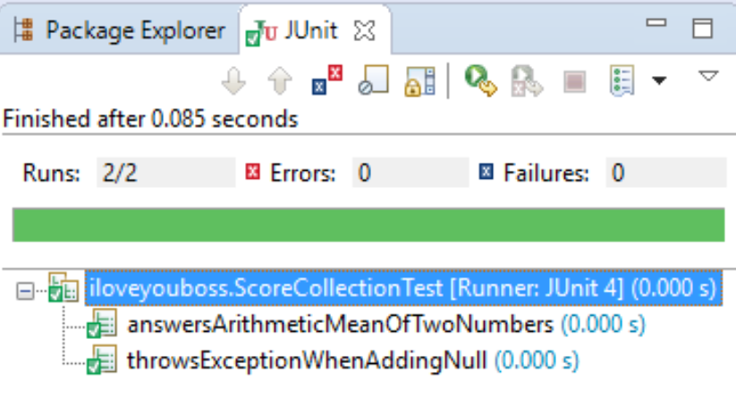
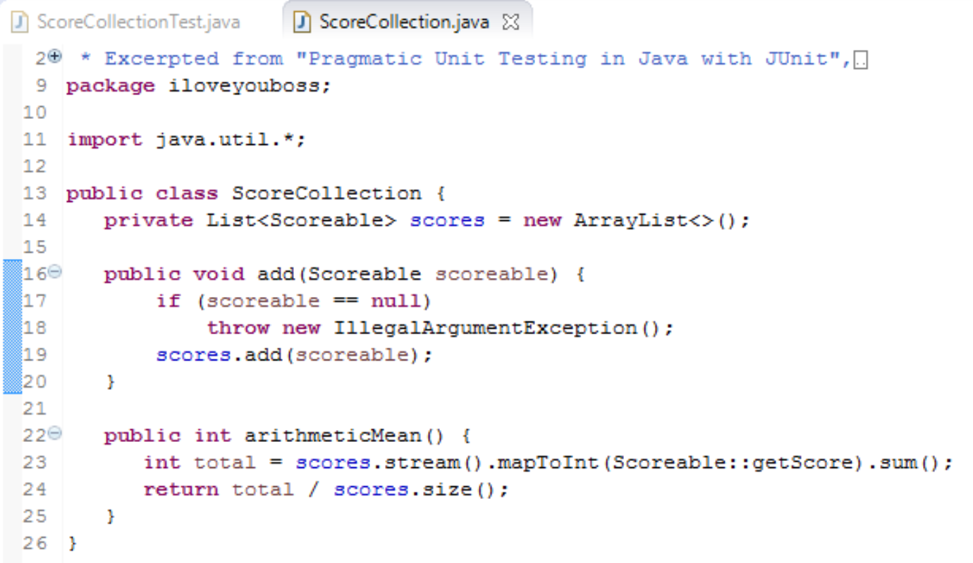
New boundary test (1): adding a null to the collection
Code Fix

Slide 20
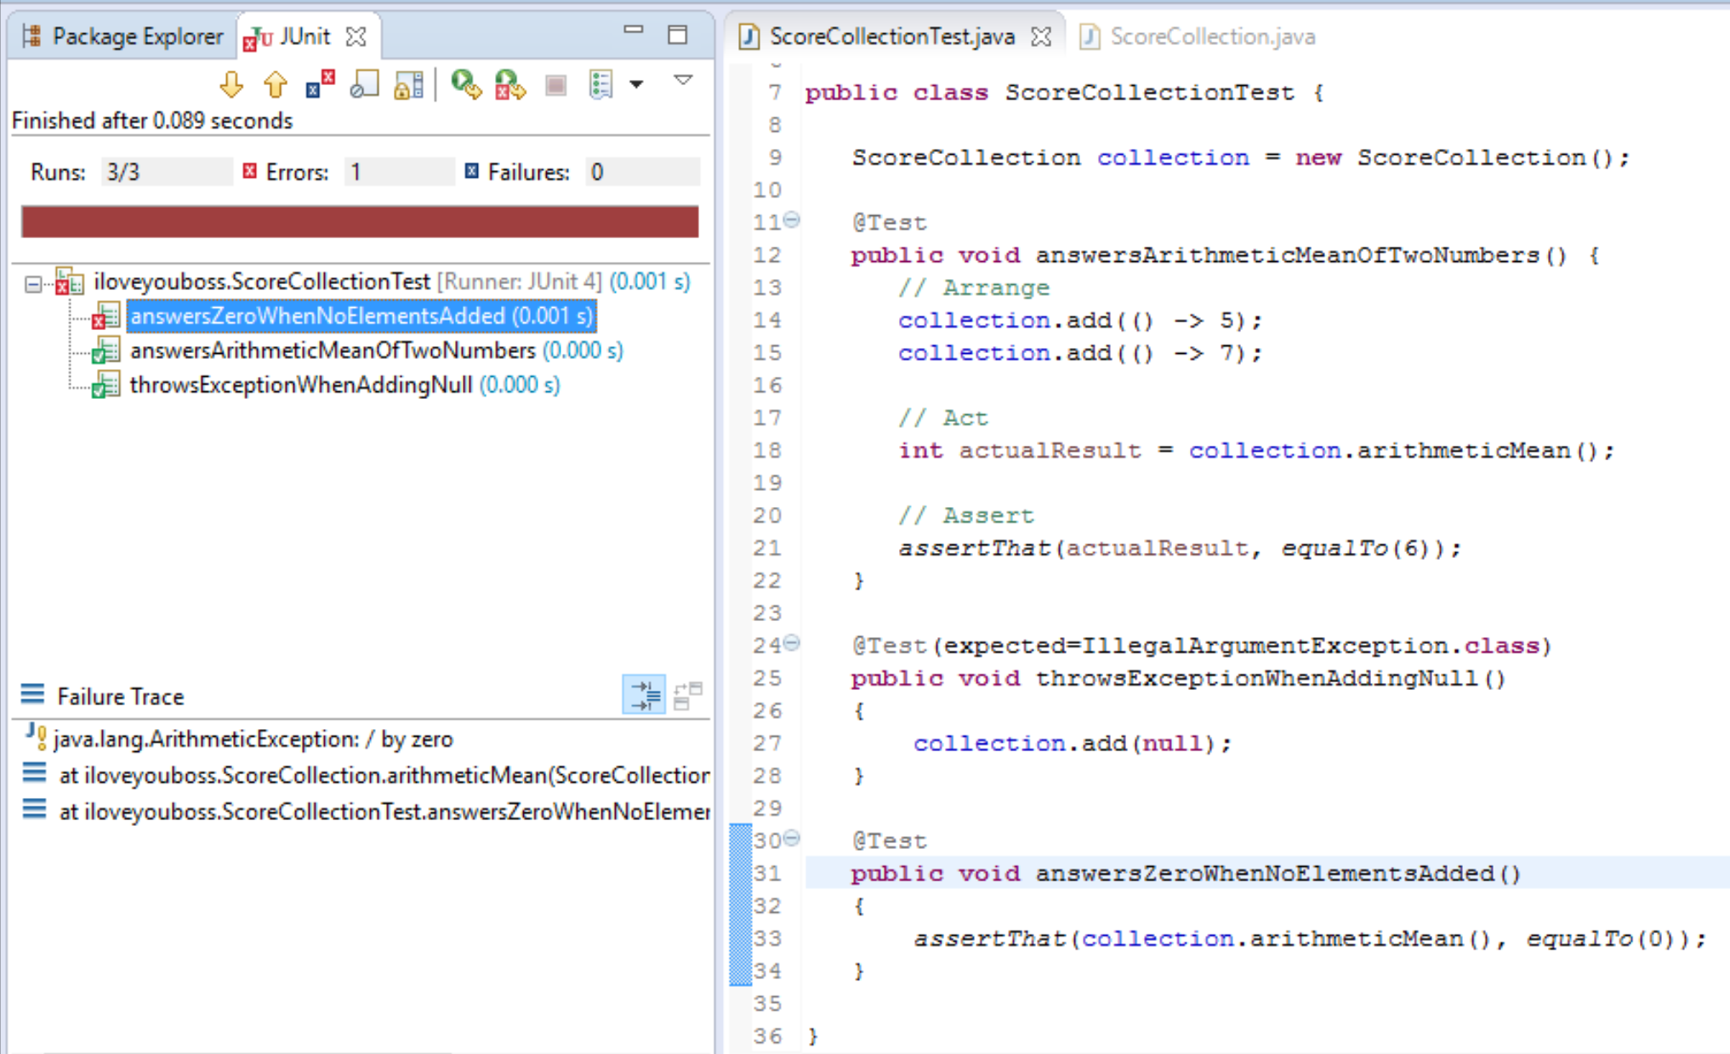
New boundary test (2): handling an empty collection

Slide 21
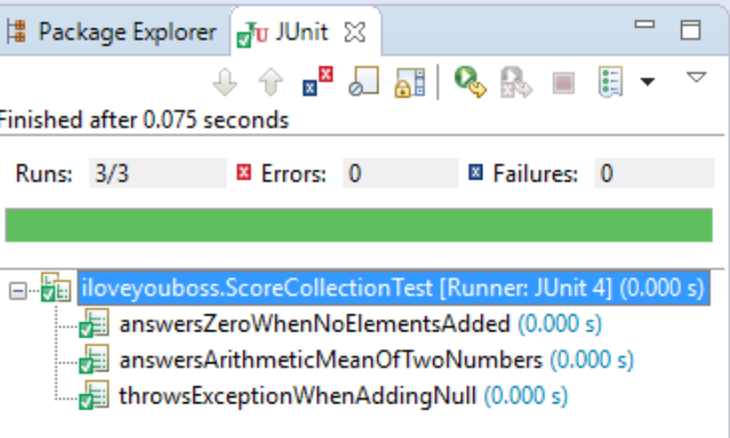
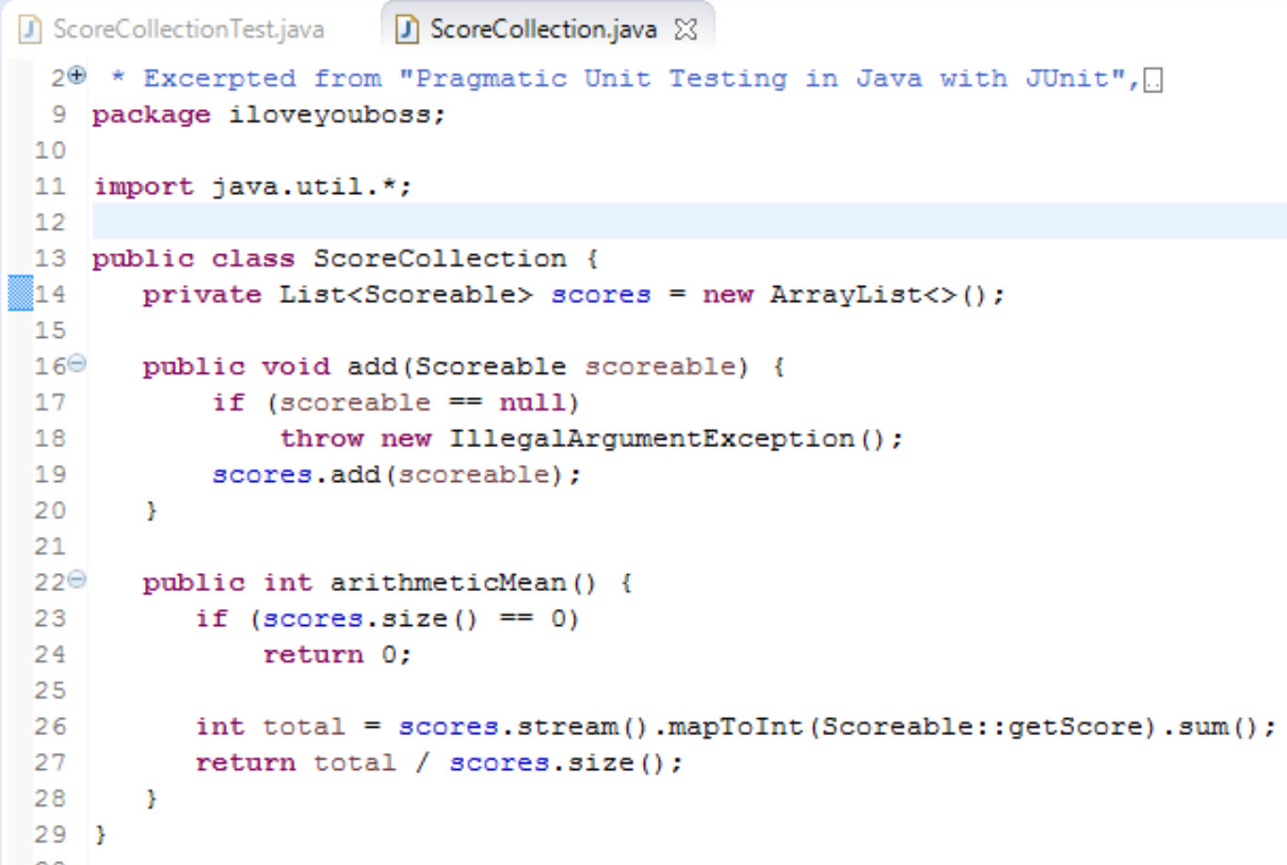
New boundary test (2): handling an empty collection
Code Fix

Slide 22
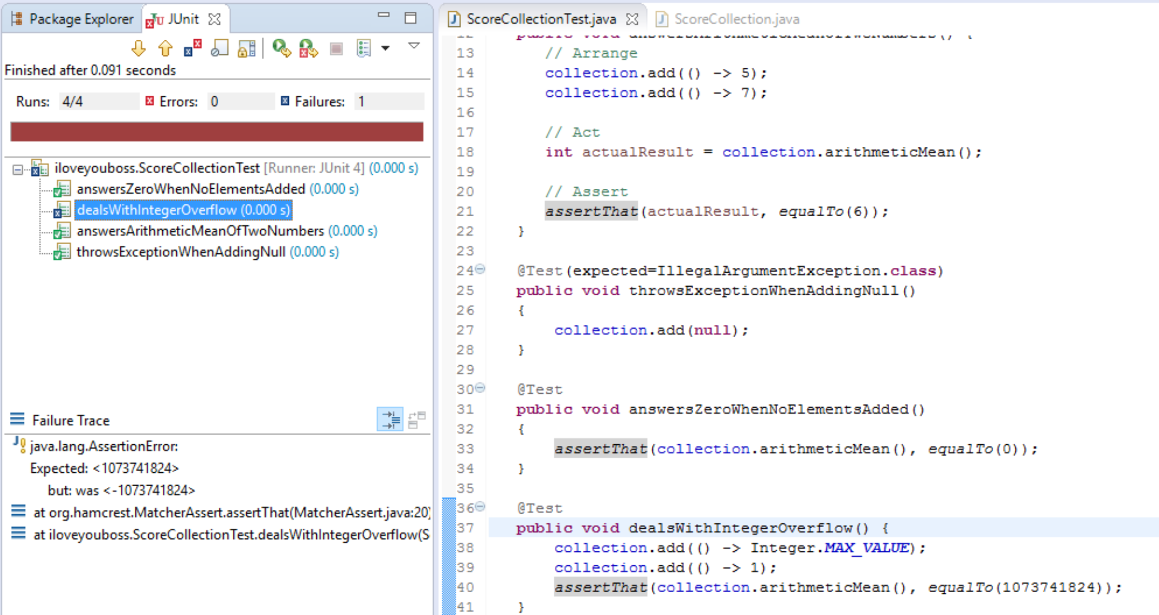
New boundary test (3): sum exceeds MAX_Integer?

Slide 23
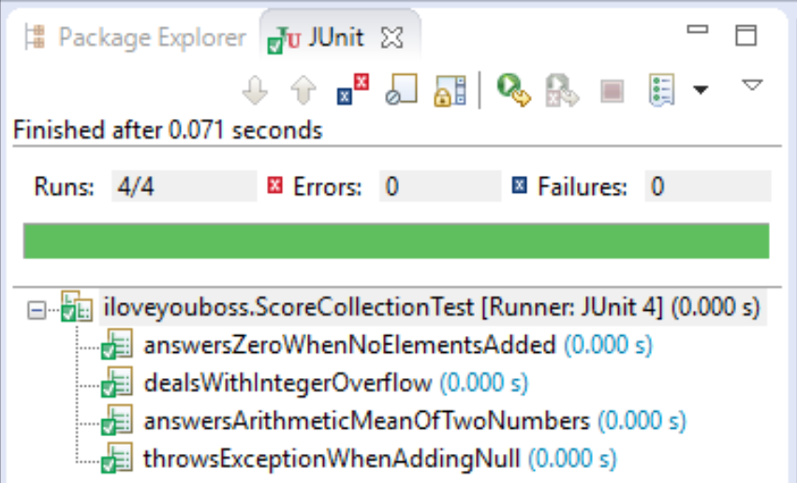
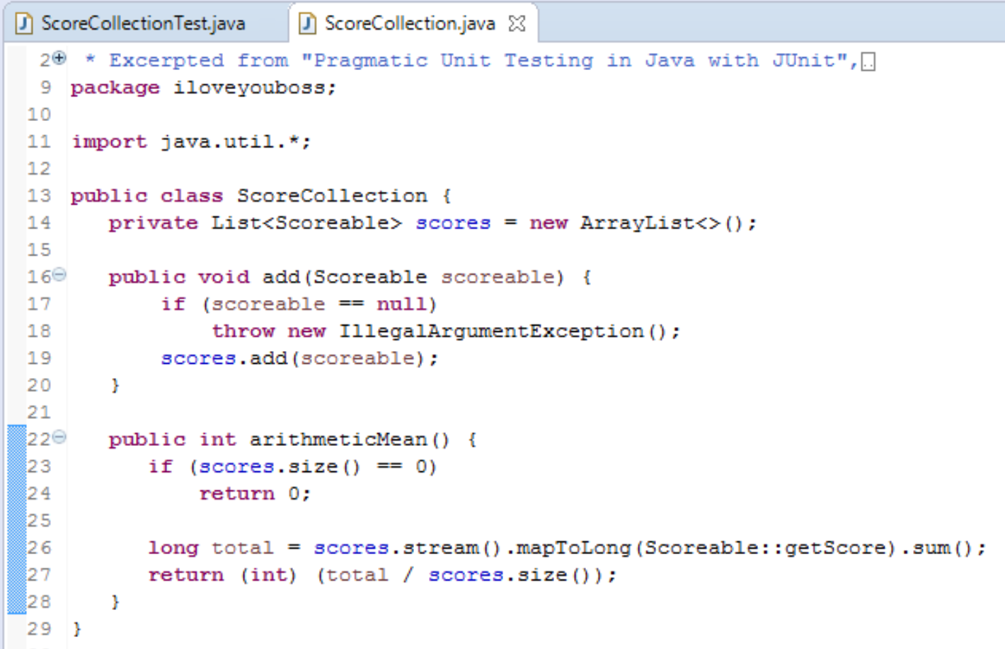
New boundary test (3): sum exceeds MAX_Integer?
Instead of int, use long type followed by an int cast.

Slide 24
You can remember Boundary Conditions with C.O.R.R.E.C.T.
Conformance - Does the value conform to an expected format?
Ordering - Is the set of values ordered or unordered as appropriate?
Range - Is the value within reasonable minimum and maximum values?
Reference - Does the code reference anything external that isn't under direct control of the code itself?
Existence - Does the value exist (e.g., is non-null, nonzero, present in a set, etc.)?
Cardinality - Are there exactly enough values?
Time (absolute and relative) - Is everything happening in order? At the right time? In time?
We will cover these in more detail in a subsequent lecture

Slide 25
Right B.I.C.E.P.
Guidelines of some areas that are important to test:
Right - Are the results right?
B - Are all the boundary conditions CORRECT?
I - Can you check inverse relationships?
C - Can you cross-check results using other means?
E - Can you force error conditions to happen?
P - Are performance characteristics within bounds?
Source Code: https://pragprog.com/titles/utj2/source_code

Slide 26
I. Check Inverse Relationships
Some methods can be checked by applying their logical inverse.
e.g. check a method that calculates a square root by squaring the result, and testing that it is tolerably close to the original number.
or – verify division by performing multiplication.
or - check that some data was successfully inserted into a database by then searching for it.
public void testSquareRootUsingInverse()
{
double x = mySquareRoot(4.0);
assertEquals(4.0, x * x, 0.0001);
}

Slide 27
Right B.I.C.E.P.
Guidelines of some areas that are important to test:
Right - Are the results right?
B - Are all the boundary conditions CORRECT?
I - Can you check inverse relationships?
C - Can you cross-check results using other means?
E - Can you force error conditions to happen?
P - Are performance characteristics within bounds?
Source Code: https://pragprog.com/titles/utj2/source_code

Slide 28
C. Cross-check Using Other Means
Where possible, use a different source for the inverse test (bug could be in original and in inverse).
Usually there is more than one way to calculate some quantity;
pick one algorithm over the others because it performs better, or has other desirable characteristics - use that one in production.
use one of the other versions to cross-check our results in the test system.
Especially helpful when there's a proven, known way of accomplishing the task that happens to be too slow or too complex to use in production code.
public void testSquareRootUsingStd()
{
double number = 3880900.0;
double root1 = mySquareRoot(number);
double root2 = Math.sqrt(number);
assertEquals(root2, root1, 0.0001);
}

Slide 29
C. Cross-check Using Other Means (2)
Another example - a library database system:
The number of copies of a particular book should always balance:
e.g. number of copies that are checked out + number of copies sitting on the shelves should always equal the total number of copies.
These are separate pieces of data, and they may even be reported by objects of different classes, but they still have to agree, and so can be used to cross-check one another.

Slide 30
Right B.I.C.E.P.
Guidelines of some areas that are important to test:
Right - Are the results right?
B - Are all the boundary conditions CORRECT?
I - Can you check inverse relationships?
C - Can you cross-check results using other means?
E - Can you force error conditions to happen?
P - Are performance characteristics within bounds?
Source Code: https://pragprog.com/titles/utj2/source_code

Slide 31
E. Force Error Conditions
In the real world, errors happen:
disks fill up,
network lines drop,
e-mail goes down,
and programs crash.
Developers should test that code handles many of these real world problems by forcing errors to occur.
That's easy enough to do with invalid parameters and the like, but to simulate specific network errors without unplugging any cables takes some special techniques (we will cover this in a later lecture).

Slide 32
E. Force Error Conditions
Some scenarios you might consider when writing tests:
Running out of memory.
Running out of disk space.
Issues with wall-clock time.
Network availability and errors.
System load.
Limited color palette.
Very high or very low video resolution.

Slide 33
Right B.I.C.E.P.
Guidelines of some areas that are important to test:
Right - Are the results right?
B - Are all the boundary conditions CORRECT?
I - Can you check inverse relationships?
C - Can you cross-check results using other means?
E - Can you force error conditions to happen?
P - Are performance characteristics within bounds?
Source Code: https://pragprog.com/titles/utj2/source_code

Slide 34
P. Performance Characteristics
Performance characteristics - does not necessarily mean measuring performance itself - but rather performance trends as input sizes grow, as problems become more complex.
The approach is not to objectively measure performance, but to incorporate general tests just to make sure that the performance curve remains stable.

Slide 35
Performance example
public void testURLFilter()
{
Timer timer = new Timer();
String naughty_url = "http://www.xxxxxxxxxxx.com";
// First, check a bad URL against a small list
URLFilter filter = new URLFilter(small_list);
timer.start();
filter.check(naughty_url);
timer.end();
assertTrue(timer.elapsedTime() < 1.0);
// Next, check a bad URL against a big list
URLFilter f = new URLFilter(big_list);
timer.start();
filter.check(naughty_url);
timer.end();
assertTrue(timer.elapsedTime() < 2.0);
// Finally, check a bad URL against a huge list
URLFilter f = new URLFilter(huge_list);
timer.start();
filter.check(naughty_url);
timer.end();
assertTrue(timer.elapsedTime() < 3.0);
}
A filter that identifies web sites to block.
The code may works well with a few dozen sample sites, but will it work as well with 10,000? 100,000?
This test may take 6-7 seconds to run, so may run only nightly.
See JUnitPerf for tools to simplify unit-level performance measurement.

Slide 36
P. Performance Characteristics
A better use of a unit-level performance measurement is to provide baseline information for purposes of making changes.
Suppose you suspect that a Java 8 lambda-oriented solution is suboptimal. You’d like to replace it with a more classic solution to see if the performance improves. Approach:
Before making optimizations, first write a performance “test” that simply captures the current elapsed time as a baseline. (Run it a few times and grab the average.)
Change the code, run the performance test again, and compare results. You’re seeking relative improvement—the actual numbers themselves don’t matter.

