Slide 1

Java language evolution (JDK 7 – 9)
Dr. Siobhán Drohan (sdrohan@wit.ie)
Eamonn de Leastar (edeleastar@wit.ie)
Produced
by:
Department of Computing and Mathematics
http://www.wit.ie/

Slide 2
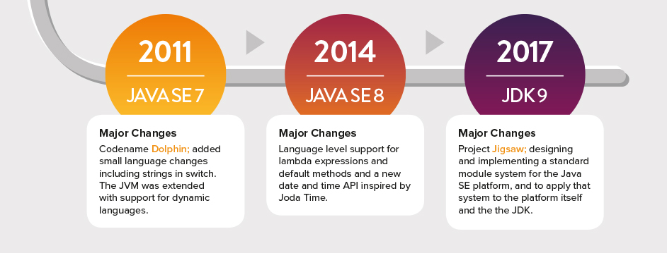

Slide 3
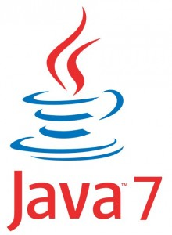

Slide 4
Java 7 – an outline of some changes
Can now switch on Strings.
Inclusion of try-with-resources.
Multi-catch.
Improved type inference.
More new I/O APIs for the Java platform.

Slide 5
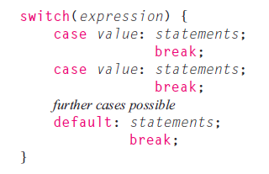
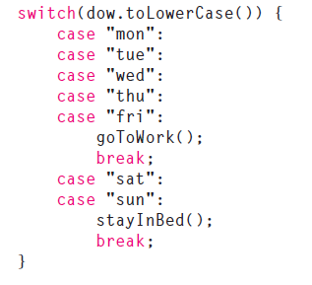
RECAP - switch control statement
Pre Java 7: can switch on int and char.
Post Java 7: can also switch on String

Slide 6
RECAP - try-with-resources
Introduced in Java 7.
It is a try statement that declares one or more resources.
A resource is an object that must be closed after the program is finished with it.
The try-with-resources statement ensures that each resource is closed at the end of the statement.

Slide 7
RECAP - try-with-resources
static String readFirstLineFromFile(String path) throws IOException {
BufferedReader br = new BufferedReader(new FileReader(path));
//try with a finally block, pre Java 7.
try {
return br.readLine();
}
finally {
if (br != null)
br.close();
}
}
static String readFirstLineFromFile(String path) throws IOException {
//try-with-resources, Java 7. br will be closed regardless of
//whether the try statement completes normally or abruptly
try (BufferedReader br = new BufferedReader(new FileReader(path))) {
return br.readLine();
}
}

Slide 8
RECAP - try-with-resources
A try-with-resources statement can have catch and finally blocks just like an ordinary try statement.
In a try-with-resources statement, any catch or finally block is run after the resources declared have been closed.
All classes implementing the java.lang.AutoCloseable interface can be used inside the try-with-resources construct.

Slide 9
RECAP - Multiple Exception Handling
In Java 7 and later, you can catch more than one type of exception with one exception handler i.e.
A single catch block can handle more than one type of exception. This feature can reduce code duplication and lessen the temptation to catch an overly broad exception.

Slide 10
RECAP - Multiple Exception Handling
In Java 7 and later, you can catch more than one type of exception with one exception handler i.e.
A single catch block can handle more than one type of exception. This feature can reduce code duplication and lessen the temptation to catch an overly broad exception.
catch (IOException|SQLException ex) {
logger.log(ex);
throw ex;
}
In the catch clause, specify the types of exceptions that block can handle, and separate each exception type with a vertical bar (|).

Slide 11
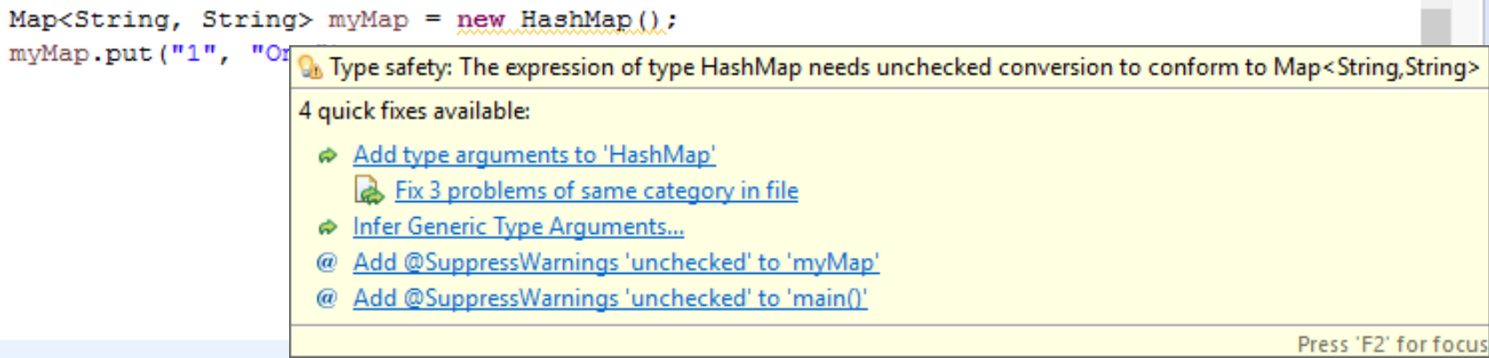
RECAP - Type Inference
Since Java 7, type inference applies to collections (<>) i.e.:
Map<String, String> myMap = new HashMap<>();
<> is required.

Slide 12
More new I/O APIs for the Java platform.
Most important package:
java.nio.file which contains many practical file utilities, new file I/O related classes and interfaces.
We will briefly look at:
java.nio.file.Path (interface)
java.nio.file.Files (class)
https://jaxenter.com/java-7-the-top-8-features-103625.html

Slide 13
java.nio.file.Path (interface)
A Java Path instance represents a path in the file system. A path can point to either a file or a directory. A path can be absolute or relative. Basically, this interface can be used in place of the java.io.File class.
import java.nio.file.Path;
import java.nio.file.Paths;
public class PathExample {
public static void main(String[] args) {
Path path = Paths.get("c:\\data\\myfile.txt");
}
}
http://tutorials.jenkov.com/java-nio/path.html

Slide 14
java.nio.file.Files (class)
This class consists exclusively of static methods that operate on files, directories, or other types of files.
It contains over 50 utility methods for File related operations which many developers would have wanted to be a part of earlier Java releases e.g.:
copy() – copy a file, with options e.g. REPLACE_EXISTING.
move() – move or rename a file to a target file.
newInputStream() – Opens a file, returning an input stream to read from the file.
readAllBytes() – Reads all the bytes from a file.
https://jaxenter.com/java-7-the-top-8-features-103625.html

Slide 15


Slide 16
Java 8 - an outline of some changes
Interfaces – default and static methods
Lambdas
Stream collection types (and new method reference, ::)
Date/time improvements
Optionals

Slide 17
RECAP: What is an interface?
A type in Java. Similar(ish) to a class
constants (final static fields)
Can contain
default & static methods and their bodies (java 8+)
abstract method signatures
Cannot contain
Any fields other than constants
Any constructors
Any concrete methods except default and static(Java 8) and private (Java 9)
Private methods and their bodies (java 9+)

Slide 18
Defining Interfaces (JDK 7) Only abstract methods
IAddressBook.java
public interface IAddressBook { void clear(); IContact getContact(String lastName); void addContact(IContact contact); int numberOfContacts(); void removeContact(String lastName); String listContacts(); }
Methods are implicitly public and abstract

Slide 19
Defining Interfaces (JDK 8) Can include default methods
public interface IAddressBook { void clear(); IContact getContact(String lastName); void addContact(IContact contact); int numberOfContacts(); void removeContact(String lastName); String listContacts(); default String typeOfEntity(){ return “Address book”; } }
Java 8 introduced default methods as a way to extend Interfaces in a backward compatible way.
They can be overridden in implementation classes.
IAddressBook.java

Slide 20
Defining Interfaces (JDK 8) Can include static methods
public interface IAddressBook{ static final int CAPACITY= 1000; void clear(); IContact getContact(String lastName); void addContact(IContact contact); int numberOfContacts(); void removeContact(String lastName); String listContacts(); default String typeOfEntity(){ return “Address book”; } static int getCapacity(){ return CAPACITY; } }
Java 8 allows static methods as a way to organise utility methods in a convenient location.
They cannot be overridden in implementation classes.
IAddressBook.java

Slide 21
Lambdas – new in JDK 8
A Java lambda expression:
Is Java's first step into functional programming.
Is a function which can be created without belonging to any class.
Can be passed around as if it was an object and executed on demand.
http://tutorials.jenkov.com/java/lambda-expressions.html

Slide 22
Lambdas - Anonymous Inner Classes
In Java, anonymous inner classes provide a way to implement classes that may occur only once in an application.
Rather than writing a separate event-handling class for each event, you can write something like this.
JButton testButton = new JButton("Test Button");
testButton.addActionListener(new ActionListener(){
@Override public void actionPerformed(ActionEvent e){
System.out.println("Click Detected by Anon Class");
}
});
http://www.oracle.com/webfolder/technetwork/tutorials/obe/java/Lambda-QuickStart/index.html

Slide 23
Lambdas - Functional Interfaces
package java.awt.event;
import java.util.EventListener;
public interface ActionListener extends EventListener {
public void actionPerformed(ActionEvent e);
}
The code that defines the ActionListener is a functional interface i.e. one abstract method.
JButton testButton = new JButton("Test Button");
testButton.addActionListener(new ActionListener(){
@Override public void actionPerformed(ActionEvent e){
System.out.println("Click Detected by Anon Class");
}
});
http://www.oracle.com/webfolder/technetwork/tutorials/obe/java/Lambda-QuickStart/index.html

Slide 24
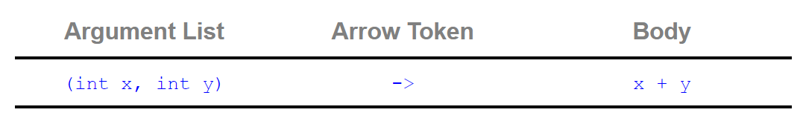
Lambdas - Syntax
Expression takes two integer arguments, named x and y, and uses the expression form to return x+y.
Can be either a single expression or a statement block.
Body is evaluated and returned.
http://www.oracle.com/webfolder/technetwork/tutorials/obe/java/Lambda-QuickStart/index.html

Slide 25
Lambdas - Example
JButton testButton = new JButton("Test Button");
testButton.addActionListener(new ActionListener(){
@Override public void actionPerformed(ActionEvent e){
System.out.println("Click Detected by Anon Class");
}
});
becomes
testButton.addActionListener(e -> System.out.println("Click Detected by Lambda Listner"));
http://www.oracle.com/webfolder/technetwork/tutorials/obe/java/Lambda-QuickStart/index.html

Slide 26
Stream
A stream
represents a sequence of objects from an input source, which supports aggregate operations e.g.
filter, reduce, find, match, etc..
takes collections, arrays and I/O sources as input.
https://www.tutorialspoint.com/java8/java8_streams.htm

Slide 27
Stream – for each
Stream has provided a new method ‘forEach’ to iterate each element of the stream.
The following code segment shows how to print 10 random numbers using forEach over an IntStream.
Random random = new Random();
random.ints().limit(10).forEach(System.out::println);
ints() returns an unlimited IntStream of random int values.
https://www.tutorialspoint.com/java8/java8_streams.htm

Slide 28
Stream – for each
Stream has provided a new method ‘forEach’ to iterate each element of the stream.
The following code segment shows how to print 10 random numbers using forEach over an IntStream.
Random random = new Random();
random.ints().limit(10).forEach(System.out::println);
limit(10) returns an IntStream with 10 entries.
https://www.tutorialspoint.com/java8/java8_streams.htm

Slide 29
Stream – for each
Stream has provided a new method ‘forEach’ to iterate each element of the stream.
The following code segment shows how to print 10 random numbers using forEach over an IntStream.
Random random = new Random();
random.ints().limit(10).forEach(System.out::println);
forEach() performs an action for each element in the IntStream
https://www.tutorialspoint.com/java8/java8_streams.htm

Slide 30
Stream – for each
Stream has provided a new method ‘forEach’ to iterate each element of the stream.
The following code segment shows how to print 10 random numbers using forEach over an IntStream.
Random random = new Random();
random.ints().limit(10).forEach(System.out::println);
Method reference (::) here refers to the static method println within the containing class. More information here: https://docs.oracle.com/javase/tutorial/java/javaOO/methodreferences.html
https://www.tutorialspoint.com/java8/java8_streams.htm

Slide 31
Stream – map
The ‘map’ method is used to map each element to its corresponding result.
The following code segment prints unique squares of numbers using map.
List<Integer> numbers = Arrays.asList(3, 2, 2, 3, 7, 3, 5);
//get list of unique squares
List<Integer> squaresList =
numbers.stream().map( i -> i*i).distinct().collect(Collectors.toList());
stream() returns a sequential Stream of the numbers collection.
https://www.tutorialspoint.com/java8/java8_streams.htm

Slide 32
Stream – map
The ‘map’ method is used to map each element to its corresponding result.
The following code segment prints unique squares of numbers using map.
List<Integer> numbers = Arrays.asList(3, 2, 2, 3, 7, 3, 5);
//get list of unique squares
List<Integer> squaresList =
numbers.stream().map( i -> i*i).distinct().collect(Collectors.toList());
map() returns a Stream consisting of the results of applying the given function to the elements of the numbers collection.
https://www.tutorialspoint.com/java8/java8_streams.htm

Slide 33
Stream – map
The ‘map’ method is used to map each element to its corresponding result.
The following code segment prints unique squares of numbers using map.
List<Integer> numbers = Arrays.asList(3, 2, 2, 3, 7, 3, 5);
//get list of unique squares
List<Integer> squaresList =
numbers.stream().map( i -> i*i).distinct().collect(Collectors.toList());
map() returns a Stream consisting of distinct elements in the Stream (uses Objects.equals(Object)).
https://www.tutorialspoint.com/java8/java8_streams.htm

Slide 34
Stream – map
The ‘map’ method is used to map each element to its corresponding result.
The following code segment prints unique squares of numbers using map.
List<Integer> numbers = Arrays.asList(3, 2, 2, 3, 7, 3, 5);
//get list of unique squares
List<Integer> squaresList =
numbers.stream().map( i -> i*i).distinct().collect(Collectors.toList());
collect() returns a mutable list of the elements in the Stream.
https://www.tutorialspoint.com/java8/java8_streams.htm

Slide 35
Stream – filter
The ‘filter’ method is used to eliminate elements based on a criteria.
The following code segment prints a count of empty strings using filter.
List<String> strings = Arrays.asList("abc", "", "bc", "efg", "abcd","", "jkl");
//get count of empty string
int count = strings.stream().filter(string -> string.isEmpty()).count();
stream() returns a sequential Stream of the strings collection
https://www.tutorialspoint.com/java8/java8_streams.htm

Slide 36
Stream – filter
The ‘filter’ method is used to eliminate elements based on a criteria.
The following code segment prints a count of empty strings using filter.
List<String> strings = Arrays.asList("abc", "", "bc", "efg", "abcd","", "jkl");
//get count of empty string
int count = strings.stream().filter(string -> string.isEmpty()).count();
filter() returns a Stream consisting of the elements that match the predicate (i.e. are empty).
https://www.tutorialspoint.com/java8/java8_streams.htm

Slide 37
Stream – filter
The ‘filter’ method is used to eliminate elements based on a criteria.
The following code segment prints a count of empty strings using filter.
List<String> strings = Arrays.asList("abc", "", "bc", "efg", "abcd","", "jkl");
//get count of empty string
int count = strings.stream().filter(string -> string.isEmpty()).count();
count() returns an int representing the number of elements in the Stream.
https://www.tutorialspoint.com/java8/java8_streams.htm

Slide 38
Date/time improvements
Old Date/Time API (java.util.Date):
Not thread safe − java.util.Date is not thread safe, thus developers have to deal with concurrency issue while using date. The new date-time API is immutable and does not have setter methods.
Poor design − Default Date starts from 1900, month starts from 1, and day starts from 0, so no uniformity. The old API had less direct methods for date operations. The new API provides numerous utility methods for such operations.
Difficult time zone handling − Developers had to write a lot of code to deal with timezone issues. The new API has been developed keeping domain-specific design in mind.
https://www.tutorialspoint.com/java8/java8_datetime_api.htm

Slide 39
Date/time improvements
New Date/Time API (java.time):
Local − Simplified date-time API with no complexity of timezone handling.
Zoned − Specialized date-time API to deal with various timezones.
Joda – based on the Joda component’s approach.
https://www.tutorialspoint.com/java8/java8_datetime_api.htm

Slide 40
Date/time improvements (Local)
// Get the current date and time
LocalDateTime currentTime = LocalDateTime.now(); System.out.println("Current DateTime: " + currentTime);
LocalDate date1 = currentTime.toLocalDate();
System.out.println("date1: " + date1);
Month month = currentTime.getMonth();
int day = currentTime.getDayOfMonth();
int seconds = currentTime.getSecond();
System.out.println("Month: " + month +“, day: " + day +“, seconds: " + seconds);
import java.time.LocalDate;
import java.time.LocalTime;
import java.time.LocalDateTime;
import java.time.Month;
https://www.tutorialspoint.com/java8/java8_datetime_api.htm

Slide 41
Date/time improvements (Local)
// Get the current date and time
LocalDateTime currentTime = LocalDateTime.now(); System.out.println("Current DateTime: " + currentTime);
LocalDate date1 = currentTime.toLocalDate();
System.out.println("date1: " + date1);
Month month = currentTime.getMonth();
int day = currentTime.getDayOfMonth();
int seconds = currentTime.getSecond();
System.out.println("Month: " + month +“, day: " + day +“, seconds: " + seconds);
import java.time.LocalDate;
import java.time.LocalTime;
import java.time.LocalDateTime;
import java.time.Month;
Current DateTime: 2017-10-16T19:53:55.053
date1: 2017-10-16
Month: OCTOBER, day: 16, seconds: 55
Console Output
https://www.tutorialspoint.com/java8/java8_datetime_api.htm

Slide 42
Date/time improvements (Zoned)
// Get the current date and time
ZonedDateTime date1 =
ZonedDateTime.parse("2017-10-03T10:15:30+05:30[Asia/Karachi]");
System.out.println("date1: " + date1);
ZoneId id = ZoneId.of("Europe/Paris");
System.out.println("ZoneId: " + id);
ZoneId currentZone = ZoneId.systemDefault();
System.out.println("CurrentZone: " + currentZone);
import java.time.ZonedDateTime;
import java.time.ZoneId;
https://www.tutorialspoint.com/java8/java8_datetime_api.htm

Slide 43
Date/time improvements (Zoned)
// Get the current date and time
ZonedDateTime date1 =
ZonedDateTime.parse("2017-10-03T10:15:30+05:30[Asia/Karachi]");
System.out.println("date1: " + date1);
ZoneId id = ZoneId.of("Europe/Paris");
System.out.println("ZoneId: " + id);
ZoneId currentZone = ZoneId.systemDefault();
System.out.println("CurrentZone: " + currentZone);
import java.time.ZonedDateTime;
import java.time.ZoneId;
date1: 2017-10-03T10:15:30+05:00[Asia/Karachi]
ZoneId: Europe/Paris
CurrentZone: Etc/UTC
Console Output
https://www.tutorialspoint.com/java8/java8_datetime_api.htm

Slide 44
Optionals: java.util.Optional<T>
Optional:
Is similar to what Optional is in Guava.
is a container object which is used to contain not-null objects.
object is used to represent null with absent value.
has various utility methods to facilitate code to handle values as ‘available’ or ‘not available’ instead of checking null values.
https://www.tutorialspoint.com/java8/java8_optional_class.htm

Slide 45
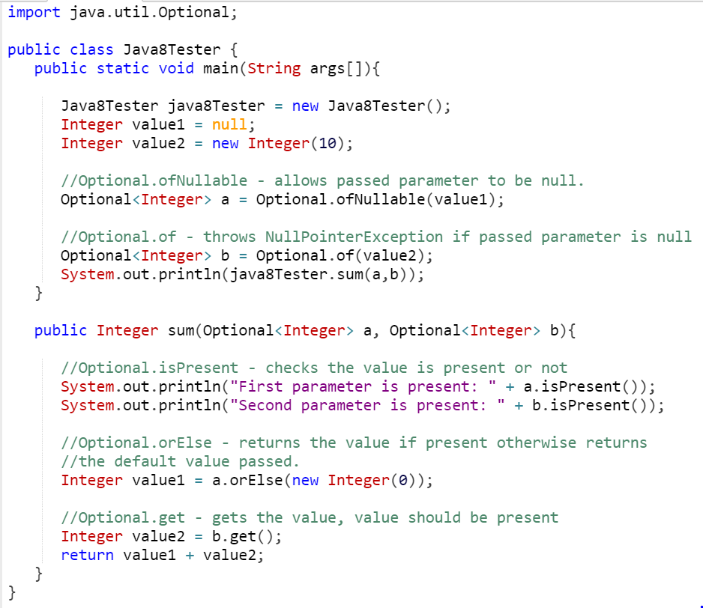
https://www.tutorialspoint.com/java8/java8_optional_class.htm

Slide 46
Console Output
First parameter is present: false
Second parameter is present: true
10
https://www.tutorialspoint.com/java8/java8_optional_class.htm

Slide 47


Slide 48
Java 9 - an outline of some changes
Interfaces – private methods
Collection factory methods
Try with resources improvements
Stream API improvements
REPL (Shell)
Module system

Slide 49
Defining Interfaces (JDK 9) With private methods
public interface IAddressBook{ static final int CAPACITY= 1000; void clear(); IContact getContact(String lastName); void addContact(IContact contact); int numberOfContacts(); void removeContact(String lastName); String listContacts(); default String typeOfEntity(){ return “Address book”; } static int getCapacity(){ return CAPACITY; } private static void displayDetails(){ //method implementation in here } }
Java 9 allows private methods as a way to avoid writing duplicate code (i.e. promote re-usability) and also to hide interface implementation.
The methods can be private and private static and are written in the same way you would write a private method in a class.
IAddressBook.java

Slide 50
Collection Factory Methods
Often you want to create a collection (e.g., a List or Set) in your code and directly populate it with some elements…
That leads to repetitive code where you instantiate the collection, followed by several `add` calls.
With Java 9, several so-called collection factory methods have been added:
NOTE: Immutable collections are created (i.e. cannot add to it) and the collection implementation is selected by Java (e.g. ArrayList, LinkedList).
Set<Integer> ints = Set.of(1, 2, 3);
List<String> strings = List.of("first", "second");
Map<String, String> map = Map.of("foo", "a", "bar", "b", "c");
https://www.pluralsight.com/blog/software-development/java-9-new-features

Slide 51
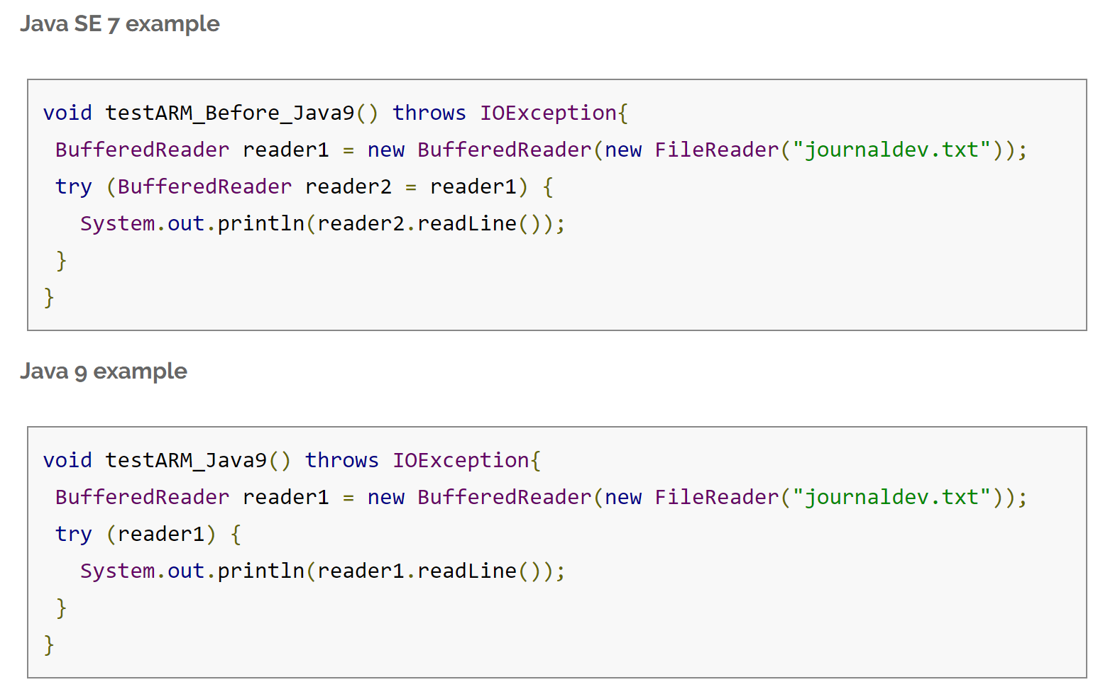
try-with-resources improvement
Improvements to avoid verbosity and improve readability.
https://www.journaldev.com/13121/java-9-features-with-examples#private-methods

Slide 52
Stream API improvement
Addition of extra methods…as a sample, we will look at the takeWhile method:
takes a predicate as an argument and returns a Stream of subset of the given Stream values until that Predicate returns false for first time. If first value does NOT satisfy that Predicate, it just returns an empty Stream.
Console Output
Stream.of(1,2,3,4,5,6,7,8,9,10)
.takeWhile(i -> i < 5 )
.forEach(System.out::println);
1
2
3
4
https://www.journaldev.com/13121/java-9-features-with-examples#private-methods

Slide 53
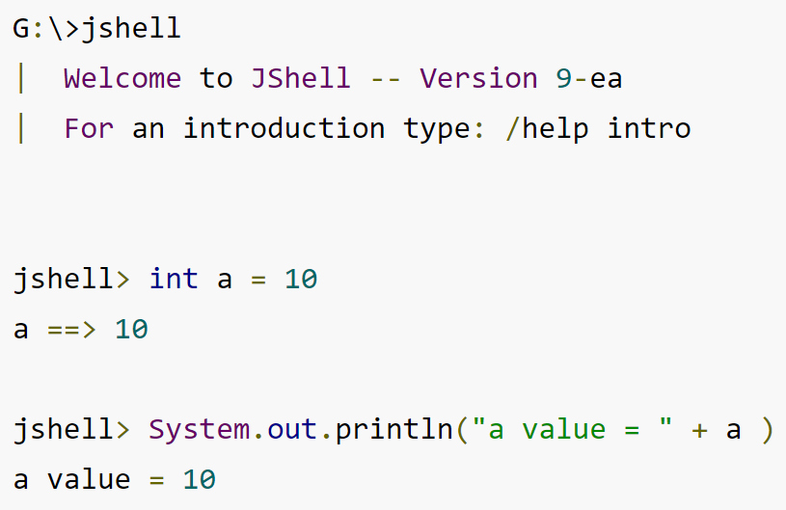
REPL (Read Evaluate Print Loop i.e. Shell)
The jshell is used to easily execute and test Java constructs like class, interface, enum, object, statements etc.
On your command line, start the shell by typing jshell.
Then enter any Java 9 statements you wish.
https://dzone.com/articles/jshell-in-five-minutes & https://www.journaldev.com/13121/java-9-features-with-examples#repl

Slide 54
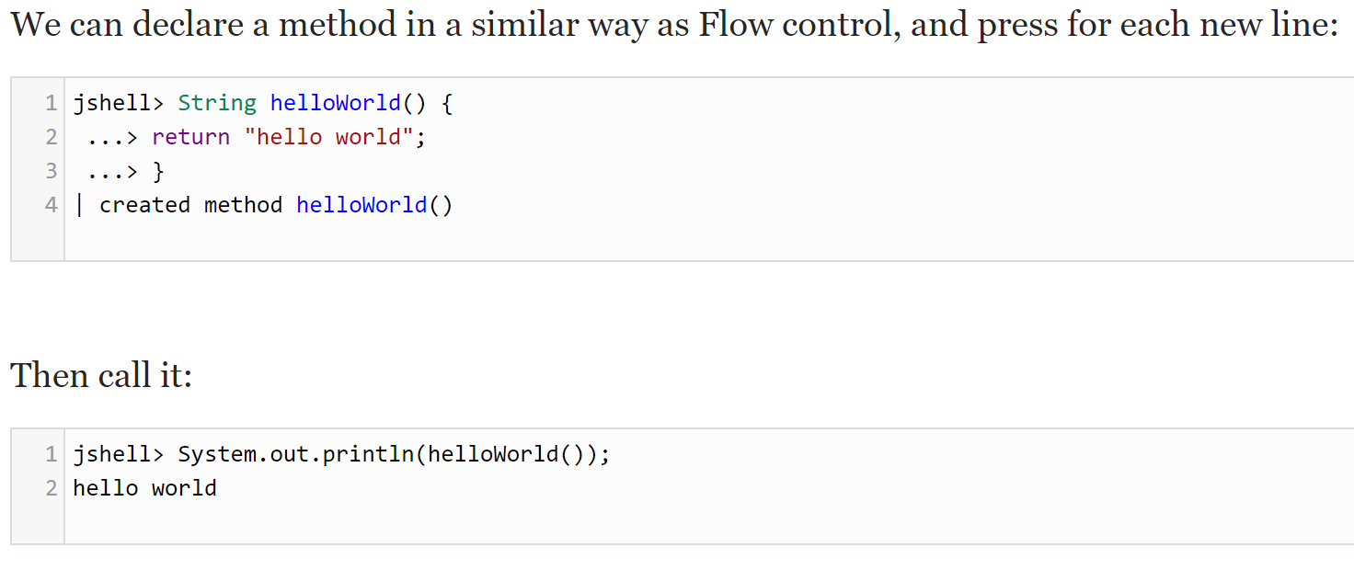
REPL (Read Evaluate Print Loop i.e. Shell)
https://dzone.com/articles/jshell-in-five-minutes & https://www.journaldev.com/13121/java-9-features-with-examples#repl

Slide 55
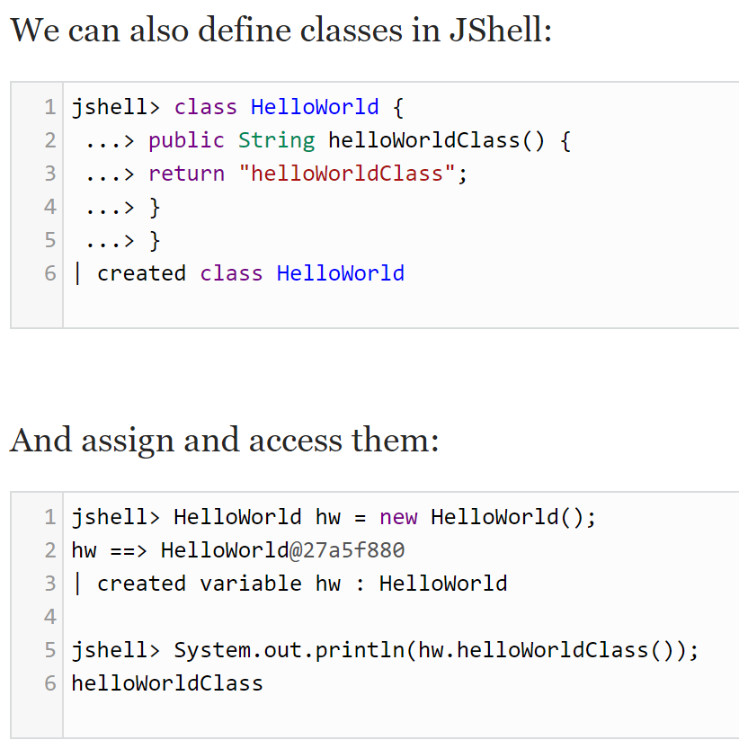
REPL (Read Evaluate Print Loop i.e. Shell)
https://dzone.com/articles/jshell-in-five-minutes & https://www.journaldev.com/13121/java-9-features-with-examples#repl

Slide 56
Module System
One of the biggest changes in Java 9; it is part of the Jigsaw Project.
With JDK9, you can separate your code into individual modules.
“A module is a named, self-describing program component that consists of one or more packages (and data)” https://jaxenter.com/new-features-in-java-9-137344.html
Each module needs a module-info.java file. It is placed in the root directory of the module. Within this file, you can declare:
which modules your code is dependent upon i.e. jdk modules, external jars, etc.
which packages are allowed to see/use your module.

Slide 57
10??

Slide 58
It’s coming…in March 2018!
10

Slide 59
Want to experiment further…
Some good code examples to experiment with can be found on these websites:
https://www.tutorialspoint.com/java8/index.htm (Java 8)
https://www.journaldev.com/12850/java-9-private-methods-interfaces (Java 8&9)
https://www.journaldev.com/13121/java-9-features-with-examples (Java 7 to 9)
A webinar that might be of interest:
https://dzone.com/articles/real-world-java-9-webinar
Articles:
https://dzone.com/guides/java-development-and-evolution
https://jaxenter.com/new-features-in-java-9-137344.html
https://www.pluralsight.com/blog/software-development/java-9-new-features
https://aboullaite.me/wrapping-up-java-9-new-features/
https://dzone.com/articles/java-9-the-exciting-bits

