Slide 1

C.O.R.R.E.C.T.
Eamonn de Leastar (edeleastar@wit.ie)
Dr. Siobhán Drohan (sdrohan@wit.ie)
Produced
by:
Department of Computing and Mathematics
http://www.wit.ie/

Slide 2
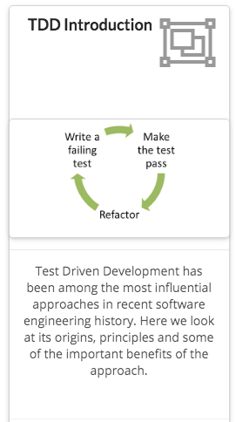
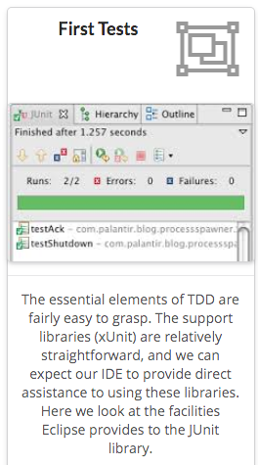
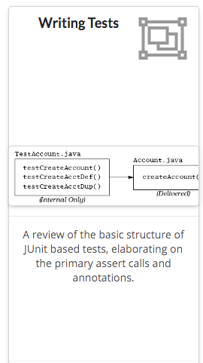

Slide 3
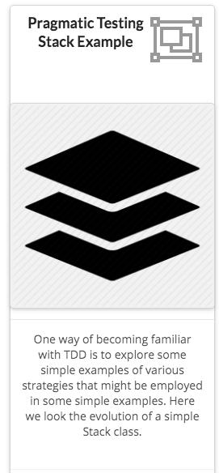
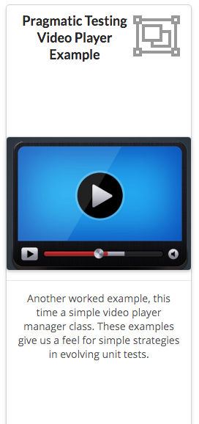
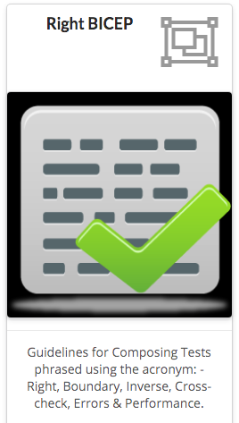

Slide 4
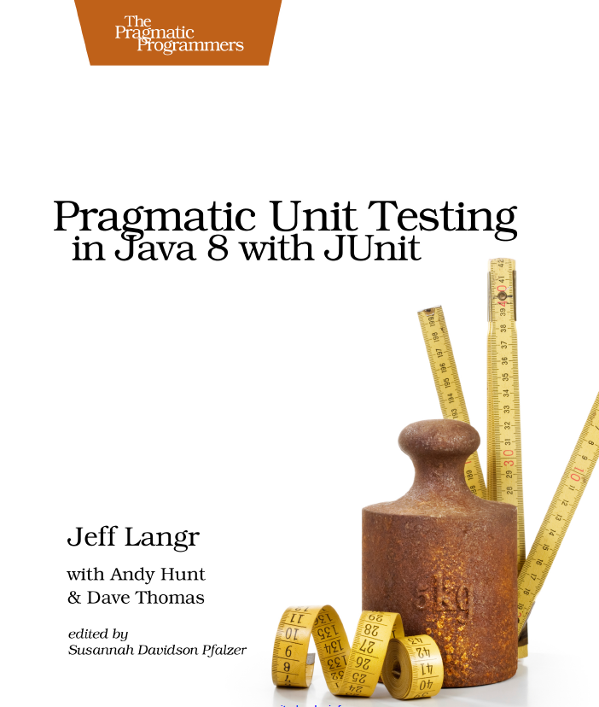
C.O.R.R.E.C.T Thinking
C.O.R.R.E.C.T. acronym can help you think about the boundary conditions to consider for your unit tests.
Source Code: https://pragprog.com/titles/utj2/source_code

Slide 5
C.O.R.R.E.C.T.
Conformance - Does the value conform to an expected format?
Ordering - Is the set of values ordered or unordered as appropriate?
Range - Is the value within reasonable minimum and maximum values?
Reference - Does the code reference anything external that isn't under direct control of the code itself?
Existence - Does the value exist (e.g. non-null, nonzero, present in a set, etc.)?
Cardinality - Are there exactly enough values?
Time - (absolute and relative) Is everything happening in order? At the right time? In time?

Slide 6
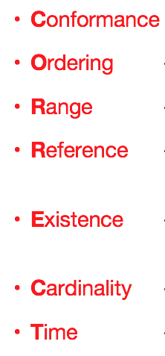
C.O.R.R.E.C.T Thinking
For each of the CORRECT criteria, consider the impact of data from all possible origins.
The underlying question to be constantly considered is:
What can go wrong?
Once you think of something that could go wrong, write a test for it. Once that test passes, again ask
What else can go wrong?

Slide 7
[C].O.R.R.E.C.T – [C]onformance
When data in a specific format is expected → consider what will happen if the data does not conform to the structure.
e.g. an email address :
name@somewhere.com
firstname.lastname@subdomain.somewhere.com
firstname.lastname%somewhere@subdomain.somewhere.com
firstname
How will code react to each of these?
Similarly, if code is producing data to a specific format, tests must verify that the generated data conforms to desired format.

Slide 8
C.[O].R.R.E.C.T – [O]rdering
public void testOrder ()
{
assertEquals(9, Largest.largest(new int[] { 9, 8, 7 }));
assertEquals(9, Largest.largest(new int[] { 8, 9, 7 }));
assertEquals(9, Largest.largest(new int[] { 7, 8, 9 }));
}
public void testDups ()
{
assertEquals(9, Largest.largest(new int[] { 9, 7, 9, 8 }));
}
public void testOne ()
{
assertEquals(1, Largest.largest(new int[] { 1 }));
}
public void testNegative ()
{
int[] negList = new int[] { -9, -8, -7 };
assertEquals(-7, Largest.largest(negList));
}
public void testEmpty ()
{
try
{
Largest.largest(new int[] {});
fail("Should have thrown an exception");
}
catch (RuntimeException e)
{
assertTrue(true);
}
}
Position of one piece of data within a larger collection.
A search routine should be tested for conditions where the search target is first or last.
For a sort routine, what might happen if the set of data is already ordered? Or sorted in precisely reverse order?

Slide 9
C.O.[R].R.E.C.T – [R]ange – Example
A variable's primitive type may allow it to take on a wider range of values than needed e.g. int age.
Consider not using primitive types to store bounded-integer values e.g. direction of travel → Bearing.
Encapsulating a bearing within a class enables you to constrain its range at one point in the system i.e. you can filter out bad data.
public class Bearing
{
public static final int MAX = 359;
private int value;
public Bearing(int value)
{
if (value < 0 || value > MAX) throw new BearingOutOfRangeException();
this.value = value;
}
public int value() { return value; }
public int angleBetween(Bearing bearing)
{
return value - bearing.value;
}
}

Slide 10
public class BearingTest
{
@Test(expected=BearingOutOfRangeException.class)
public void throwsOnNegativeNumber()
{
new Bearing(-1);
}
@Test(expected=BearingOutOfRangeException.class)
public void throwsWhenBearingTooLarge()
{
new Bearing(Bearing.MAX + 1);
}
@Test
public void answersValidBearing()
{
assertThat(new Bearing(Bearing.MAX).value(), equalTo(Bearing.MAX));
}
@Test
public void answersAngleBetweenItAndAnotherBearing()
{
assertThat(new Bearing(15).angleBetween(new Bearing(12)), equalTo(3));
}
@Test
public void angleBetweenIsNegativeWhenThisBearingSmaller()
{
assertThat(new Bearing(12).angleBetween(new Bearing(15)), equalTo(-3));
}
}

Slide 11
C.O.R.[R].E.C.T – [R]eference
What things does the method-under-test reference that are outside the scope of the method itself?
external dependencies
object state
other conditions
e.g.
a method in a web application to display a customer's account history might require that the customer is first logged on.
the method pop() for a stack requires a nonempty stack.
shifting the transmission in a car to Park from Drive requires that the car is stopped.

Slide 12
C.O.R.[R].E.C.T – [R]eference
@Test
public void remainsInDriveAfterAcceleration()
{
transmission.shift(Gear.DRIVE);
car.accelerateTo(35);
assertThat(transmission.getGear(),
equalTo(Gear.DRIVE));
}
@Test
public void ignoresShiftToParkWhileInDrive()
{
transmission.shift(Gear.DRIVE);
car.accelerateTo(30);
transmission.shift(Gear.PARK);
assertThat(transmission.getGear(),
equalTo(Gear.DRIVE));
}
@Test
public void allowsShiftToParkWhenNotMoving()
{
transmission.shift(Gear.DRIVE);
car.accelerateTo(30);
car.brakeToStop();
transmission.shift(Gear.PARK);
assertThat(transmission.getGear(),
equalTo(Gear.PARK));
}
If assumptions are made about:
the state of the class,
the state of other objects,
the global application,
Then you need to verify your code is well-behaved if these assumptions/conditions are not met.

Slide 13
C.O.R.R.[E].C.T – [E]xistence
Make sure the method under test can stand up to nothing!
Network resource files URLs license keys users printers…
may all disappear without notice.
Many Java library methods will throw an exception of some sort when faced with non-existent data.
Difficulty: hard to debug a generic runtime exception; but easier when your exceptions report a specific message!
Should unit test with plenty of nulls, zeros, empty strings etc...

Slide 14
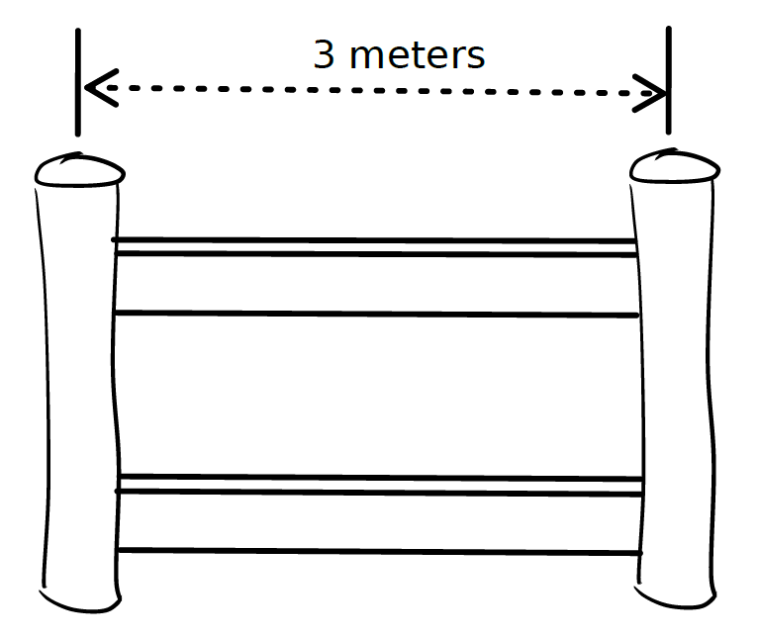
C.O.R.R.E.[C].T – [C]ardinality
Riddle: You have to erect a number of fence sections to cover a straight line 12 feet long. Each section of fencing covers 3 feet, and each end of a section must be held up with a fence post:
How many fence posts do you need?
feet

Slide 15
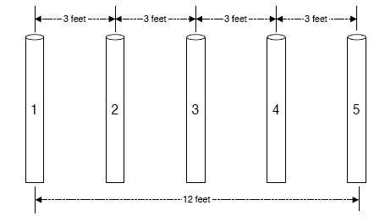
C.O.R.R.E.[C].T – [C]ardinality
This problem, and the related common errors, come up so often that they are graced with the name “fencepost errors” or “off-by-one errors”

Slide 16
C.O.R.R.E.[C].T – [C]ardinality
Related to CORR[E]CT: Existence i.e. how to make sure there are exactly as many items as needed.
The count of some set of values is most interesting in these three cases:
1. Zero
2. One
3. More than one
It's called the “0-1-n-Rule” and it's based on the premise that if method can handle more than one of something, it can probably handle 10, 20, or 1,000.
Sometimes n may be significant -
top 10 results
leading 100 users

Slide 17
C.O.R.R.E.[C].T – [C]ardinality
Example: If maintaining a top 10 list of items, tests should consider:
Producing a report when:
there are no items in the list (zero)
there’s only one item in the list (one)
there aren’t yet ten items in the list (many)
Adding an item when:
there are no items in the list (zero)
there’s only one item in the list (one)
there aren’t yet ten items in the list (many)
there are already ten items in the list (many boundary)

Slide 18
C.O.R.R.E.C.[T] – [T]ime
You need to keep several aspects of time in mind:
Relative time (ordering in time)
Absolute time (elapsed and wall clock)
Concurrency issues

Slide 19
C.O.R.R.E.C.[T] – [T]ime – Relative ordering in time
Some interfaces are inherently stateful:
login() will be called before logout().
prepareStatement() is called before executeStatement().
connect() before read() which is before close().
Test calling methods out of the expected order try skipping the first, last and middle of a sequence (i.e. C[O]RRECT – [O]rdering).
Relative time can include timeout issues:
How long your code is willing to wait for a resource to become available.
What happens in your code if the resource never becomes available?

Slide 20
C.O.R.R.E.C.[T] – [T]ime - Absolute
The actual elapsed or “wall clock” time:
Elapsed time: when waiting for a resource, is the elapsed time too long?
Wall Clock time: Most of the time, this makes no difference. However, occasionally, the actual time of day will matter.
e.g.: Question: every day of the year is 24 hours long? - true or false?

Slide 21
C.O.R.R.E.C.[T] – [T]ime - Absolute
Answer: It Depends!
In UTC (Universal Coordinated Time, the modern version of Greenwich Mean Time, or GMT), the answer is TRUE.
In areas of the world that does not observe Daylight Savings Time (DST), the answer is TRUE.
In most of the U.S. (which does observe DST), the answer is FALSE.
In April, you'll have a day with 23 hours (spring forward) and in October you'll have a day with 25 (fall back).
This means that arithmetic won't always work as you expect two days in the year (you need to test on these two boundary days):
1:45AM plus 30 minutes might equal 1:15AM, rather than 2:15AM.
Question: every day of the year is 24 hours long? - true or false?

Slide 22
C.O.R.R.E.C.[T] – [T]ime - Concurrency
What will happen if multiple threads use this same object at the same time?
Are there global or instance level data or methods that need to be synchronized?
How about external access to files or hardware?
If you have concurrency needs, you need to write tests that demonstrate the use of multiple client threads.

