Slide 1

SOLID Principles
Eamonn de Leastar (edeleastar@wit.ie) Dr. Siobhán Drohan (sdrohan@wit.ie)
Produced
by:
Department of Computing and Mathematics
http://www.wit.ie/

Slide 2

SOLID Class Design Principles
In the mid-1990s, Robert C. Martin gathered five principles for object-oriented class design, presenting them as the best guidelines for building a maintainable object oriented system.
Michael Feathers attached the acronym SOLID
to these principles in the early 2000s.

Slide 3
SOLID Class Design Principles
S Single Responsibility Principle (SRP). Classes should have one, and only one, reason to change. Keep your classes small and single-purposed.
O Open-Closed Principle (OCP). Design classes to be open for extension but closed for modification; you should be able to extend a class without modifying it. Minimize the need to make changes to existing classes.
L Liskov Substitution Principle (LSP). Subtypes should be substitutable for their base types. From a client’s perspective, override methods shouldn’t break functionality.
I Interface Segregation Principle (ISP). Clients should not be forced to depend on methods they don’t use. Split a larger interface into a number of smaller interfaces.
D Dependency Inversion Principle (DIP). High-level modules should not depend on low-level modules; both should depend on abstractions. Abstractions should not depend on details; details should depend on abstractions.

Slide 4
SOLID Principles in Poster form…
http://blogs.msdn.com/b/cdndevs/archive/2009/07/15/the-solid-principles-explained-with-motivational-posters.aspx
SOLID Motivational Posters, by Derick Bailey, is licensed under a Creative Commons Attribution-Share Alike 3.0 United States License.

Slide 5
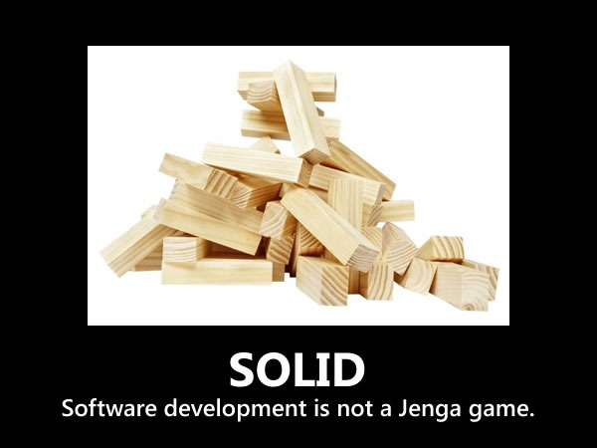

Slide 6
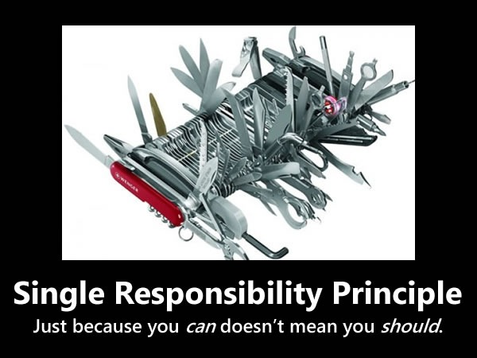

Slide 7
“S” in SOLID - Single Responsibility Principle
Every object should have a single responsibility and all of its services should be aligned with that responsibility.
“Responsibility” is defined as “a reason to change”
Notes:
http://blogs.msdn.com/b/cdndevs/archive/2009/07/15/the-solid-principles-explained-with-motivational-posters.aspx

Slide 8
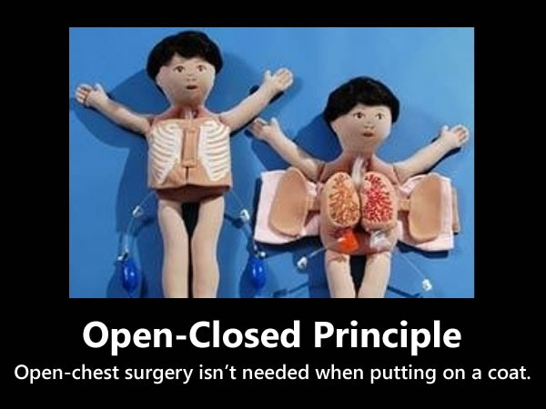

Slide 9
“O” in SOLID - Open-Closed Principle
Software entities – such as classes, modules, or functions should be open for extension but closed for modification.
Better to make changes to classes by adding to or building on them (using mechanisms like subclassing or polymorphism) rather than modifying their code.
Notes:
http://blogs.msdn.com/b/cdndevs/archive/2009/07/15/the-solid-principles-explained-with-motivational-posters.aspx

Slide 10
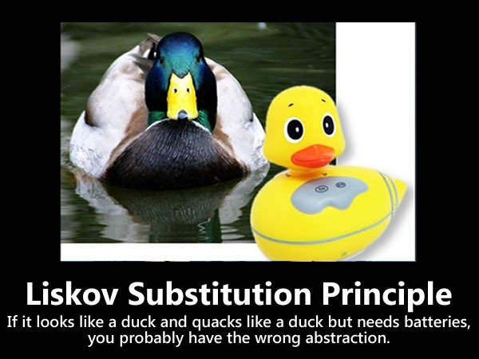

Slide 11
“L” in SOLID - Liskov Substitution Principle
Subclases should be substitutable for the classes from which they were derived.
For example, if ASCIITableConsole is a subclass of Console, you should be able to replace Console with ASCIITableConsole without any significant side effects.
Notes:
http://blogs.msdn.com/b/cdndevs/archive/2009/07/15/the-solid-principles-explained-with-motivational-posters.aspx

Slide 12
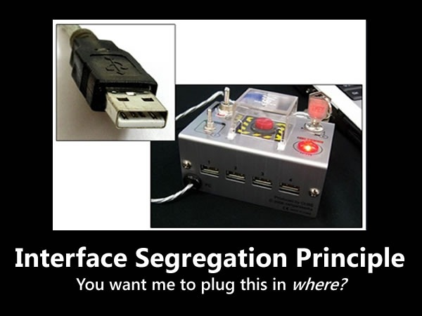

Slide 13
“I” in SOLID - Interface Segregation Principle
Many client specific interfaces are better than one general purpose interface.
Make fine grained interfaces that are client specific.

Slide 14
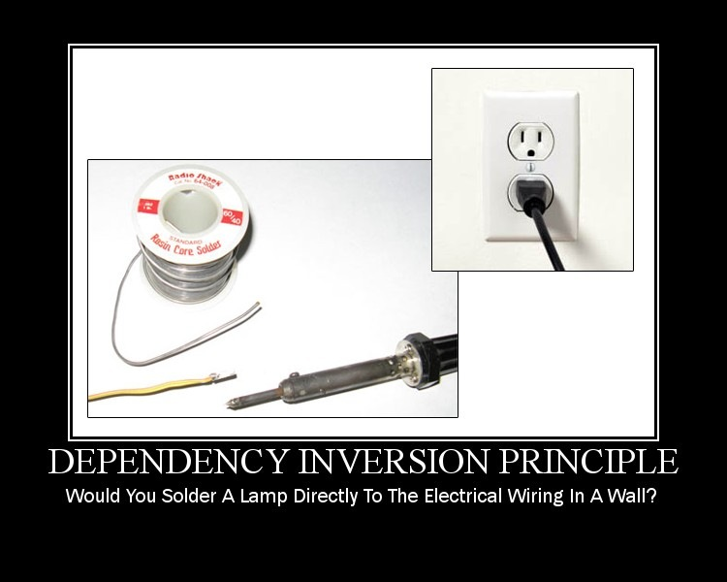

Slide 15
“D” in SOLID - Dependency Inversion Principle
High-level modules shouldn’t depend on low-level modules, but both should depend on shared abstractions.
In addition, abstractions should not depend on details – instead, details should depend on abstractions.
Depend on abstractions, not on concretions.

