Slide 1

Single Responsibility Principle (SRP)
Eamonn de Leastar (edeleastar@wit.ie) Dr. Siobhán Drohan (sdrohan@wit.ie)
Produced
by:
Department of Computing and Mathematics
http://www.wit.ie/

Slide 2
“S” in SOLID - Single Responsibility Principle
Every object should have a single responsibility and all of its services should be aligned with that responsibility.
“Responsibility” is defined as “a reason to change”
Notes:
http://blogs.msdn.com/b/cdndevs/archive/2009/07/15/the-solid-principles-explained-with-motivational-posters.aspx

Slide 3
SRP: The Single Responsibility Principle
THERE SHOULD NEVER BE MORE THAN ONE REASON FOR A CLASS TO CHANGE.
Each responsibility is an axis of change.
When requirements change → a change in responsibility amongst the classes.
If a class assumes more than one responsibility → more than one reason for it to change.
→ changes to one responsibility may impair or inhibit the class’ ability to meet the others.

Slide 4
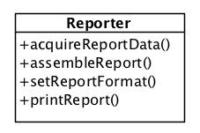
Single Responsibility Principle – Example 1
Consider a Class that assembles and prints a report.
The class can be changed for two reasons.
the content of the report can change.
the format of the report can change.
These two things change for very different causes; one perhaps substantive, and one cosmetic.
Notes:
http://blogs.msdn.com/b/cdndevs/archive/2009/07/15/the-solid-principles-explained-with-motivational-posters.aspx

Slide 5
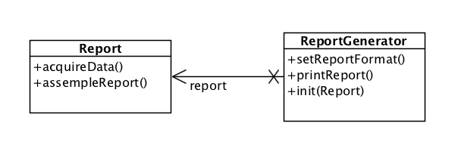
Single Responsibility Principle – Example 1
SRP: these two aspects of the problem are really two separate responsibilities, and should therefore be in separate classes:
SRP: Avoid coupling two things that change for different reasons at different times.
Notes:
http://blogs.msdn.com/b/cdndevs/archive/2009/07/15/the-solid-principles-explained-with-motivational-posters.aspx

Slide 6
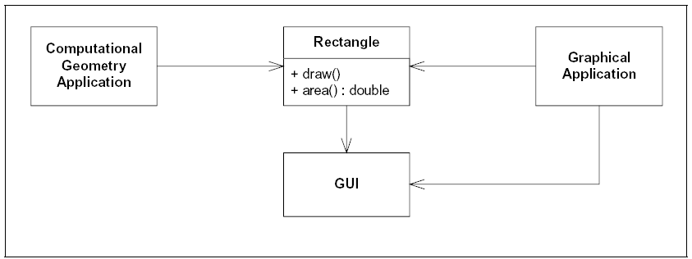
Single Responsibility Principle – Example 2
The Rectangle class has two methods:
one draws the rectangle on the screen
the other computes the area of the rectangle.
Two applications use this class:
one application uses Rectangle to help it with the mathematics of geometric shapes.
the other uses the class to render a Rectangle on a window.

Slide 7
SRP Violation
Rectangle has two responsibilities:
provide a mathematical model of the geometry of a rectangle.
render the rectangle on a graphical user interface.
Violation of SRP:
the GUI must be included in the in the computational geometry application.
the class files for the GUI have to be deployed to the target platform.
if a change to the Graphical Application causes the Rectangle to change for some reason, that change may force us to rebuild, retest, and redeploy the Computational Geometry Application.

Slide 8
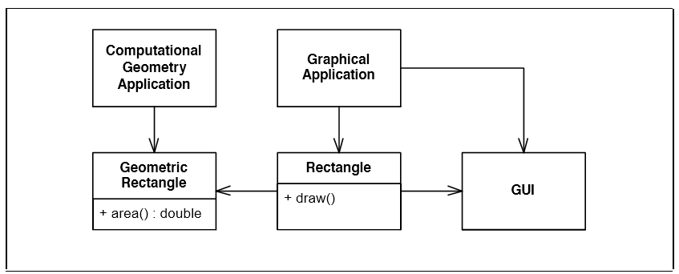
Single Responsibility Principle – Example 2
Separate the two responsibilities into two separate classes
Moves the computational portions of Rectangle into the GeometricRectangle class.
Now changes made to the way rectangles are rendered cannot affect the ComputationalGeometry Application.

Slide 9
What is a Responsibility?
“A reason for change.”
If you can think of more than one motive for changing a class, then that class has more than one responsibility.
interface Modem
{
void dial(String pno);
void hangup();
void send(char c);
char recv();
}

Slide 10
Modem Responsibilities
interface Modem
{
void dial(String pno);
void hangup();
void send(char c);
char recv();
}
Two responsibilities:
connection management (dial and hangup functions)
data communication (send and recv functions)
They have little in common
may change for different reason
will be called from different parts of the applications
They will change for different reasons.

Slide 11
Should the responsibilities be separated?
It depends!
How do you foresee the application changing?
e.g. could the signature of the connection methods potentially change, without any change to the send/receive mechanism?
interface Modem
{
void dial(String pno);
void hangup();
void send(char c);
char recv();
}

Slide 12
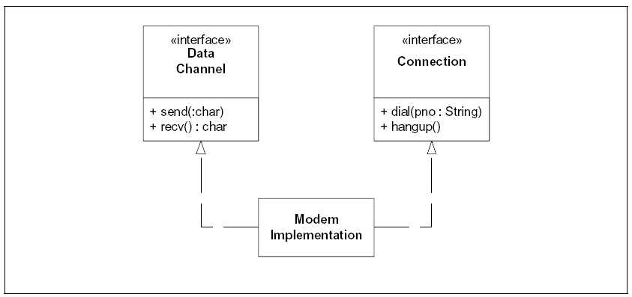
Should the responsibilities be separated?
If the application can change in ways that cause the two responsibilities to change at different times → separate the responsibilities.
Separation here is at interface level and not class level.
CAUTION: Needless complexity can occur when there is no foreseeable need to separate the responsibilities.

Slide 13
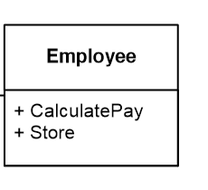
Single Responsibility Principle – Example 4
Coupling persistence services (store) with business rules (calculatePay) could violate SRP.

Slide 14
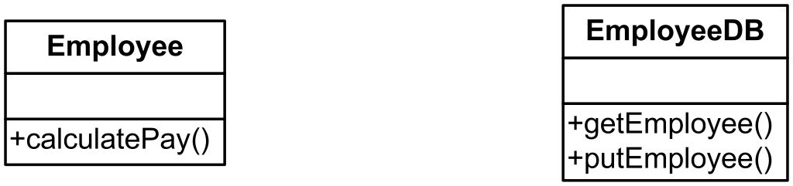
Separate the Responsibilities

Slide 15
Single Responsibility Principle – Example 5
Design an Application to manage a contact list.
It should support:
Console based UI
Load/save to/from a file on disk
Simple reports and search functions

Slide 16
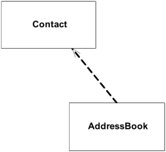
AddressBook
Propose two classes:
Contact - to represent each contact
AddressBook - to incorporate
serialization
reporting
UI
etc…
Violates SRP as AddressBook has multiple reasons to change
Data structure change (e.g. HashMap to TreeMap)
Serialization mechanism (e.g. binary to XML)
Alternative reports (e.g. different formats and content)
Command line syntax changes

Slide 17
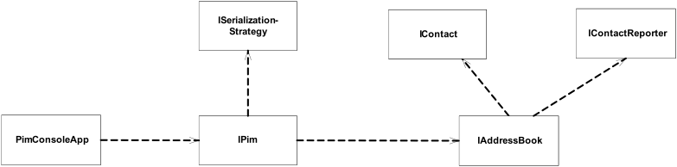
Refactor Addressbook
IAddressBook responsible for contact data structure
IContactReporter responsible for format and content of reports
ISerializationStrategy responsible for persistence
IPim responsible for binding address book to serialization mechanism – and for exposing coherent top level functionality
PimConsoleApp responsible binding an running application to an IPim.

Slide 18
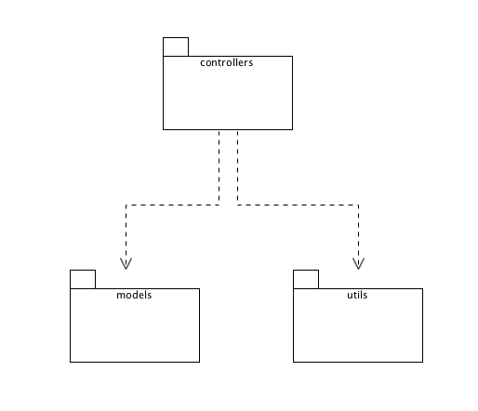
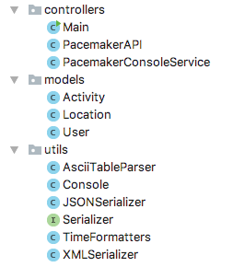
Pacemaker-console-solution

Slide 19
Pacemaker - package responsibilities
Application services + user interface
information model for the app
general purpose utilities

Slide 20
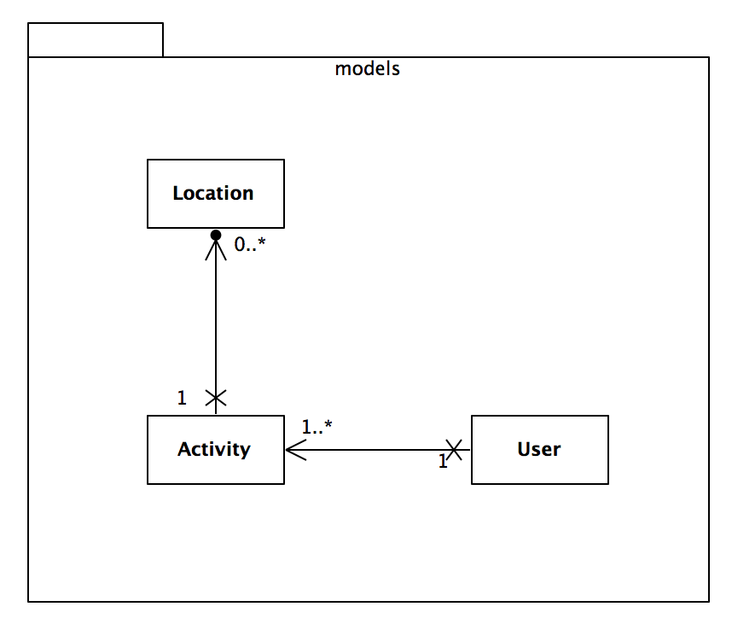
Pacemaker – Model

Slide 21
Pacemaker – Model Responsibilities
Represent individual locations
Represent individual Activities
Represent individual Users

Slide 22
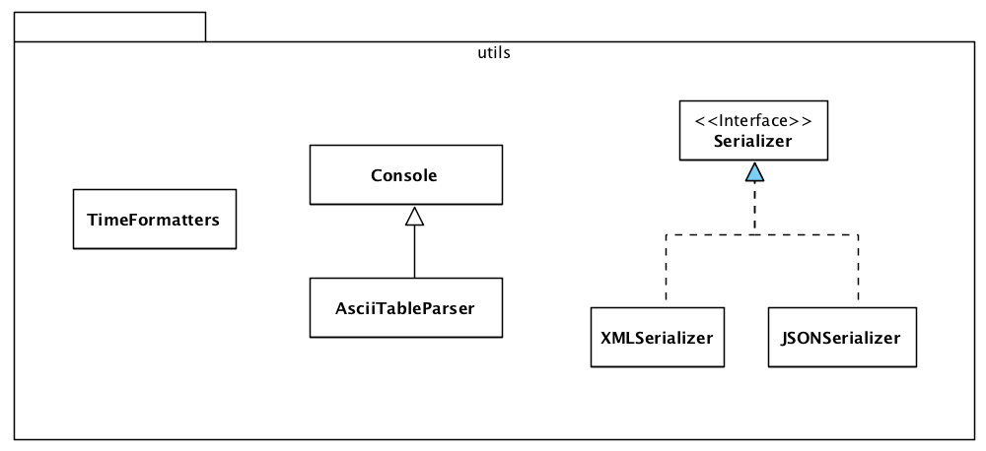
Pacemaker – Utils

Slide 23
Pacemaker – utils responsibilities
Encapsulate rendering of Model elements to a standard console
Encapsulate data structure serialisation
Centralise data/time formatting for application
Specialise to use table btc-ascii component
Specialise serialisation for XML
Specialise serialisation for JSON

Slide 24
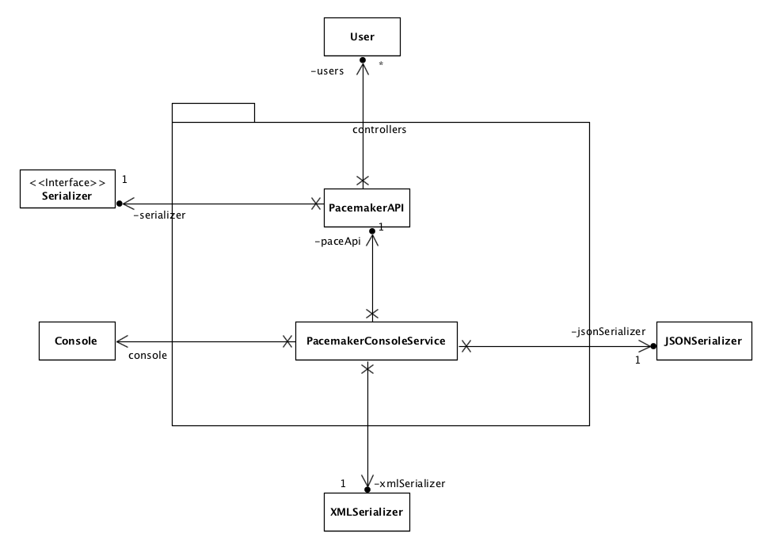

Slide 25
Implement the core application features as represented by the Model.
Deliver a console user experience

Slide 26
SRP Summary
Changes in requirements are manifested as changes in class responsibilities.
Therefore a ‘cohesive’ responsibility is a single axis of change – requirement changes often are restricted to a few cohesive responsibilities (in a reasonably designed system).
Thus, to avoid coupling responsibilities that change for different reasons, a class should have only one responsibility, one reason to change.
Violation of SRP causes spurious dependencies between modules that are hard to anticipate, in other words fragility.

Slide 27
