Slide 1

Open Closed Principle (OCP)
Eamonn de Leastar (edeleastar@wit.ie)
Dr. Siobhán Drohan (sdrohan@wit.ie)
Produced
by:
Department of Computing and Mathematics
http://www.wit.ie/

Slide 2
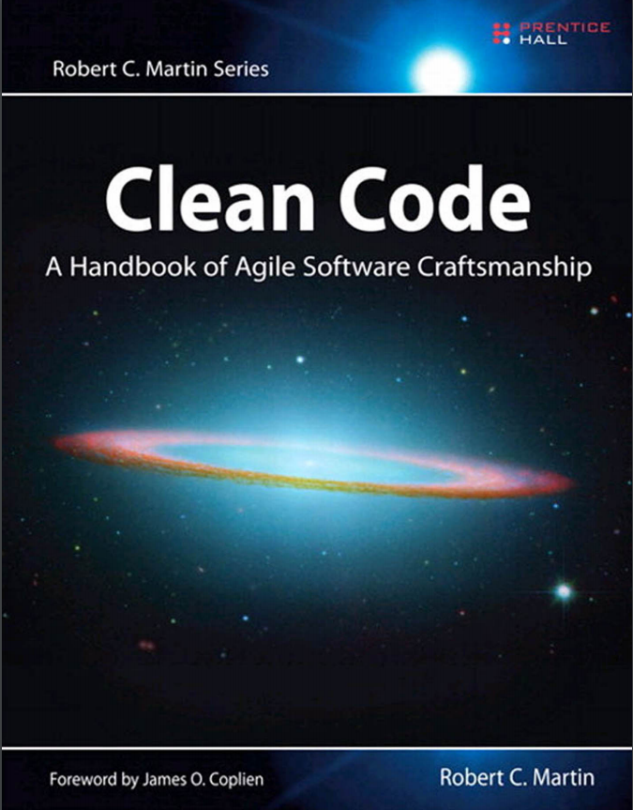
SOLID Class Design Principles
In this talk, we will refer to the SOLID principles examples in this book and also this website.
SOLID → five principles for object-oriented class design i.e.
best guidelines for building a maintainable object-oriented system.

Slide 3
SOLID Class Design Principles
S Single Responsibility Principle (SRP). Classes should have one, and only one, reason to change. Keep your classes small and single-purposed.
O Open-Closed Principle (OCP). Design classes to be open for extension but closed for modification; you should be able to extend a class without modifying it. Minimize the need to make changes to existing classes.
L Liskov Substitution Principle (LSP). Subtypes should be substitutable for their base types. From a client’s perspective, override methods shouldn’t break functionality.
I Interface Segregation Principle (ISP). Clients should not be forced to depend on methods they don’t use. Split a larger interface into a number of smaller interfaces.
D Dependency Inversion Principle (DIP). High-level modules should not depend on low-level modules; both should depend on abstractions. Abstractions should not depend on details; details should depend on abstractions.

Slide 4
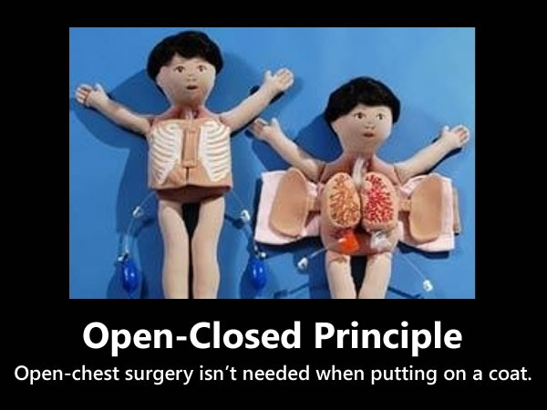

Slide 5
Change happens!
“All systems change during their lifecycles. This must be borne in mind when developing systems expected to last longer than the first version.”
(Jacobson et al., 1992)
Notes:
http://blogs.msdn.com/b/cdndevs/archive/2009/07/15/the-solid-principles-explained-with-motivational-posters.aspx

Slide 6
“O” in SOLID - Open-Closed Principle
The Open/Closed Principle
Software entities (classes, modules, methods, etc.) should be open for extension but closed for modification.
Notes:
http://blogs.msdn.com/b/cdndevs/archive/2009/07/15/the-solid-principles-explained-with-motivational-posters.aspx

Slide 7
“O” in SOLID - Open-Closed Principle
The Open/Closed Principle
Software entities (classes, modules, methods, etc.) should be open for extension but closed for modification.
The idea is that it’s often better to make changes to things like classes by adding to or building on top of them (using mechanisms like subclassing or polymorphism) rather than modifying their code.
Notes:
http://blogs.msdn.com/b/cdndevs/archive/2009/07/15/the-solid-principles-explained-with-motivational-posters.aspx

Slide 8
OCP - avoidance of rigid code
When a single change to a program results in a cascade of changes to dependent modules:
→ design smells of rigidity.
OCP advice:
refactor the system so further changes of that kind will not cause more modifications.
OCP ideal:
further changes of that kind are achieved by adding new code, NOT by changing code that already exists.

Slide 9

Open and Closed? Contradiction?

Slide 10
Open and Closed? Contradiction?
Open For Extension:
the behavior of the module can be extended.
the module can be made to behave in new and different ways as the requirements of the application change.
Closed for Modification:
extending the behaviour of the module does not result in changes to the source (or binary) code of the module.

Slide 11
Open and Closed? Contradiction?
The normal way to extend the behavior of a module is to make changes to the source code of that module.
A module that cannot be changed is normally thought to have a fixed behavior.
How can these two opposing attributes be resolved?

Slide 12
Abstraction
Create abstractions that:
are fixed.
will be the abstract base classes.
represent an unbounded group of possible behaviours (i.e. all the possible derived classes).
It is possible for a module to manipulate an abstraction.
The abstraction is:
Closed for modification – it is fixed.
Open for extension – can create new derivative classes of the abstraction.

Slide 13
Open-Closed Principle
So, the idea is that it’s often better to
make changes to things like classes by
adding to or building on top of them
(using mechanisms like
sub-classing or polymorphism)
rather than modifying their code.
Notes:
http://blogs.msdn.com/b/cdndevs/archive/2009/07/15/the-solid-principles-explained-with-motivational-posters.aspx

Slide 14
Open-Closed Principle
OCP states:
Design modules that never change.
When requirements change:
you extend the behavior of such modules by adding new code.
not by changing old code that already works.

Slide 15
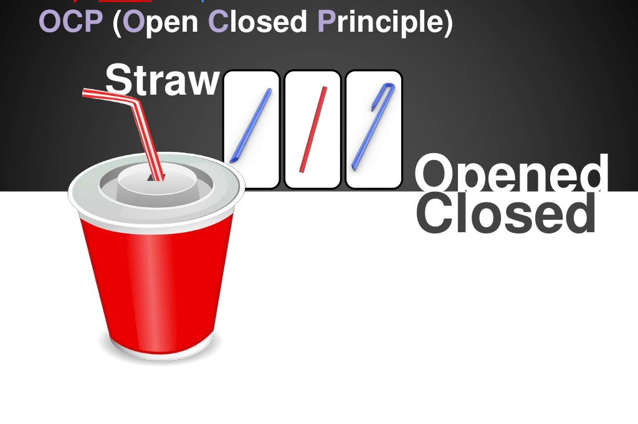

Slide 16
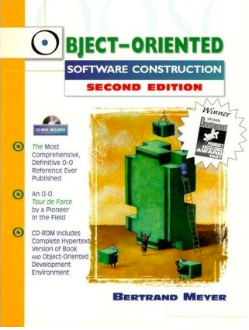
Source Material - OCP first characterized in OOSC...
“The book, known among its fans as "OOSC", presents object technology as an answer to major issues of software engineering, with a special emphasis on addressing the software quality factors of correctness, robustness, extendibility and reusability. It starts with an examination of the issues of software quality, then introduces abstract data types as the theoretical basis for object technology and proceeds with the main object-oriented techniques: classes, objects, genericity, inheritance, Design by Contract,concurrency, and persistence. It includes extensive discussions of methodological issues.”
http://en.wikipedia.org/wiki/Object-Oriented_Software_Construction
http://en.wikipedia.org/wiki/Open/closed_principle

Slide 17
An Abstract Example of OCP

Slide 18
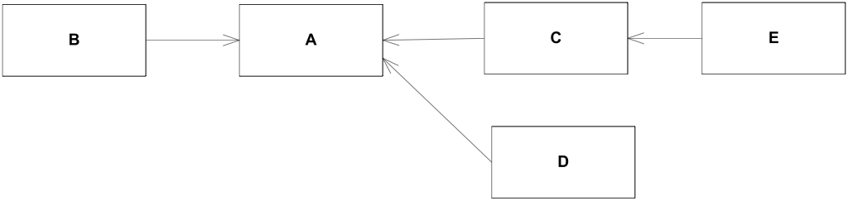
Example (1)
Module A is used by client modules B, C, D, which may themselves have their own clients (E).

Slide 19
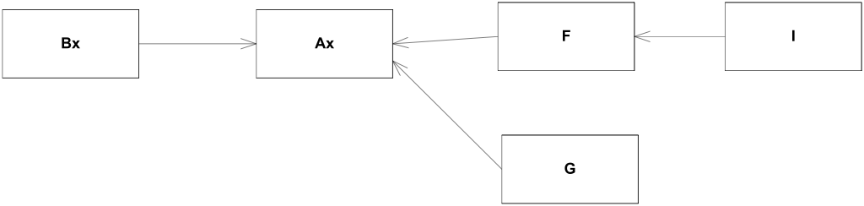
Example (2)
A new client – Bx – requires an extended or adapted version of A –called Ax.
Further clients of Ax are developed (F, G, I)

Slide 20
Example (3)
With non-OO methods, there are two solutions:
Adapt module A so that it will offer the extended or modified functionality required by the new clients.
Leave A as it is, make a copy, change the module’s name to Ax, and perform all the necessary adaptations on the new module. With this technique Ax retains no further connection to A.

Slide 21
Solution-1 (modify A’s functionality)
A may have been around for a long time and have many clients such as B, C and D.
The adaptations needed to satisfy the new clients’ requirements may invalidate the assumptions on the basis of which the old ones used A.
Change to A may start a dramatic series of changes in clients, clients of clients and so on.
Nightmare scenario:
Entire parts of the software that were supposed to have been finished and sealed are reopened, triggering a new cycle of development, testing, debugging and documentation.

Slide 22
Solution-2 (copy A, paste as Ax)
On the surface, solution 2 seems better as it does not require modifying any existing software.
But this solution may be even more catastrophic since it only postpones the day of reckoning.
Leads to an explosion of variants of the original modules, many of them very similar to each other although never quite identical.

Slide 23
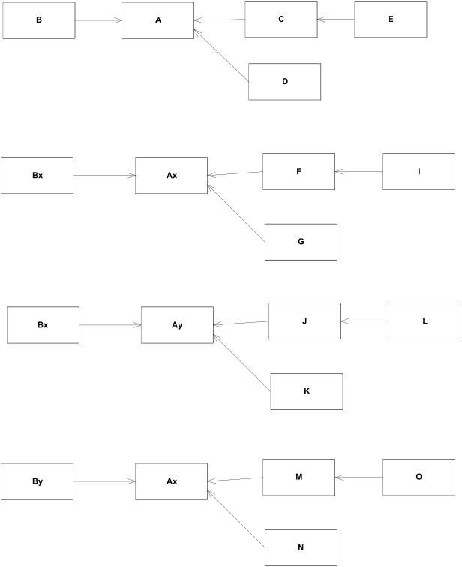
Solution-2
Abundance of modules, not matched by abundance of available functionality (many of the apparent variants being in fact quasi-clones), creates a huge configuration management problem.

Slide 24
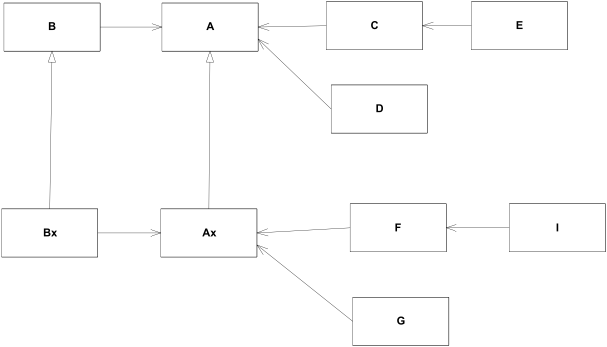
OO Solution – Abstraction, Interfaces & Inheritance
Using interfaces and inheritance developers can adopt a much more incremental approach.

Slide 25
Returning to Abstraction
In Java it is possible to create abstractions that are fixed and yet represent an unbounded group of possible behaviors:
Specified as interfaces and abstract classes.
The unbounded group of possible behaviors is represented as derived classes and classes that implement the interfaces.
A module can implement these abstractions:
Can be closed for modification since it fulfills an abstraction that is fixed.
Yet the behavior of that module can be extended by creating new implementations of the abstraction.

Slide 26
Client and Server
Example

Slide 27
Client is not open and closed
Client
Server
Both Client and Server are concrete Java classes and Client uses Server.
If we want the Client to use a different server, the Client source code must be modified to use the new server class:
Client is directly coupled to Server.
Violation of OCP: extending the behaviour of Client results in modifications to its source code.

Slide 28
Client is both open and closed
Client
<<interface>> ClientInterface
ClientInterface is abstract with abstract member functions:
i.e. closed for modification.
Server implements ClientInterface.
Client uses ClientInterface:
However, objects of the Client class will be using objects of the derivative Server class.
If we want Client to use a different server class, a new derivative of the ClientInterface can be created. The Client class can remain unchanged.
i.e. open for extension.
Server

Slide 29
Shape Example

Slide 30
Shape Example
Application must be able to draw circles and squares on a standard GUI.
The circles and squares must be drawn in a particular order.
A list of the circles and squares will be created in the appropriate order and the program must walk the list in that order and draw each circle or square.

Slide 31
Shape Example 1 (violates OCP)
Shape
uses
<<enum>> ShapeType
extends
extends
Circle
Square
uses
Point
uses
uses
Server
uses
Notes:
Source: //https://steveschols.wordpress.com/2012/05/08/the-open-closed-principle-the-heart-of-object-oriented-design/

Slide 32
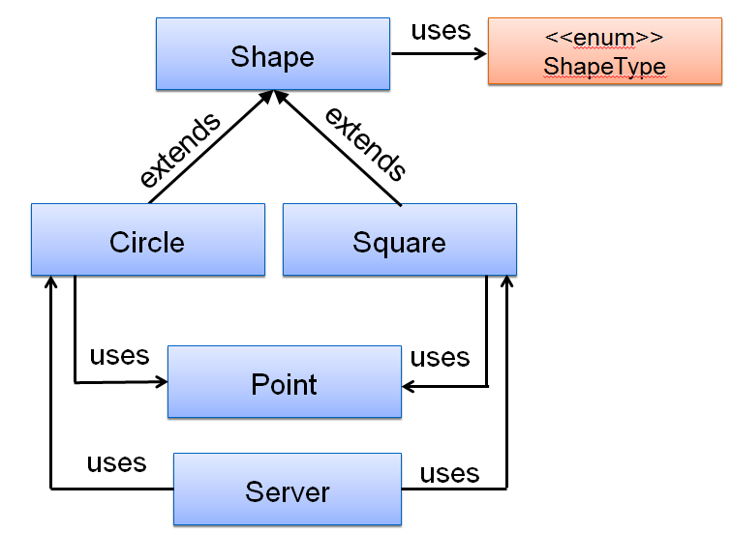
Shape Example 1 (violates OCP)
public class Point {
private double xCoord;
private double yCoord;
public Point(){
this.setxCoord(0.0);
this.setyCoord(0.0);
}
public Point(double xCoord, double yCoord){
this.setxCoord(xCoord);
this.setyCoord(yCoord);
}
// getter and setter methods…
}
public class Shape
{
private ShapeType type;
// getter and setter…
}
public enum ShapeType
{
CIRCLE, SQUARE
}

Slide 33
Shape Example 1 (violates OCP)
public class Circle extends Shape
{
private double radius;
private Point center;
public Circle() {
super.setType(ShapeType.CIRCLE);
this.setRadius(10); //default size
this.setCenter(new Point()); //default location
}
// getter methods…
// setter methods…
}

Slide 34
Shape Example 1 (violates OCP)
public class Square extends Shape
{
private double length;
private Point leftCorner;
public Square() {
super.setType(ShapeType.SQUARE);
this.setLength(10); //default size
this.setLeftCorner(new Point()); //default location
}
// getter methods…
// setter methods…
}

Slide 35
Shape Example 1 (violates OCP)
public class Server {
void drawSquare(Square square) {
System.out.println("I'm drawing a square");
}
void drawCircle(Circle circle) {
System.out.println("I'm drawing a circle");
}
void drawAllShapes(List<Shape> shapes) {
for (Shape shape : shapes) {
switch (shape.getType()) {
case SQUARE:
drawSquare((Square) shape);
break;
case CIRCLE:
drawCircle((Circle) shape);
break;
}
}
}
public static void main(String args[]){
List<Shape> shapes = new ArrayList<>();
shapes.add(new Circle());
shapes.add(new Square());
shapes.add(new Circle());
Server app = new Server();
app.drawAllShapes(shapes);
}
}

Slide 36
Proposed Extension : Triangle
public class Triangle extends Shape
{
private Point pointA;
private Point pointB;
private Point pointC;
public Triangle()
{
super.setType(ShapeType.TRIANGLE);
this.setPointA(new Point());
this.setPointB(new Point());
this.setPointC(new Point());
}
// getter methods…
// setter methods…
}
public enum ShapeType
{
CIRCLE, SQUARE, TRIANGLE
}
Open for Extension?
Yes. New Triangle class.

Slide 37
Proposed Extension : Triangle
public class Server {
void drawSquare(Square square) {
System.out.println("I'm drawing a square");
}
void drawCircle(Circle circle) {
System.out.println("I'm drawing a circle");
}
void drawAllShapes(List<Shape> shapes) {
for (Shape shape : shapes) {
switch (shape.getType()) {
case SQUARE:
drawSquare((Square) shape);
break;
case CIRCLE:
drawCircle((Circle) shape);
break;
}
}
}
Open or Closed for Modification?

Slide 38
Proposed Extension : Triangle
void drawSquare(Square square) {
System.out.println("I'm drawing a square");
}
void drawCircle(Circle circle) {
System.out.println("I'm drawing a circle");
}
void drawTriangle(Triangle triangle) {
System.out.println("I'm drawing a triangle");
}
Server class
void drawAllShapes(List<Shape> shapes) {
for (Shape shape : shapes) {
switch (shape.getType()) {
case SQUARE:
drawSquare((Square) shape);
break;
case CIRCLE:
drawCircle((Circle) shape);
break;
case TRIANGLE:
drawTriangle((Triangle) shape);
break;
}
}
}
Class has to be modified to include new shape type –
Not Closed for Modification!

Slide 39
Shape Example 2 (conforming to OCP)
<<interface>> Shape
implements
implements
Circle
Square
uses
Point
uses
uses
Server
uses
Notes:
Source: //https://steveschols.wordpress.com/2012/05/08/the-open-closed-principle-the-heart-of-object-oriented-design/

Slide 40
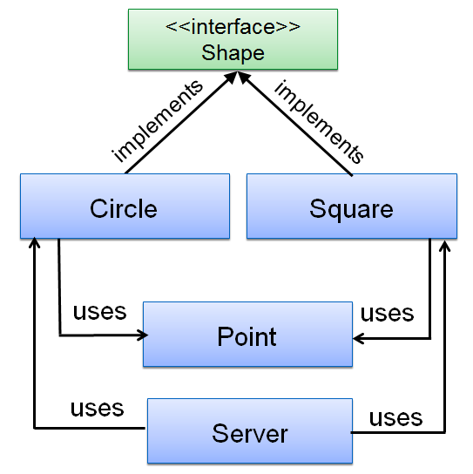
Shape Example 2 (conforming to OCP)
public class Circle implements Shape
{
private double radius;
private Point center;
public Circle() {
this.setRadius(10); //default size
this.setCenter(new Point()); //default location
}
public void draw()
{
System.out.println("I'm drawing a circle");
}
//getters and setters
}
Interface defines abstraction Shape.
Circle implements this abstraction.
public interface Shape
{
public void draw();
}

Slide 41
Shape Example 2 (conforming to OCP)
public class Square implements Shape
{
private double length;
private Point leftCorner;
public Square() {
this.setLength(10); //default size
this.setLeftCorner(new Point()); //default location
}
public void draw()
{
System.out.println("I'm drawing a square");
}
//getters and setters
}
Interface defines abstraction Shape.
Square implements this abstraction.
public interface Shape
{
public void draw();
}

Slide 42
Shape Example 2 (conforming to OCP)
public class Server
{
void drawAllShapes(List<Shape> shapes)
{
for (Shape shape : shapes)
{
shape.draw();
}
}
//rest of code…
}
drawAllShapes method is changed to refer to Shape only.

Slide 43
Open and Closed
Is Shape interface open to extension (e.g. Triangle)? Yes!
Is Server closed for this extensions? Yes!
public class Triangle implements Shape
{
private Point pointA;
private Point pointB;
private Point pointC;
public void draw()
{
System.out.println("I'm drawing a triangle");
}
}
public class Server
{
void drawAllShapes(List<Shape> shapes)
{
for (Shape shape : shapes)
{
shape.draw();
}
}
//rest of code…
}
Server’s behaviour can be extended without modification – it is closed.

Slide 44
Strategic Closure (1)
It should be clear that no significant program can be 100% closed.
Consider what would happen to the drawAllShapes methods (on the previous slide) if:
we decided that all Circles should be drawn before any Squares. The drawAllShapes method is NOT closed against a change like this.
In general, no matter how “closed” a module is, there will always be some kind of change against which it is not closed.
Notes:
http://www.objectmentor.com/resources/articles/ocp.pdf

Slide 45
Strategic Closure (2)
Since closure cannot be complete, it must be strategic.
That is, the designer must choose the kinds of changes against which to close his/her design.
This takes a certain amount of foresight derived from experience. The experienced designer knows the users and the industry well enough to judge the probability of different kinds of changes. S/he then makes sure that the open-closed principle is invoked for the most probable changes.
Notes:
http://www.objectmentor.com/resources/articles/ocp.pdf

Slide 46
OCP Summary
Without OCP:
code tends to have large switch statements or if-then constructions, possibly enums.
adding a new implementation (type) means adding new code to the client of the type.
the client of a class must be aware of all subclasses.
With OCP:
Use abstraction and dynamic binding to avoid dependency on a concrete class.
The abstraction is:
Closed for modification – it is fixed.
Open for extension – can create new derivative classes of the abstraction.

Slide 47
Additional References
Jacobson, I., Johnsson, P., Christerson, M. & Overgaard, G. (1992) Object-Oriented Software Engineering: A Use Case Driven Approach, Addison-Wesley.

