Slide 1
Introducing APIs

Slide 2
Agenda
Data Interchange Formats
CSV, Name/Value, YAML, XML, JSLN
Web vs APIs
API Exploration Tools
Chrome, Curl, Restlet Client

Slide 3
CSV
A comma-separated values (CSV) (also sometimes called character-separated values, because the separator character does not have to be a comma) file stores tabular data (numbers and text) in plain-text form. Plain text means that the file is a sequence of characters, with no data that has to be interpreted instead, as binary numbers. A CSV file consists of any number of records, separated by line breaks of some kind; each record consists of fields, separated by some other character or string, most commonly a literal comma or tab. Usually, all records have an identical sequence of fields.
http://en.wikipedia.org/wiki/Comma-separated_values
“mocha”, “costa”, 2.0, 3.5, 0
“americano”, “costa”, 3.0, 4.5, 1
“cappucino”, “starbucks”, 4.0, 1.5, 0
coffees.csv

Slide 4
Name/Value Pairs
A name–value pair, key–value pair, field–value pair or attribute–value pair is a fundamental data representation in computing systems and applications. Designers often desire an open-ended data structure that allows for future extension without modifying existing code or data. In such situations, all or part of the data model may be expressed as a collection of tuples <attribute name, value>; each element is an attribute–value pair. Depending on the particular application and the implementation chosen by programmers, attribute names may or may not be unique.
http://en.wikipedia.org/wiki/Attribute-value_pair
db.url=jdbc:cloudbees://pacemaker
db.driver=com.mysql.jdbc.Driver
db.user=pacemaker
db.pass=pacemaker
jpa.ddl=create
application .conf
name="mocha"
shop="costa"
rating=3.5
price=2.0
favourite=0
id=1
coffees.conf

Slide 5
YAML
YAML (/ˈjæməl/, rhymes with camel) is a human-readable data serialization format that takes concepts from programming languages such as C, Perl, and Python, and ideas from XML and the data format of electronic mail (RFC 2822). YAML was first proposed by Clark Evans in 2001,[1] who designed it together with Ingy döt Net[2] and Oren Ben-Kiki.[2] It is available for several programming languages.
YAML is a recursive acronym for "YAML Ain't Markup Language". Early in its development, YAML was said to mean "Yet Another Markup Language",[3] but it was then reinterpreted (backronyming the original acronym) to distinguish its purpose as data-oriented, rather than document markup.
http://en.wikipedia.org/wiki/YAML
Coffee(c1):
name : mocha
shop : costa
price : 2.0
rating : 3.5
favourite : 0
Coffee(c2):
name : americano
shop : costa
price : 3.0
rating : 4.5
favourite : 1
Coffee(c3):
name : cappucino
shop : starbucks
price : 4.0
rating : 1.5
favourite : 0
data.yaml

Slide 6
XML
Extensible Markup Language (XML) is a markup language that defines a set of rules for encoding documents in aformat that is both human-readable and machine-readable. It is defined in the XML 1.0 Specification[3] produced by theW3C, and several other related specifications,[4] all free open standards.[5]
The design goals of XML emphasize simplicity, generality, and usability over the Internet.[6] It is a textual data format with strong support via Unicode for the languages of the world. Although the design of XML focuses on documents, it is widely used for the representation of arbitrary data structures, for example in web services.
Many application programming interfaces (APIs) have been developed to aid software developers with processing XML data, and several schema systems exist to aid in the definition of XML-based languages.
http://en.wikipedia.org/wiki/XML
<?xml version="1.0" encoding="UTF-8"?>
<coffee objname="c1">
<name> mocha </name>
<shop> costa </shop>
<price> 2.0 </price>
<rating> 3.5</rating>
<favourite> 0 </favourite>
</coffee>
<coffee objname="c1">
<name> americano </name>
<shop> costa </shop>
<price> 3.0 </price>
<rating> 4.5 </rating>
<favourite> 1 </favourite>
</coffee>
<coffee objname="c1">
<name> cappucino </name>
<shop> starbucks </shop>
<price> 4.0 </price>
<rating> 1.5 </rating>
<favourite> 0 </favourite>
</coffee>
data.xml

Slide 7
JSON
JSON (/ˈdʒeɪsɒn/ jay-sawn, /ˈdʒeɪsən/ jay-sun), or JavaScript Object Notation, is a text-based open standard designed for human-readable data interchange. Derived from the JavaScript scripting language, JSON is a language for representing simple data structures and associative arrays, called objects. Despite its relationship to JavaScript, JSON is language-independent, with parsers available for many languages.
The JSON format was originally specified by Douglas Crockford, and is described in RFC 4627. The official Internet media type for JSON is application/json. The JSON filename extension is .json.
The JSON format is often used for serializing and transmitting structured data over a network connection. It is used primarily to transmit data between a server and web application, serving as an alternative to XML.
http://en.wikipedia.org/wiki/JSON
{
"name":"mocha",
"shop":"costa",
"rating":3.5,
"price":2.0,
"favourite":0,
"id":1
},
{
"name":"americano",
"shop":"costa",
"rating":4.5,
"price":3.0,
"favourite":1,
"id":2
},
{
"name":"cappuccino lite",
"shop":"starbucks",
"rating":1.5,
"price":4.0,
"favourite":1,
"id":3
}

Slide 8

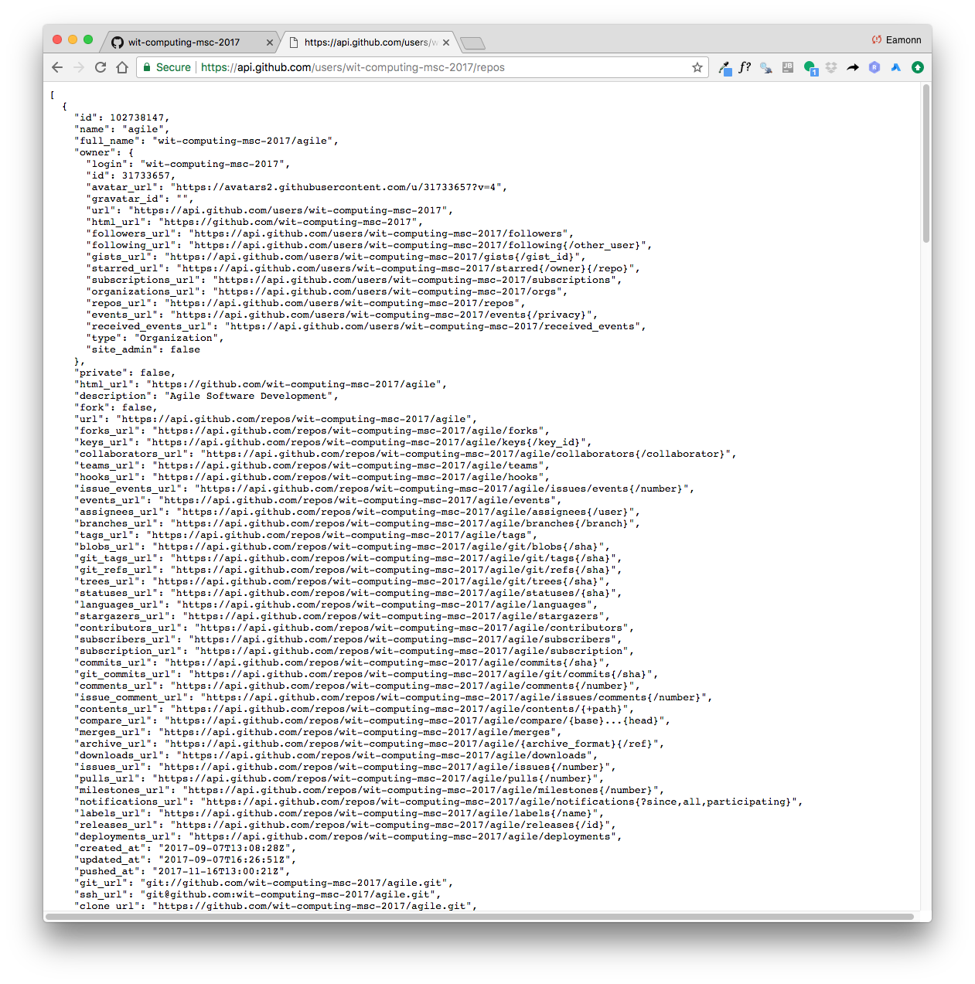
Web vs API
Both use HTTP:
GET, PUT, POST, DELETE etc…
Web
request formulated by browser
HTML response
API
request formulated by program (typically)
JSON response (typically)
Web
API

Slide 9
Web
Chrome
https://github.com/wit-computing-msc-2017

Slide 10
API
Chrome
https://api.github.com/users/wit-computing-msc-2017/repos

Slide 11
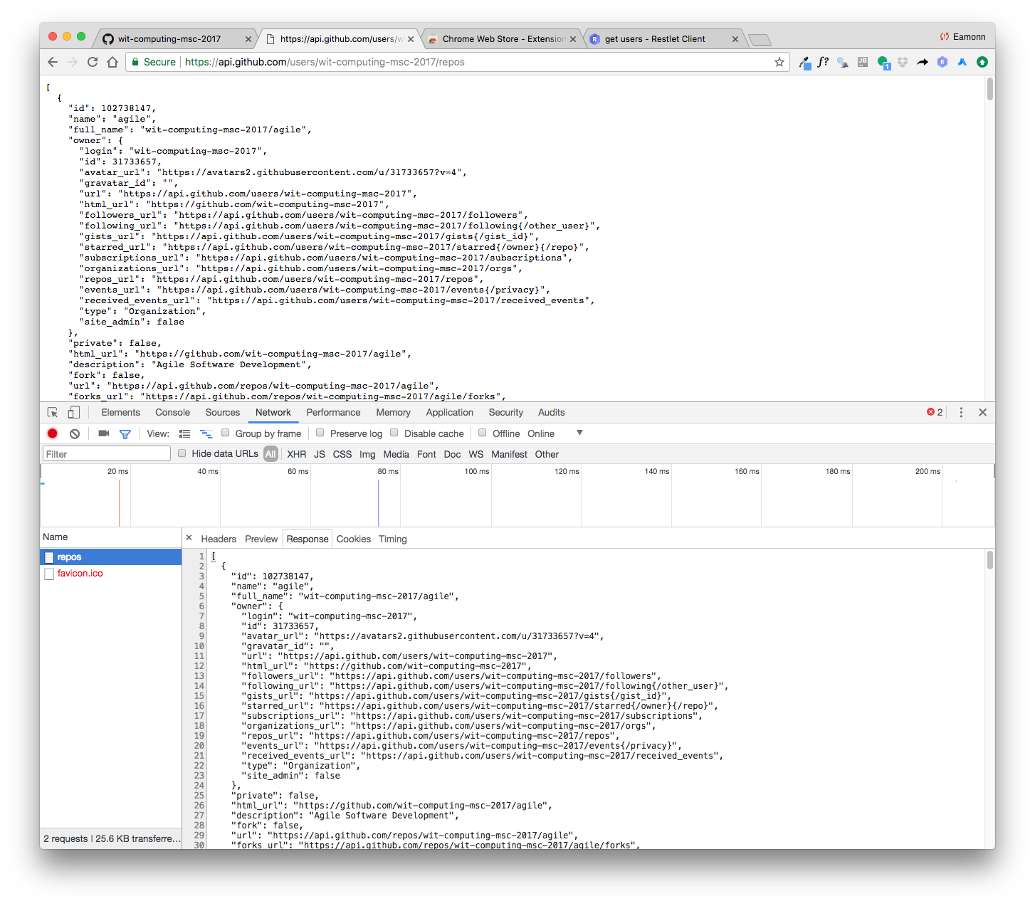
Chrome Developer tools

Slide 12
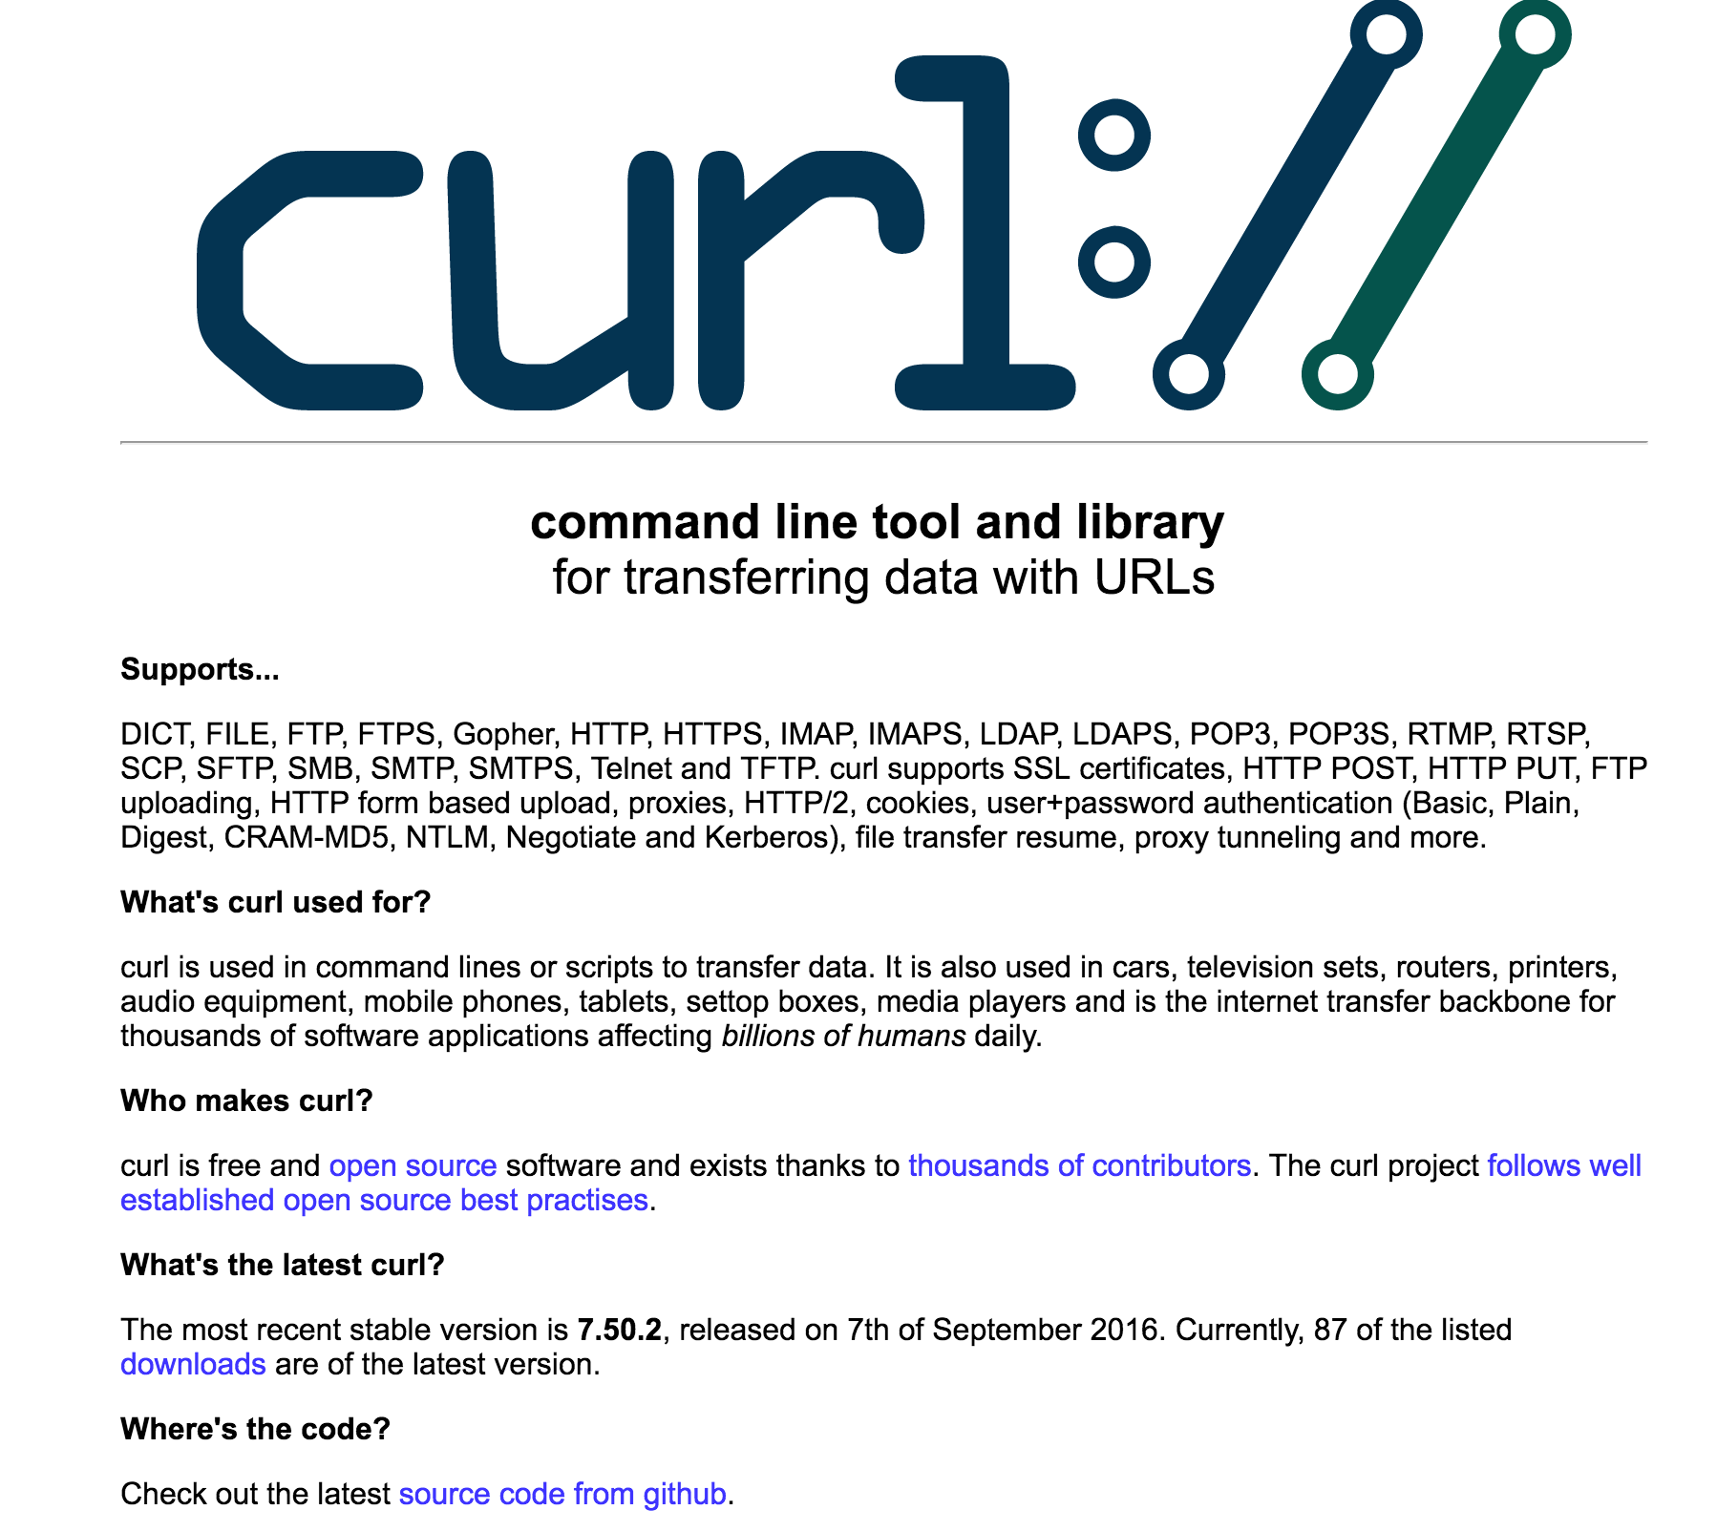
Curl: https://curl.haxx.se/
Command Line Application
$ curl https://api.github.com/users/wit-computing-msc-2017/repos

Slide 13
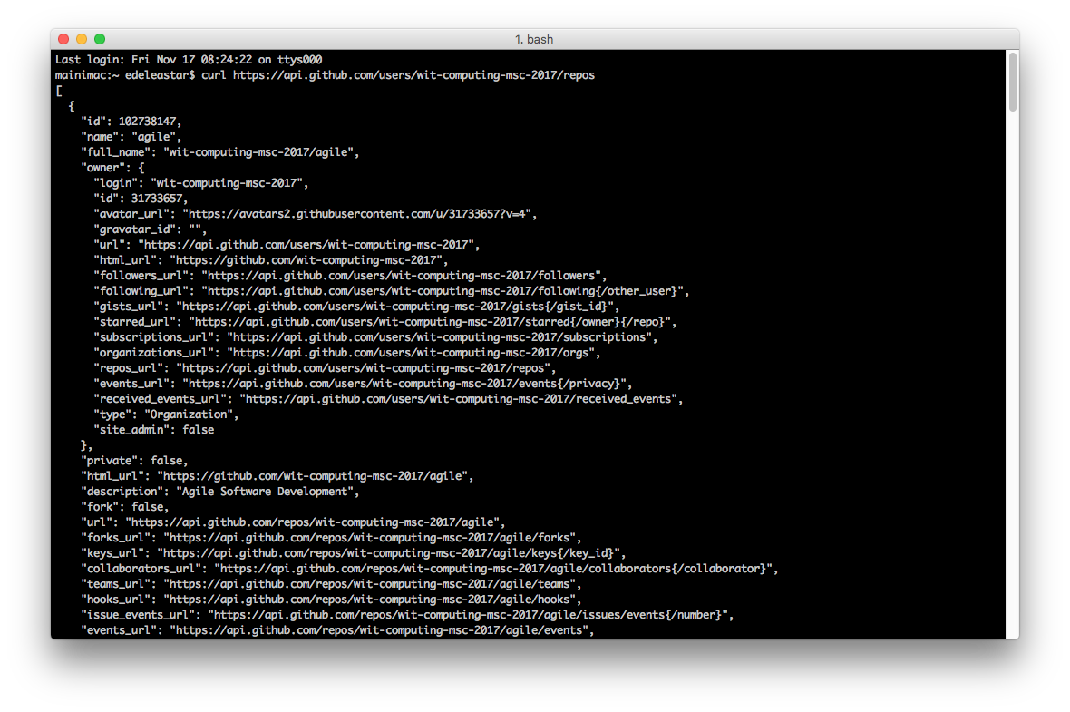
$ curl https://api.github.com/users/wit-computing-msc-2017/repos

Slide 14
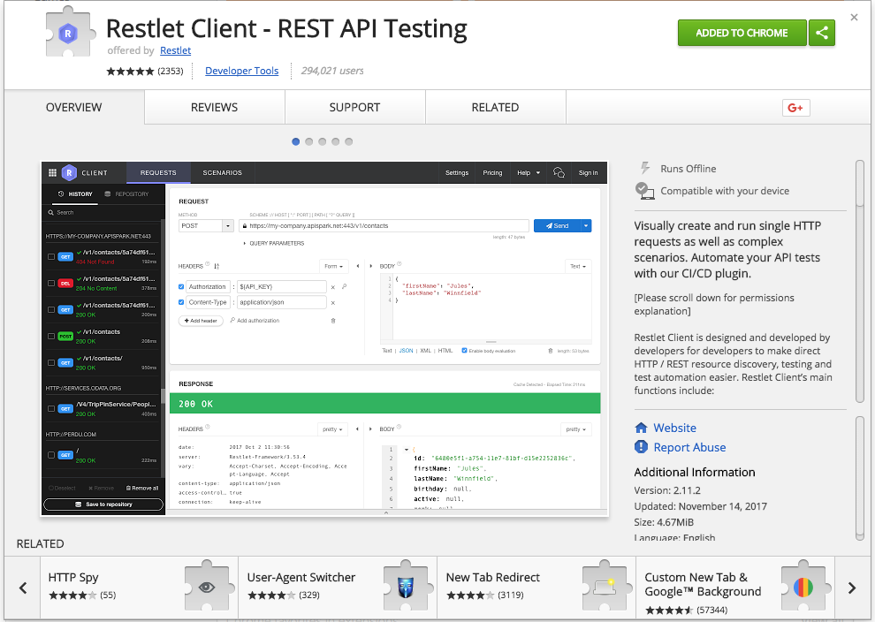
Chrome Extension

Slide 15
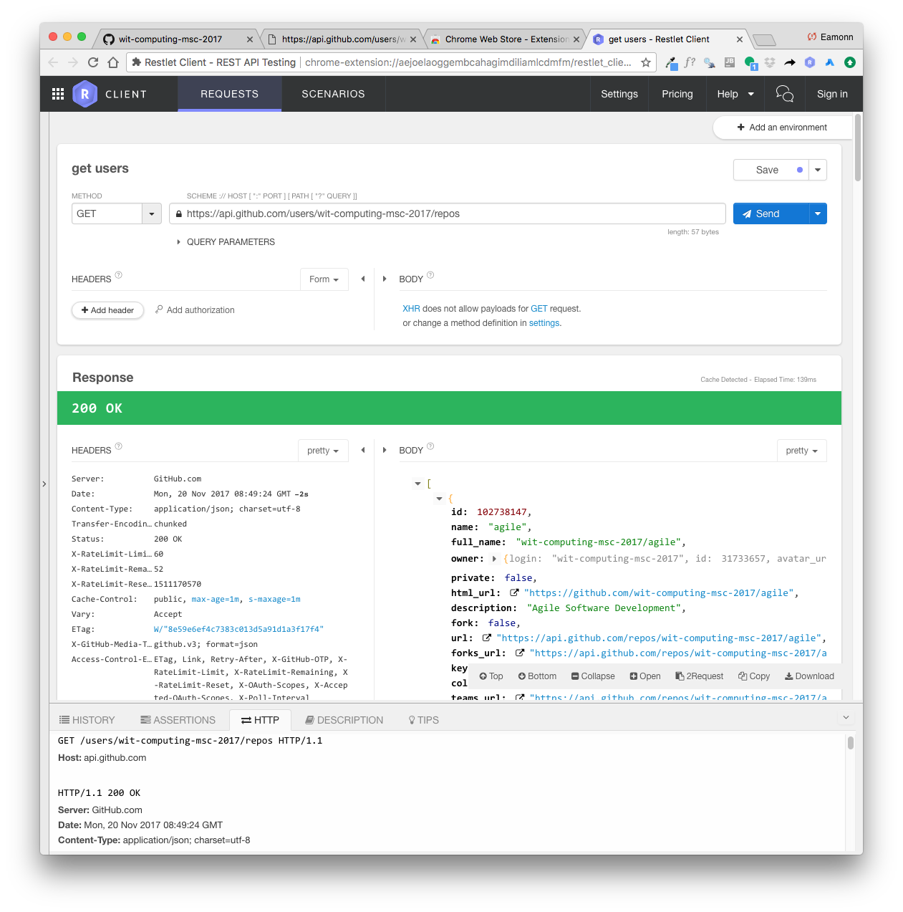
Chrome Extension

