Slide 1
Javalin

Slide 2
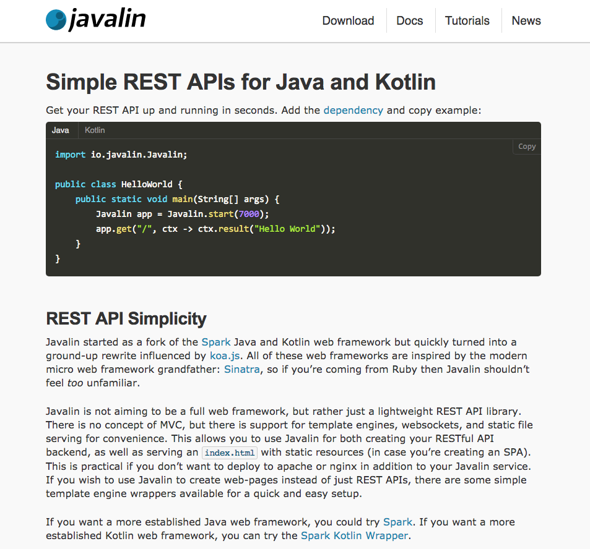

Slide 3
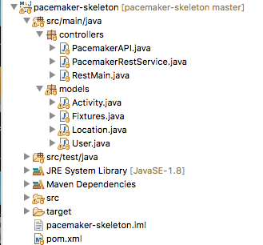
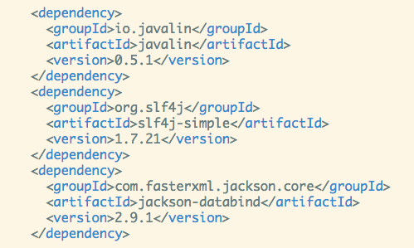
pacemaker-skeleton
Extend project to include Javalin components
pom.xml

Slide 4
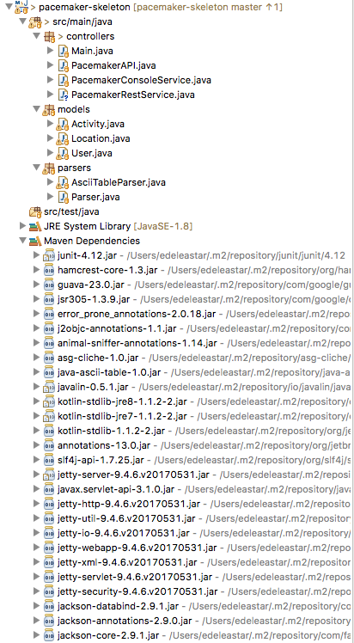
Eclipse downloads and injects range of components to support creation of REST services, including
web server
http protocol support
json/java translation

Slide 5
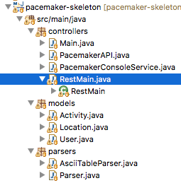
Leave existing application sources in place
Introduce a new main() method to start the application
package controllers;
import io.javalin.Javalin;
public class RestMain {
public static void main(String[] args) throws Exception {
Javalin app = Javalin.start(7000);
}
}

Slide 6
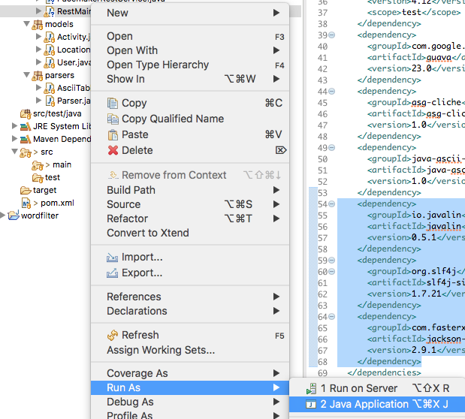
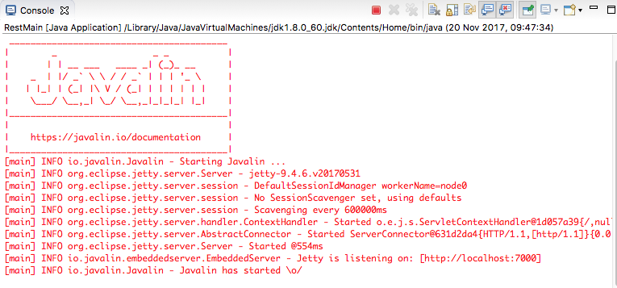
Launch this new main

Slide 7
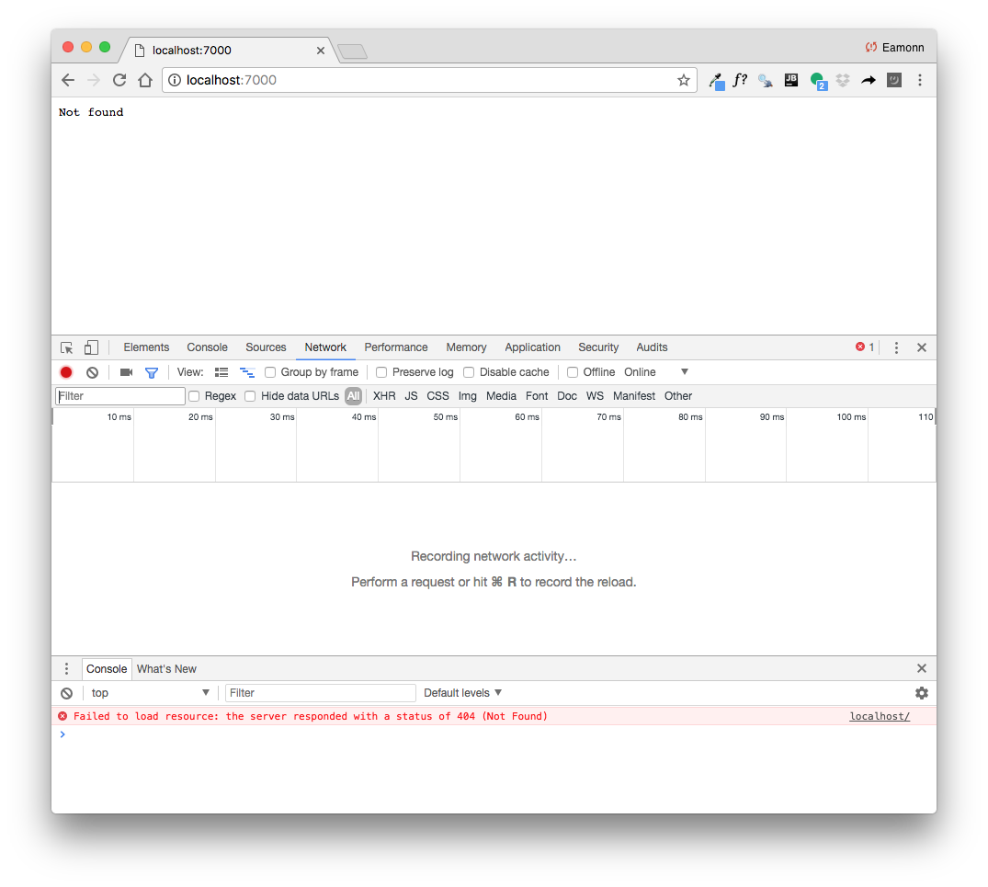
Web Application (which will serve an API) running on local workstation

Slide 8
package controllers;
import io.javalin.Javalin;
public class RestMain {
public static void main(String[] args) throws Exception {
Javalin app = Javalin.start(7000);
PacemakerRestService service = new PacemakerRestService();
configRoutes(app, service);
}
static void configRoutes(Javalin app, PacemakerRestService service) {
app.get("/users", ctx -> {
service.listUsers(ctx);
});
}
}
Extend main to define REST API
package controllers;
import io.javalin.Context;
public class PacemakerRestService {
PacemakerAPI pacemaker = new PacemakerAPI();
public void listUsers(Context ctx) {
// TODO: return users in json format
}
}
First version of API (stubb)

Slide 9
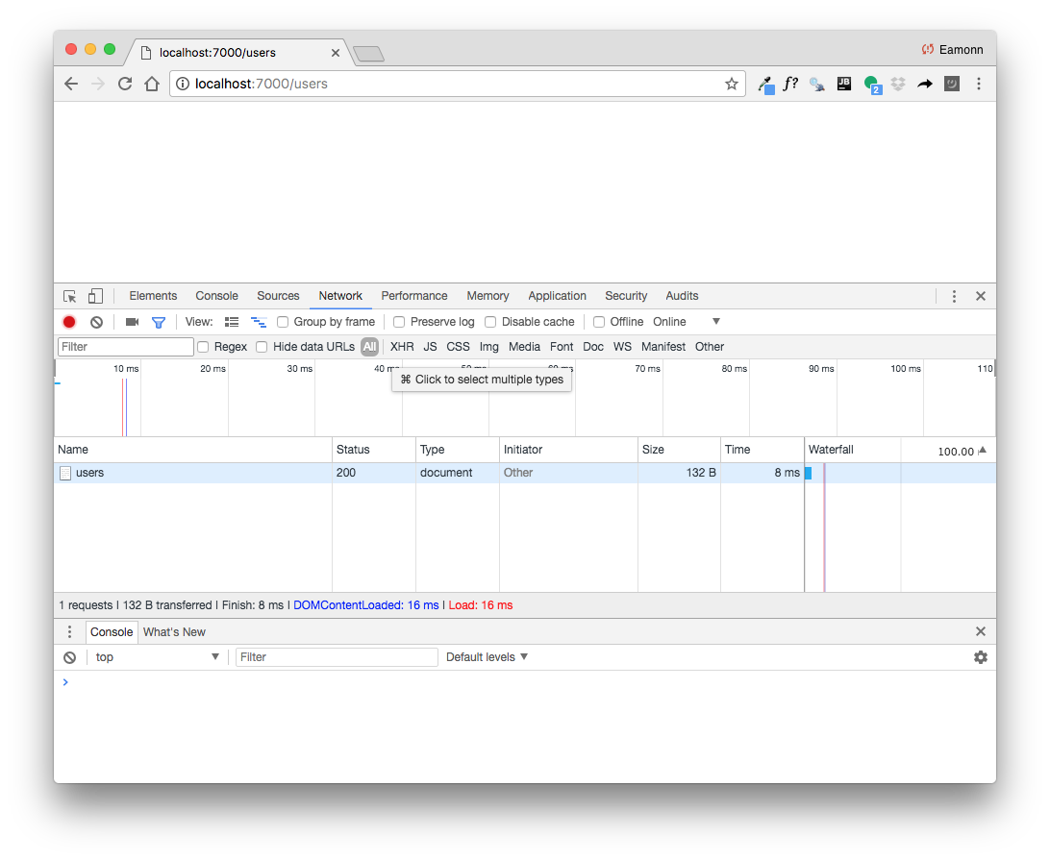
package controllers;
import io.javalin.Context;
public class PacemakerRestService {
PacemakerAPI pacemaker = new PacemakerAPI();
public void listUsers(Context ctx) {
// TODO: return users in json format
}
}
listUsers () should query pacemakerAPI and return users in json format

Slide 10
package controllers;
import io.javalin.Context;
public class PacemakerRestService {
PacemakerAPI pacemaker = new PacemakerAPI();
public void listUsers(Context ctx) {
ctx.json(pacemaker.getUsers());
}
}
Fetch list of users from pacemaker.
Convert list to JSON.
Send JSON list as response to client

Slide 11
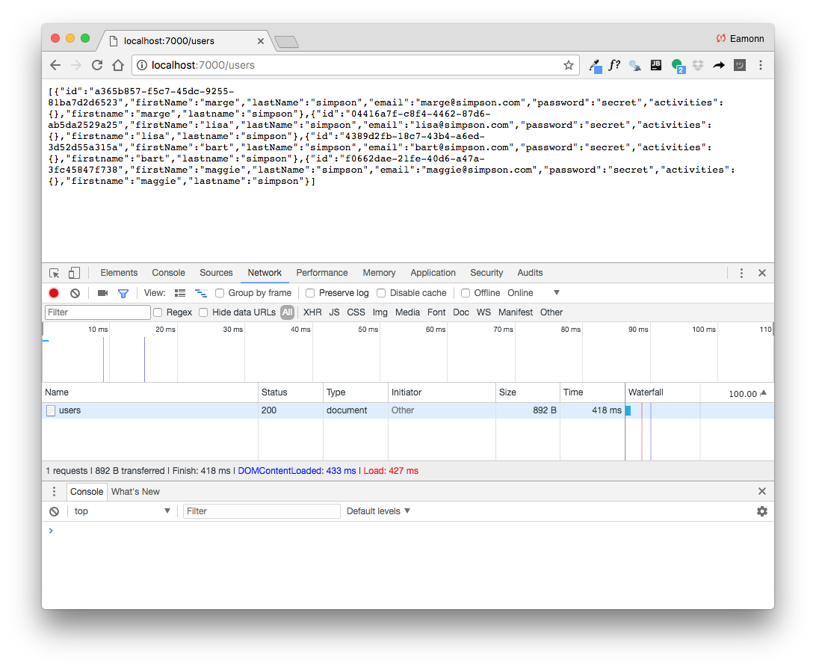

Slide 12
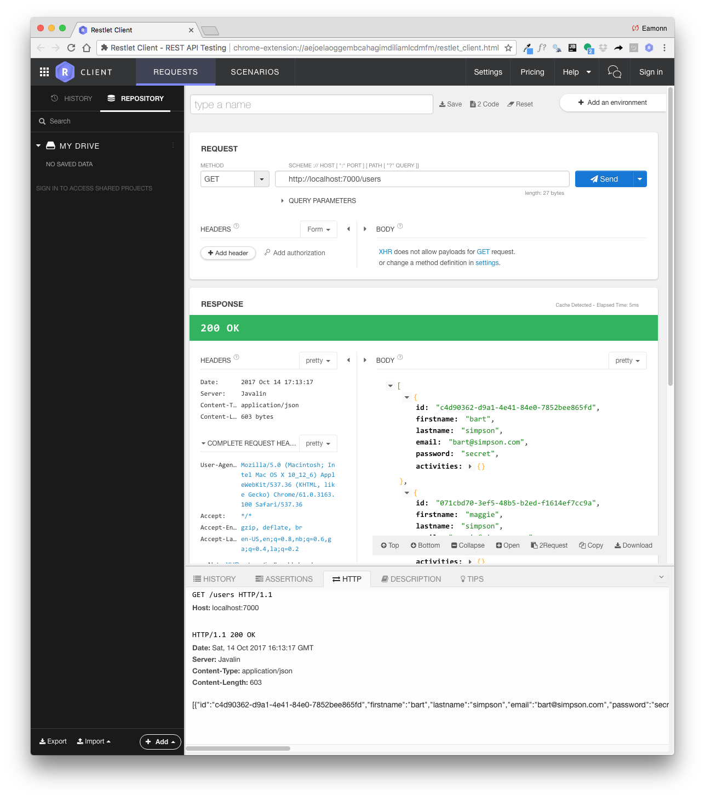

Slide 13
pacemaker Endpoints
GET /users : read all users
POST /users : create a new user
GET /users/id : get a specific user (by id)
GET /users/id/activities : get activities for specific user (by id)
POST /users/id/activities : create activity for specific user (by id)
Endpoints deliver API for user and activity resources
Access to API from any REST away client

Slide 14
GET /users : read all users
POST /users : create a new user
GET /users/id : get a specific user (by id)
GET /users/id/activities : get activities for specific user (by id)
POST /users/id/activities : create activity for specific user (by id)
Endpoint Interface
static void configRoutes(Javalin app, PacemakerRestService service) {
app.get("/users", ctx -> {
service.listUsers(ctx);
});
app.post("/users", ctx -> {
service.createUser(ctx);
});
app.get("/users/:id", ctx -> {
service.listUser(ctx);
});
app.get("/users/:id/activities", ctx -> {
service.getActivities(ctx);
});
app.post("/users/:id/activities", ctx -> {
service.createActivity(ctx);
});
Routes:
here we define the supported endpoints

Slide 15
Create User Endpoint
POST /users : create a new user
Endpoint Interface
app.post("/users", ctx -> {
service.createUser(ctx);
});
Endpoint Implementation
public void createUser(Context ctx) {
User user = ctx.bodyAsClass(User.class);
User newUser = pacemaker
.createUser(user.firstname, user.lastname, user.email, user.password);
ctx.json(newUser);
}

Slide 16
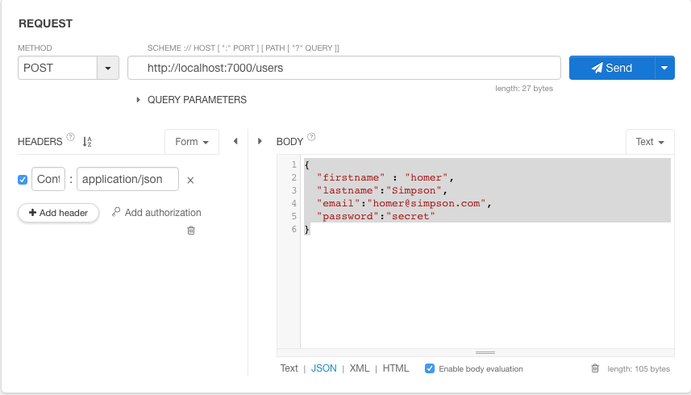
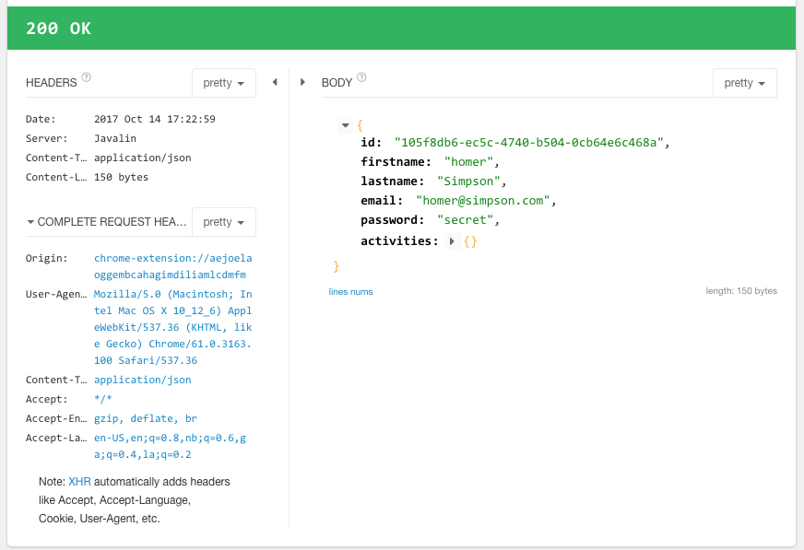
Formulate POST request
Testing the Endpoint
Inspect response

Slide 17
public void createUser(Context ctx) {
User user = ctx.bodyAsClass(User.class);
User newUser = pacemaker
.createUser(user.firstname, user.lastname, user.email, user.password);
ctx.json(newUser);
}

Slide 18
Covert incoming JSON object to Java Object
public void createUser(Context ctx) {
User user = ctx.bodyAsClass(User.class);
User newUser = pacemaker
.createUser(user.firstname, user.lastname, user.email, user.password);
ctx.json(newUser);
}
Create object using pacemaker
Convert new user object (including id) to json and return to client

Slide 19
POST /users/id/activities : create activity for specific user (by id)
app.post("/users/:id/activities", ctx -> {
service.createActivity(ctx);
});
public void createActivity(Context ctx) {
String id = ctx.param("id");
User user = pacemaker.getUser(id);
if (user != null) {
Activity activity = ctx.bodyAsClass(Activity.class);
Activity newActivity = pacemaker
.createActivity(id, activity.type, activity.location, activity.distance);
ctx.json(newActivity);
} else {
ctx.status(404);
}
}

Slide 20
POST /users/id/activities : create activity for specific user (by id)
app.post("/users/:id/activities", ctx -> {
service.createActivity(ctx);
});
Retrieve user id from url
public void createActivity(Context ctx) {
String id = ctx.param("id");
User user = pacemaker.getUser(id);
if (user != null) {
Activity activity = ctx.bodyAsClass(Activity.class);
Activity newActivity = pacemaker
.createActivity(id, activity.type, activity.location, activity.distance);
ctx.json(newActivity);
} else {
ctx.status(404);
}
}
Lookup user in pacemaker
Recover activity payload from request
Return ‘not found’ if no mathing user (by id)
Create new activity & return it to client

