Slide 1


Java Control Statements An introduction to the Java Programming Language
Produced
by:
Eamonn de Leastar (edeleastar@wit.ie)
Dr. Siobhan Drohan (sdrohan@wit.ie)

Slide 2
Essential Java
Overview
Introduction
Syntax
Basics
Arrays
Classes
Classes Structure
Static Members
Commonly used Classes
Control Statements
Control Statement Types
If, else, switch
For, while, do-while
Inheritance
Class hierarchies
Method lookup in Java
Use of this and super
Constructors and inheritance
Abstract classes and methods
Interfaces
Collections
ArrayList
HashMap
Iterator
Vector
Enumeration
Hashtable
Exceptions
Exception types
Exception Hierarchy
Catching exceptions
Throwing exceptions
Defining exceptions
Common exceptions and errors
Streams
Stream types
Character streams
Byte streams
Filter streams
Object Serialization

Slide 3
Overview: Road Map
Control Statement Types
If, else, switch
For, while, do-while

Slide 4
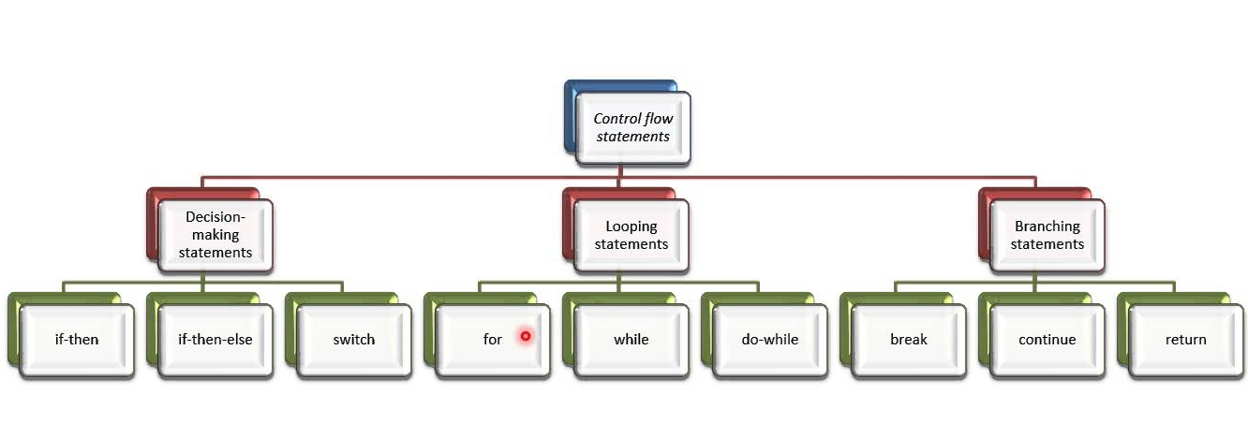
What are Control Statements?
Control statements are statements that control execution of other statements

Slide 5
Overview: Road Map
Control Statement Types
If, else, switch
For, while, do-while

Slide 6
if statement syntax
boolean condition to be tested
‘if’ keyword
actions if condition is true
if(perform some test)
{
Do these statements if the test gave a true result
}

Slide 7
Example if Statement
int i = 1;
if(i > 0)
{
System.out.println("Greater than zero");
}
int i = 1;
if(i > 0)
System.out.println("Greater than zero");
int i = 3;
if(i > 2)
{
System.out.println("Greater than zero");
System.out.println("Greater than one");
System.out.println("Greater than two");
}

Slide 8
if-else statement syntax
boolean condition to be tested
‘if’ keyword
actions if condition is true
if(perform some test) {
Do these statements if the test gave a true result
}
else {
Do these statements if the test gave a false result
}
actions if condition is false
‘else’ keyword

Slide 9
Example if-else Statement
int i = 1;
if(i > 0)
System.out.println("Greater than zero");
else
System.out.println("Not greater than zero");
Braces can be omitted if single statements used.
int i = 3;
if(i > 2)
{
System.out.println("Greater than zero");
System.out.println("Greater than one");
System.out.println("Greater than two");
}
else
{
System.out.println("Either equal to two");
System.out.println("Or less than two");
}

Slide 10
Nested if statements
if (condition)
{
if(nested_condition1)
{
nested_action1;
}
else
{
if(nested_condition2)
{
nested_action2;
}
else
{
nested_action3;
}
}
}
else
{
action2;
}
Any form of if statement can be nested
There can be other if statements within of if statements

Slide 11
Example Nested Statement
int i = 3;
if(i > 2)
{
System.out.println("Greater than zero");
System.out.println("Greater than one");
System.out.println("Greater than two");
}
else
{
if(i == 2)
System.out.println("Equal to two");
else
System.out.println("Less than two");
}

Slide 12
More if statement syntax
if(condition1…perform some test)
{
Do these statements if condition1 gave a true result
}
else if(condition2…perform some test)
{
Do these statements if condition1 gave a false result and condition2 gave a true result
}
else
{
Do these statements if both condition1 and
condition2 gave a false result
}

Slide 13
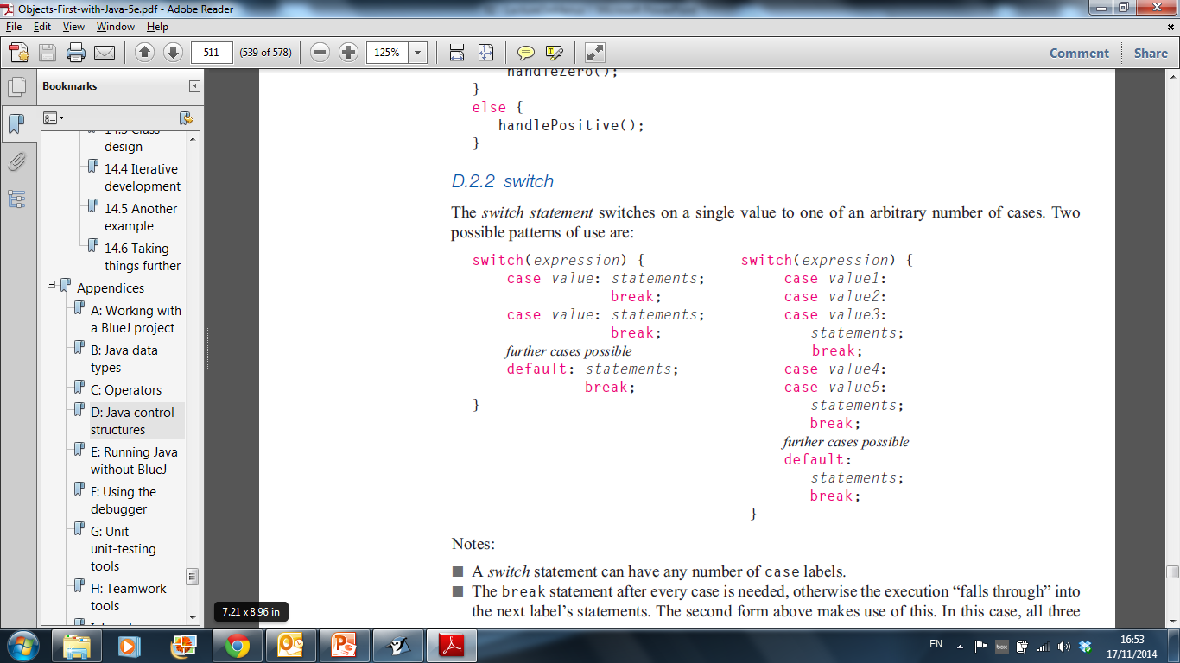
The switch statement – pattern one
Pre Java 7: can switch on int and char.
Post Java 7: can also switch on String
A switch statement can have any number of case labels.

Slide 14
The switch statement – pattern two
The break statement stops execution “falling through” into the next label’s statements.
The default case is optional.

Slide 15
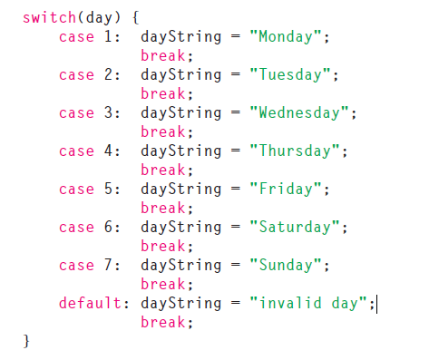
The switch statement – example 1

Slide 16
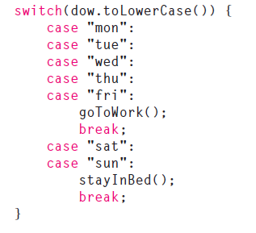
The switch statement – example 2

Slide 17
The switch statement – example 3
switch (group){
case 'A':
System.out.println("10.00 a.m ");
break;
case 'B':
System.out.println("1.00 p.m ");
break;
case 'C':
System.out.println("11.00 a.m ");
break;
default:
System.out.println(“Enter option A, B or C only!");
}

Slide 18
Example switch statement…
int i = 2;
switch(i)
{
case 1: System.out.println("1");
case 2: System.out.println("2");
case 3: System.out.println("3");
default: System.out.println("default");
}
Console
2
3
default
Console
int i = 2;
switch(i)
{
case 1: System.out.println("1"); break;
case 2: System.out.println("2"); break;
case 3: System.out.println("3"); break;
default: System.out.println("default");
}
2

Slide 19
…Example switch statement
int i = 2;
switch(i)
{
case 1:
System.out.println("1");
break;
case 2:
case 3:
System.out.println("2");
System.out.println("or");
System.out.println("3");
break;
default:
System.out.println("default");
}
Console
2
or
3

Slide 20
Overview: Road Map
Control Statement Types
If, else, switch
For, while, do-while

Slide 21
for loop - pseudo-code
General form of a for loop
for(initialization; boolean condition; post-body action)
{
statements to be repeated
}

Slide 22
for loop - syntax
for(int i = 0; i < 4; i++)
for(initialization; boolean condition; post-body action)
{
statements to be repeated
}

Slide 23
for loop - example
Console
for(int i=1; i<5; i++)
{
System.out.println("Index is equal to " + i);
}
Index is equal to 1
Index is equal to 2
Index is equal to 3
Index is equal to 4
int i=1;
for(;;)
{
System.out.println("Infinite loop");
if(i==2) break;
i++;
}
Console
Infinite loop
Infinite loop

Slide 24
while loop - pseudo code
General form of a while loop
while keyword
boolean condition
while(loop condition) {
loop body
}
Statements to be repeated
Pseudo-code expression of the actions of a while loop
while we wish to continue, do the things in the loop body

Slide 25
while loop
Declare and initialise loop control variable (LCV)
while(condition based on LCV)
{
“do the job to be repeated”
“update the LCV”
}
This structure should always be used

Slide 26
while - example
int i=1;
while(i < 5)
{
System.out.println(i);
i++;
}
Console
1
2
3
4
Console
int i=5;
while(i < 5)
{
System.out.println(i);
i++;
}

Slide 27
do-while
Similar to the while statement:
condition is evaluated at the end of the statement
block is executed at least once
do
{
statement;
} while(condition);

Slide 28
Example do-while Statement
int i=1;
do
{
System.out.println(i);
i++;
}while(i < 5);
Console
1
2
3
4
Console
int i=5;
do
{
System.out.println(i);
i++;
}while(i < 5);
5

Slide 29
Topics covered in this lecture:
Overview
Introduction
Syntax
Basics
Arrays
Classes
Classes Structure
Static Members
Commonly used Classes
Control Statements
Control Statement Types
If, else, switch
For, while, do-while
Inheritance
Class hierarchies
Method lookup in Java
Use of this and super
Constructors and inheritance
Abstract classes and methods
Interfaces
Collections
ArrayList
HashMap
Iterator
Vector
Enumeration
Hashtable
Exceptions
Exception types
Exception Hierarchy
Catching exceptions
Throwing exceptions
Defining exceptions
Common exceptions and errors
Streams
Stream types
Character streams
Byte streams
Filter streams
Object Serialization

