Slide 1


Object Oriented Concepts An introduction to the Java Programming Language
Produced
by:
Eamonn de Leastar (edeleastar@wit.ie)
Dr. Siobhan Drohan (sdrohan@wit.ie)

Slide 2
Object-Oriented Software
Developing object-oriented software is identifying:
Objects
Characteristics of individual objects
Relationships between objects
Objects interact by sending messages to each other
Interacting objects make an object-oriented system

Slide 3
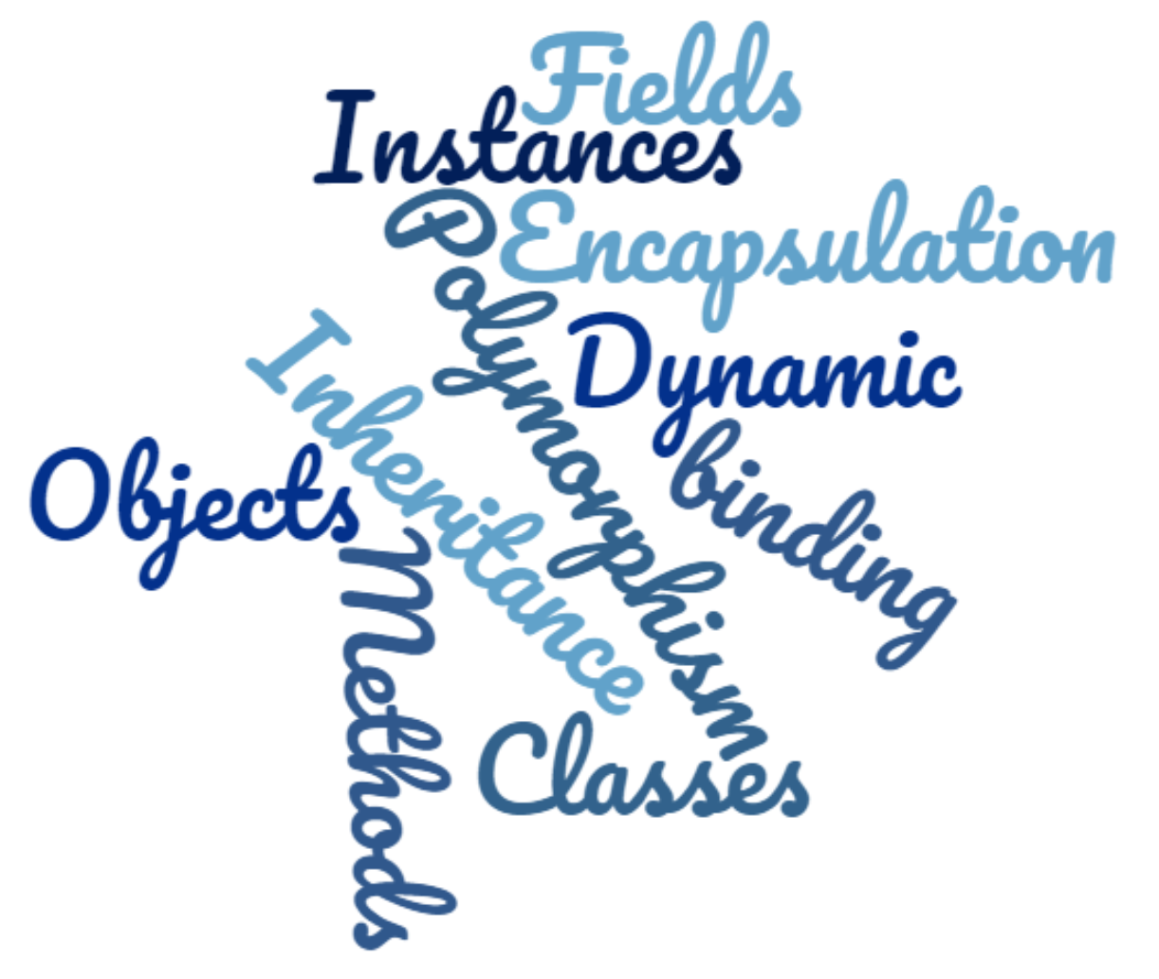
Object-Oriented Terms

Slide 4
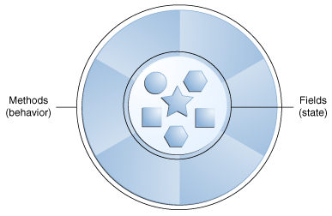
Objects
State represents data:
What an object knows, or what an object contains.
Behaviour…what an object can do.

Slide 5
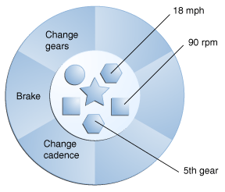
Object state
Each instance of the Bicycle class will have it’s own copy of the variables.

Slide 6
Objects and Loose Coupling
Changing an object’s data does not lead to changes in an object’s external behavior
An object’s external interface stays the same
Promotes loose coupling between objects
object1
object2
state
state
behavior
behavior
object3
state
behavior
6

Slide 7
Interactions between Objects
Object interact by sending messages to each other
Objects and interactions between them make up an object-oriented system
aBroker:
aPolicyFactory:
aPerson:
createPolicy
aPolicy
aPolicy:
new(“Joe Smith”, “35 years”)
aPerson
setOwner(aPerson)
…
7

Slide 8
Methods → concrete implementation of a message
aBroker:
aPerson:
message
receiver
message
sender
getAge()
message
Methods may have arguments

Slide 9
Method Signature → Unique Identifier
getAge ()
Method name
Parameter list
calculateAnswer(double, double, int, int)
Notes:
https://docs.oracle.com/javase/tutorial/java/javaOO/methods.html

Slide 10
Object’s Public Protocol
aPerson
age
name
children
public protocol i.e. the set of messages that can be sent to an object.
getAge
setAge
addChild
…
An object can also call it’s own methods (e.g. private methods)

Slide 11
Fields
aPerson
Fields are the attributes of an object.
Also known as instance variables.
age
name
children
getAge
setAge
addChild
…

Slide 12
Object-Oriented Principle: Encapsulation
Objects hide implementation of the messages behind their public protocols (aka implementation hiding).
aBroker:
aPerson:
getName()
Joe Smith
getAge()
35

Slide 13
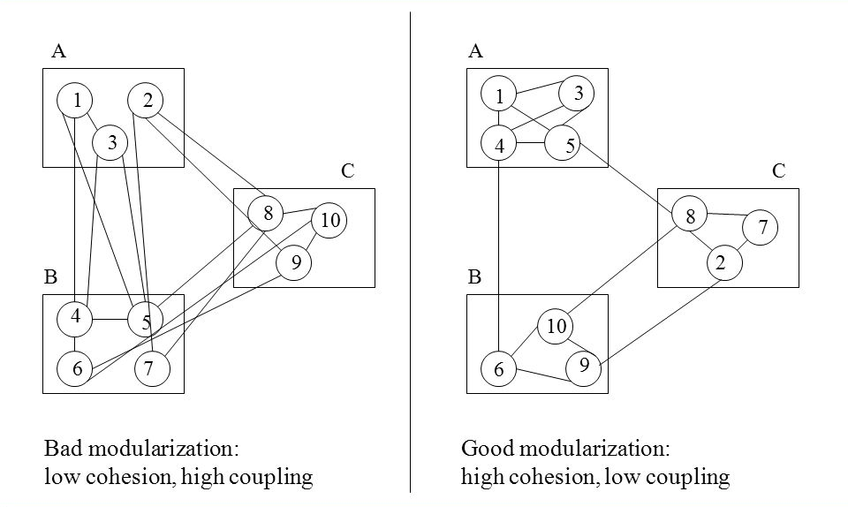
Modularization: Cohesion and Coupling
✓
Notes:
http://slideplayer.com/slide/5318703/

Slide 14
Classes
Factories for creating objects
Template for the same kind of objects that describes their state and behavior
aPerson
age
name
children
getAge
setAge
addChild
…

Slide 15
Instances → every object is an instance of some class
Person
age
name
children
address
getAge
setAge
addChild
…
John Smith
Jim Smith
35
John Smith
Jimmy, Chloe
60
Jim Smith
John, Tom
Two objects of type Person. Both have the same protocol.

Slide 16
Object-Oriented Principle: Inheritance
Policy
client
premium
policyNumber
getClient
setClient
…
specialization
generalization
HomePolicy
AutoPolicy
LifePolicy
house
auto
getHouse
setHouse
getAuto
setAuto

Slide 17
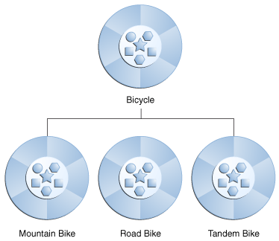
Why Inheritance?
Inheritance represents real-world modeling
Inheritance promotes reuse and extensibility

Slide 18
Object-Oriented Principle: Polymorphism
Polymorphism - different objects respond to the same message in different ways.
Supported by overriding.
Animal
talk()
Dog
Cat
talk()
talk()
aCat.talk();
aDog.talk();
meows
barks
Overriding means that a subclass may implement the same method as the superclass, but with different code.

Slide 19
Dynamic Binding (runtime method binding)
anAnimal.talk();
aDog
aCat
…
…
talk
talk
It is runtime binding of a method invoked in the message to the method that implements that message.

