Slide 1

Implementation Inheritance An introduction to the Java Programming Language
Produced
by:
Eamonn de Leastar (edeleastar@wit.ie)
Dr. Siobhan Drohan (sdrohan@wit.ie)

Slide 2
Essential Java
Overview
Introduction
Syntax
Basics
Arrays
Classes
Classes Structure
Static Members
Commonly used Classes
Control Statements
Control Statement Types
If, else, switch
For, while, do-while
Inheritance
Class hierarchies
Method lookup in Java
Use of this and super
Constructors and inheritance
Abstract classes and methods
Interfaces
Collections
ArrayList
HashMap
Iterator
Vector
Enumeration
Hashtable
Exceptions
Exception types
Exception Hierarchy
Catching exceptions
Throwing exceptions
Defining exceptions
Common exceptions and errors
Streams
Stream types
Character streams
Byte streams
Filter streams
Object Serialization

Slide 3
Agenda
What is inheritance?
Implementation Inheritance
Method lookup in Java
Use of this and super
Constructors and inheritance
Abstract classes and methods

Slide 4
What is Inheritance?
Inheritance is one of the primary object-oriented principles.
Implementation Inheritance | Interface Inheritance
Promotes reuse. Commonalities are stored in a parent class (superclass). Commonalities are shared between children classes (subclasses). | Mechanism for introducing Types into java design. Classes can support more than one interface, i.e. be of more than one type.

Slide 5
Implementation Inheritance
Policy
client
premium
policyNumber
getClient
setClient
…
specialization
generalization
HomePolicy
AutoPolicy
LifePolicy
house
auto
getHouse
setHouse
getAuto
setAuto

Slide 6
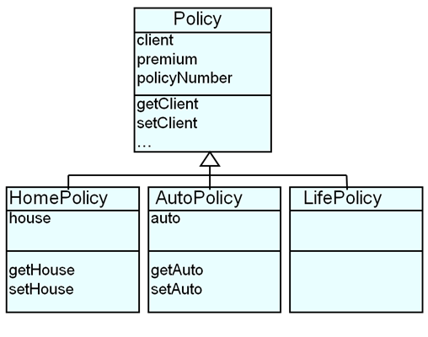
Defining Inheritance
public class Policy {…
public class HomePolicy extends Policy{…
public class AutoPolicy extends Policy{…
public class LifePolicy extends Policy{…

Slide 7
Defining Inheritance
public class Policy {…
public class HomePolicy extends Policy{…
public class AutoPolicy extends Policy{…
public class LifePolicy extends Policy{…
If the class does not explicitly specify a superclass, its superclass is Object class.
public class Policy{…
public class Policy extends Object{…

Slide 8
Variables and Inheritance
Variables can be declared against the superclass, and assigned objects of the subclass.
Policy policy;
policy = new Policy();
Policy policy;
policy = new HomePolicy();
Policy policy;
policy = new AutoPolicy();
Policy policy;
policy = new LifePolicy();

Slide 9
What is Inherited?
Subclasses inherit from superclass:
Fields (instance variables) i.e. data.
Methods i.e. behaviours.

Slide 10
Inheriting Fields
All fields from superclasses are inherited by a subclass.
Inheritance goes all the way up the hierarchy.
Policy:
client
premium
policyNumber
HomePolicy:
client
premium
policyNumber
house

Slide 11
Inheriting Methods
All methods from superclasses are inherited by a subclass
Inheritance goes all the way up the hierarchy
Policy:
getClient
setClient
…
HomePolicy:
getClient
setClient
…
getHouse
setHouse

Slide 12
Agenda
What is inheritance?
Implementation Inheritance
Method lookup in Java
Use of this and super
Constructors and inheritance
Abstract classes and methods

Slide 13
Method Lookup
HomePolicy homePolicy = new HomePolicy();
homePolicy.getPremium();
Policy
premium
2
Policy class – method getPremium() is found.
getPremium
setPremium
HomePolicy
house
1
HomePolicy class – method getPremium() is not found.
getHouse
setHouse

Slide 14
this vs. super
They are both names of the receiver object:
this: used for pointing to the current class instance.
super: lookup begins in the superclass of the class where super was defined.
class HomePolicy extends Policy
{
private int instalments;
private String house;
public void setInstalments (int instalments){
this.instalments = instalments;
}
public void print(){
super.print();
System.out.println("for house " + getHouse().toString();
}
//…
}

Slide 15
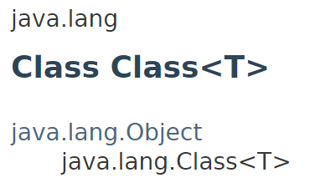
getClass()
getClass()
Method in java.lang.Object.
It returns the runtime class of the receiver object e.g.
com.example.HomePolicy
getClass().getName()
Method in java.lang.Class.
It returns the name of the class or interface of the receiver object e.g.
HomePolicy

Slide 16
class Policy
{
//…
public void print()
{
System.out.println("A " + getClass().getName() + ", $" + getPremium());
}
//..
}
Policy p = new Policy();
p.print();
A Policy, $1,200.00
16
class HomePolicy extends Policy
{
//…
public void print()
{
super.print();
System.out.println("for house " + getHouse().toString();
}
//…
}
Policy
HomePolicy
HomePolicy h = new HomePolicy();
h.print();
A HomePolicy, $1,200.00
for house 200 Great Street

Slide 17
Method Overriding
If a class defines the same method as its superclass, it is said that the method is overridden
Method signatures must match
Policy
HomePolicy
//Method in the Policy class
public void print()
{
System.out.println("A " + getClass().getName() + ", $" + getPremium());
}
//Overridden method in the HomePolicy class
public void print()
{
super.print();
System.out.println("for house " + getHouse().toString();
}

Slide 18
Agenda
What is inheritance?
Implementation Inheritance
Method lookup in Java
Use of this and super
Constructors and inheritance
Abstract classes and methods

Slide 19
Constructors and Inheritance
public Policy(double premium, Client aClient, String policyNumber)
{
this.premium = premium;
this.policyNumber = policyNumber;
this.client = aClient;
}
Policy
HomePolicy
public HomePolicy(double premium,
Client aClient,
String policyNumber,
House aHouse)
{
super(premium, aClient, policyNumber);
this.house = aHouse;
}
First line must be a call to the super constructor

Slide 20
Constructors and Inheritance
Constructors are not inherited by the subclasses.
If the call is not coded explicitly then an implicit zero-argument super() is called.
If the superclass does not have a zero-argument constructor, this causes an error.
Adopting this approach eventually leads to the Object class constructor that creates the object.

Slide 21
Overview: Road Map
What is inheritance?
Implementation Inheritance
Method lookup in Java
Use of this and super
Constructors and inheritance
Abstract classes and methods

Slide 22
Defining Abstract Classes
public abstract class Policy {
// can contain zero or more abstract methods.
// a class that has an abstract method must be declared abstract.
// cannot create an instance of this abstract class.
}

Slide 23
Defining Abstract Classes
public abstract class Policy {
// can contain zero or more abstract methods.
// a class that has an abstract method must be declared abstract.
// cannot create an instance of this abstract class.
}
Concrete Subclasses complete the implementation.
Abstract class functions as a “base” for subclasses.
Policy
(abstract)
HomePolicy
AutoPolicy
LifePolicy

Slide 24
Defining Abstract Methods
public abstract class Policy
{
// abstract classes can contain concrete methods as well.
// abstract classes are not required to have abstract methods.
/* each subclass must have a concrete implementation of the abstract method, or make themselves abstract. */
public abstract void calculateFullPremium();
}

Slide 25
Defining Abstract Methods
public abstract class Policy
{
// abstract classes can contain concrete methods as well.
// abstract classes are not required to have abstract methods.
/* each subclass must have a concrete implementation of the abstract method, or make themselves abstract. */
public abstract void calculateFullPremium();
}
Policy (abstract)
calculateFullPremium
Abstract method.
HomePolicy
AutoPolicy
LifePolicy

Slide 26
Defining Abstract Methods
public class HomePolicy extends Policy
{
//…
public void calculateFullPremium()
{
//calculation may depend on a criteria about the house
}
}
All subclasses must implement all abstract methods
public class AutoPolicy extends Policy
{
//…
public void calculateFullPremium()
{
//calculation may depend on a criteria about the auto
}
}
public class LifePolicy extends Policy
{
//…
public void calculateFullPremium()
{
//calculation may depend on a criteria about the client
}
}

Slide 27
Summary
What is inheritance?
Implementation Inheritance
Method lookup in Java
Use of this and super
Constructors and inheritance
Abstract classes and methods

Slide 28
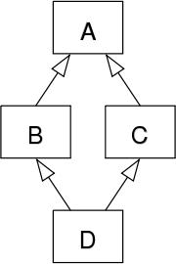
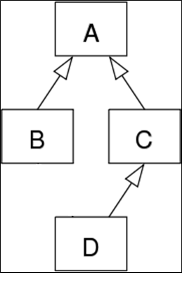
Multiple Inheritance ?
✗
✗
✓
Not supported in Java.
WHY?
Notes:
http://findnerd.com/list/view/Why-multiple-inheritance-is-not-possible-in-JAVA/14230/

Slide 29
Thought Experiment: Multiple Inheritance
Let’s pretend that Java allows multiple inheritance
http://javacodeonline.blogspot.ie/2009/08/deadly-diamond-of-death.html

Slide 30
Thought Experiment: Multiple Inheritance
public abstract class AbstractSuperClass{
abstract void do(); }
http://javacodeonline.blogspot.ie/2009/08/deadly-diamond-of-death.html

Slide 31
Thought Experiment: Multiple Inheritance
public abstract class AbstractSuperClass{
abstract void do(); }
public class ConcreteOne extends AbstractSuperClass{ void do(){ System.out.println("I am testing multiple Inheritance"); } }
http://javacodeonline.blogspot.ie/2009/08/deadly-diamond-of-death.html

Slide 32
Thought Experiment: Multiple Inheritance
public abstract class AbstractSuperClass{
abstract void do(); }
public class ConcreteOne extends AbstractSuperClass{ void do(){ System.out.println("I am testing multiple Inheritance"); } }
public class ConcreteTwo extends AbstractSuperClass{ void do(){ System.out.println("I will cause the Deadly Diamond of Death"); } }
Each class provides their own implementation of void do()
http://javacodeonline.blogspot.ie/2009/08/deadly-diamond-of-death.html

Slide 33
Thought Experiment: Multiple Inheritance
So far, our class diagram looks like this:
No problems, yet…
<<abstract>>
AbstractSuperClass
ConcreteOne
ConcreteTwo
http://javacodeonline.blogspot.ie/2009/08/deadly-diamond-of-death.html

Slide 34
Thought Experiment: Multiple Inheritance
Now, if multiple inheritance were allowed, a fourth class comes into picture which extends the above two concrete classes.
public class DiamondEffect extends ConcreteOne, ConcreteTwo{ //Some methods of this class }
http://javacodeonline.blogspot.ie/2009/08/deadly-diamond-of-death.html

Slide 35
Thought Experiment: Multiple Inheritance
Diamond shape class diagram
<<abstract>>
AbstractSuperClass
ConcreteOne
ConcreteTwo
DiamondEffect
http://javacodeonline.blogspot.ie/2009/08/deadly-diamond-of-death.html

Slide 36
Thought Experiment: Multiple Inheritance
The DiamondEffect class inherits all the methods of the parent classes.
BUT we have a common method, void do(), in the two concrete classes, each with a different implementation.
So which void do() implementation will be used for the DiamondEffect class as it inherits both these classes?
<<abstract>>
AbstractSuperClass
ConcreteOne
ConcreteTwo
DiamondEffect
http://javacodeonline.blogspot.ie/2009/08/deadly-diamond-of-death.html

Slide 37

Deadly Diamond of Death
Actually this is a critical issue that the java designers wanted to avoid, so, the result was…
(although it is supported in C++ via Virtual Base class feature)
Multiple Inheritance
http://javacodeonline.blogspot.ie/2009/08/deadly-diamond-of-death.html

