Slide 1

Collections An introduction to the Java Programming Language
Produced
by:
Eamonn de Leastar (edeleastar@wit.ie)
Dr. Siobhan Drohan (sdrohan@wit.ie)

Slide 2
Agenda
The Collection Framework
Interfaces
Collection
List
Set
Map
Iterator
Implementations
ArrayList
HashMap
HashSet

Slide 3
What are Collections?
Collections are Java objects that group multiple elements into a single unit.
Represent data items that form a natural group e.g. users, locations, activities.
Collections store, retrieve, and manipulate other Java objects
Any Java object may be part of a collection, so collection can contain other collections.
Collections do not store primitives.
Benefits:
Reusability
Uniformity
Faster development
Higher quality
Interoperability
Less programming

Slide 4
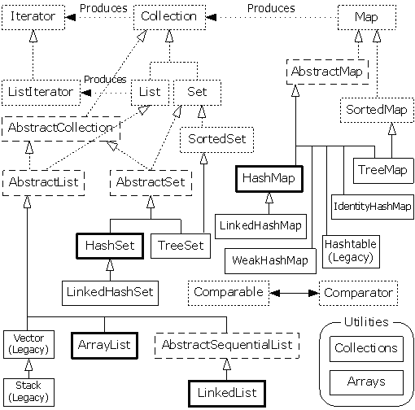
?

Slide 5
Collection Architecture
Interfaces - abstract data types representing collections
Implementation - concrete implementation of collection interfaces
Algorithms - methods for manipulating collection objects (e.g. sorting, searching, shuffling, etc).

Slide 6
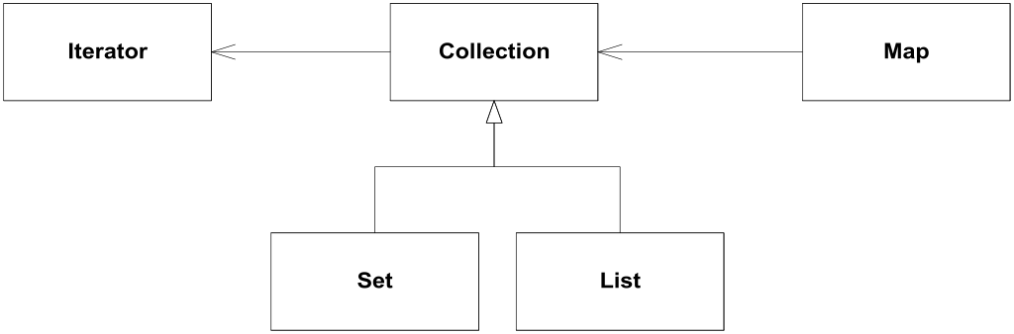
Interfaces
Collection “uses” Iterator
Map “uses” Collection
Set extends Collection (subtyping)‏
List extends Collection (subtyping)‏

Slide 7
Collection Interface
Collection represents a group of objects
These collection objects are known as collection elements
There is no direct implementation of this interface in JDK
Concrete implementations are provided for subtypes
Collections in general can allow duplicate elements, and can be ordered
Unordered collections that allow duplicate elements should implement directly Collection interface

Slide 8
Adding Elements
In general two methods are defined for adding elements to the collection:
interface Collection
{
//…
/**
* Adds element to the receiver.
* Returns true if operation is successful, otherwise returns false.
*/
boolean add(Object element);
/**
* Adds each element from collection c to the receiver.
* Returns true if operation is successful, otherwise returns false.
*/
boolean addAll(Collection c);
}

Slide 9
Removing Elements
Similarly to adding protocol, there are two methods are defined for removing elements from the collection:
interface Collection
{
//…
/**
* Removes element from the receiver.
* Returns true if operation is successful, otherwise returns false.
*/
boolean remove(Object element);
/**
* Removes each element contained in collection c from the receiver.
* Returns true if operation is successful, otherwise returns false.
*/
boolean removeAll(Collection c);
}

Slide 10
Other Collection Methods
Includes methods for:
Checking how many elements are in the collection
Checking if an element is in the collection
Iterating through collection
boolean contains(Object element);
boolean containsAll(Collection c);
int size();
boolean isEmpty();
void clear();
boolean retainAll(Collection c);
Iterator iterator;

Slide 11
Iterator Interface
Defines a protocol for iterating through a collection:
public interface Iterator
{
/**
* Returns whether or not the underlying collection has next
* element for iterating.
*/
boolean hasNext();
/**
* Returns next element from the underlying collection.
*/
Object next();
/**
* Removes from the underlying collection the last element returned by next.
*/
void remove();
}

Slide 12
Set Interface
Set is a collection that does not contain duplicate elements
This is supported by additional behavior in constructors and add(), hashCode(), and equals() methods
All constructors in a set must create a set that does not contain duplicate elements
It is not permitted for a set to contain itself as an element
If set element changes, and that affects equals comparisons, the behavior of a set is not specified

Slide 13
List Interface
List represents an ordered collection
Also known as sequence
Lists may contain duplicate elements
Lists extend behavior of collections with operations for:
Positional Access
Search
List Iteration
Range-view

Slide 14
Map Interface
Map is an object that maps keys to values
Keys must be unique, i.e. map cannot contain duplicate keys
Each key in the map can map to most one value, i.e. one key cannot have multiple values
Map interface defines protocols for manipulating keys and values

Slide 15
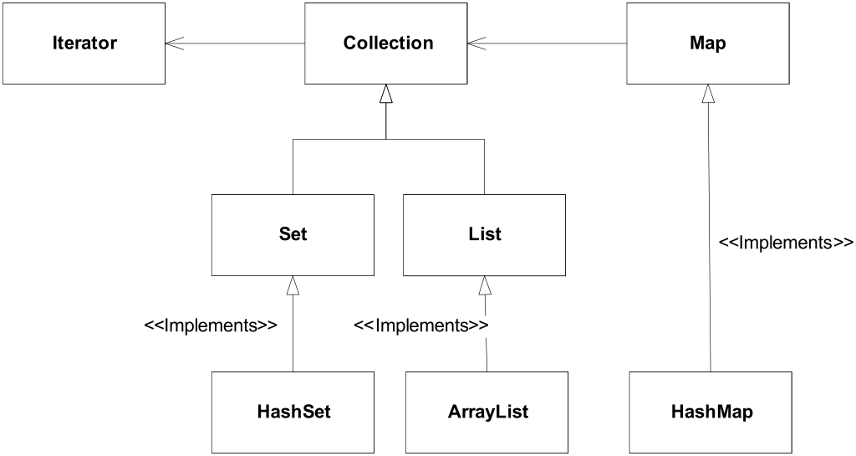
Most Commonly Used Collections
Three of the most commonly used collections:
HashSet
ArrayList
HashMap

Slide 16
ArrayList
Represents resizable-array implementation of the List interface
Permits all elements including null
It is generally the best performing List interface implementation
Instances of this class have a capacity
It is size of the array used to store the elements in the list, and it’s always at least as large as the list size
It grows as elements are added to the list

Slide 17
ArrayList Examples
//declare list
ArrayList list = new ArrayList();
//add elements to the list
list.add("First element");
list.add("Second element");
//get the list size
int listSize = list.size();
//print the list size and the first element
System.out.println(listSize);
System.out.println(list.get(0));
//add first element in the list
list.add(0,"Added element");
//get the list iterator
Iterator iterator = list.iterator();
while (iterator.hasNext())
{
String element = (String)iterator.next();
System.out.println(element);
}
Console
2
First element
Console
Added element
First element
Second element

Slide 18
HashMap
Collection that contains pair of objects
Values are stored at keys
It is a hash table based implementation of the Map interface
Permits null values and null keys
The order of the map is not guaranteed
Two parameters affect performance of a hash map:
Initial capacity, indicates capacity at the map creation time
Load factor, indicates how full the map should be before increasing its size
0.75 is the default

Slide 19
HashMap Example
//create a number dictionary
HashMap numberDictionary = new HashMap();
numberDictionary.put("1", "One");
numberDictionary.put("2", "Two");
numberDictionary.put("3", "Three");
numberDictionary.put("4", "Four");
numberDictionary.put("5", "Five");
//get an iterator of all the keys
Iterator keys = numberDictionary.keySet().iterator();
while (keys.hasNext())
{
String key = (String)keys.next();
String value = (String)numberDictionary.get(key);
System.out.println("Number: " + key + ", word: " + value);
}
Number: 5, word: Five
Number: 4, word: Four
Number: 3, word: Three
Number: 2, word: Two
Number: 1, word: One
Console

Slide 20
HashSet
Concrete implementation of the Set interface
Backed up by an instance of HashMap
Order is not guaranteed
Performance of the set is affected by size of the set and capacity of the map
It is important not to set the initial capacity too high, or the load factor too low if performance of iteration is important
Elements in the set cannot be duplicated

Slide 21
HashSet Example
//create new set
HashSet set = new HashSet();
//add elements to the set
set.add("One");
set.add("Two");
set.add("Three");
//elements cannot be duplicated in the set
set.add("One");
//print the set
System.out.println(set);
Console
[One, Three, Two]
Notes:
.

