Slide 1

Using Collections An introduction to the Java Programming Language
Produced
by:
Eamonn de Leastar (edeleastar@wit.ie)
Dr. Siobhan Drohan (sdrohan@wit.ie)

Slide 2
Agenda
Generic Collections
Reviewing the Collection Interface
Summary of Features & Performance
Working with Collections

Slide 3
Generic Collections
Collections use polymorphism to store objects of any type.
A drawback is type loss on retrieval.
HashMap stores key/value pairs as java Objects.
get() method returns a matching Object for the given key.
HashMap numberDictionary = new HashMap();
numberDictionary.put("1", "One");
numberDictionary.put("2", "Two");
Object value = numberDictionary.get("1”);
String strValue = (String) value;

Slide 4
Generic Collections
Collections use polymorphism to store objects of any type.
A drawback is type loss on retrieval.
HashMap stores key/value pairs as java Objects.
get() method returns a matching Object for the given key.
HashMap numberDictionary = new HashMap();
numberDictionary.put("1", "One");
numberDictionary.put("2", "Two");
Object value = numberDictionary.get("1”);
String strValue = (String) value;
The key/values in this code are actually Strings
The return value must be type cast back to a String in order to accurately recover the stored object.

Slide 5
Untyped = Unsafe
Type casting is undesirable (due to possibility of run time errors).
Therefore, use of untyped (pre-Java 5) collections is considered ‘unsafe’.
Typed collections avoid type loss.
Runtime checks are simplified because the type is known.

Slide 6
Revised syntax
The type of object to be stored is indicated on declaration:
private ArrayList<String> notes;
... and on creation:
notes = new ArrayList<String>();
Collection types are parameterized.

Slide 7
Using a typed collection
ArrayList list = new ArrayList();
list.add("First element");
list.add("Second element");
String first = (String)list.get(0);
String second = (String)list.get(1);
untyped / unsafe
ArrayList<String> list = new ArrayList<String>();
list.add("First element");
list.add("Second element");
String first = list.get(0);
String second = list.get(1);
typed / safe

Slide 8
Using a Typed Iteration
ArrayList list = new ArrayList();
Iterator iterator = list.iterator();
while (iterator.hasNext()
{
String element = (String)iterator.next();
System.out.println(element);
}
untyped / unsafe
ArrayList<String> list = new ArrayList<String>();
Iterator<String> iterator = list.iterator();
while (iterator.hasNext())‏
{
String element = iterator.next();
System.out.println(element);
}
typed / safe

Slide 9
Typed HashMaps
HashMaps operate with (key,value) pairs.
A typed HashMap required two type parameters: private HashMap<String, String> responses; ... responses = new HashMap<String, String> ();

Slide 10
HashMaps
HashMap numberDictionary = new HashMap();
numberDictionary.put("1", "One");
numberDictionary.put("2", "Two");
Object value = numberDictionary.get(“1”);
String strValue = (String) value;
untyped / unsafe
HashMap<String,String> numberDictionary =
new HashMap<String,String>();
numberDictionary.put("1", "One");
numberDictionary.put("2", "Two");
String value = numberDictionary.get(“1”);
typed / safe

Slide 11
for-each loop (pseudo code)
General form of the for-each loop
for keyword
for(ElementType element : collection) {
loop body
}
Statement(s) to be repeated
Pseudo-code expression of the actions of a for-each loop
For each element in collection, do the things in the loop body.
If a collections provides an Iterator, the enhanced for loop simplifies code.

Slide 12
For-each Loop
Iteration over collections is a common operation.
If a collections provides an Iterator, Enhanced for loop simplifies code
ArrayList<String> list = new ArrayList<String>();
//…
Iterator <String> iterator = list.iterator();
while (iterator.hasNext())
{
String element = iterator.next();
System.out.println(element);
}
Standard while loop
ArrayList<String> list = new ArrayList<String>();
//…
for (String element : list)
{
System.out.println(element);
}
For-each loop

Slide 13
Agenda
Generic Collections
Reviewing the Collection Interface
Summary of Features & Performance
Working with Collections

Slide 14
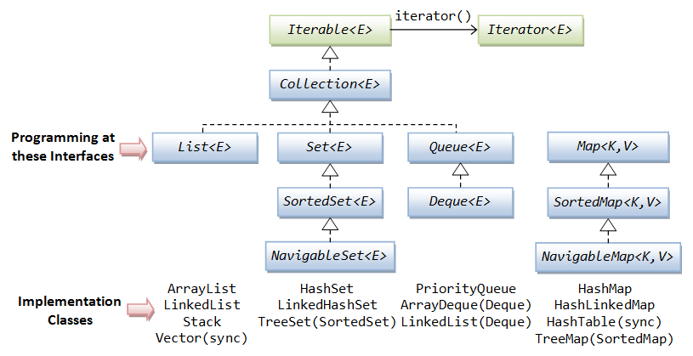
Collections Framework

Slide 15
Collection
Interface
Collection is the root of the collection hierarchy
There is no direct implementation of this interface in JDK
Concrete implementations are provided for its subtypes

Slide 16
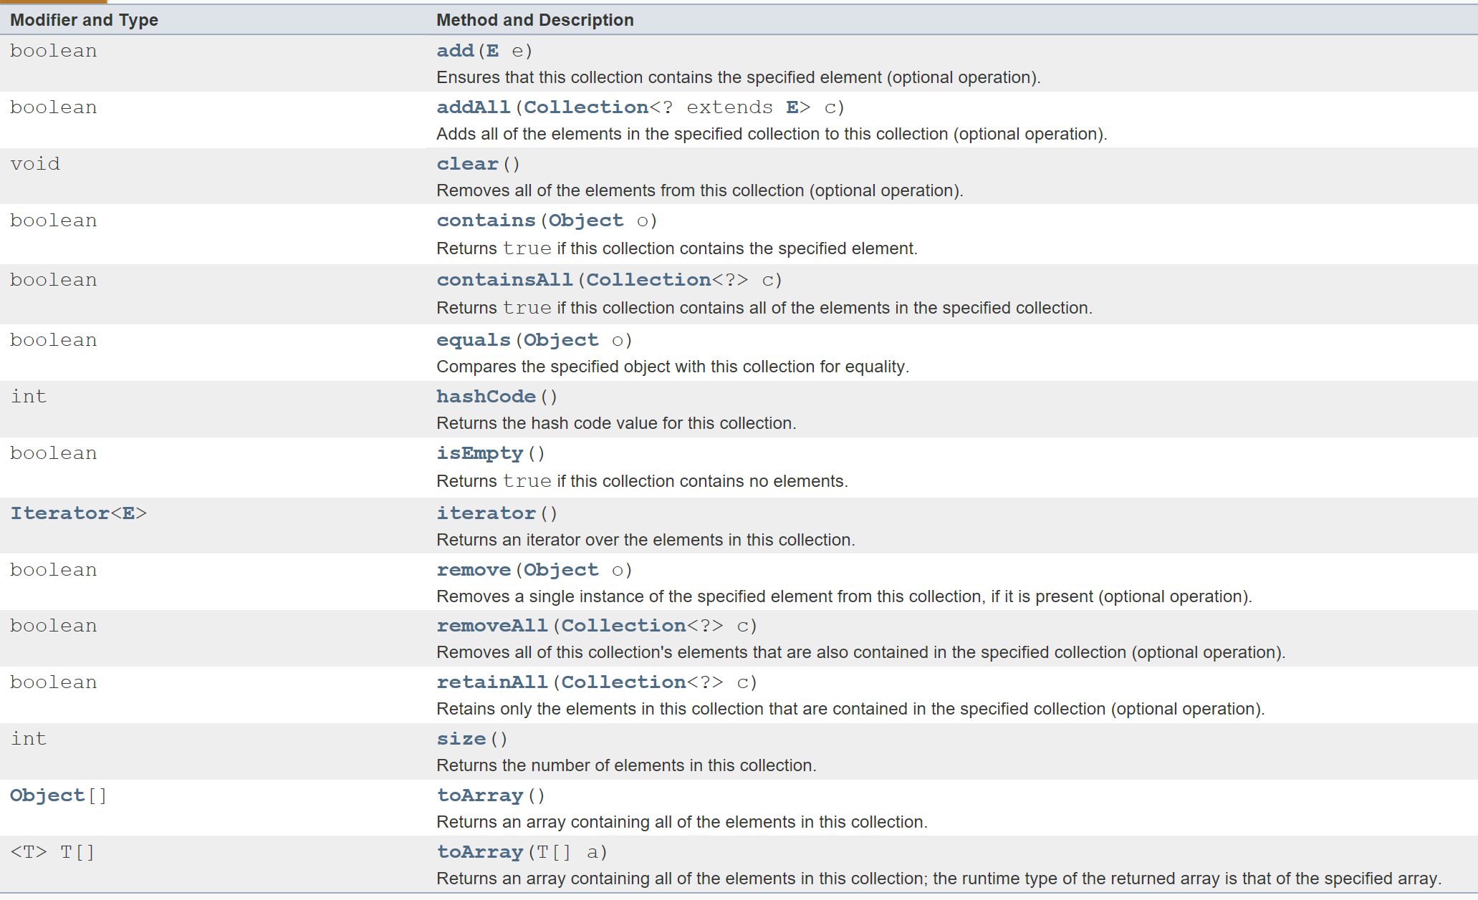
Collection Interface

Slide 17
Agenda
Generic Collections
Reviewing the Collection Interface
Summary of Features & Performance
Working with Collections

Slide 18
Collection Summary
Class | Map | Set | List | Ordered | Sorted | Allow Duplicates
HashSet |  | X |  | No | No | No
TreeSet |  | X |  | Sorted | By natural order or custom comparison rules | No
LinkedHashSet |  | X |  | By insertion order | No | No
ArrayList |  |  | X | By index | No | Yes
Vector |  |  | X | By index | No | Yes
LinkedList |  |  | X | By index | No | Yes
HashMap | X |  |  | No | No | No duplicate key allowed
Hashtable | X |  |  | No | No | No duplicate key allowed
TreeMap | X |  |  | Sorted | By natural order or custom comparison rules | No duplicate key allowed
LinkedHashMap | X |  |  | By insertion order or last access order | No | No duplicate key allowed

Slide 19
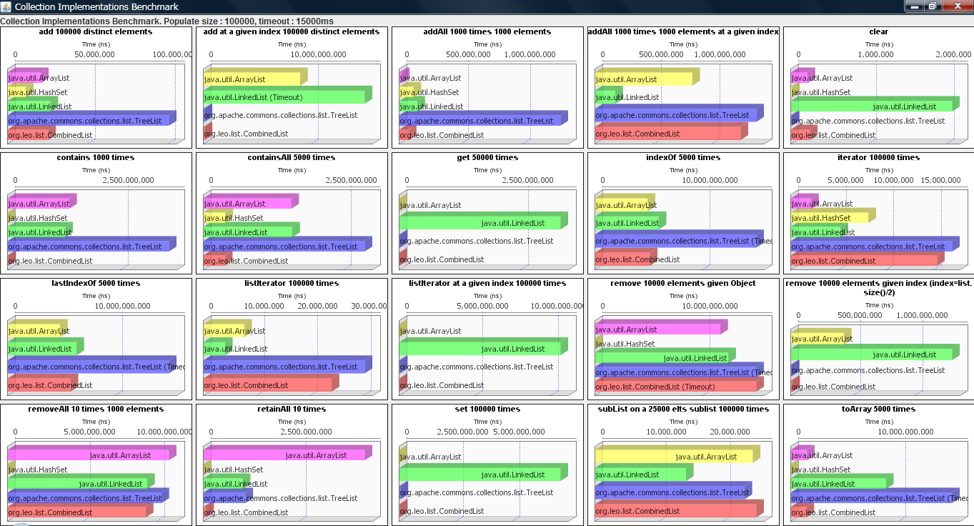
Java Collection Performance
https://dzone.com/articles/java-collection-performance

Slide 20
Java Collection Performance
https://dzone.com/articles/java-collection-performance

Slide 21
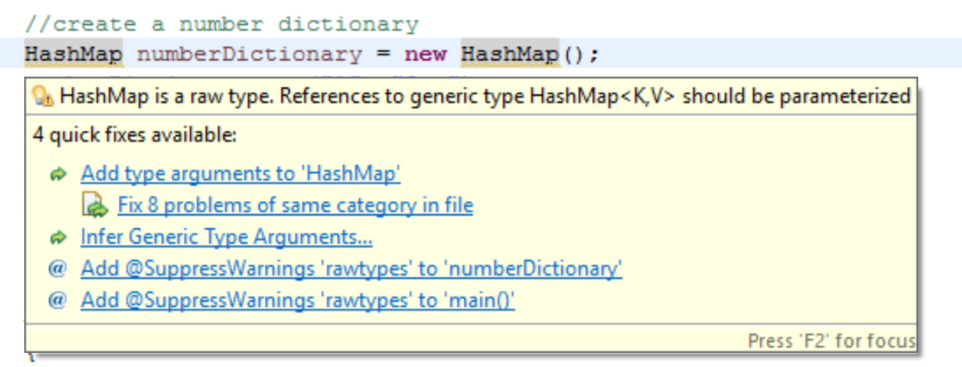
Compiler warnings for untyped collections

Slide 22
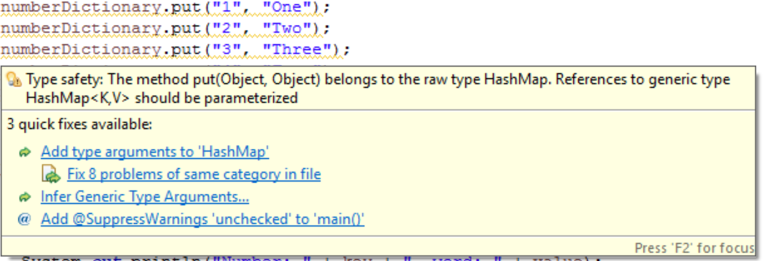
Compiler warnings for untyped (= unsafe) collections

Slide 23
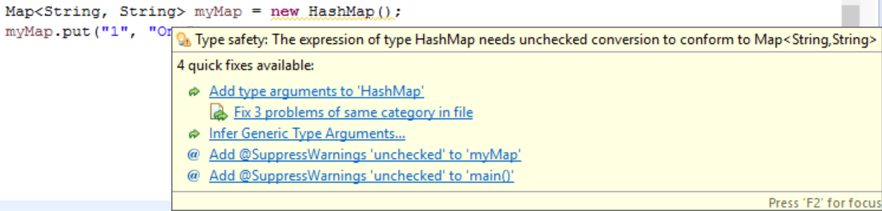
Type Inference
Since Java 7, type inference applies to collections (<>) :
Map<String, String> myMap = new HashMap<>();
<> is required.

Slide 24
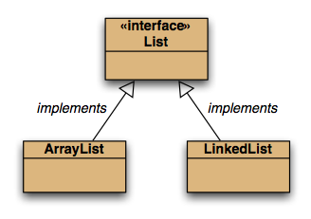
Defining Collections
For more maintainable code, define collections like this:
List<Product> products = new ArrayList<Product>();
Map<String, String> addresses = new HashMap<String, String>();
Set<String> words = new HashSet<String>();
Why?

Slide 25
Defining Collections
For more maintainable code, define collections like this:
List<Product> products = new ArrayList<Product>();
Map<String, String> addresses = new HashMap<String, String>();
Set<String> words = new HashSet<String>();
Why?
If we want to use a LinkedList instead of an ArrayList → minor changes in the class i.e.
new ArrayList<Product>();
becomes
new LinkedList<Product>();
and import java.util.LinkedList;

Slide 26
while vs for-each
List<String> list = new ArrayList<String>();
//…
Iterator <String> iterator = list.iterator();
while (iterator.hasNext())
{
String element = iterator.next();
System.out.println(element);
}
Standard while loop
List<String> list = new ArrayList<String>();
//…
for (String element : list)
{
System.out.println(element);
}
for-each loop

Slide 27
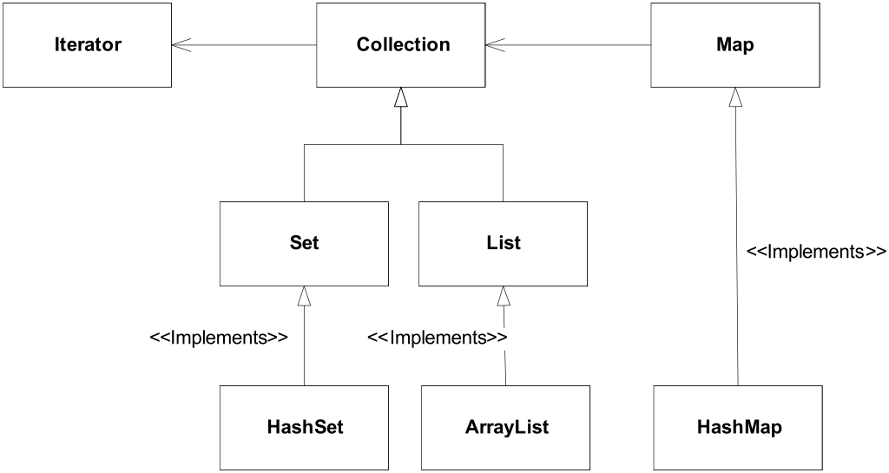
Summary
The Java Collections Framework hierarchy consists of two distinct interface trees:
The first tree starts with the Collection interface, which provides for the basic functionality used by all collections
Set: does not allow duplicate elements. Useful for storing collections such as a deck of cards or student records.
List: provides for an ordered collection, for situations in which you need precise control over where each element is inserted. You can retrieve elements from a List by their exact position..
The second tree starts with the Map interface, which maps keys and values.

Slide 28
ArrayList
An indexed sequence that grows and shrinks dynamically
LinkedList
An ordered sequence that allows efficient insertions and removal at any location
ArrayDeque
A double-ended queue that is implemented as a circular array
HashSet
An unordered collection that rejects duplicates
TreeSet
A sorted set
LinkedHashSet
A set that remembers the order in which elements were inserted
PriorityQueue
A collection that allows efficient removal of the smallest element
HashMap
A data structure that stores key/value associations

Slide 29
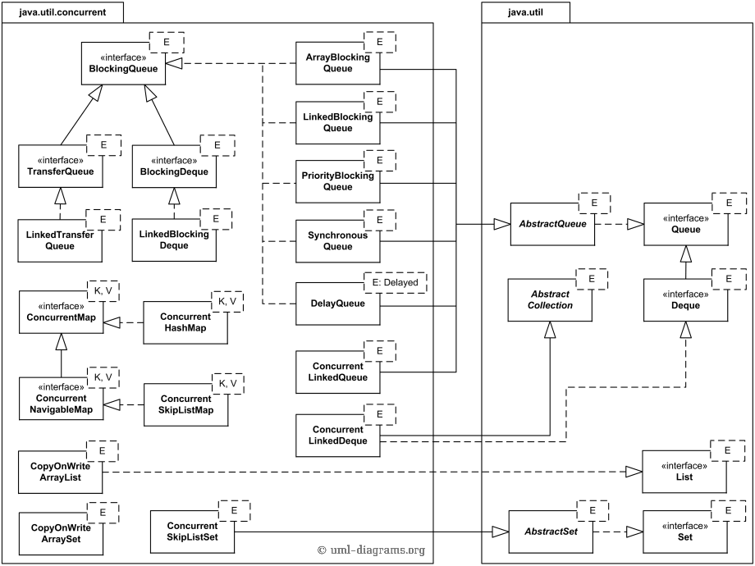
Concurrent Collections
Used in the context of multi-threaded applications (beyond scope of this course)

Slide 30
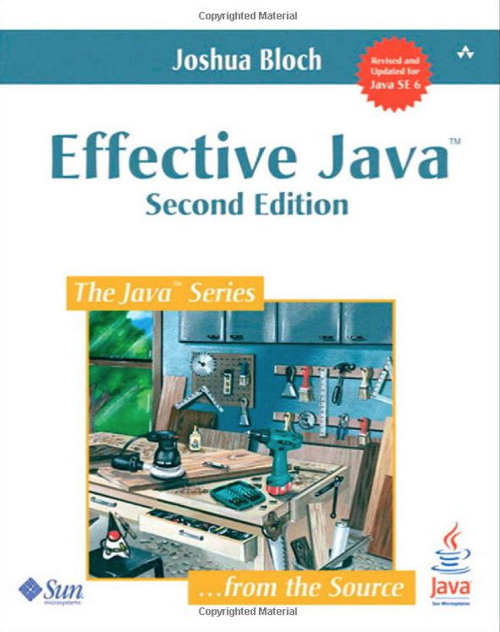
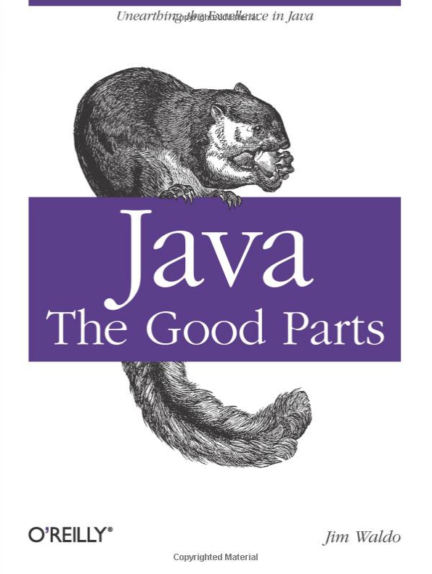
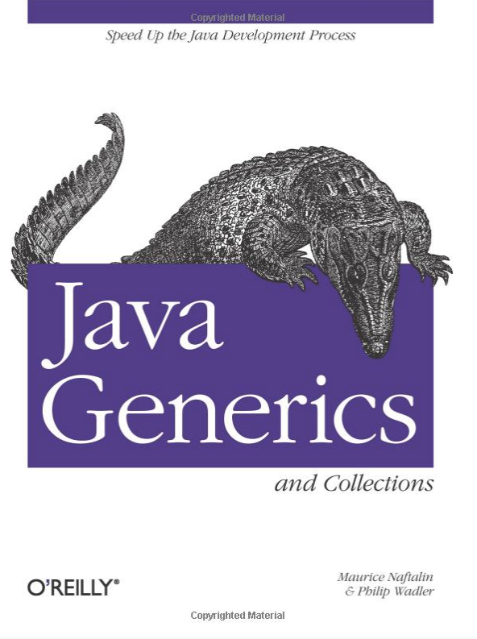
Useful References

