Slide 1

I/O Streams in Java
Eamonn de Leastar (edeleastar@wit.ie)
Dr. Siobhán Drohan (sdrohan@wit.ie)
Produced
by:
Department of Computing and Mathematics
http://www.wit.ie/

Slide 2
Essential Java
Overview
Introduction
Syntax
Basics
Arrays
Classes
Classes Structure
Static Members
Commonly used Classes
Control Statements
Control Statement Types
If, else, switch
For, while, do-while
Inheritance
Class hierarchies
Method lookup in Java
Use of this and super
Constructors and inheritance
Abstract classes and methods
Interfaces
Collections
ArrayList
HashMap
Iterator
Vector
Enumeration
Hashtable
Exceptions
Exception types
Exception Hierarchy
Catching exceptions
Throwing exceptions
Defining exceptions
Common exceptions and errors
Streams
Stream types
Character streams
Byte streams
Filter streams
Object Serialization

Slide 3
Road Map
Introduction to I/O Streams
Byte-oriented I/O Streams
Character-oriented I/O Streams
Layered I/O Streams (e.g. buffering)
Line-oriented I/O Streams
Scanning
Pacemaker I/O
Further Reading:
Data Streams
Object Streams
Command Line I/O

Slide 4
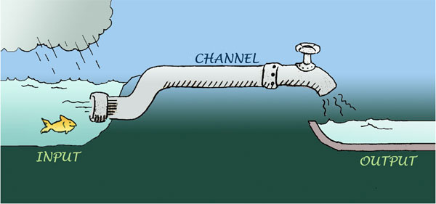
Introduction
An I/O Stream represent a sequence of data:
a one way, sequential flow of data.
Conceptualise it as water flowing through a pipe.
https://docs.oracle.com/javase/tutorial/essential/io/streams.html

Slide 5
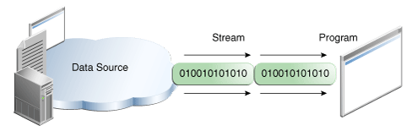
Input Stream
A program uses an input stream to read data from a source, one item at a time:
https://docs.oracle.com/javase/tutorial/essential/io/streams.html

Slide 6
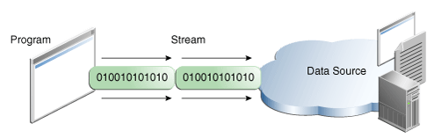
Output Stream
A program uses an output stream to write data to a destination, one item at time:
https://docs.oracle.com/javase/tutorial/essential/io/streams.html

Slide 7
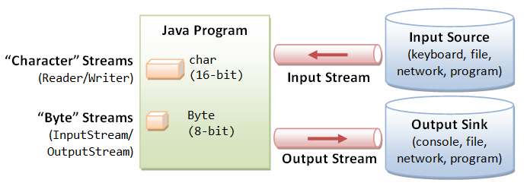
I/O Streams
java.io package
Notes:
http://www3.ntu.edu.sg/home/ehchua/programming/java/j5b_io.html

Slide 8
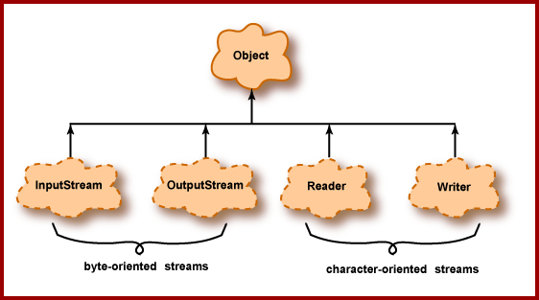
Abstract classes in I/O Streams
java.io package
http://chortle.ccsu.edu/java5/notes/chap82/ioHierarchyTop.gif

Slide 9
Road Map
Introduction to I/O Streams
Byte-oriented I/O Streams
Character-oriented I/O Streams
Layered I/O Streams (e.g. buffering)
Line-oriented I/O Streams
Scanning
Pacemaker I/O
Further Reading:
Data Streams
Object Streams
Command Line I/O

Slide 10
Byte-oriented Streams Programs use byte streams to perform input and output of 8-bit bytes.

Slide 11
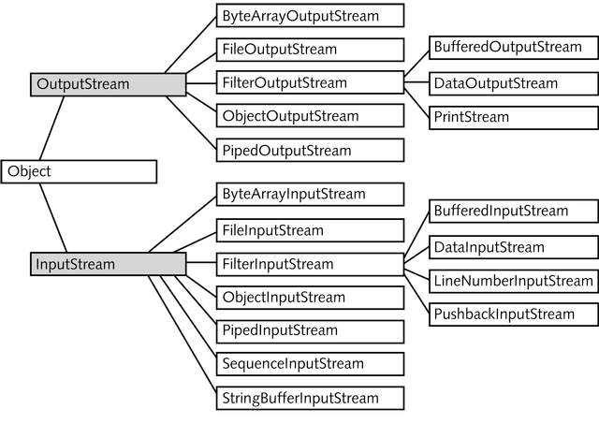
Byte Streams (I/O of 8-bit bytes)
InputStream & OutputStream are abstract; all descendants are concrete.
Frequently used to read/write from files i.e. FileInputStream and FileOutputStream.
java.io package

Slide 12
Byte Streams I/O: Steps
Open an input/output stream associated with a physical device.
Read from the opened input stream until "end-of-stream" encountered or Write to the opened output stream.
Close the input/output stream.

Slide 13
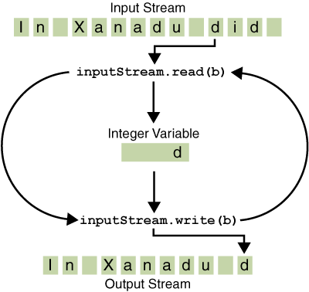

Byte Streams I/O: Steps
In Xanadu did Kubla Khan
A stately pleasure-dome decree:
Where Alph, the sacred river, ran
through caverns measureless to man
Down to a sunless sea.
Xanadu.txt: Sample file that we will use to explain Byte Streams

Slide 14
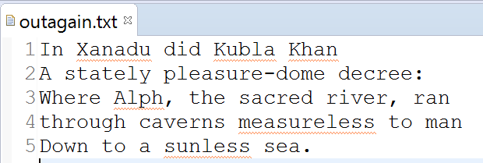
Byte Streams I/O: CopyBytes Example
public class CopyBytes
{
public static void main(String[] args) throws IOException
{
FileInputStream in = null;
FileOutputStream out = null;
try{
in = new FileInputStream("xanadu.txt");
out = new FileOutputStream("outagain.txt");
int c;
while ((c = in.read()) != -1){
out.write(c);
}
}
finally{
if (in != null){
in.close();
}
if (out != null){
out.close();
}
}
}
}

Slide 15
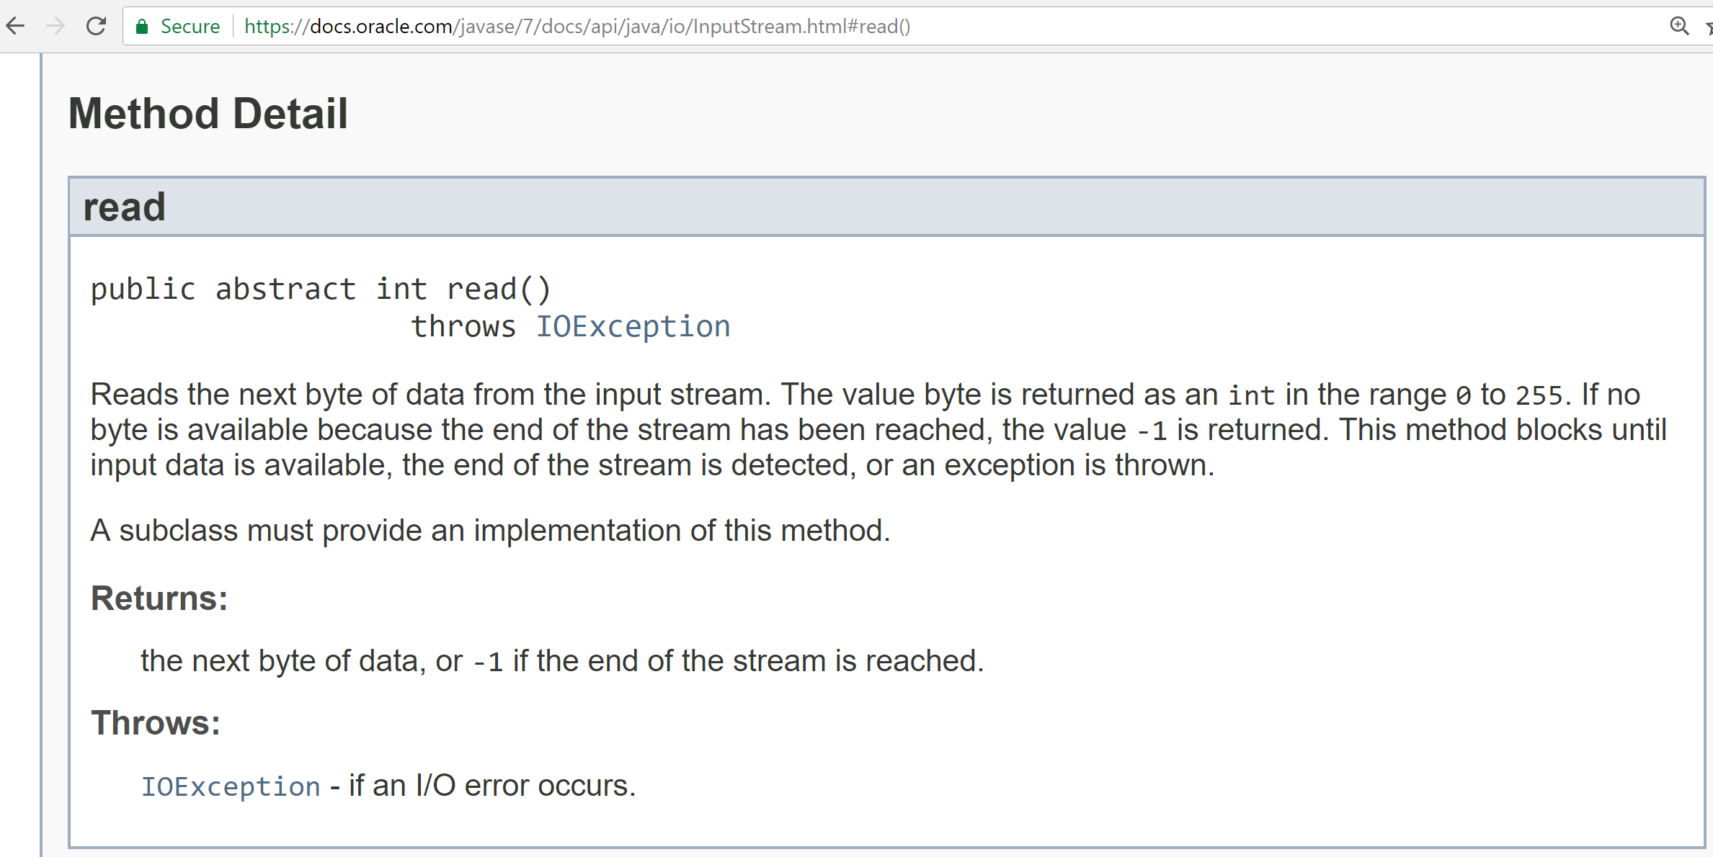

Slide 16
Byte Streams – CopyBytes Example
An int return type allows read() to use -1 to indicate end of stream.
A finally block is used to guarantee that both streams will be closed even if an error occurs; this helps avoid resource leaks.
If Java was unable to open one or both files, the associated file stream variable won’t deviate from its initial null value; hence the test for null in the finally block.
Java 7’s try-with-resources would be useful here.

Slide 17
CopyBytes: Before using try-with-resources
public class CopyBytes
{
public static void main(String[] args) throws IOException
{
FileInputStream in = null;
FileOutputStream out = null;
try{
in = new FileInputStream("xanadu.txt");
out = new FileOutputStream("outagain.txt");
int c;
while ((c = in.read()) != -1){
out.write(c);
}
}
finally{
if (in != null){
in.close();
}
if (out != null){
out.close();
}
}
}
}

Slide 18
CopyBytes - using try-with-resources
public class CopyBytes
{
public static void main(String[] args) throws IOException
{
try (FileInputStream in = new FileInputStream("xanadu.txt");
FileOutputStream out = new FileOutputStream("outagain.txt") )
{
int c;
while ((c = in.read()) != -1){
out.write(c);
}
}
}
}
try-with-resources is a new construct in Java 7.
When the try block finishes, the resources instantiated
in the try clause are closed automatically.
All classes implementing the java.lang.AutoCloseable
interface can be used inside the try-with-resources
construct.

Slide 19
Road Map
Introduction to I/O Streams
Byte-oriented I/O Streams
Character-oriented I/O Streams
Layered I/O Streams (e.g. buffering)
Line-oriented I/O Streams
Scanning
Pacemaker I/O
Further Reading:
Data Streams
Object Streams
Command Line I/O

Slide 20
Character-oriented Streams Programs use character streams to perform input and output of 16-bit bytes (i.e. Unicode characters).

Slide 21
Character-oriented Streams
Java Stores characters as Unicode.
But the external data source could store characters in other character sets e.g. US-ASCII, UTF-8, etc.
Character stream I/O automatically translates Unicode character values to and from the local character set.
Working with character streams is no more complicated than I/O with byte streams.

Slide 22
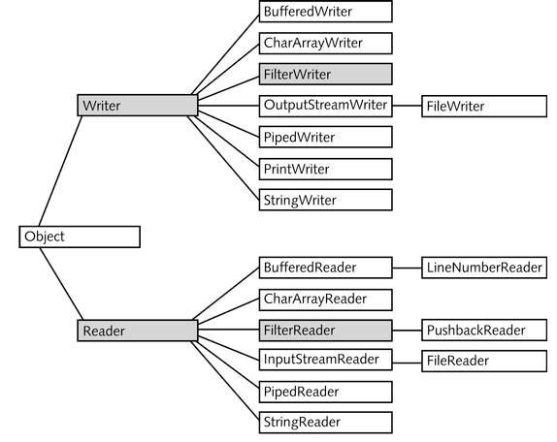
Character-oriented Streams

Slide 23
Character-oriented Streams: CopyCharacters Example
public class CopyCharacters{
public static void main(String[] args) throws IOException{
FileReader in = null;
FileWriter out = null;
try{
in = new FileReader("xanadu.txt");
out = new FileWriter("outchar.txt");
int c;
while ((c = in.read()) != -1){
out.write(c);
}
}
finally{
if (in != null){
in.close();
}
if (out != null){
out.close();
}
}
}
}

Slide 24
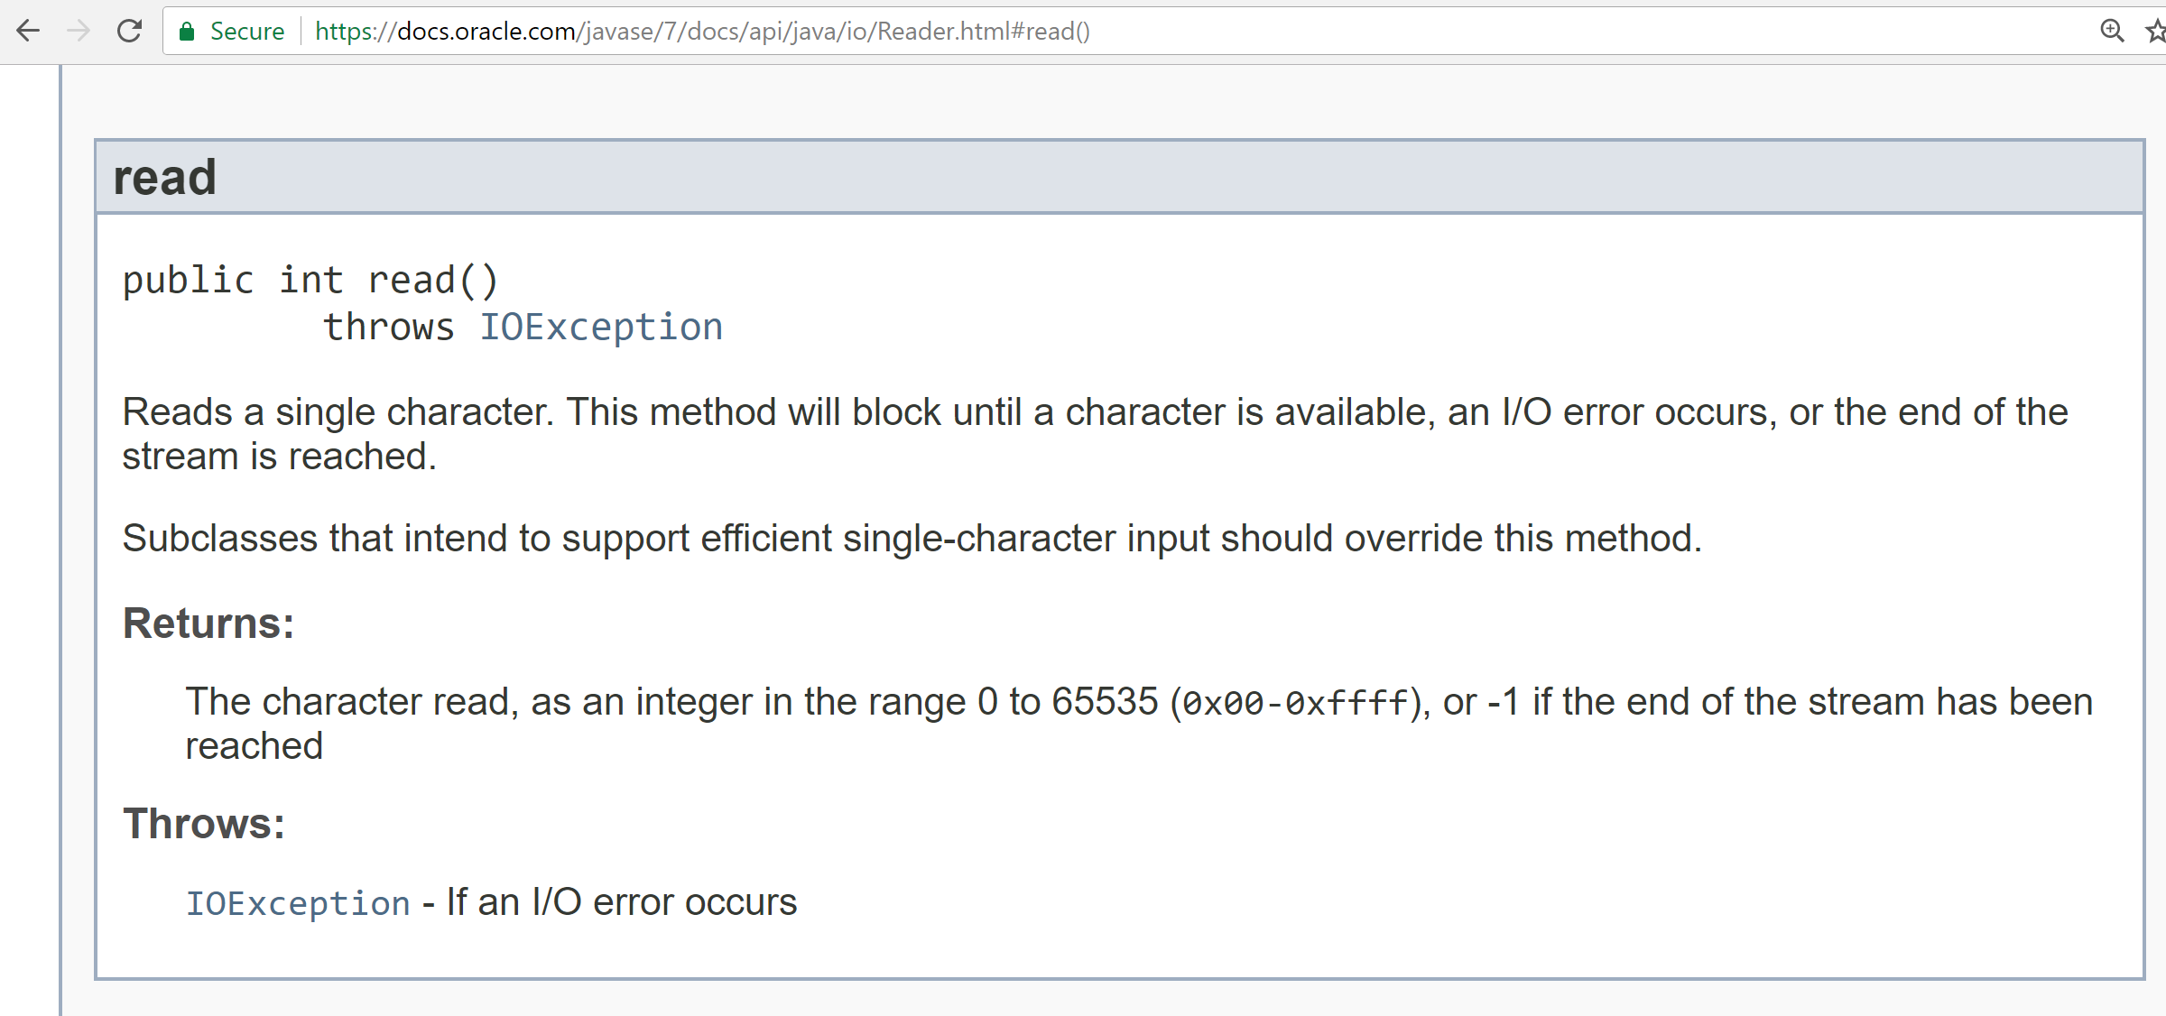

Slide 25
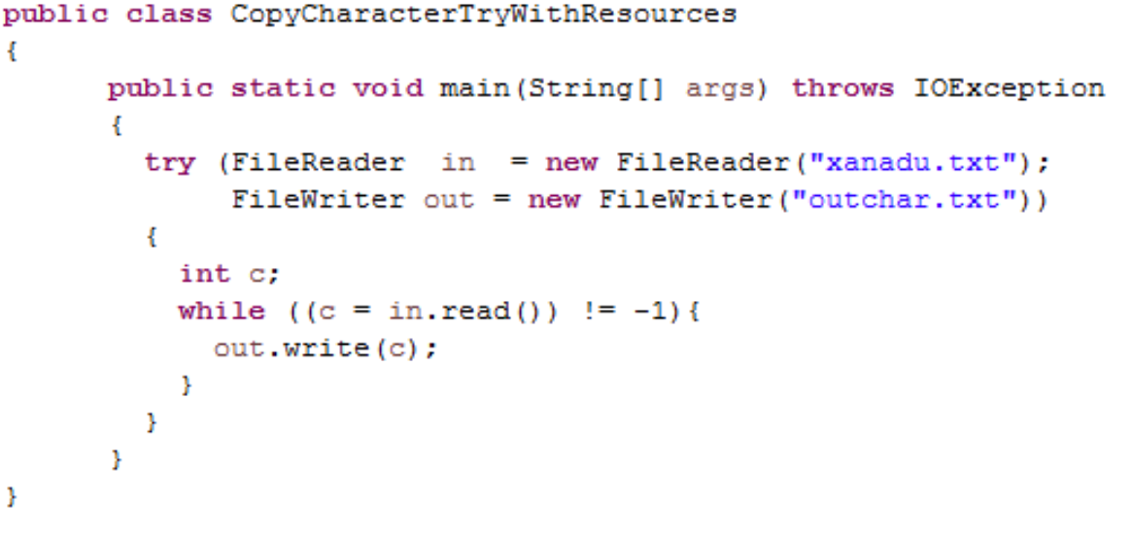
CopyCharacters using try-with-resources

Slide 26
CopyCharacters vs CopyBytes
CopyCharacters is very similar to CopyBytes.
CopyCharacters uses FileReader and FileWriter.
CopyBytes uses FileInputStream and FileOutputStream.

Slide 27
CopyCharacters vs CopyBytes
CopyCharacters is very similar to CopyBytes.
CopyCharacters uses FileReader and FileWriter.
CopyBytes uses FileInputStream and FileOutputStream.
Both use an int variable to read to and write from.
CopyCharacters→ int variable holds a character value between 0 and 65535.
CopyBytes → int variable holds a byte value between 0 and 255.

Slide 28
CopyCharacters vs CopyBytes
CopyCharacters is very similar to CopyBytes.
CopyCharacters uses FileReader and FileWriter.
CopyBytes uses FileInputStream and FileOutputStream.
Both use an int variable to read to and write from.
CopyCharacters→ int variable holds a character value between 0 and 65535.
CopyBytes → int variable holds a byte value between 0 and 255.
Character streams are often "wrappers" for byte streams.
A byte stream to perform the physical I/O
The character stream handles translation between characters and bytes.

Slide 29
Road Map
Introduction to I/O Streams
Byte-oriented I/O Streams
Character-oriented I/O Streams
Layered I/O Streams (e.g. buffering)
Line-oriented I/O Streams
Scanning
Pacemaker I/O
Further Reading:
Data Streams
Object Streams
Command Line I/O

Slide 30
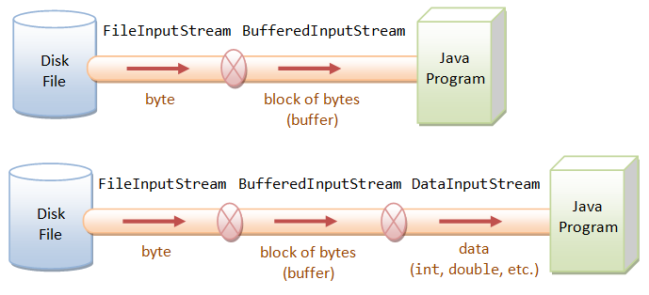
Layered I/O Streams
I/O streams are often layered (chained) with other I/O streams e.g. for buffering, data-format conversion, etc.
http://www3.ntu.edu.sg/home/ehchua/programming/java/j5b_io.html

Slide 31
Buffered I/O
So far, we have only looked at reading/writing a single character of data:
→ grossly inefficient e.g. each call can trigger a disk read/write.
To speed up the I/O, we can read/write blocks of bytes into a memory buffer in one single I/O operation.
http://www3.ntu.edu.sg/home/ehchua/programming/java/j5b_io.html

Slide 32
Buffered I/O
FileInputStream/FileOutputStream is not buffered.
But
You can chain it to a BufferedInputStream/ BufferedOutputStream to provide the buffering.
To chain streams, pass the instance of one stream to the constructor of another.
http://www3.ntu.edu.sg/home/ehchua/programming/java/j5b_io.html

Slide 33
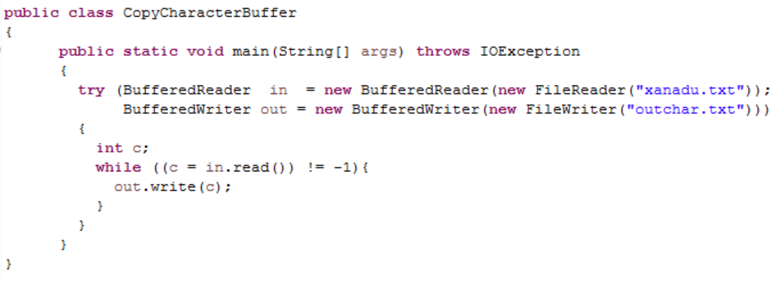
Buffered I/O - CopyCharacter

Slide 34
Flushing Buffers
There are four buffered stream classes used to wrap unbuffered streams:
BufferedInputStream and BufferedOutputStream for byte streams
BufferedReader and BufferedWriter for character streams
It often makes sense to write out a buffer at critical points, without waiting for it to fill.
This is known as flushing the buffer.
More info on flushing buffers here: https://docs.oracle.com/javase/tutorial/essential/io/buffers.html

Slide 35
Road Map
Introduction to I/O Streams
Byte-oriented I/O Streams
Character-oriented I/O Streams
Layered I/O Streams (e.g. buffering)
Line-oriented I/O Streams
Scanning
Pacemaker I/O
Further Reading:
Data Streams
Object Streams
Command Line I/O

Slide 36
Line-Oriented I/O
Character I/O usually occurs in bigger units than single characters.
One common unit is the line:
a string of characters with a line terminator at the end.
A line terminator can be, depending on the OS:
a carriage-return and line-feed sequence ("\r\n")
a single carriage-return ("\r")
a single line-feed ("\n").

Slide 37
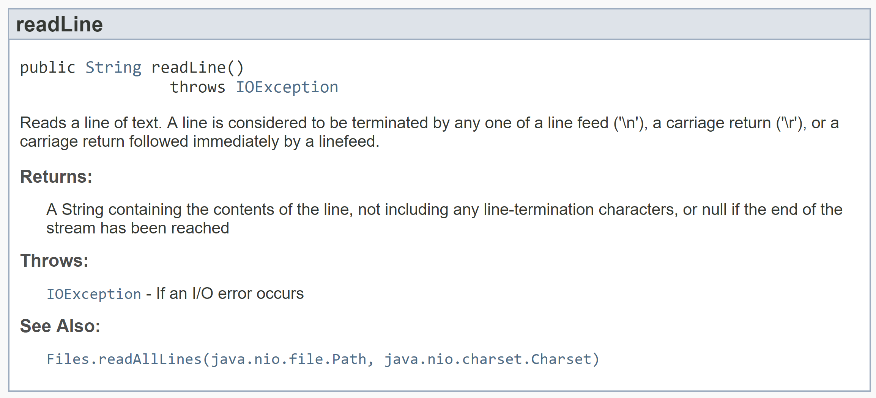
java.io.BufferedReader
Supporting all possible line terminators

Slide 38
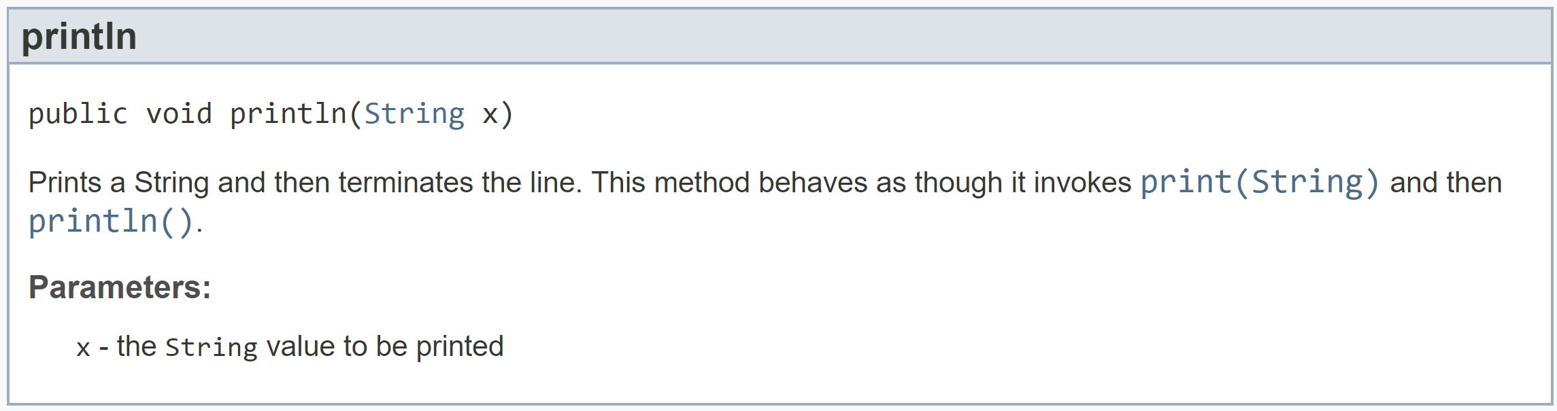
java.io.PrintWriter
Using this class, gives access to the println series of methods; FileWriter only ouptuts character by character.
Note: there is no PrintReader equivalent.

Slide 39
Line-Oriented I/O Example (characters)
public static void main(String[] args) throws IOException
{
try(BufferedReader in =
new BufferedReader(new FileReader("xanadu.txt"));
PrintWriter out =
new PrintWriter(
new BufferedWriter(
new FileWriter("characteroutput.txt"))))
{
String l;
while ((l = in.readLine()) != null){
out.println(l);
}
}
}

Slide 40
Road Map
Introduction to I/O Streams
Byte-oriented I/O Streams
Character-oriented I/O Streams
Layered I/O Streams (e.g. buffering)
Line-oriented I/O Streams
Scanning
Pacemaker I/O
Further Reading:
Data Streams
Object Streams
Command Line I/O

Slide 41
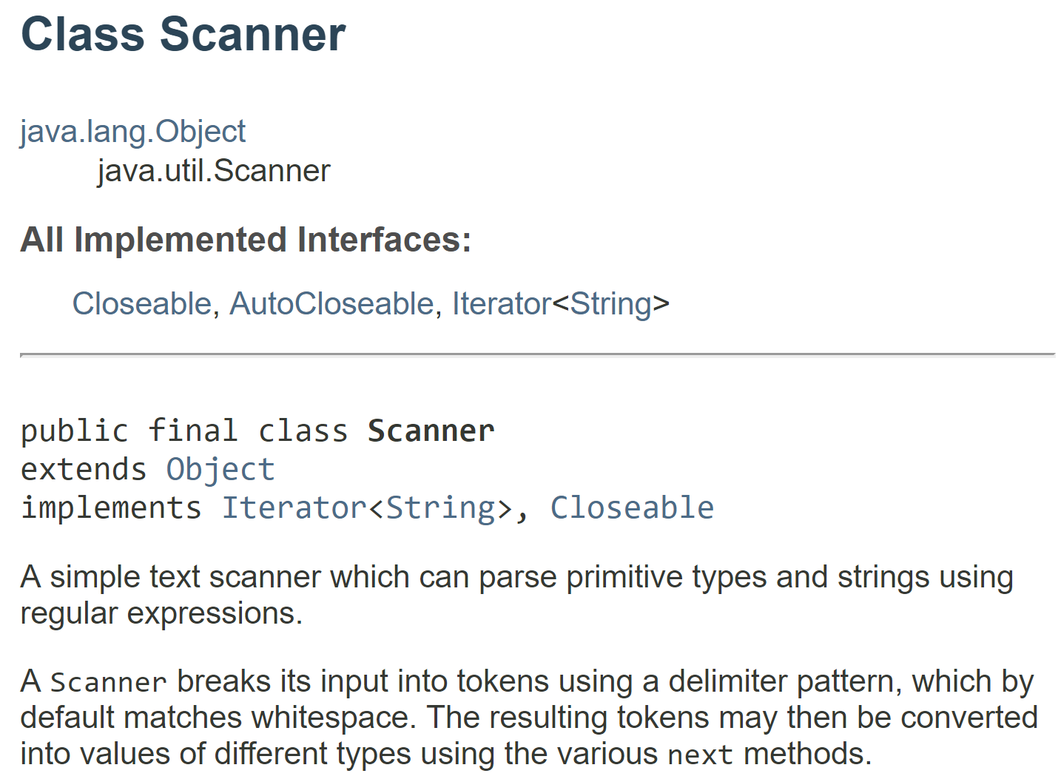


Slide 42
Scanning
By default, a Scanner uses white space to separate tokens.
To use a different token separator, invoke useDelimiter(), specifying a regular expression (i.e. a sequence of symbols and characters expressing a string/pattern).
Even though a scanner is not a stream, you need to close it to indicate that you're done with its underlying stream.

Slide 43
ScanFile
public class ScanFile
{
public static void main(String[] args) throws IOException
{
Scanner s = null;
try
{
s = new Scanner(new BufferedReader(
new FileReader("xanadu.txt")));
while (s.hasNext())
{
System.out.println(s.next());
}
}
finally
{
if (s != null)
{
s.close();
}
}
}
}
This class reads in
the individual words in
the xanadu.txt file and
prints them out to the
console, one per line.

Slide 44
Translating Individual Tokens
public class ScanSum
{
public static void main(String[] args) throws IOException
{
Scanner s = null;
double sum = 0;
try{
s = new Scanner(new BufferedReader(new FileReader("usnumbers.txt")));
while (s.hasNext()){
if (s.hasNextDouble()){
sum += s.nextDouble();
}
else{
s.next();
}
}
}
finally{
s.close();
}
System.out.println(sum);
}
}
usnumbers.txt
45
3
4
6
rogue text
8.4
3
more rogue text
6.46
Console output
75.86
19

Slide 45
Road Map
Introduction to I/O Streams
Byte-oriented I/O Streams
Character-oriented I/O Streams
Layered I/O Streams (e.g. buffering)
Line-oriented I/O Streams
Scanning
Pacemaker I/O
Further Reading:
Data Streams
Object Streams
Command Line I/O

Slide 46
Abstract the mechanism
package utils;
public interface Serializer
{
void push(Object o);
Object pop();
void write() throws Exception;
void read() throws Exception;
}
Defining this interface will allow us to build different serialization strategies e.g. XML, JSON, etc.
We can decide which to use at compile time, or at run time.

Slide 47
Different Serializers
public class XMLSerializer implements Serializer
{
private Stack stack = new Stack();
private File file;
public XMLSerializer(File file)
{
this.file = file;
}
//more code
public class BinarySerializer
implements Serializer
{
private Stack stack = new Stack();
private File file;
public BinarySerializer(File file)
{
this.file = file;
}
public class JSONSerializer implements Serializer
{
private Stack stack = new Stack();
private File file;
public JSONSerializer(File file)
{
this.file = file;
}
//more code

Slide 48
Deciding at compile time
public Main() throws Exception
{
//XML Serializer
//File datastore = new File("datastore.xml");
//Serializer serializer = new XMLSerializer(datastore);
//JSON Serializer
//File datastore = new File("datastore.json");
//Serializer serializer = new JSONSerializer(datastore);
//Binary Serializer
File datastore = new File("datastore.txt");
Serializer serializer = new BinarySerializer(datastore);

Slide 49
Deciding at runtime
Welcome to pacemaker-console - ?help for instructions
pm> ?la
abbrev name params
lu list-users ()
cu create-user (first name, last name, email, password)
lu list-user (email)
lius list-user (id)
la list-activities (userid, sortBy: type, location, distance, date, duration)
la list-activities (user id)
du delete-user (id)
aa add-activity (user-id, type, location, distance, datetime, duration)
al add-location (activity-id, latitude, longitude)
cff change-file-format (file format: xml, json)
l load ()
s store ()
pm>

Slide 50
Binary Strategy
public class BinarySerializer implements ISerializationStrategy
{
public Object read(String filename) throws Exception
{
ObjectInputStream is = null;
Object obj = null;
try
{
is = new ObjectInputStream(new BufferedInputStream(
new FileInputStream(filename)));
obj = is.readObject();
}
finally
{
if (is != null)
{
is.close();
}
}
return obj;
}
//..
}
44

Slide 51
Binary Strategy (contd.)
public class BinarySerializer implements ISerializationStrategy
{
//..
public void write(String filename, Object obj) throws Exception
{
ObjectOutputStream os = null;
try
{
os = new ObjectOutputStream(new BufferedOutputStream(
new FileOutputStream(filename)));
os.writeObject(obj);
}
finally
{
if (os != null)
{
os.close();
}
}
}
}
45

Slide 52
XML Strategy
public class XMLSerializer implements ISerializationStrategy
{
public Object read(String filename) throws Exception
{
ObjectInputStream is = null;
Object obj = null;
try
{
XStream xstream = new XStream(new DomDriver());
is = xstream.createObjectInputStream(new FileReader(filename));
obj = is.readObject();
}
finally
{
if (is != null)
{
is.close();
}
}
return obj;
}
//...
}
46

Slide 53
XML Strategy (contd.)
public class XMLSerializer implements ISerializationStrategy
{
//...
public void write(String filename, Object obj) throws Exception
{
ObjectOutputStream os = null;
try
{
XStream xstream = new XStream(new DomDriver());
os = xstream.createObjectOutputStream(new FileWriter(filename));
os.writeObject(obj);
}
finally
{
if (os != null)
{
os.close();
}
}
}
}
47

Slide 54
Road Map
Introduction to I/O Streams
Byte-oriented I/O Streams
Character-oriented I/O Streams
Layered I/O Streams (e.g. buffering)
Line-oriented I/O Streams
Scanning
Pacemaker I/O
Further Reading:
Data Streams
Object Streams
Command Line I/O

Slide 55
Data Streams
Data streams support binary I/O of primitive data type values (boolean, char, byte, short, int, long, float, and double) as well as String values.
All data streams implement either the DataInput interface or the DataOutput interface.
The most widely-used implementations of these interfaces are DataInputStream and DataOutputStream.

Slide 56
DataStream (1)
public class DataStream
{
static final String dataFile = "invoicedata";
static final double[] prices = { 19.99, 9.99, 15.99, 3.99, 4.99 };
static final int[] units = { 12, 8, 13, 29, 50 };
static final String[] descs = { "Java T-shirt", "Java Mug",
"Duke Juggling Dolls",
"Java Pin", "Java Key Chain"};
public static void main(String[] args) throws IOException
{
DataOutputStream out = new DataOutputStream(
new BufferedOutputStream(new FileOutputStream(dataFile)));
for (int i = 0; i < prices.length; i++)
{
out.writeDouble(prices[i]);
out.writeInt(units[i]);
out.writeUTF(descs[i]);
}
out.close();
//…continued

Slide 57
DataStream (2)
//…continued
DataInputStream in = new DataInputStream(
new BufferedInputStream(
new FileInputStream(dataFile)));
double price;
int unit;
String desc;
double total = 0.0;
try
{
while (true)
{
price = in.readDouble();
unit = in.readInt();
desc = in.readUTF();
System.out.format("You ordered %d units of %s at $%.2f%n",
unit, desc, price);
total += unit * price;
}
}
catch (EOFException e)
{
System.out.println("End of file");
}
}
}
31

Slide 58
Data Streams Observations
The writeUTF method writes out String values in a modified form of UTF-8.
A variable-width character encoding that only needs a single byte for common Western characters.
Generally, we detect an end-of-file condition by catching EOFException, instead of testing for an invalid return value.
Each specialized write in DataStreams is exactly matched by the corresponding specialized read.
Floating point numbers not recommended for monetary values
In general, floating point is bad for precise values.
The correct type to use for currency values is java.math.BigDecimal.
Unfortunately, BigDecimal is an object type, so it won't work with data streams – need Object Streams.
32

Slide 59
Road Map
Introduction to I/O Streams
Byte-oriented I/O Streams
Character-oriented I/O Streams
Layered I/O Streams (e.g. buffering)
Line-oriented I/O Streams
Scanning
Pacemaker I/O
Further Reading:
Data Streams
Object Streams
Command Line I/O

Slide 60
Object Streams
Data streams support I/O of primitive data types
Object streams support I/O of objects
A class that can be serialized implements the marker interface Serializable.
The object stream classes are ObjectInputStream and ObjectOutputStream.
An object stream can contain a mixture of primitive and object values
If readObject() doesn't return the object type expected, attempting to cast it to the correct type may throw a ClassNotFoundException.
33

Slide 61
ObjectStreams
public class ObjectStreams
{
static final String dataFile = "invoicedata";
static final BigDecimal[] prices = {new BigDecimal("19.99"),
new BigDecimal("9.99"),
new BigDecimal("15.99"),
new BigDecimal("3.99"),
new BigDecimal("4.99") };
static final int[] units = { 12, 8, 13, 29, 50 };
static final String[] descs = { "Java T-shirt", "Java Mug",
"Duke Juggling Dolls",
"Java Pin", "Java Key Chain" };
public static void main(String[] args)
throws IOException, ClassNotFoundException
{
ObjectOutputStream out = null;
try
{
out = new ObjectOutputStream(
new BufferedOutputStream(new FileOutputStream(dataFile)));
out.writeObject(Calendar.getInstance());
for (int i = 0; i < prices.length; i++)
{
out.writeObject(prices[i]);
out.writeInt(units[i]);
out.writeUTF(descs[i]);
}
}
finally
{
out.close();
}
//…
}
34

Slide 62
ObjectStreams
ObjectInputStream in = null;
try
{
in = new ObjectInputStream(
new BufferedInputStream(new FileInputStream(dataFile)));
Calendar date = null;
BigDecimal price;
int unit;
String desc;
BigDecimal total = new BigDecimal(0);
date = (Calendar) in.readObject();
System.out.format("On %tA, %<tB %<te, %<tY:%n", date);
try
{
while (true)
{
price = (BigDecimal) in.readObject();
unit = in.readInt();
desc = in.readUTF();
System.out.format("You ordered %d units of %s at $%.2f%n",unit, desc, price);
total = total.add(price.multiply(new BigDecimal(unit)));
}
}
catch (EOFException e)
{
}
System.out.format("For a TOTAL of: $%.2f%n", total);
}
finally
{
in.close();
}
35

Slide 63
readObject() and writeObject()
The writeObject and readObject methods contain some sophisticated object management logic.
This is particularly important for objects that contain references to other objects.
If readObject is to reconstitute an object from a stream, it has to be able to reconstitute all the objects the original object referred to.
These additional objects might have their own references, and so on.
In this situation, writeObject traverses the entire web of object references and writes all objects in that web onto the stream. Thus a single invocation of writeObject can cause a large number of objects to be written to the stream.
36

Slide 64
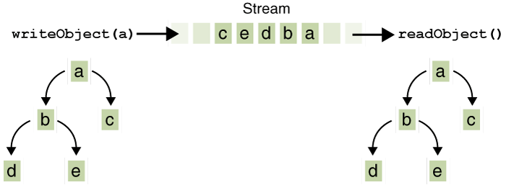
Suppose:
If writeObject is invoked to write a single object named a.
This object contains references to objects b and c,
while b contains references to d and e.
Invoking writeobject(a) writes a and all the objects necessary to reconstitute a
When a is read by readObject, the other four objects are read back as well, and all the original object references are preserved.
37

Slide 65
Road Map
Introduction to I/O Streams
Byte-oriented I/O Streams
Character-oriented I/O Streams
Layered I/O Streams (e.g. buffering)
Line-oriented I/O Streams
Scanning
Pacemaker I/O
Further Reading:
Data Streams
Object Streams
Command Line I/O

Slide 66
Command Line I/O
A program is often run from the command line, and interacts with the user in the command line environment.
The Java platform supports this kind of interaction in two ways:
Standard Streams
Console
21

Slide 67
Standard Streams
A feature of many operating systems, they read input from the keyboard and write output to the display.
They also support I/O on files and between programs.
The Java platform supports three Standard Streams:
Standard Input, accessed through System.in;
Standard Output, accessed through System.out;
Standard Error, accessed through System.err.
These objects are defined automatically (do not need to be opened)
Standard Output and Standard Error are both for output
Having error output separately allows the user to divert regular output to a file and still be able to read error messages.
22

Slide 68
System.in, System.out, System.err
For historical reasons, the standard streams are byte streams (more logically character streams).
System.out and System.err are defined as PrintStream objects.
Although it is technically a byte stream, PrintStream utilises an internal character stream object to emulate many of the features of character streams.
By contrast, System.in is a byte stream with no character stream features.
To utilise Standard Input as a character stream, wrap System.in in InputStreamReader.
InputStreamReader cin = new InputStreamReader(System.in);
23

Slide 69
Console
New in Java 6 - a more advanced alternative to the Standard Streams
This is a single pre-defined object of type Console that has most of the features provided by the Standard Streams.
The Console object also provides input and output streams that are true character streams, through its reader and writer methods.
Before a program can use the Console, it must attempt to retrieve the Console object by invoking System.console().
If the Console object is available, this method returns it.
If it returns NULL, then Console operations are not permitted, either because the OS doesn't support them, or because the program was launched in a non-interactive environment.
24

Slide 70
Password Entry
The Console object supports secure password entry through its readPassword method.
This method helps secure password entry in two ways:
It suppresses echoing, so the password is not visible on the users screen.
readPassword returns a character array, not a String, so that the password can be overwritten, removing it from memory as soon as it is no longer needed.
25

Slide 71
Password (1)
public class Password
{
public static void main(String[] args) throws IOException
{
Console c = System.console();
if (c == null)
{
System.err.println("No console.");
System.exit(1);
}
String login = c.readLine("Enter your login: ");
char[] oldPassword = c.readPassword("Enter your old password: ");
//..
}
}
26

Slide 72
Password (2)
//..
if (verify(login, oldPassword))
{
boolean noMatch;
do
{
char[] newPassword1 = c.readPassword("Enter your new password: ");
char[] newPassword2 = c.readPassword("Enter new password again: ");
noMatch = !Arrays.equals(newPassword1, newPassword2);
if (noMatch)
{
c.format("Passwords don't match. Try again.%n");
}
else
{
change(login, newPassword1);
c.format("Password for %s changed.%n", login);
}
Arrays.fill(newPassword1, ' ');
Arrays.fill(newPassword2, ' ');
}
while (noMatch);
}
Arrays.fill(oldPassword, ' ');
}
27

Slide 73
format method
System.out.format("The value of " + "the float variable is " + "%f, while the value of the " + "integer variable is %d, " + "and the string is %s",
floatVar, intVar, stringVar);
Format specifiers begin with a percent sign (%) and end with a converter.

Slide 74
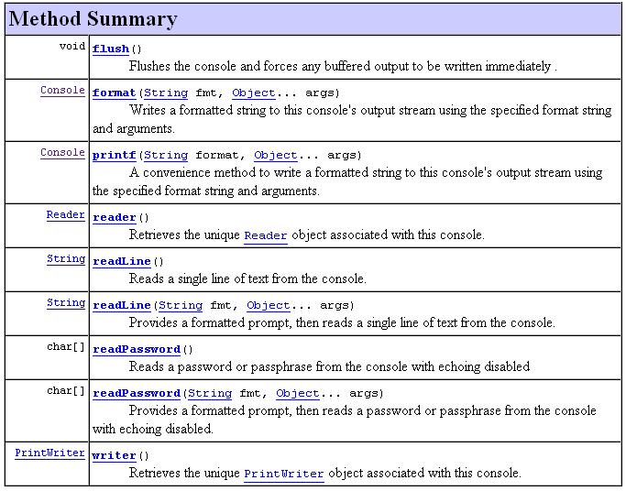
Console Methods
28

