Slide 1
Agile Software Development
Dr. Siobhan Drohan (sdrohan@wit.ie)
Eamonn de Leastar (edeleastar@wit.ie)

Slide 2
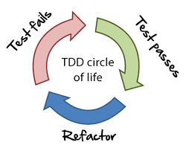
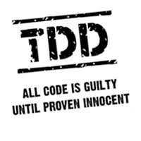
Agile and Test Driven Development (TDD)

Slide 3
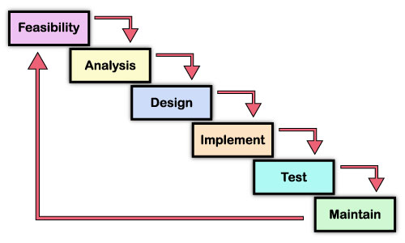
Waterfall - development approach

Slide 4
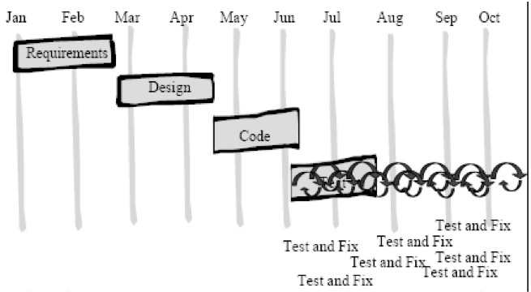
Waterfall - development approach

Slide 5
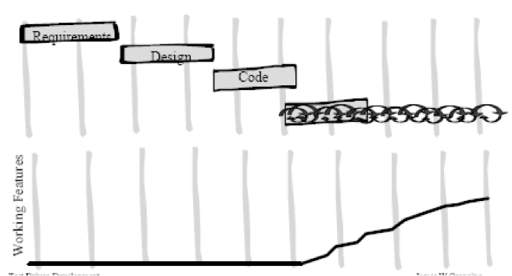
Waterfall - Working Features

Slide 6
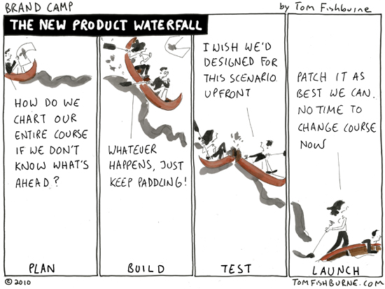
https://www.linkedin.com/pulse/enterprise-performance-management-solutions-agile-projects-mkpadi/

Slide 7
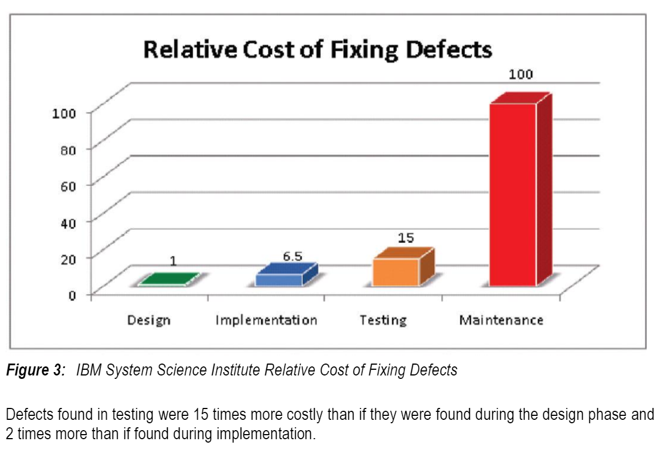
Waterfall
https://www.researchgate.net/publication/255965523_Integrating_Software_Assurance_into_the_Software_Development_Life_Cycle_SDLC

Slide 8
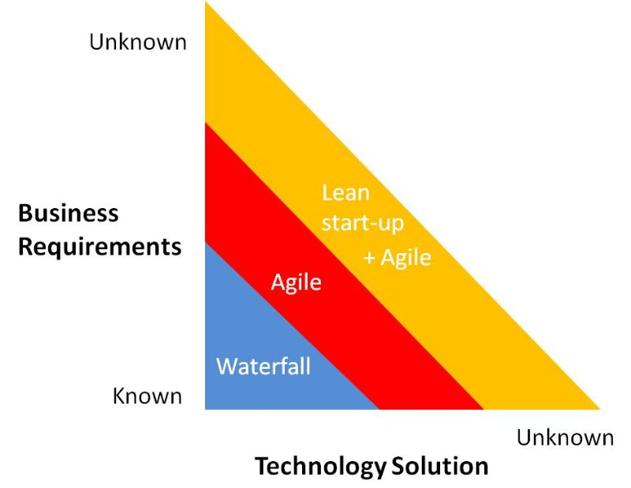
Waterfall Vs Agile
https://www.linkedin.com/pulse/enterprise-performance-management-solutions-agile-projects-mkpadi/
Notes:
Waterfall works best when there is a defined problem and a prescribed solution that meets it exactly.

Slide 9
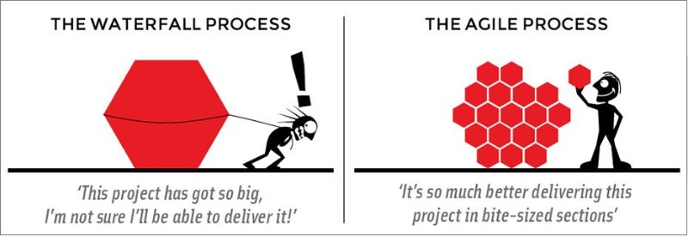
Waterfall Vs Agile
https://www.linkedin.com/pulse/pragmatic-pivoting-software-development-life-cycle-beyond-mkpadi/

Slide 10
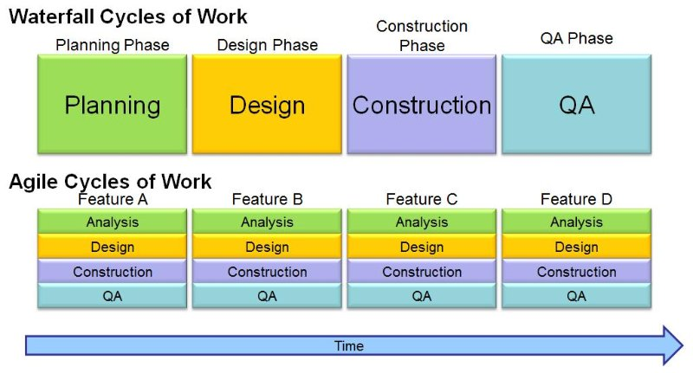
Waterfall Vs Agile
https://www.linkedin.com/pulse/enterprise-performance-management-solutions-agile-projects-mkpadi/

Slide 11
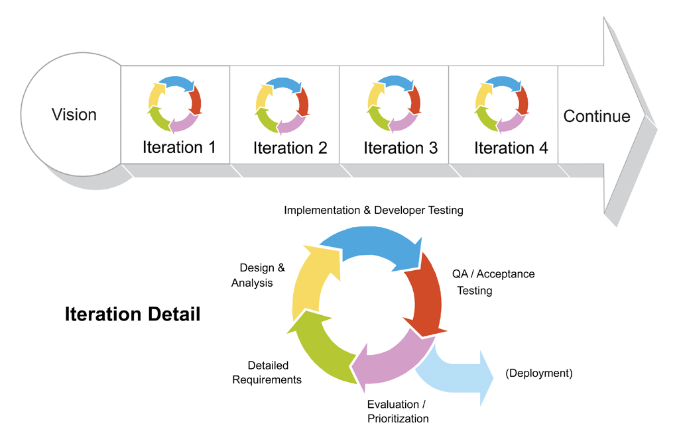
Agile – Iterative Approach
https://cloudhcm.wordpress.com/2014/09/13/project-management-tool-for-saas-implementation-projects/

Slide 12
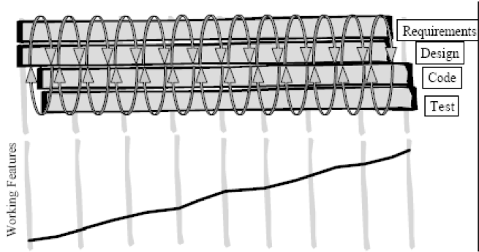
Iterative Approach - Working Features

Slide 13
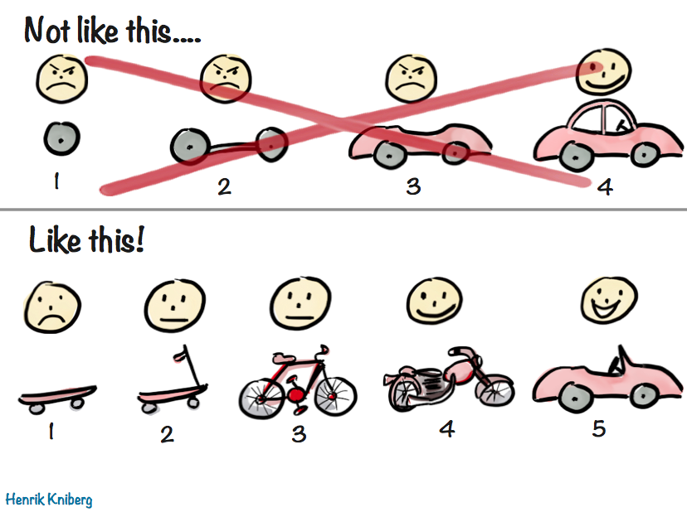
Agile – Both Iterative and Incremental
https://m.dotdev.co/the-agile-bicycle-829a83b18e7

Slide 14
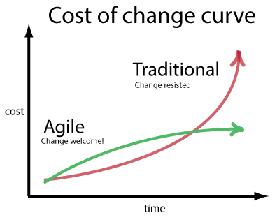
Waterfall vs Agile – Cost of Change
https://www.linkedin.com/pulse/enterprise-performance-management-solutions-agile-projects-mkpadi/

Slide 15
Developer landscape has changed just a little (!) …
New tools have dramatically eased mundane developer tasks:
Automated test tools (e.g. JUnit)
System build tools (e.g. Maven, Gradle, SBT)
Version control (e.g. Git repositories, Github hosting service)
Continuous integration
Used properly, OO languages can make software much easier to change.
The cost curve is significantly flattened, i.e. costs don’t increase dramatically with time.
Up front modeling becomes a liability – some speculative work will certainly be wrong, especially in a business environment.

Slide 17
“Good programmers write code,
great programmers write tests”

Slide 18
“Never,
in the field of programming,
have so many
owed so much
to so few”
- Martin Fowler on the developers behind JUnit

Slide 19
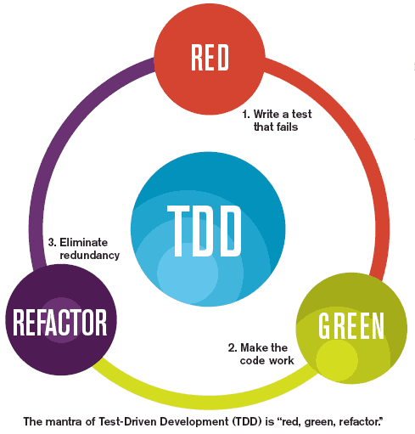

Slide 20
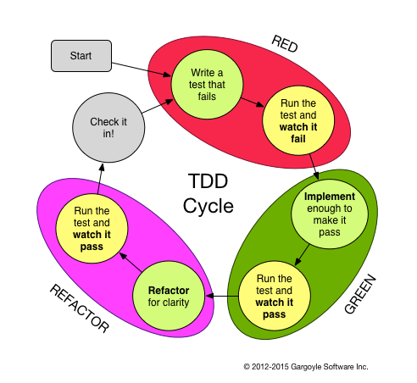

Slide 21
TDD – Definition
Test-driven development (TDD) refers to a style of programming in which three activities are tightly interwoven:
coding,
testing (in the form of writing unit tests) and
design (in the form of refactoring).
https://www.agilealliance.org/glossary/tdd/

Slide 22
What is Unit Testing?
A unit test is a piece of code written by a developer that exercises a very small, specific area of functionality of the code being tested.
Usually a unit test exercises some particular method in a particular context
Unit tests are performed to prove that a piece of code does what the developer thinks it should do.
The question remains open as to whether that's the right thing to do according to the customer or end-user:
that is acceptance testing (Acceptance Test Driven Development, Behaviour Driven Development)

Slide 23
What is Regression Testing?
New code and changes to old code can affect the rest of the code base.
‘Affect’ sometimes means ‘break’.
We need to rerun tests on the old code, to verify it still works – this is regression testing.
Regression testing is required for a stable, maintainable code base.
Unit tests retain their value over time and allows others to prove the software still works (as tested).

Slide 24
What does Unit Testing Accomplish ?
Does the code do what was expected?
i.e. is the code fulfilling the intent of the developer?
Does the code do what was expected all the time?
exceptions get thrown, disks get full, network lines drop, buffers overflow - is the code still performing as expected?
Can the code be depended upon?
Need to know for certain both its strengths and its limitations.
Does the test document the developers intent?
An important side-effect of unit testing is that it helps communicate the code's intended use.

Slide 25
TDD – General
An iterative technique to develop software.
Tests are written before the code itself.
As much (or more) about design as testing.
Encourages design from user’s point of view.
Encourages testing classes/units in isolation – Unit testing.
A test framework is used so that automated testing can be done after every small change to the code.
This may be as often as every 5 or 10 minutes.
Axiom:
‘Code that isn’t tested doesn’t work’
‘Code that isn’t regression tested suffers from code rot (breaks eventually)’

Slide 26
TDD – General (Contd.)
As much (or more) about documentation as testing.
The tests are the documentation of what the code does.
Must be learned and practiced.
Consequences:
Fewer bugs;
More maintainable code - loosely-coupled, highly-cohesive systems.
During development, the program always works—it may not do everything required, but what it does, it does right.
Breaks the cycle of more pressure == fewer tests (the fewer tests you write, the less productive you are and the less stable your code becomes).

Slide 27
How is Unit Testing carried out?
Step 1: Decide how to test the method in question before writing the code itself
Step 2: Write the test code itself, either before or concurrently with the implementation code.
Step 3: Run the test itself, and probably all the other tests in that part of the system.
Key Feature of executing unit tests:
You need to be able to determine at a glance whether all tests are succeeding/failing. The JUnit Framework will do this for us!

Slide 28
Why bother with TDD?

Slide 29
TDD – Why bother with TDD/Unit Testing
Significant reductions in defect rates, at the cost of a moderate increase in initial development effort:
generally these overheads are more than offset
by a reduction in effort in projects' final phases.
Anecdotal evidence suggests that TDD leads to improved design qualities in the code, and more generally a higher degree of technical quality.
https://www.agilealliance.org/glossary/tdd/

Slide 30
Excuses for not engaging in TDD

Slide 31
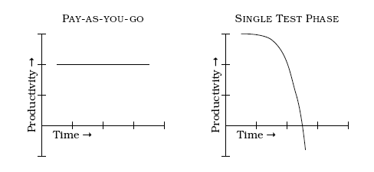
Excuse #1
“It takes too much time to write the tests"
The trade-off is not “test now” versus “test later”
It's linear work now versus exponential work and complexity trying to fix and rework at the end.

Slide 32
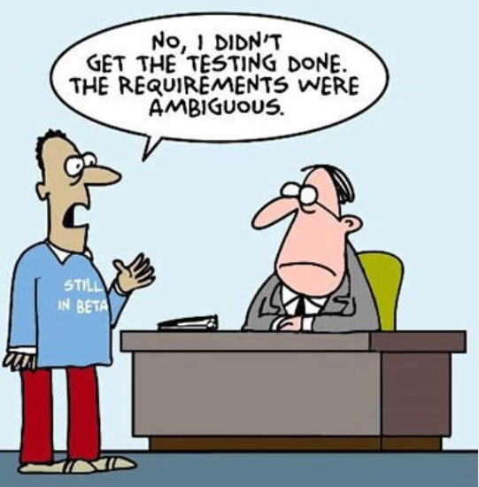
Excuse #2
https://www.ca.com/us/products/excuse-free-testing.html

Slide 33
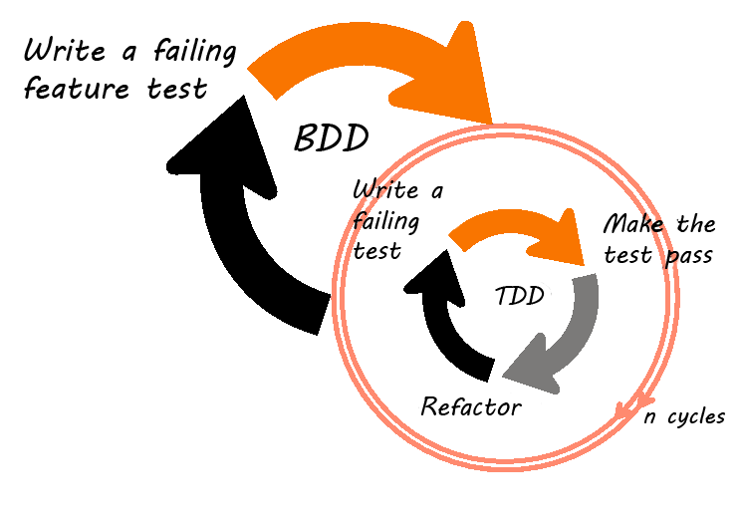
Excuse #2 (contd.)
http://wiki.expertiza.ncsu.edu/index.php/CSC/ECE_517_Fall_2014/ch1b_28_cg

Slide 34
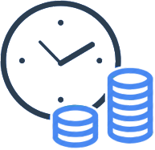
Excuse #3
“It takes too long to run the tests”

Slide 35
Excuse #3
“It takes too long to run the tests”
Separate out the longer-running tests from the short ones.
Only run the long tests once a day, or once every few days as appropriate, and run the shorter tests constantly.
Your code isn’t finished until you have verified it works!

Slide 36
Excuse #4
“It's not developers job to test his/her code”

Slide 37

Excuse #4
“It's not developers job to test his/her code”
Integral part of developer job is to create working code.
Notes:
http://softwaretestingsolution.com/blog/developers-testers-together-can/

Slide 38
Excuse #5
“But it compiles!"

Slide 39
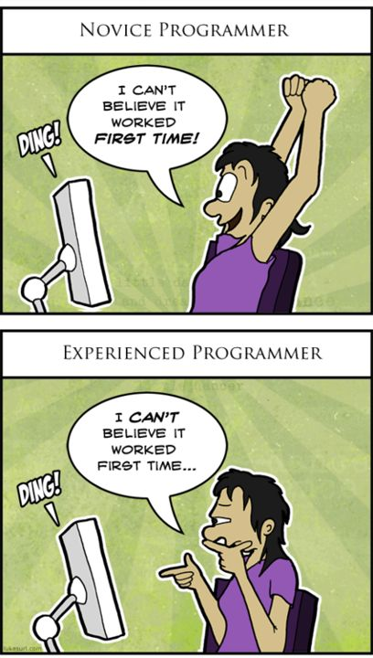
Excuse #5
“But it compiles!”
A compiler's blessing is a pretty shallow compliment.
Notes:
http://www.insercorp.com/blog/post/august/01/2014/first-and-last-note-from-the-desk-of-the-web-intern

Slide 40
Excuse #6
“We refactor our code so frequently, that the time we invest in tests just isn't worth it - they are going to change and be irrelevant anyhow"

Slide 41
Excuse #6
“We refactor our code so frequently, that the time we invest in tests just isn't worth it - they are going to change and be irrelevant anyhow“
How can you be certain you didn’t break anything when refactoring your code?
Regression testing is one of the number one reasons for doing TDD…good regression tests will, almost immediately, show up un-intended side effects of your code change.
A good rule is…NEVER refactor without tests!
http://codesheriff.blogspot.ie/2011/11/excuse-5-frequent-refactoring-excuse.html

Slide 42
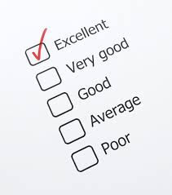
Excuse #7
“We are such talented programmers, we don’t need tests"
http://codesheriff.blogspot.ie/2011/11/excuse-5-frequent-refactoring-excuse.html

Slide 43
Excuse #7
“We are such talented programmers, we don’t need tests“
Everyone has bugs in their code…we are human after all!
Ok, even if you are a “bug-free coder”, what about Regression testing in the future by you and other programmers?
http://codesheriff.blogspot.ie/2011/11/excuse-5-frequent-refactoring-excuse.html

Slide 44
Can we engage in TDD too much?

Slide 45
