Slide 1
Agile Software Development
Dr. Siobhán Drohan (sdrohan@wit.ie)
Eamonn de Leastar (edeleastar@wit.ie)

Slide 2

First JUnit Tests (JUnit 3)

Slide 3
What is JUnit?
JUnit:
is a Unit Testing Framework for Java.
enables you to write and run repeatable tests.
is used to Unit Test a small piece of code.
When following TDD, developers should write and execute the JUnit tests before writing any code.

Slide 4
JUnit Versions
JUnit 3 (http://junit.sourceforge.net/junit3.8.1/)
JUnit 4 (http://junit.org/junit4/)
Version we will mainly use is 4.12
JUnit 5 (http://junit.org/junit5/)
First general availability release published on September 10, 2017. Bug fix version released on October 3, 2017.
Not supported directly in Eclipse IDE (you can use it via Maven, which we will show you in future weeks)

Slide 5
JUnit Version 3
As conventions differ between the versions, it is important to be able to use Version 3 and 4 (at least) and 5 (desirable).
In Version 3:
Test class must extend TestCase.
setUp/tearDown methods are overridden from TestCase (note that this is optional).
Test methods must begin with “test” word.

Slide 6
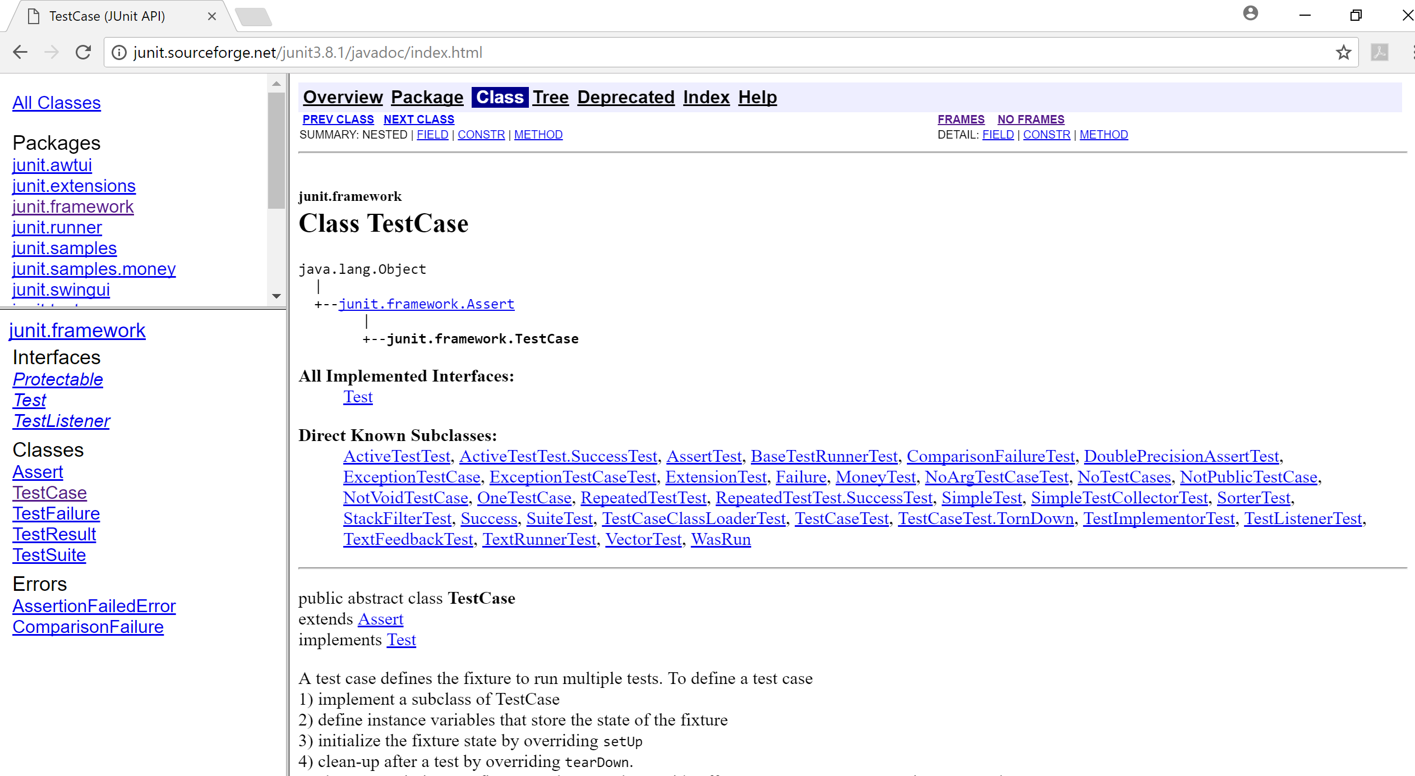
1. Test Class must extend TestCase
http://junit.sourceforge.net/junit3.8.1/javadoc/index.html

Slide 7
1. Test Class must extend TestCase
import junit.framework.TestCase;
public class TestLargest extends TestCase
{
//JUnit testing code omitted
}
http://junit.sourceforge.net/junit3.8.1/javadoc/index.html

Slide 8
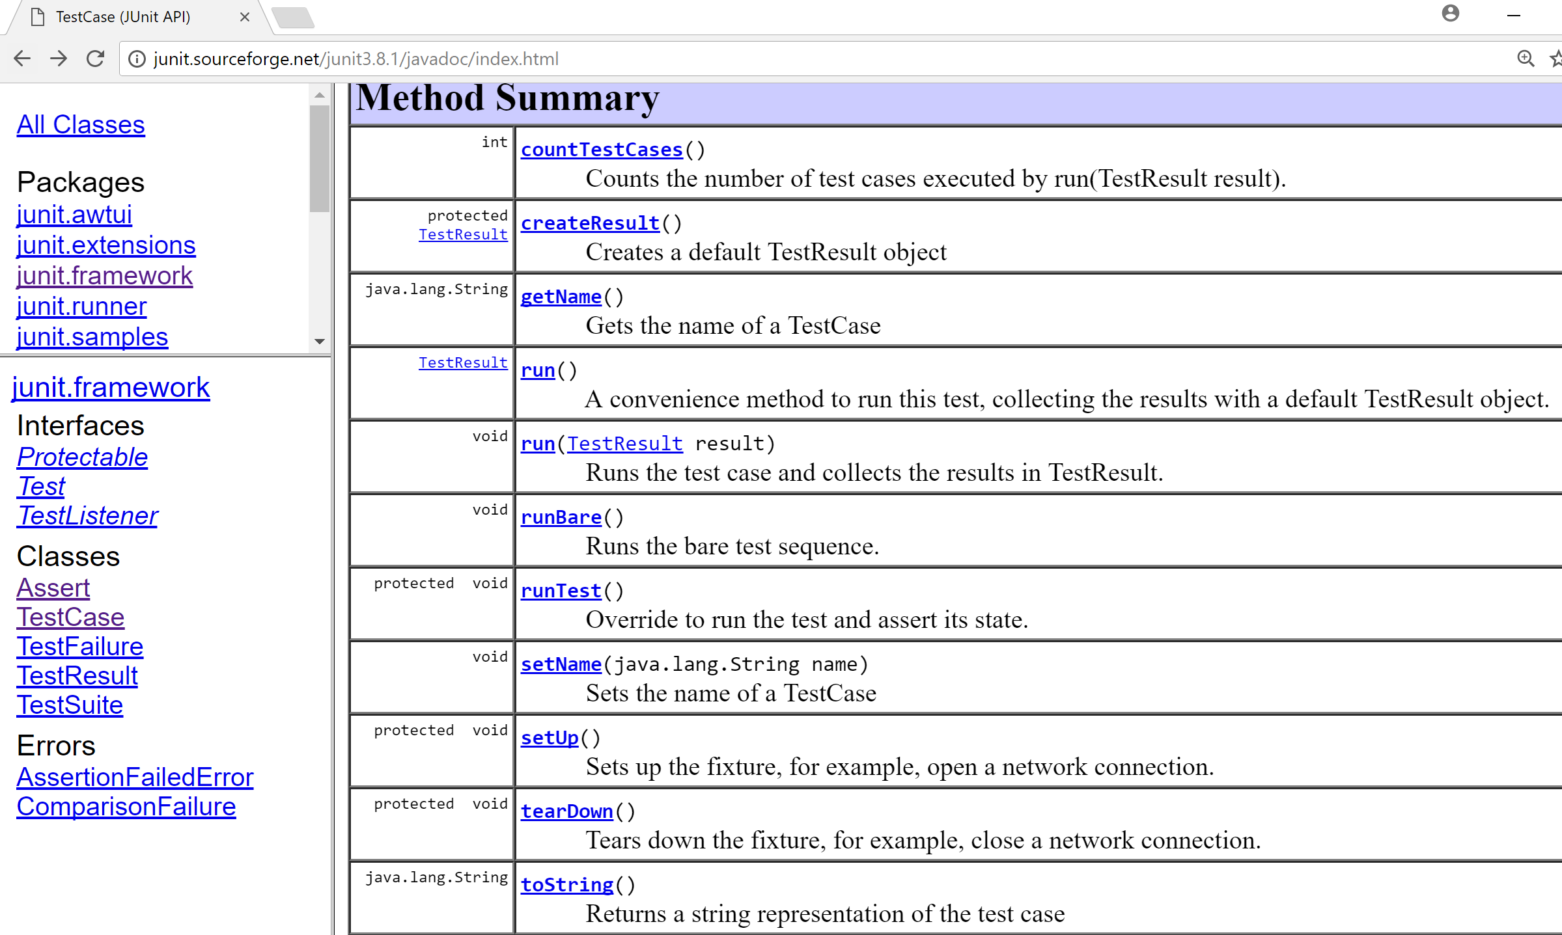
2. setUp/tearDown methods are overridden from TestCase (note
that this is optional).
http://junit.sourceforge.net/junit3.8.1/javadoc/index.html

Slide 9
3. Test methods must begin with
“test” word.
import junit.framework.TestCase;
public class TestLargest extends TestCase
{
public TestLargest (String name)
{
super(name);
}
public void testOrder ()
{
int[] arr = new int[3];
arr[0] = 8;
arr[1] = 9;
arr[2] = 7;
assertEquals(9, Largest.largest(arr));
}
}

Slide 10
Let’s look at Assertions now…and then we will look at a JUnit testing a simple program.
import junit.framework.TestCase;
public class TestLargest extends TestCase
{
public TestLargest (String name)
{
super(name);
}
public void testOrder ()
{
int[] arr = new int[3];
arr[0] = 8;
arr[1] = 9;
arr[2] = 7;
assertEquals(9, Largest.largest(arr));
}
}

Slide 11
Assertions
To check if code is behaving as you expect
use an assertion i.e. a simple method call that verifies that something is true.

Slide 13
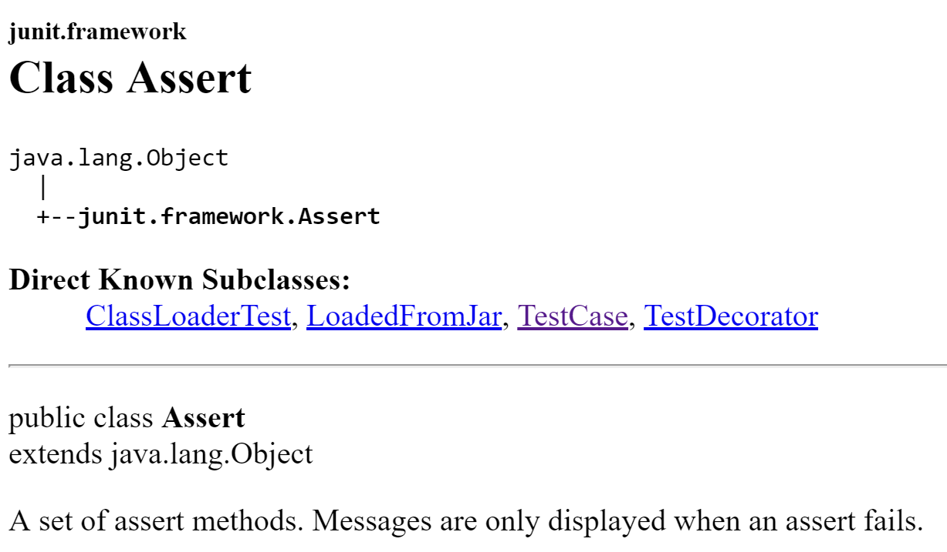

Slide 14
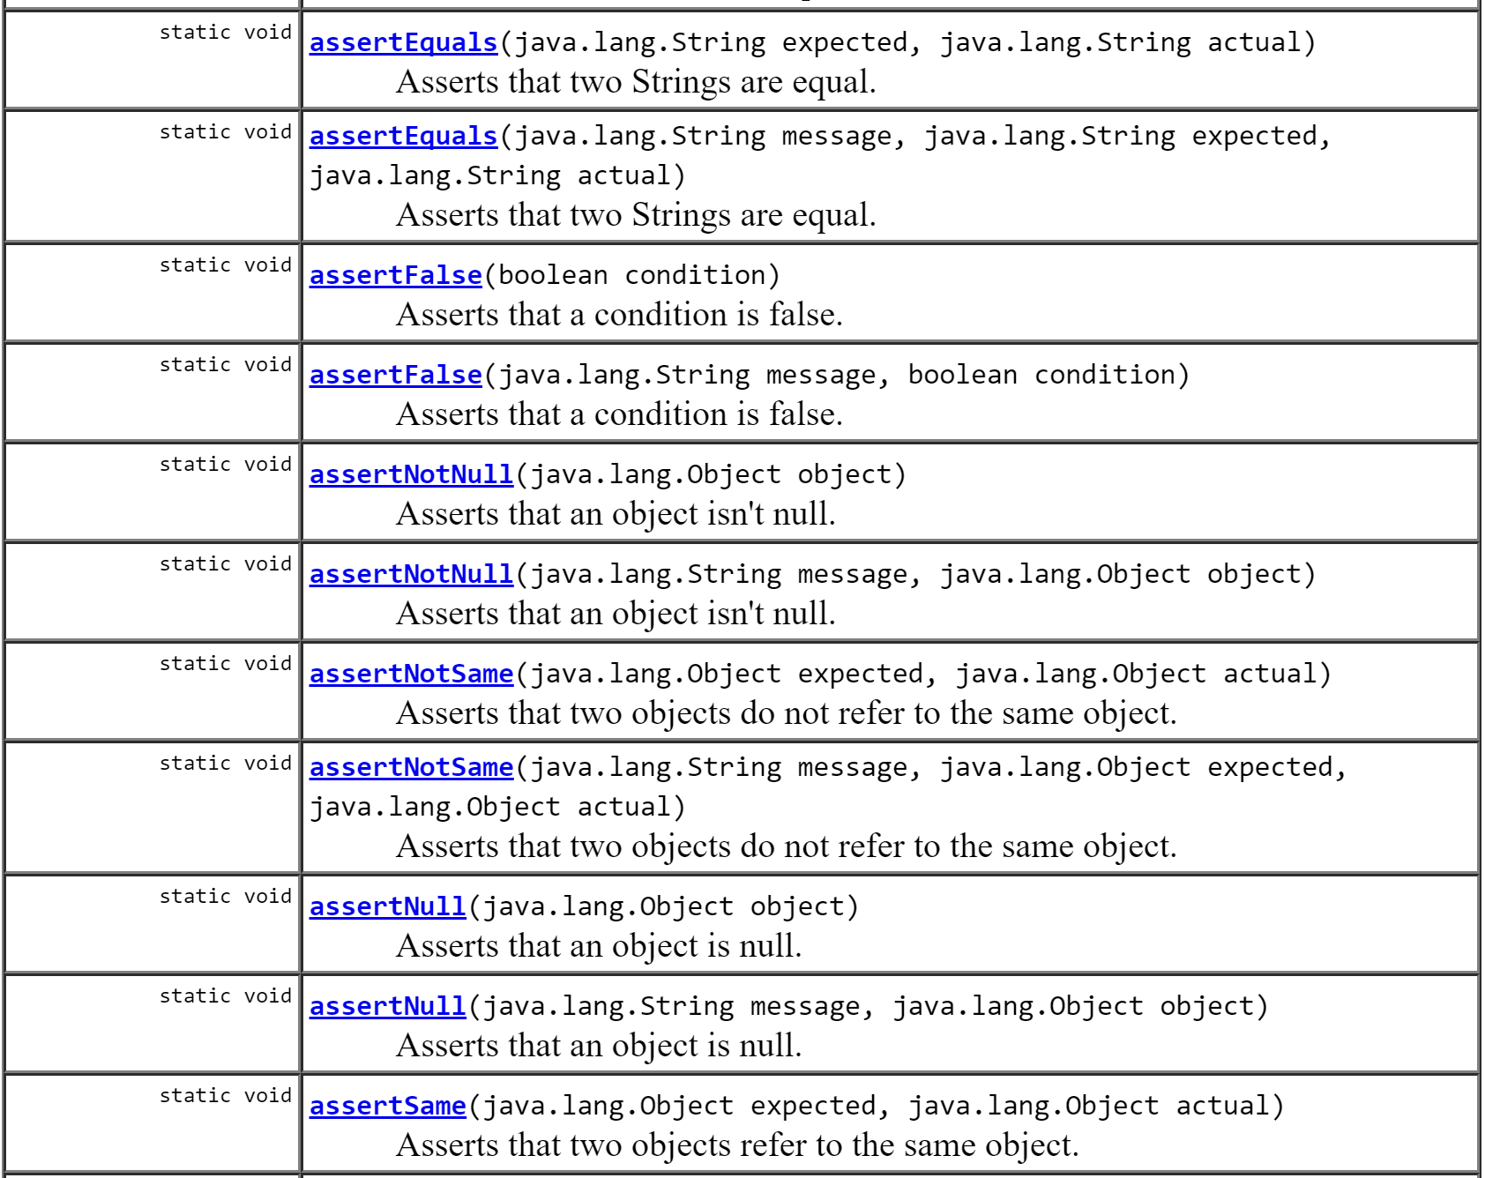
Some of the many “assertion” methods in the Assert class…

Slide 15
Using Asserts
You could use this assert to check all sorts of things, including whether numbers are equal to each other.
int a = 2;
//...
assertTrue (a == 2);

Slide 16
Using Asserts
You could use this assert to check all sorts of things, including whether numbers are equal to each other.
To check that two integers are equal, a method that takes two integer parameters might be more useful.
int a = 2;
//...
assertTrue (a == 2);
public void assertEquals (int a, int b)
{
assertTrue(a == b);
}

Slide 17
Using Asserts
You could use this assert to check all sorts of things, including whether numbers are equal to each other.
To check that two integers are equal, a method that takes two integer parameters might be more useful.
We can now write the first test a little more expressively:
int a = 2;
//...
assertTrue (a == 2);
public void assertEquals (int a, int b)
{
assertTrue(a == b);
}
int a = 2;
assertEquals (2, a);

Slide 18
JUnit Example
Testing code to return the largest number in a Primitive Array.

Slide 19
Planning Tests
Method to test: A static method designed to find the largest number in a list of numbers.
The following tests would seem to make sense:
[7, 8, 9] → 9
[8, 9, 7] → 9
[9, 7, 8] → 9
(supplied test data → expected result)
public static int largest (int[] list)
{
...
}

Slide 20
More Test Data + First Implementation
Already have this data:
[7, 8, 9] → 9
[8, 9, 7] → 9
[9, 7, 8] → 9
What about this set:
[7, 9, 8, 9] → 9
[1] → 1
[-9, -8, -7] → -7
public static int largest (int[] list)
{
int index, max = Integer.MAX_VALUE;
for (index = 0; index < list.length - 1; index++)
{
if (list[index] > max)
{
max = list[index];
}
}
return max;
}
(supplied test data → expected result)

Slide 21
Writing the TestCase
import junit.framework.TestCase;
public class TestLargest extends TestCase
{
public TestLargest (String name)
{
super(name);
}
public void testOrder ()
{
int[] arr = new int[3];
arr[0] = 8;
arr[1] = 9;
arr[2] = 7;
assertEquals(9, Largest.largest(arr));
}
}
This is a TestCase called TestLargest.
It uses the following test data: [8, 9, 7] → 9
It has one Unit Test (testOrder) - to verify the behaviour of the largest method.

Slide 22
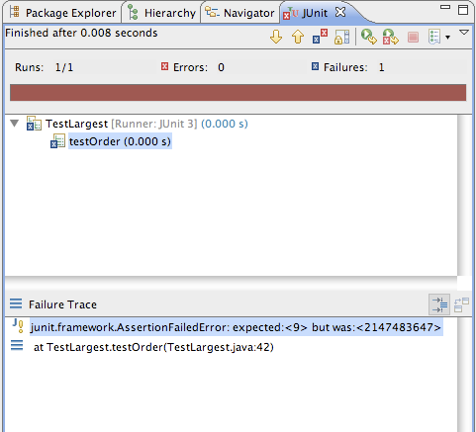
Running the TestCase
Status of the
Automated Test
Execution.
One test ran and
that one test failed.
Lists the test
classes and all
the test methods
within them.
Lists all the tests
that failed, along
with assertion
errors.

Slide 23
Running the TestCase
Why did the test return such a huge number instead of 9?
Where could this large number have come from?

Slide 24
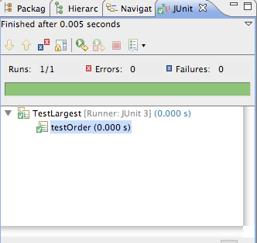
Bug
public static int largest (int[] list)
{
//int index, max = Integer.MAX_VALUE;
int index, max = 0;
for (index = 0; index < list.length - 1; index++)
{
if (list[index] > max)
{
max = list[index];
}
}
return max;
}
First line should initialize max to zero, not MAX_VALUE.

Slide 25
Further Tests
What happens when the largest number appears in different places in the list - first or last, and somewhere in the middle?
Bugs most often show up at the “edges”.
In this case, edges occur when the largest number is at the start or end of the array that we pass in.
Aggregate into a single unit test:
public void testOrder ()
{
assertEquals(9, Largest.largest(new int[] { 9, 8, 7 }));
assertEquals(9, Largest.largest(new int[] { 8, 9, 7 }));
assertEquals(9, Largest.largest(new int[] { 7, 8, 9 }));
}

Slide 26
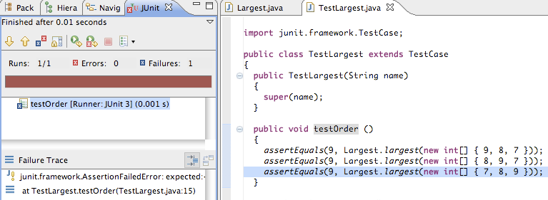
Failure

Slide 27
Failure + Fix
public static int largest (int[] list)
{
int index, max = 0;
//for (index = 0; index < list.length - 1; index++)
for (index = 0; index < list.length; index++)
{
if (list[index] > max)
{
max = list[index];
}
}
return max;
}

Slide 28
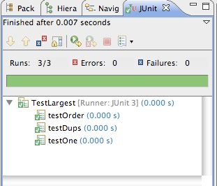
Further Boundary Conditions
public void testDups ()
{
assertEquals(9, Largest.largest(new int[] { 9, 7, 9, 8 }));
}
public void testOne ()
{
assertEquals(1, Largest.largest(new int[] { 1 }));
}
Now exercising multiple tests

Slide 29
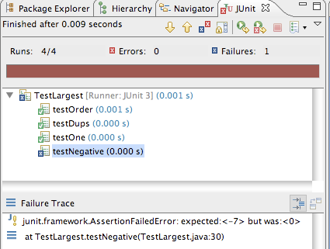
Failure on testNegative
public void testNegative ()
{
int[] negList = new int[] { -9, -8, -7 };
assertEquals(-7, Largest.largest(negList));
}

Slide 30
fix testNegative
public static int largest (int[] list)
{
//int index, max = 0;
int index, max = Integer.MIN_VALUE;
for (index = 0; index < list.length; index++)
{
if (list[index] > max)
{
max = list[index];
}
}
return max;
}
Choosing 0 to initialize max was a bad idea;
Should have been MIN VALUE, so as to be less than all negative numbers as well.

Slide 31
Expected Errors?
public static int largest (int[] list)
{
int index, max = Integer.MIN_VALUE;
if (list.length == 0)
{
throw new RuntimeException("Empty list");
}
for (index = 0; index < list.length; index++)
{
if (list[index] > max)
{
max = list[index];
}
}
return max;
}
If the array is empty, this is considered an error, and an exception should be thrown.
public void testEmpty ()
{
try
{
Largest.largest(new int[] {});
fail("Should have thrown an exception");
}
catch (RuntimeException e)
{
assertTrue(true);
}
}

Slide 32
Some more TDD theory…

Slide 33
TDD – Common Pitfalls ( individual programmer)
Forgetting to run tests frequently
Writing too many tests at once
Writing tests that are too large or coarse-grained
Writing overly trivial tests, for instance omitting assertions
Writing tests for trivial code, for instance accessors
https://www.agilealliance.org/glossary/tdd/

Slide 34
TDD – Common Pitfalls ( teams)
Partial adoption - only a few developers on the team use TDD.
Poor maintenance of the test suite - most commonly leading to a test suite with a prohibitively long running time.
Abandoned test suite (i.e. seldom or never run) - sometimes as a result of poor maintenance, sometimes as a result of team turnover.
https://www.agilealliance.org/glossary/tdd/

Slide 35
TDD – Signs of Use
"code coverage" is a common approach to evidencing the use of TDD; while high coverage does not guarantee appropriate use of TDD, coverage below 80% is likely to indicate deficiencies in a team's mastery of TDD.
version control logs should show that test code is checked in each time product code is checked in, in roughly comparable amounts.
https://www.agilealliance.org/glossary/tdd/

Slide 36
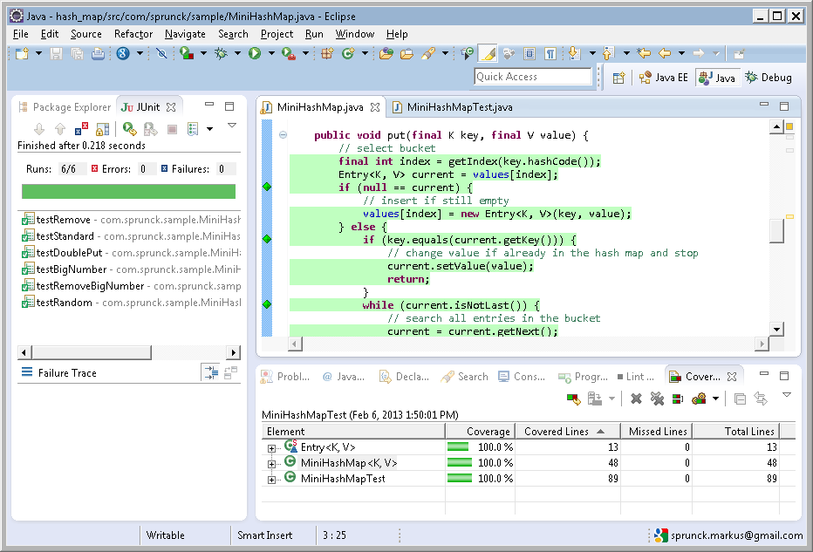
TDD – Code Coverage – 100% Example

Slide 37
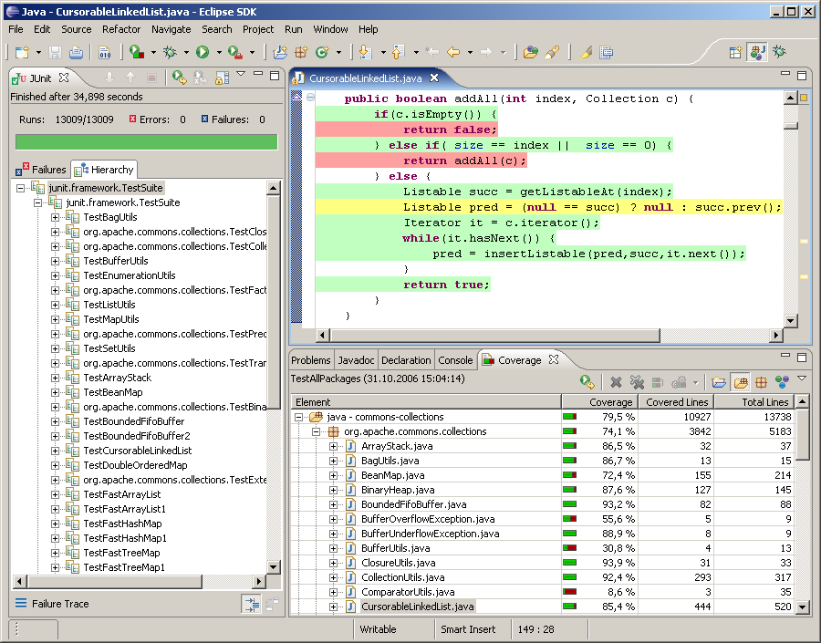
TDD – Code Coverage – 85.4% Example

Slide 38
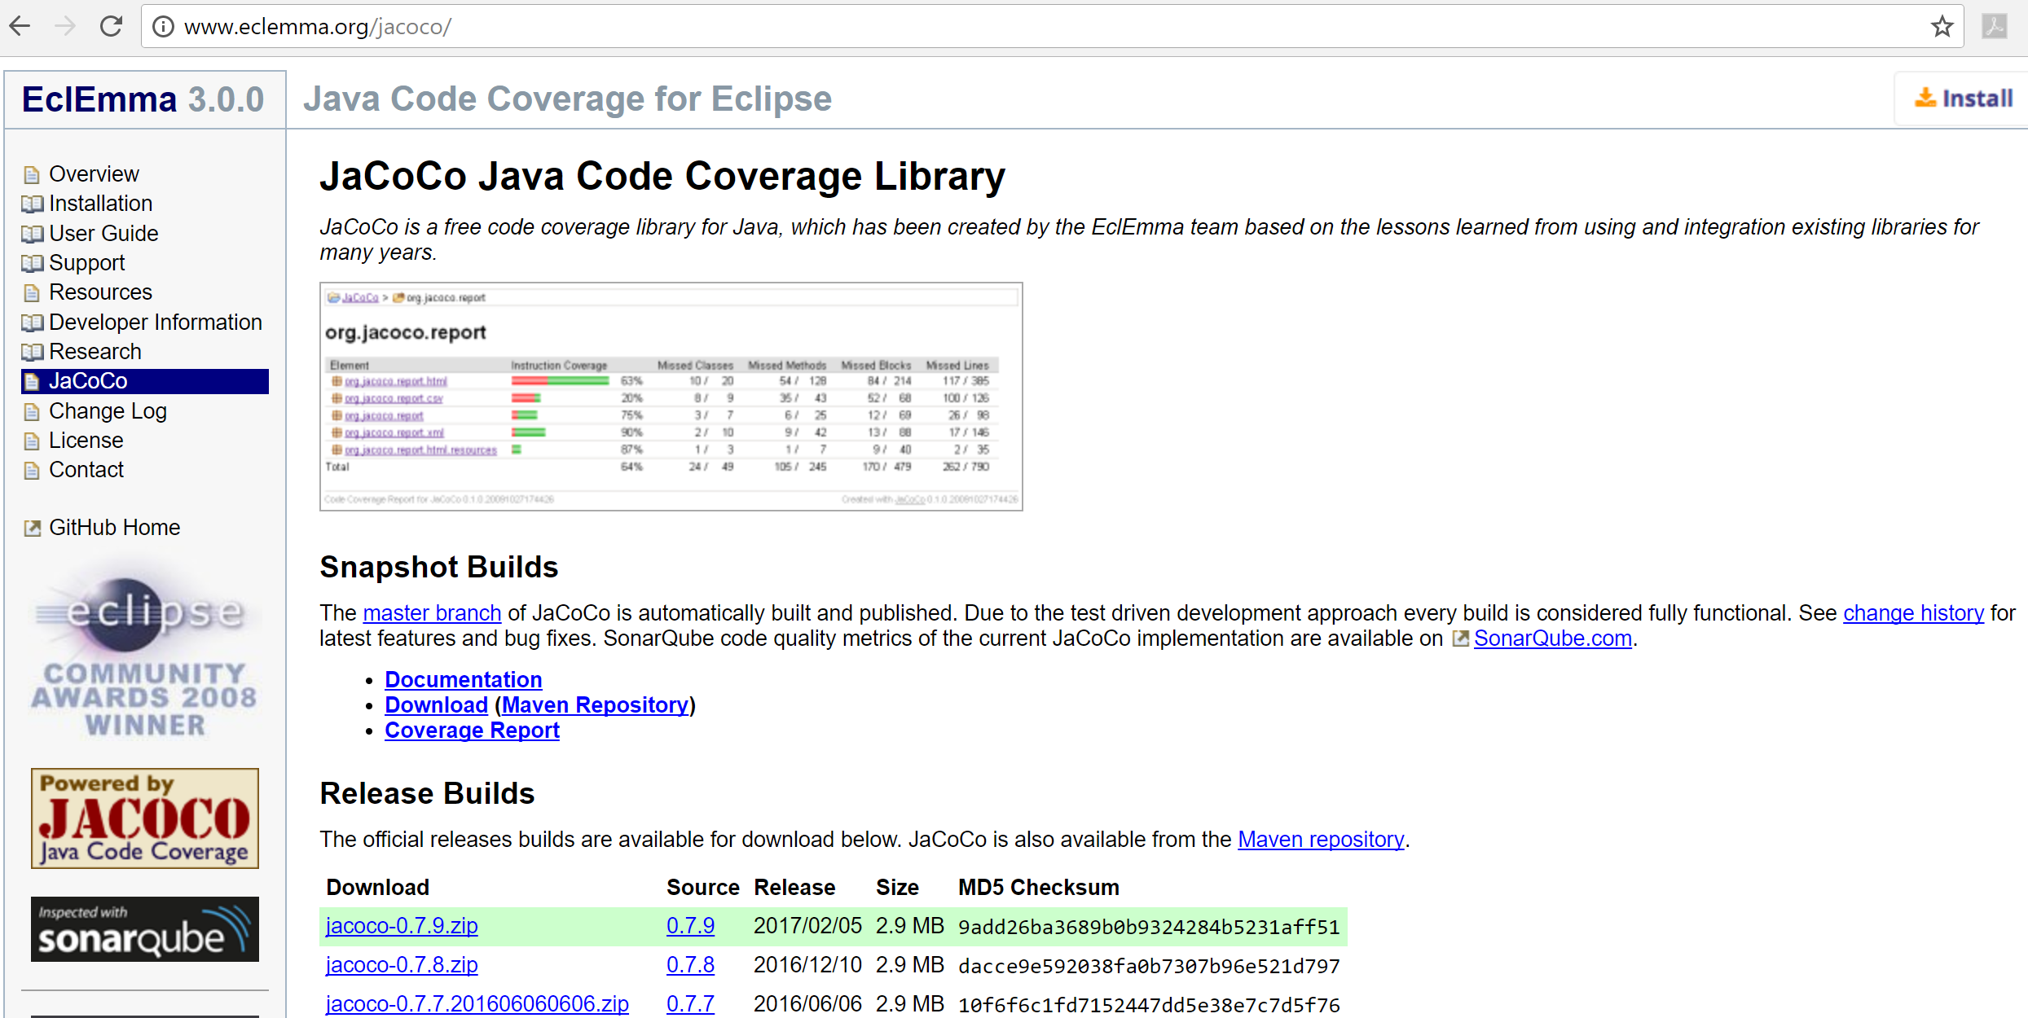
TDD – Code Coverage Tool

