Slide 1

Annotations in Java (JUnit)
Eamonn de Leastar (edeleastar@wit.ie)
Dr. Siobhán Drohan (sdrohan@wit.ie)
Produced
by:
Department of Computing and Mathematics
http://www.wit.ie/

Slide 2

What are Annotations?
They are metadata:
Provide information for the compiler (and humans) about the program.
Not part of the program itself and don’t affect the code they are annotating.
Some software tools use annotations to generate code

Slide 3
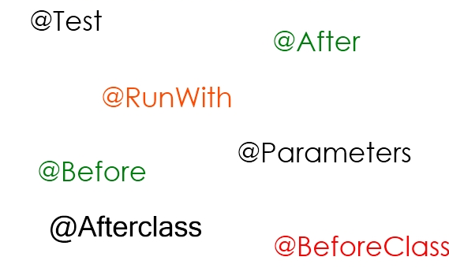
Where are Annotations used?
Annotations are typically applied to declarations e.g.
classes
fields
methods, and
other program elements.

Slide 4
Activity.java from lab04 → @Override
Compiler checks
methods are actually overridden. Also
makes the code more
human-readable.
@Override
public int hashCode()
{
return Objects.hashCode(this.id, this.type,
this.location, this.distance);
}
@Override
public String toString()
{
return toStringHelper(this).addValue(id)
.addValue(type)
.addValue(location)
.addValue(distance)
.addValue(route)
.toString();
}

Slide 5
Some Built in Annotations
There are three annotation types that are predefined by the language specification itself:
@Deprecated— indicates that the marked element is deprecated and should no longer be used. The compiler generates a warning whenever a program uses a method, class, or field with the @Deprecated annotation.
@Override annotation informs the compiler that the element is meant to override an element declared in a superclass. It not required to use this annotation when overriding a method, it helps to prevent errors. If a method marked with @Override fails to correctly override a method in one of its superclasses, the compiler generates an error.
@SuppressWarnings annotation tells the compiler to suppress specific warnings that it would otherwise generate e.g. casting errors.
https://docs.oracle.com/javase/tutorial/java/annotations/predefined.html

Slide 6
JUnit 3
import junit.framework.TestCase;
public class TestLargest extends TestCase
{
private int[] arr;
public TestLargest (String name)
{
super(name);
}
public void setUp()
{
arr = new int[] {8,9,7};
}
public void tearDown()
{
arr = null;
}
public void testOrder ()
{
assertEquals(9, Largest.largest(arr));
}
public void testOrder2 ()
{
assertEquals(9, Largest.largest(new int[] { 9, 8, 7 }));
assertEquals(9, Largest.largest(new int[] { 8, 9, 7 }));
assertEquals(9, Largest.largest(new int[] { 7, 8, 9 }));
}
}
Test class extend TestCase
setUp/tearDown are overridden from TestCase
test methods must begin with “test” word.

Slide 7
JUnit 4 included Annotations
import org.junit.After;
import org.junit.Before;
import org.junit.Test;
import static org.junit.Assert.fail;
import static org.junit.Assert.assertTrue;
import static org.junit.Assert.assertEquals;
public class TestLargest
{
private int[] arr;
@Before
public void setUp()
{
arr = new int[] {8,9,7};
}
@After
public void tearDown()
{
arr = null;
}
@Test
public void order ()
{
assertEquals(9, Largest.largest(arr));
}
@Test
public void dups ()
{
assertEquals(9, Largest.largest(new int[] { 9, 7, 9, 8 }));
}
@Before - run before each test case
@After - run after each test case
@Test - the test case itself
No need to extend TestCase
We will use Junit 4 from here on in.

Slide 8
Exceptions: JUnit 3 vs JUnit 4
Use @Test (expected = ...) to specify exception
Simpler, but less verbose
public void testEmpty ()
{
try
{
Largest.largest(new int[] {});
fail("Should have thrown an exception");
}
catch (RuntimeException e)
{
assertTrue(true);
}
}
@Test (expected = RuntimeException.class)
public void testEmpty ()
{
Largest.largest(new int[] {});
}

Slide 9
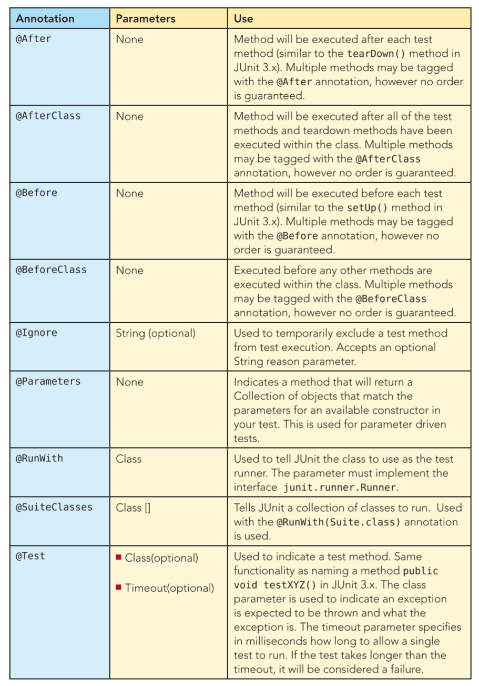
JUnit 4 Annotations (1)
https://dzone.com/refcardz/junit-and-easymock

Slide 10
JUnit 4 Annotations (2)
https://dzone.com/refcardz/junit-and-easymock

Slide 11
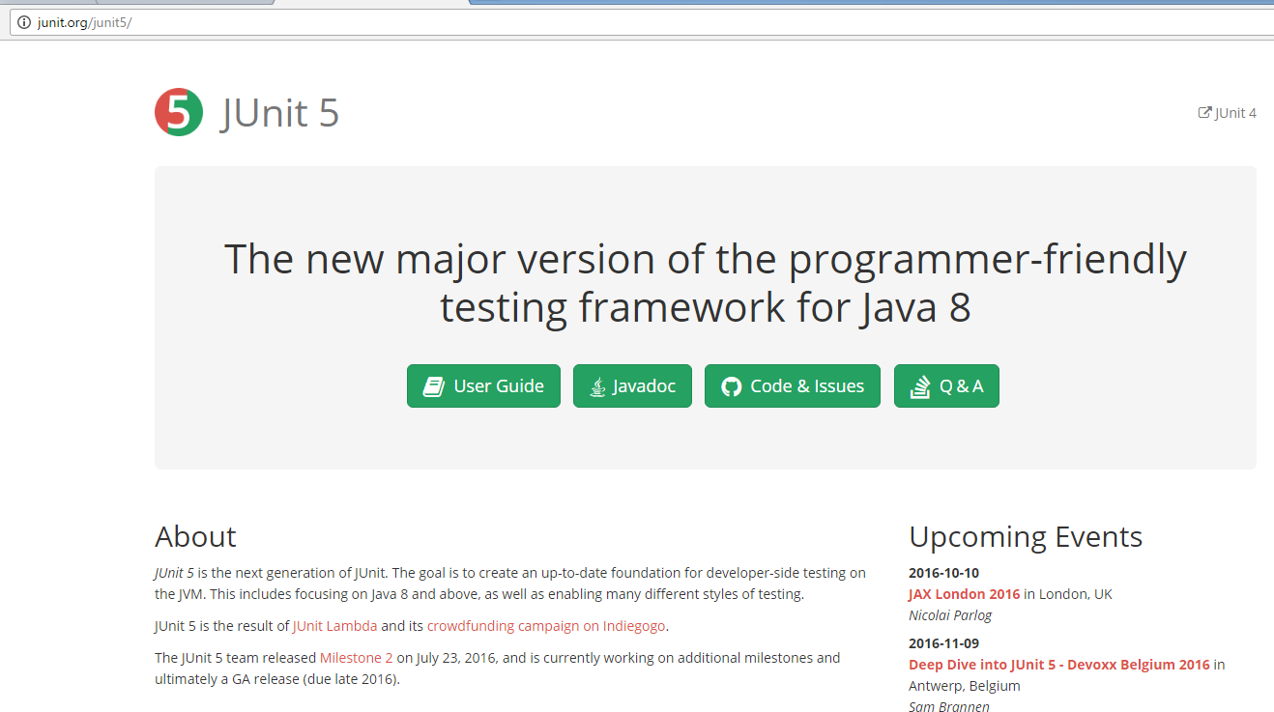

Slide 12

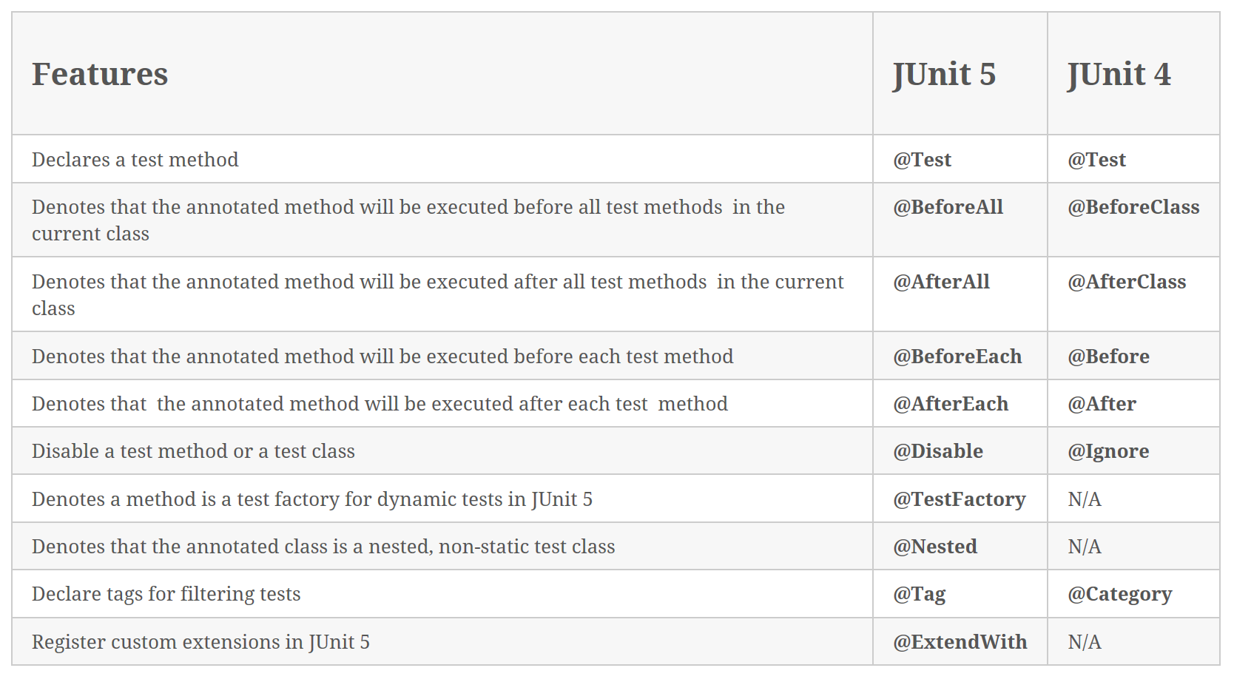
JUnit 5, suitable for Java 8 onwards, was released July 2016.
Table source: http://howtoprogram.xyz/2016/08/10/junit-5-vs-junit-4/
More information: https://dzone.com/articles/first-look-at-junit-5

Slide 13
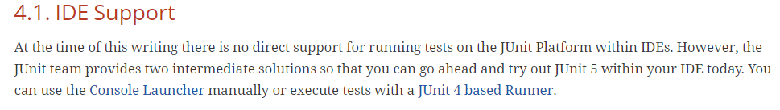
This course is using JUnit4.
http://junit.org/junit5/docs/current/user-guide/#running-tests-ide
If you wish to investigate JUnit5, please go to this link: http://junit.org/junit5/

